Slide 1
CHAPTER 10 POWERPOINT
NETWORK MODELS

Slide 2
THE NETWORK MODEL
Describes patterns of flow in a connected system, where the flow might involve material, people, or funds
System elements may be locations (e.g., cities, warehouses, or assembly lines), or points in time.
We construct diagrams to represent such systems with elements are represented by nodes (circles). The paths of flow are represented by arcs or arrows.
Chapter 10
Copyright © 2013 John Wiley & Sons, Inc.

Slide 3
THE TRANSPORTATION MODEL
A very common supply chain involves the shipment of goods from suppliers at one set of locations to customers at another set of locations.
The classic transportation model is characterized by a set of supply sources (each with known capacities), a set of demand locations (each with known requirements) and the unit costs of transportation between supply-demand pairs.
Chapter 10
Copyright © 2013 John Wiley & Sons, Inc.

Slide 4
TRANSPORTATION PROBLEM: MODEL FORMULATION
The transportation model has two kinds of constraints:
  Less-than capacity constraints and
  Greater-than demand constraints
If total capacity equals total demand, both capacity and demand constraints are “=”.
If capacity exceeds demand, the capacity constraints are “<” and the demand constraints are “>”.
If demand exceeds capacity, the capacity constraints are “>” and the demand constraints are “<”.
Chapter 10
Copyright © 2013 John Wiley & Sons, Inc.

Slide 5
TRANSPORTATION PROBLEM: SPREADSHEET MODEL
Helpful to depart from the standard linear programming layout of Chapter 9 and adopt a special format
We can construct a model in rows and columns to mirror the table of parameters that describes the problem.
In the Parameters module of the worksheet, all of the unit costs are displayed in an array.
In the Decisions module, the decision variables appear in an array of the same size.
At the right of each decision row is the “Sent” quantity, the sum of the flows along the row.
These figures align with the capacities given in the Parameters module.
Below each decision column is the “Received” quantity, which is the sum down the column.
Chapter 10
Copyright © 2013 John Wiley & Sons, Inc.

Slide 6
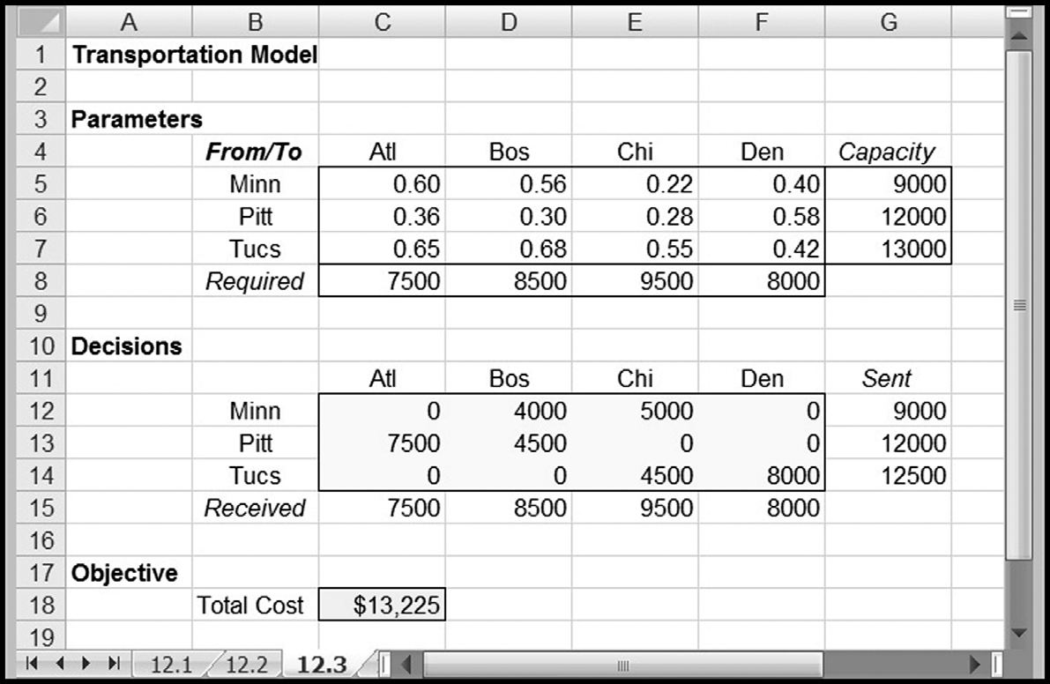
EXAMPLE: TRANSPORTATION PROBLEM
Chapter 10
Copyright © 2013 John Wiley & Sons, Inc.

Slide 7
EXCEL MINI-LESSON: THE SUMPRODUCT FUNCTION
The SUMPRODUCT function takes the pairwise products of two sets of numbers and sums the products. The form of the function is the following:
  SUMPRODUCT(Array1, Array2)
    Array1 references the first set of numbers.
    Array2 references the second set of numbers.
Chapter 10
Copyright © 2013 John Wiley & Sons, Inc.

Slide 8
SENSITIVITY ANALYSIS
Concepts of sensitivity analysis introduced in Chapter 9 apply here as well.
The Optimization Sensitivity tool may be used with network linear programming models with no new considerations.
We can interpret patterns in the optimal solution in terms of economic priorities.
Chapter 10
Copyright © 2013 John Wiley & Sons, Inc.

Slide 9
SENSITIVITY ANALYSIS ON TRANSPORTATION PROBLEMS
In the transportation model, we have supply and demand constraints.
The solution to the model provides shadow prices on each.
The shadow price on a demand constraint tells us how much it costs to ship the marginal unit to the corresponding location. (Sometimes, this figure is not obvious without some careful thought.)
Chapter 10
Copyright © 2013 John Wiley & Sons, Inc.

Slide 10
PROCESS AS APPLIED TO SOLUTION
OF TRANSPORTATION PROBLEM
Identify a high priority demand—one that is covered by a unique source—and allocate the entire demand to this route. Remove this demand from consideration.
Identify a high priority capacity—one that supplies a single destination—and allocate the entire supply to this route. Remove this supply from consideration.
Repeat the previous two steps using remaining demands and remaining supplies each time, until all shipments are accounted for.
Chapter 10
Copyright © 2013 John Wiley & Sons, Inc.

Slide 11
ASSIGNMENT MODEL
An important special case of the transportation problem occurs when all capacities and all requirements are equal to one.
In addition, total supply equals total demand.
The classic assignment model is characterized by a set of people, a set of tasks, and a score for each possible assignment of a person to a task.
The problem is to find the best assignment of people to tasks.
Chapter 10
Copyright © 2013 John Wiley & Sons, Inc.

Slide 12
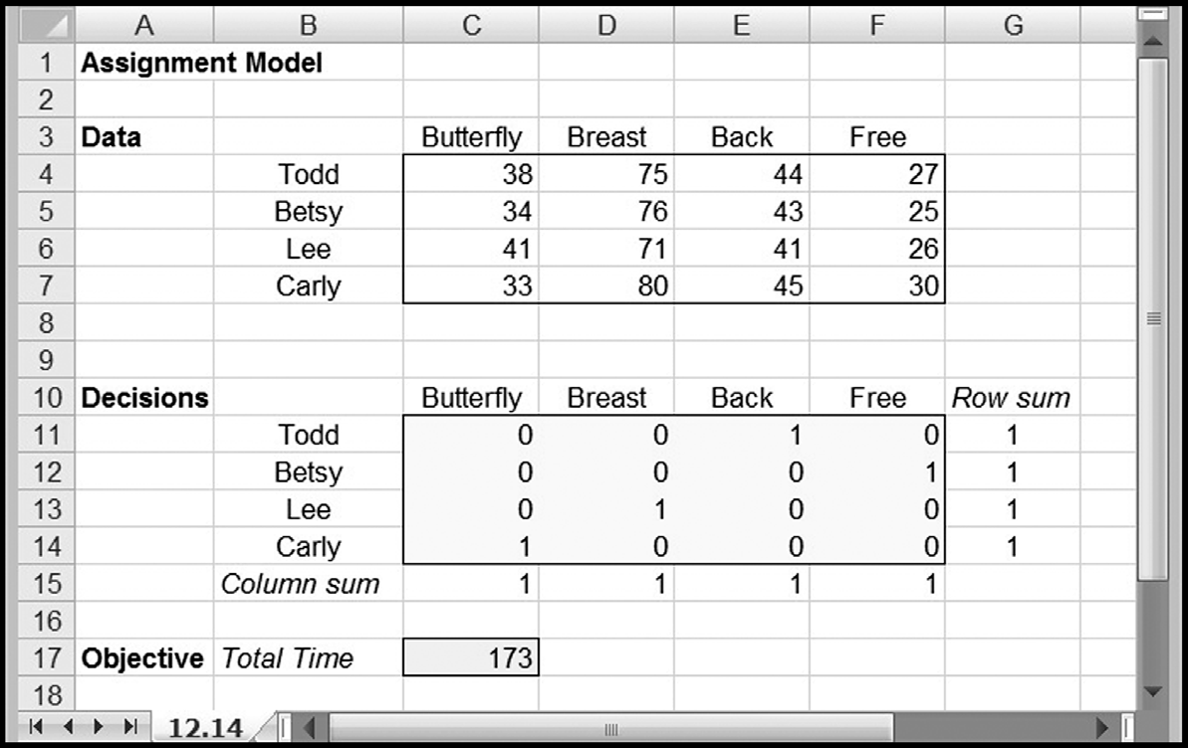
ASSIGNMENT PROBLEM: SPREADSHEET MODEL
Chapter 10
Copyright © 2013 John Wiley & Sons, Inc.

Slide 13
ASSIGNMENT PROBLEM: SENSITIVITY ANALYSIS
It is rare that we would want to perform sensitivity analysis with respect to either the supply parameters or the demand parameters in an assignment model.
However, we may well be interested in sensitivity analysis with respect to the cost parameters.
Chapter 10
Copyright © 2013 John Wiley & Sons, Inc.

Slide 14
THE TRANSSHIPMENT MODEL
The transshipment problem is a more complex version of the transportation problem, characterized by two stages of flow instead of just one.
Chapter 10
Copyright © 2013 John Wiley & Sons, Inc.

Slide 15
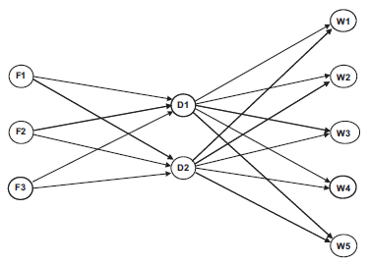
THE TRANSSHIPMENT MODEL: GRAPHICAL DISPLAY
Chapter 10
Copyright © 2013 John Wiley & Sons, Inc.

Slide 16
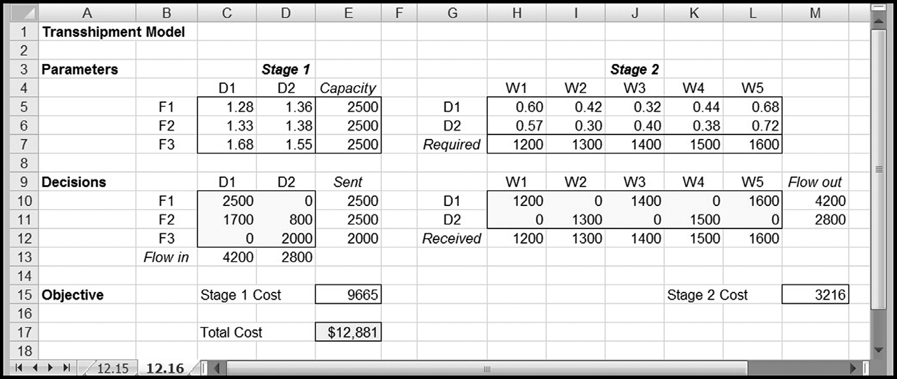
TRANSSHIPMENT PROBLEM: SPREADSHEET MODEL
Chapter 10
Copyright © 2013 John Wiley & Sons, Inc.

Slide 17
A STANDARD FORM FOR NETWORK MODELS
It is possible to formulate any of these problems as linear programs built exclusively on balance equations.
Although this approach may not seem as intuitive, it does link the flow diagram and the spreadsheet model more closely, and it allows us to see a more general structure that encompasses other network models as well.
Chapter 10
Copyright © 2013 John Wiley & Sons, Inc.

Slide 18
CLASSIC NETWORK MODEL
In a classic network model, each node in the network corresponds to a material-balance equation—the requirement that total outflow must equal total inflow.
Once we have a network diagram for a problem, we can translate it into a linear program by following these simple steps:
  Define a variable for each arc.
  Include supplies as input flows and demands as output flows.
  Construct the balance equation for each node.
Chapter 10
Copyright © 2013 John Wiley & Sons, Inc.

Slide 19
BALANCE EQUATIONS
In this version of the model, every constraint is a balance equation. Thus, the constraints take the following form.
(Flow Out) – (Flow In) = 0
We write a balance equation with a positive right-hand side when there is flow into the network and with a negative right-hand side when there is flow out of the network.
Chapter 10
Copyright © 2013 John Wiley & Sons, Inc.

Slide 20
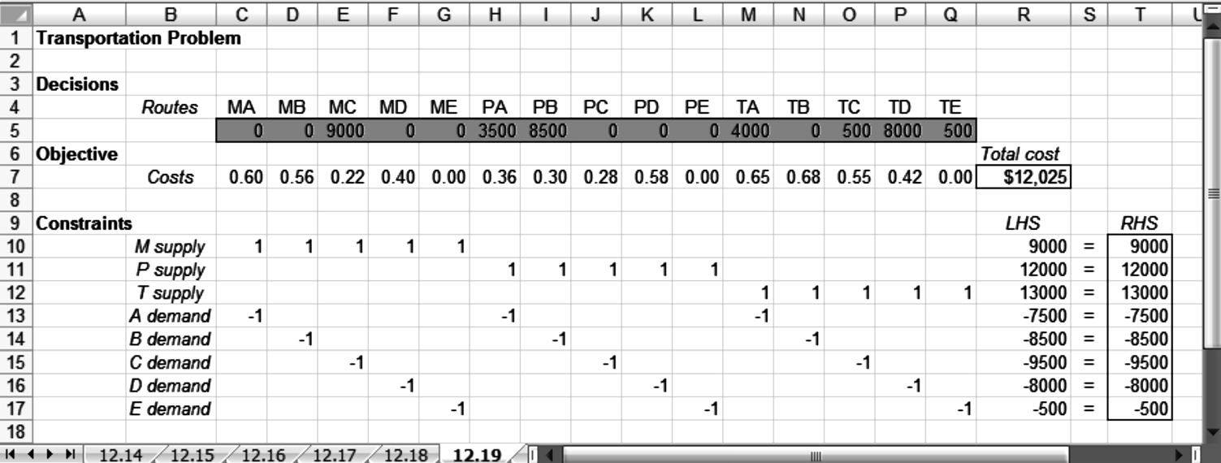
WORKSHEET FOR THE REVISED MODEL
Chapter 10
Copyright © 2013 John Wiley & Sons, Inc.

Slide 21
ADVANTAGES OF STANDARD FORM
We can draw on the network diagram as a debugging aid.
This may not seem like a large enough benefit to warrant using the standard form when the classical layout is so intuitive.
However, the concept becomes helpful in models that are more complicated than the transportation model.
Chapter 10
Copyright © 2013 John Wiley & Sons, Inc.

Slide 22
NETWORK MODELS WITH YIELDS
In example models, quantity sent from a source node = quantity that arrives at a destination node—not always the case
Some flows of interest are subject to positive or negative yields.
Waste in a manufacturing process is an example of a negative yield; interest on a bank balance is an example of a positive yield.
Chapter 10
Copyright © 2013 John Wiley & Sons, Inc.

Slide 23
YIELDS AS REDUCTIONS IN FLOW
One common type of yield phenomenon involves technologies that produce waste.
For example:
  When wood is cut, shaped, and sanded in a manufacturing process, the amount of useable wood that exits the process is less than the amount that entered.
  When metal enters a process that involves grinding, drilling, and polishing, the same is true of the amount of metal at the end of the process compared to the amount at the start.
This type of reduction in the amount of a flow is called process yield.
Chapter 10
Copyright © 2013 John Wiley & Sons, Inc.

Slide 24
YIELDS AS REDUCTIONS IN FLOW
There is an intimate relation between the network diagram and the spreadsheet model.
Each arc in the network corresponds to a variable, each node in the network corresponds to a constraint, and all constraints are written as balance equations.
The variables are measured in, for example, tons of supply; these are the quantities that are started into the various processes.
To compute the quantities in tons of output, we have to apply yield factors.
The objective function computes the revenue from the schedule of outputs, as supply costs are fixed for the purposes of this decision.
Chapter 10
Copyright © 2013 John Wiley & Sons, Inc.

Slide 25
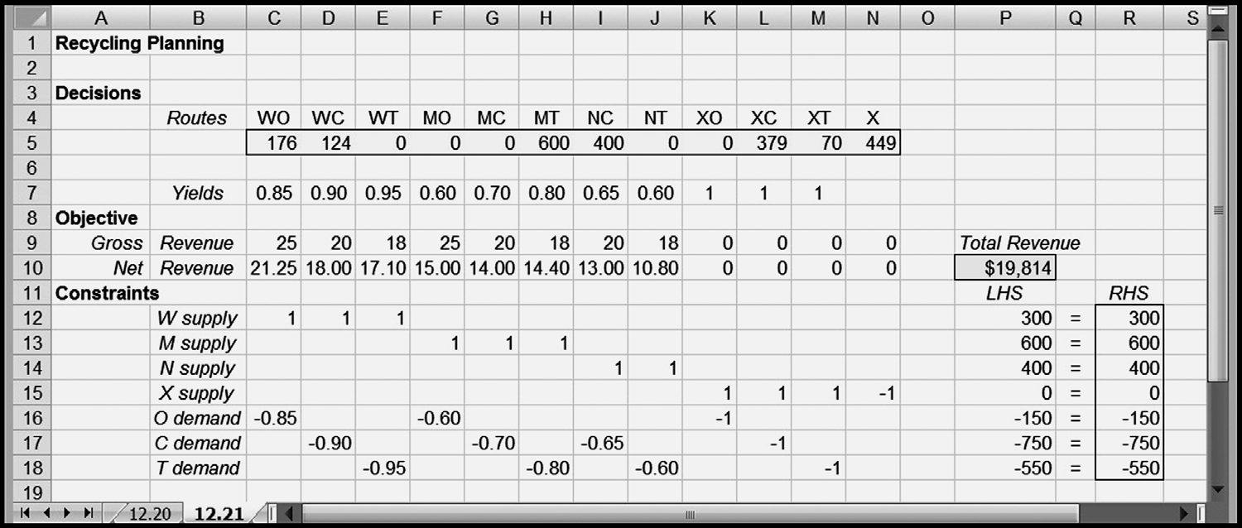
EXAMPLE: PAPER RECYCLING COMPANY
Chapter 10
Copyright © 2013 John Wiley & Sons, Inc.

Slide 26
YIELDS AS EXPANSIONS IN FLOW
In production processes, yields are typically less than one: outputs are smaller than inputs because some waste is generated along the way.
However, in other kinds of processes, yields can be greater than one.
An example of this feature arises in funds-flow models.
Chapter 10
Copyright © 2013 John Wiley & Sons, Inc.

Slide 27
INVESTMENT AND FUNDS-FLOW PROBLEMS
Investment and funds-flow problems lend themselves to network modeling.
Nodes represent points in time at which funds flows occur.
We can imagine tracking a bank account, with funds flowing in and out, depending on our decisions.
Chapter 10
Copyright © 2013 John Wiley & Sons, Inc.

Slide 28
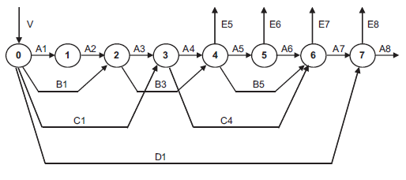
DIAGRAM OF AN INVESTMENT PROBLEM
Chapter 10
Copyright © 2013 John Wiley & Sons, Inc.

Slide 29
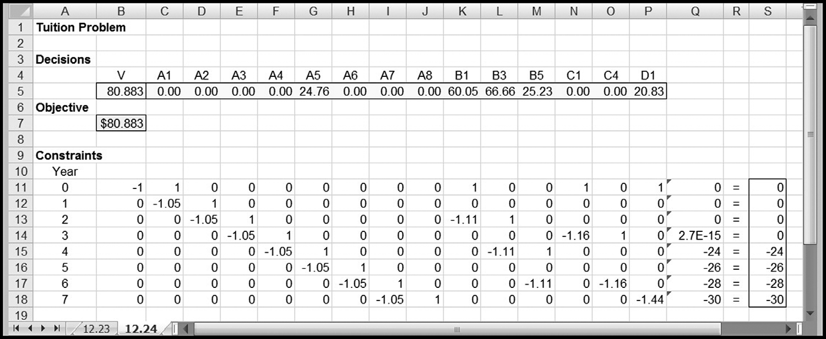
SPREADSHEET FOR AN INVESTMENT MODEL
Chapter 10
Copyright © 2013 John Wiley & Sons, Inc.

Slide 30
SOLVER TIP: RESCALING THE MODEL
Rescaling parameters to appear in thousands (or millions) spares us from entering a lot of zeros.
As a guideline, the parameters in the objective function and the constraints should not differ from each other, or from the values of the decision variables, by more than a factor of 100,000.
A model that tracks cash flows in the millions while also computing percentage returns as decimal fractions violates this rule.
Sometimes, rescaling problems are difficult to avoid when we’re trying to keep the model easy to understand.
In these cases, Solver can perform internal rescaling of the model if we check the option box for Use Automatic Scaling.
It is always preferable for the model builder to do the rescaling.
Chapter 10
Copyright © 2013 John Wiley & Sons, Inc.

Slide 31
*7. NETWORK MODELS FOR PROCESS TECHNOLOGIES
Some nodes represent production operations that actually transform the substance between inflow and outflow.
This type of network is particularly suitable for the analysis of production plans in process industries, such as paper, steel, or chemicals.
Chapter 10
Copyright © 2013 John Wiley & Sons, Inc.

Slide 32
REFINING EXAMPLE
For each node in the diagram, we write a balance equation.
Conceptually, there is a twist: Because the nodes represent production processes, the input material may differ from the output material, and there may be multiple input materials and multiple output materials.
Chapter 10
Copyright © 2013 John Wiley & Sons, Inc.

Slide 33
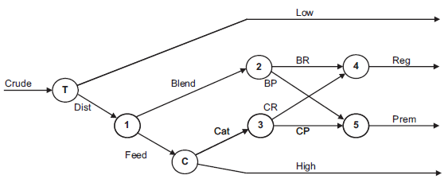
*FORMULATION OF REFINING EXAMPLE
Chapter 10
Copyright © 2013 John Wiley & Sons, Inc.

Slide 34
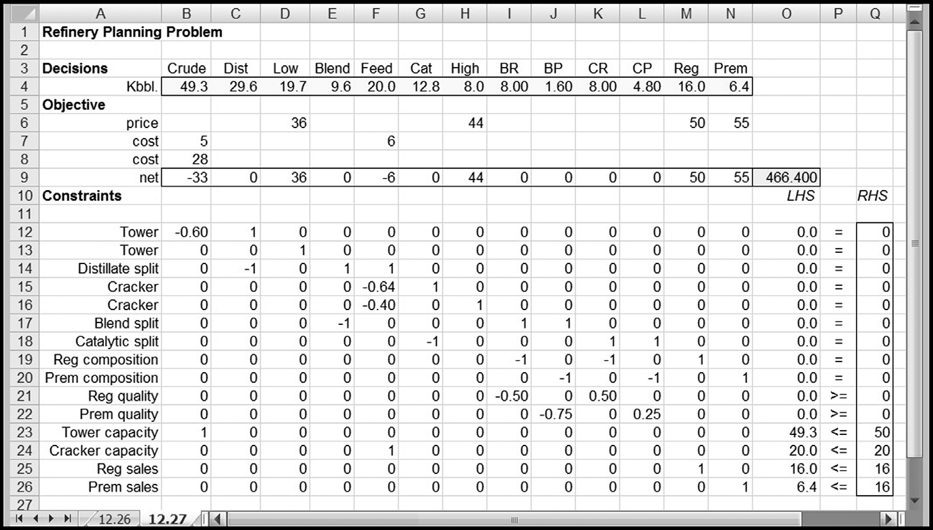
*SPREADSHEET MODEL OF REFINING PROBLEM
Chapter 10
Copyright © 2013 John Wiley & Sons, Inc.

Slide 35
SUMMARY
Network models represent a distinct class of linear programs.
They have special advantages because network diagrams can be used in the modeling process.
Transportation, assignment, and transshipment models exhibit a characteristic From/To structure that lends itself readily to spreadsheet display.
The balance equations in transshipment nodes are the key constraint format for network models, extending to models in which yield factors apply and even to process models where the inflow and outflow may not be of the same material.
Chapter 10
Copyright © 2013 John Wiley & Sons, Inc.

Slide 36
SUMMARY (CONT’D)
The constraints in some network linear programs consist exclusively of balance equations, whereas constraints in more complicated models may include allocation, covering, and blending constraints appended to a central network representation.
The concepts of sensitivity analysis that were introduced in Chapter 9 apply as well to network models.
In particular, when it comes to interpreting optimal solutions, the network diagram is a convenient device for constructing patterns.
The diagram often provides visual hints that lead to a systematic description of the economic priorities in the solution of a network linear program.
Chapter 10
Copyright © 2013 John Wiley & Sons, Inc.

Slide 37
COPYRIGHT © 2013 JOHN WILEY & SONS, INC.
All rights reserved. Reproduction or translation of this work beyond that permitted in section 117 of the 1976 United States Copyright Act without express permission of the copyright owner is unlawful. Request for further information should be addressed to the Permissions Department, John Wiley & Sons, Inc. The purchaser may make back-up copies for his/her own use only and not for distribution or resale. The Publisher assumes no responsibility for errors, omissions, or damages caused by the use of these programs or from the use of the information herein.
12 - <number>

