Slide 1
CHAPTER 11 POWERPOINT
INTEGER OPTIMIZATION

Slide 2
INTRODUCTION
The optimal solution of a linear program may contain fractional decision variables, and this is appropriate—or at least tolerable—in most applications.
In some cases it may be necessary to ensure that some or all of the decision variables take on integer values.
Accommodating the requirement that variables must be integers is the subject of integer programming.
Chapter 11
Copyright © 2013 John Wiley & Sons, Inc.

Slide 3
INTEGER VARIABLES AND THE INTEGER SOLVER
Solver allows us to directly designate decision variables as integer values.
In integer linear programs, Solver employs an algorithm that checks all possible assignments of integer values to variables, although some of the assignments may not have to be examined explicitly.
This procedure may require the solution of a large number of linear programs; Solver can do this quickly and reliably with the simplex algorithm, and will eventually locate a global optimum.
In the case of integer nonlinear programs, certain difficulties can arise, although Solver will always attempt to find a solution.
Chapter 11
Copyright © 2013 John Wiley & Sons, Inc.

Slide 4
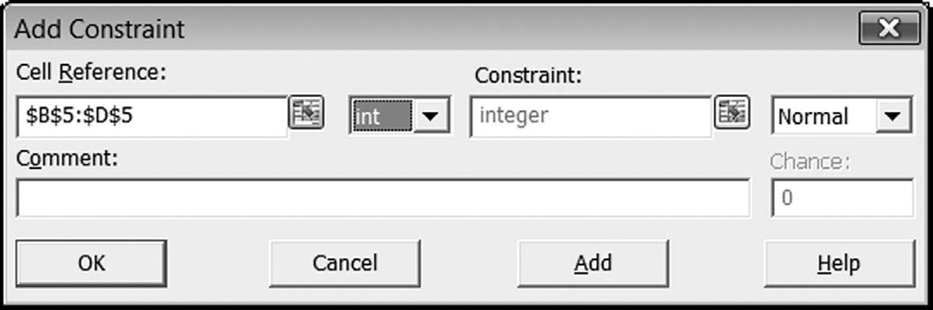
DESIGNATING VARIABLES AS INTEGERS
Chapter 11
Copyright © 2013 John Wiley & Sons, Inc.

Slide 5
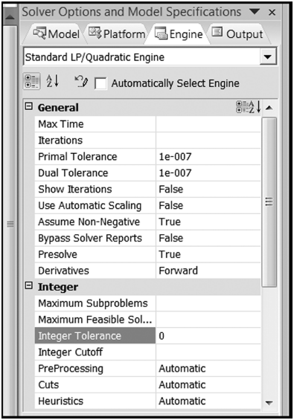
SETTING THE TOLERANCE PARAMETER
Chapter 11
Copyright © 2013 John Wiley & Sons, Inc.

Slide 6
SOLVER TIP: INTEGER OPTIONS
The most important integer option is the Tolerance parameter.
The default value of the parameter is 5%, and we may leave this value undisturbed while we debug our model.
Once we are convinced that our model is running correctly, we can set the Tolerance parameter to 0% so that an optimal solution is guaranteed.
Chapter 11
Copyright © 2013 John Wiley & Sons, Inc.

Slide 7
BINARY VARIABLES AND BINARY CHOICE MODELS
A binary variable, which takes on the values zero or one, can be used to represent a “go/no-go” decision.
We can think in terms of discrete projects, where the decision to accept the project is represented by the value 1, and the decision to reject the project is represented by the value 0.
Chapter 11
Copyright © 2013 John Wiley & Sons, Inc.

Slide 8
THE CAPITAL BUDGETING PROBLEM
Companies, committees, and even households often find themselves facing a problem of allocating a capital budget.
As the problem arises in many firms, there is a specified budget for the year, to be invested in multi-year projects.
There are typically several proposed projects under consideration.
The challenge is to determine how to maximize the value of the projects selected, subject to the limitation on expenditures represented by the capital budget.
Chapter 11
Copyright © 2013 John Wiley & Sons, Inc.

Slide 9
THE CAPITAL BUDGETING PROBLEM
In the classic version of the capital budgeting problem, each project is described by two values: the expenditure required and the value of the project.
As a project is typically a multi-year activity, its value is represented by the net present value (NPV) of its cash flows over the project life.
The expenditure, combined with the expenditures of other projects selected, cannot be more than the budget available.
Chapter 11
Copyright © 2013 John Wiley & Sons, Inc.

Slide 10
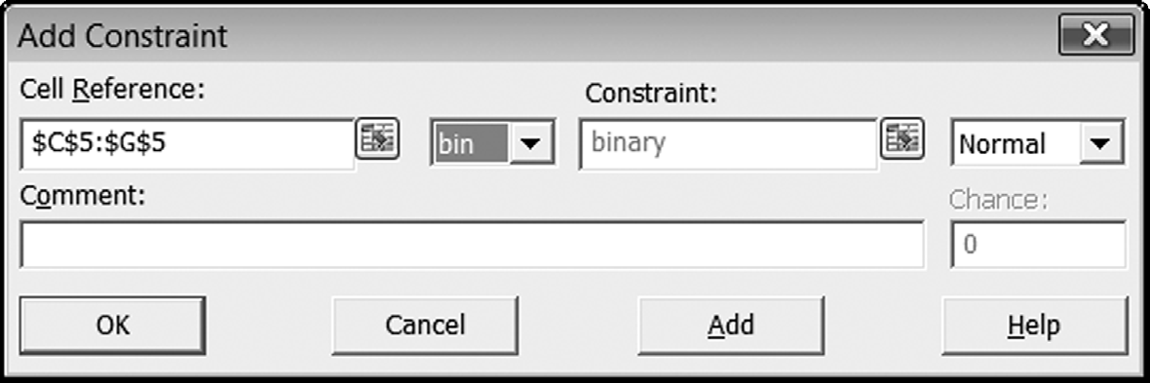
DESIGNATING VARIABLES AS BINARY INTEGERS
Chapter 11
Copyright © 2013 John Wiley & Sons, Inc.

Slide 11
THE SET COVERING PROBLEM
The set covering problem is a variation of the covering model in which the variables are all binary.
In addition, the parameters in the constraints are all zeroes and ones.
In the classic version of the set covering problem, each project is described by a subset of locations that it “covers.”
The problem is to cover all locations with a minimal number of projects.
Chapter 11
Copyright © 2013 John Wiley & Sons, Inc.

Slide 12
BINARY VARIABLES AND LOGICAL RELATIONSHIPS
We sometimes encounter additional conditions affecting the selection of projects in problems like capital budgeting.
These include relationships among projects, fixed costs, and quantity discounts.
Chapter 11
Copyright © 2013 John Wiley & Sons, Inc.

Slide 13
RELATIONSHIPS AMONG PROJECTS
Projects can be related in any number of ways, five of which are as follows:
  At least m projects must be selected.
  At most n projects must be selected.
  Exactly k projects must be selected.
  Some projects are mutually exclusive.
  Some projects have contingency relationships.
Chapter 11
Copyright © 2013 John Wiley & Sons, Inc.

Slide 14
RELATIONSHIP: AT LEAST M PROJECTS MUST BE SELECTED
y2 + y5 > 1
Project 2, or Project 5, or both, will be selected, thus satisfying the requirement of at least one selection.
Chapter 11
Copyright © 2013 John Wiley & Sons, Inc.

Slide 15
RELATIONSHIP: AT MOST N PROJECTS MUST BE SELECTED
y4 + y5 < 1
Project 4, or Project 5, or neither, but not both will be selected, thus satisfying the requirement of at most one selection.
Chapter 11
Copyright © 2013 John Wiley & Sons, Inc.

Slide 16
RELATIONSHIP: EXACTLY K PROJECTS MUST BE SELECTED
y4 + y5 = 1
Exactly one of either Project 4 or Project 5 will be selected, thus satisfying the requirement of exactly one selection.
Chapter 11
Copyright © 2013 John Wiley & Sons, Inc.

Slide 17
RELATIONSHIP:
SOME PROJECTS HAVE CONTINGENCY RELATIONSHIPS
y3 – y5 > 0
If Project 5 is selected, then project 3 must be as well.
Chapter 11
Copyright © 2013 John Wiley & Sons, Inc.

Slide 18
LINKING CONSTRAINTS AND FIXED COSTS
We commonly encounter situations in which activity costs are composed of fixed costs and variable costs, with only the variable costs being proportional to activity level.
With an integer programming model, we can also integrate the fixed component of cost.
Chapter 11
Copyright © 2013 John Wiley & Sons, Inc.

Slide 19
LINKING CONSTRAINTS AND FIXED COSTS
We separate the fixed and variable components of cost.
In algebraic terms, we write cost as:
Cost = Fy + cx
where F represents the fixed cost, and c represents the linear variable cost.
The variables x and y are decision variables, where x is a normal (continuous) variable, and y is a binary variable.
Chapter 11
Copyright © 2013 John Wiley & Sons, Inc.

Slide 20
LINKING CONSTRAINTS AND FIXED COSTS
To achieve consistent linking of the two variables, we add the following generic linking constraint to the model:
x < My
where the number M represents an upper bound on the variable x.
In other words, M is at least as large as any value we can feasibly choose for x.
Chapter 11
Copyright © 2013 John Wiley & Sons, Inc.

Slide 21
LINKING CONSTRAINT: X < MY
When y = 0 (and therefore no fixed cost is incurred), the right-hand side becomes zero, and Solver interprets the constraint as x <= 0.
  Since we also require x >= 0, these two constraints together force x to be zero.
  Thus, when y = 0, it will be consistent to avoid the fixed cost.
On the other hand, when y = 1, the right-hand side will be so large that Solver does not need to restrict x at all, permitting its value to be positive while we incur the fixed cost.
  Thus, when y = 1, it will be consistent to incur the fixed cost.
Of course, because we are optimizing, Solver will never produce a solution with the combination of y = 1 and x = 0, because it would always be preferable to set y = 0.
Chapter 11
Copyright © 2013 John Wiley & Sons, Inc.

Slide 22
SOLVER TIP:
LOGICAL FUNCTIONS AND INTEGER PROGRAMMING
Experienced Excel programmers might be tempted to use the logical functions (IF, AND, OR, etc.) to express certain relationships.
Unfortunately, the linear solver does not always detect the nonlinearity caused by the use of logical functions, so it is important to remember never to use an IF function in a model built for the linear solver.
Chapter 11
Copyright © 2013 John Wiley & Sons, Inc.

Slide 23
THRESHOLD LEVELS AND QUANTITY DISCOUNTS
Threshold level requirement: a decision variable is either at least as large as a specified minimum, or else it is zero.
The existence of a threshold level does not directly affect the objective function of a model, and it can be represented in the constraints with the help of binary variables.
Chapter 11
Copyright © 2013 John Wiley & Sons, Inc.

Slide 24
THRESHOLD LEVELS
Suppose we have a variable x that is subject to a threshold requirement. Let m denote the minimum feasible value of x if it is nonzero. Then we can capture this structure in an integer programming model by including the following pair of constraints:
x – my > 0
x – My < 0
where, as before, M is a large number that is greater than or equal to any value x could feasibly take.
Chapter 11
Copyright © 2013 John Wiley & Sons, Inc.

Slide 25
*THE FACILITY LOCATION MODEL
The transportation model (discussed in Chapter 10) is typically used to find optimal shipping schedules in supply chains and logistics systems.
The applications of the model can be viewed as tactical problems, in the sense that the time interval of interest is usually short, say a week or a month.
Over that time period, the supply capacities and locations are unlikely to change at all, and the demands can be predicted with reasonable precision.
Chapter 11
Copyright © 2013 John Wiley & Sons, Inc.

Slide 26
*THE FACILITY LOCATION MODEL
Over a longer time frame, a strategic version of the problem arises. In this setting, the decisions relate to the selection of supply locations as well as the shipment schedule.
These decisions are strategic in the sense that, once determined, they influence the system for a relatively long time interval.
The basic model for choosing supply locations is called the facility location model.
Chapter 11
Copyright © 2013 John Wiley & Sons, Inc.

Slide 27
THE CAPACITATED PROBLEM
Conceptually, we can think of this problem as having two stages.
In the first stage, decisions must be made about how many warehouses to open and where they should be.
Then, once we know where the warehouses are, we can construct a transportation model to optimize the actual shipments.
The costs at stake are also of two types: fixed costs associated with keeping a warehouse open and variable transportation costs associated with shipments from the open warehouses.
Chapter 11
Copyright © 2013 John Wiley & Sons, Inc.

Slide 28
THE UNCAPACITATED PROBLEM
Once we see how to solve the facility location problem with capacities given, it is not difficult to adapt the model to the uncapacitated case.
Obviously, we could choose a virtual capacity for each warehouse that is as large as total demand, so that capacity would never interfere with the optimization.
Chapter 11
Copyright © 2013 John Wiley & Sons, Inc.

Slide 29
THE ASSORTMENT MODEL
The facility location model, with or without capacity constraints, clearly has direct application to the design of supply chains and the choice of locations from a discrete set of alternatives.
But the model can actually be used in other types of problems because it captures the essential trade-off between fixed costs and variable costs.
An example from the field of Marketing is the assortment problem, which asks which items in a product line should be carried, when customers are willing to substitute.
Chapter 11
Copyright © 2013 John Wiley & Sons, Inc.

Slide 30
SUMMARY
Integer programming problems are optimization problems in which at least one of the variables is required to be an integer.
Solver’s solutions to linear integer programs are reliable: a global optimal solution always occurs as long as the Integer Tolerance parameter has been set to zero.
Binary variables can represent all-or-nothing decisions that allow only accept/reject alternatives.
Chapter 11
Copyright © 2013 John Wiley & Sons, Inc.

Slide 31
SUMMARY
Binary variables can also be instrumental in capturing complicated logic in linear form so that we can harness the linear solver to find solutions.
Binary variables make it possible to accommodate problem information on:
  Contingency conditions between projects
  Mutual exclusivity among projects
  Linking constraints for consistency
  Threshold constraints for minimum activity levels
With the capability of formulating these kinds of relationships in optimization problems, our modeling abilities expand well beyond the basic capabilities of the linear and nonlinear solvers.
Chapter 11
Copyright © 2013 John Wiley & Sons, Inc.

Slide 32
COPYRIGHT © 2013 JOHN WILEY & SONS, INC.
All rights reserved. Reproduction or translation of this work beyond that permitted in section 117 of the 1976 United States Copyright Act without express permission of the copyright owner is unlawful. Request for further information should be addressed to the Permissions Department, John Wiley & Sons, Inc. The purchaser may make back-up copies for his/her own use only and not for distribution or resale. The Publisher assumes no responsibility for errors, omissions, or damages caused by the use of these programs or from the use of the information herein.
13 - <number>

