Slide 1
CHAPTER 12 POWERPOINT
NON-SMOOTH MODELS

Slide 2
INTRODUCTION
Evolutionary solver is a Solver algorithm that can be effective on models that cannot be optimized in any other way.
The evolutionary solver is particularly suited to models containing nonsmooth objective functions.
Because the evolutionary solver makes virtually no assumptions about the nature of the objective function, it is not able to identify an optimal solution.
Chapter 12
Copyright © 2013 John Wiley & Sons, Inc.

Slide 3
INTRODUCTION (CONT’D)
This method conducts a systematic search with random elements, comparing the solutions encountered along the way and retaining the better ones.
The best solution it finds may not be optimal, although it may be a very good solution.
This type of procedure is called a heuristic procedure, meaning that it is a systematic procedure for identifying good solutions, but not guaranteed optimal solutions.
Chapter 12
Copyright © 2013 John Wiley & Sons, Inc.

Slide 4
FEATURES OF THE EVOLUTIONARY SOLVER
The evolutionary solver is designed to mimic the process of biological evolution in certain ways.
The algorithm proceeds through a series of stages, which are analogous to generations in a biological population. In each generation the approach considers not a single solution, but a population of perhaps 25 or 50 solutions.
New members are introduced to this population through a process that mimics mating in that offspring solutions combine the traits of their parent solutions.
Occasional mutations occur in the form of offspring solutions with some random characteristics that do not come from their parents.
Chapter 12
Copyright © 2013 John Wiley & Sons, Inc.

Slide 5
FEATURES OF THE EVOLUTIONARY SOLVER (CONT’D)
The ‘‘fitness’’ of each member of the population is determined by the value of its objective function.
Members of the population that are less fit (have a relatively worse value of the objective function) are removed from the population by a process that mimics natural selection.
This process of selection propels the population toward better levels of fitness (better values of the objective function).
The procedure stops when there is evidence that the population is no longer improving (or if one of the user-designated stopping conditions is met).
When it stops, the procedure displays the bes tmember of the final population as the solution.
Chapter 12
Copyright © 2013 John Wiley & Sons, Inc.

Slide 6
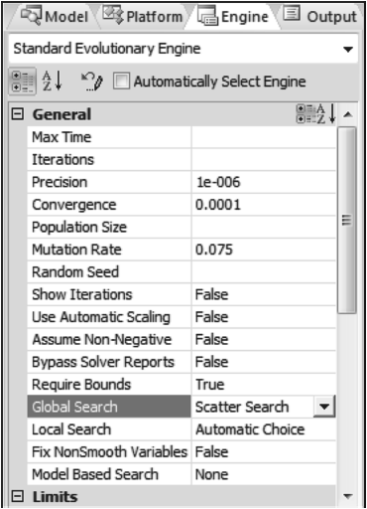
THE ENGINE TAB FOR THE EVOLUTIONARY SOLVER
Chapter 12
Copyright © 2013 John Wiley & Sons, Inc.

Slide 7
THE ADVERTISING BUDGET PROBLEM
The decision variables in this problem are the quarterly expenditures on advertising.
The objective function is nonlinear but smooth, since there are diminishing returns to advertising
Chapter 12
Copyright © 2013 John Wiley & Sons, Inc.

Slide 8
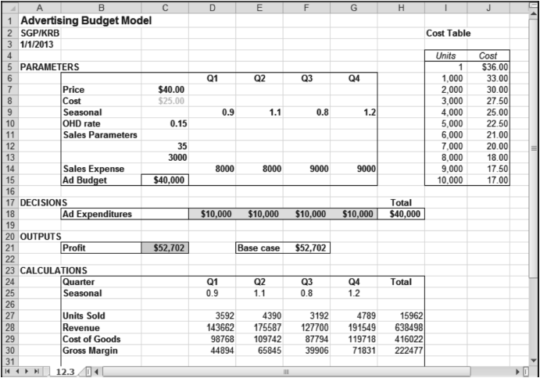
ADVERTISING BUDGET MODEL WITH UNIT COST TABLE
Chapter 12
Copyright © 2013 John Wiley & Sons, Inc.

Slide 9
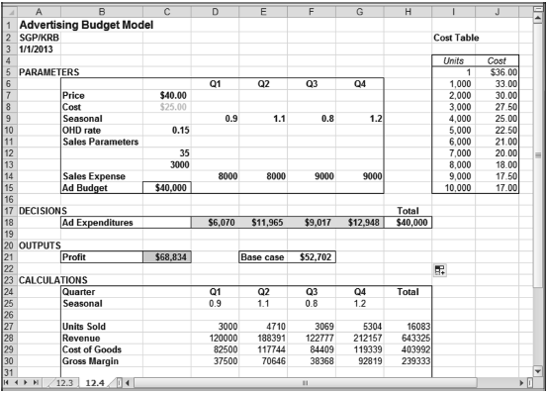
OPTIMAL ALLOCATION FROM THE NONLINEAR SOLVER
Chapter 12
Copyright © 2013 John Wiley & Sons, Inc.

Slide 10
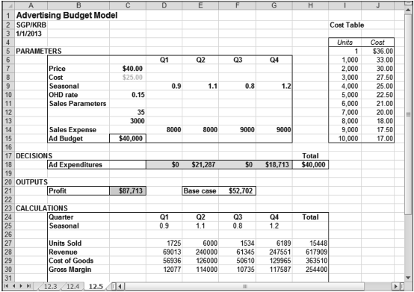
OPTIMAL ALLOCATION FROM THE EVOLUTIONARY SOLVER
Chapter 12
Copyright © 2013 John Wiley & Sons, Inc.

Slide 11
RESULTS OF USING EVOLUTIONARY SOLVER
The evolutionary solver finds a solution with a profit of $87,541, which is 63 percent higher than the base case and 25 percent higher than the solution found by the nonlinear solver.
The advertising expenditures in this solution focus on the fourth quarter.
Repeated runs of Scatter Search fail to improve on this solution significantly, so we can accept it as optimal or nearly so.
This example demonstrates that even a modest alteration to one function in a model (here, the product’s cost) can fundamentally change the approach required for optimization.
The lesson for model building: recognize that the choice of Excel functions may affect the most suitable optimization algorithms to use and the results that can be achieved.
Chapter 12
Copyright © 2013 John Wiley & Sons, Inc.

Slide 12
THE CAPITAL BUDGETING PROBLEM
Although the evolutionary solver can work with constraints, it is less efficient when constraints are present, and performance tends to deteriorate as the number of constraints increases.
Rather than imposing an explicit constraint, we add a term to the objective function that penalizes the solution for violations of a constraint.
Chapter 12
Copyright © 2013 John Wiley & Sons, Inc.

Slide 13
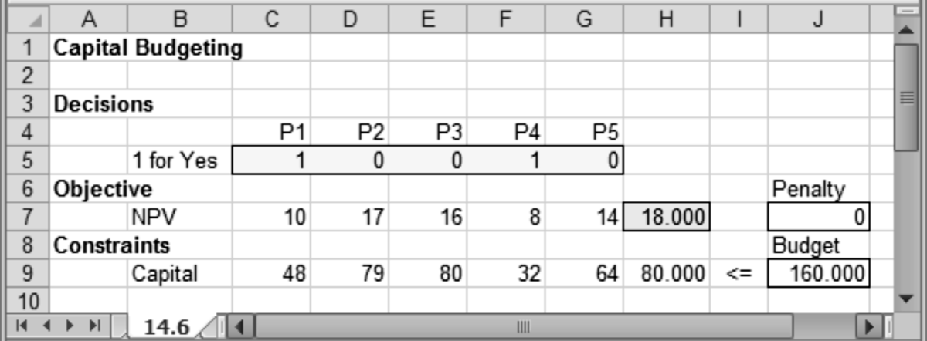
WORKSHEET FOR THE MODIFIED MARR CORPORATION EXAMPLE
Chapter 12
Copyright © 2013 John Wiley & Sons, Inc.

Slide 14
RESULTS OF RUNNING EVOLUTIONARY SOLVER ON THIS MODEL
A solution of $35 million, which is better than the optimum in the base case.
If the previous run stopped because of convergence, we should expand the population size.
If it stopped because improvement was impossible, then the Max time without Improvement parameter should be increased or the Tolerance parameter should be reduced to zero.
If this stopping condition persists, then it is a good idea to start the search with a different set of decision variables.
If we simply run into the time limit, then the maximum time parameter should be increased to 60 seconds (and beyond, if we have the time).
It appears that an objective function of $35 million is the best we can achieve.
Chapter 12
Copyright © 2013 John Wiley & Sons, Inc.

Slide 15
SUMMARY
The evolutionary solver contains an algorithm that complements the nonlinear solver, the linear solver, and the integer solver.
Evolutionary solver can often find good, near-optimal solutions to very difficult problems, and it may be the only effective procedure when there is a nonsmooth objective function.
The evolutionary solver works with a set of specialized parameters.
Practice and experience using the evolutionary solver are the key ingredients in effective parameter selection.
We usually reserve the use of the evolutionary solver for only the most difficult problems, when the other solvers would fail or when we cannot build a suitable model with a smooth objective function.
Chapter 12
Copyright © 2013 John Wiley & Sons, Inc.

Slide 16
COPYRIGHT © 2013 JOHN WILEY & SONS, INC.
All rights reserved. Reproduction or translation of this work beyond that permitted in section 117 of the 1976 United States Copyright Act without express permission of the copyright owner is unlawful. Request for further information should be addressed to the Permissions Department, John Wiley & Sons, Inc. The purchaser may make back-up copies for his/her own use only and not for distribution or resale. The Publisher assumes no responsibility for errors, omissions, or damages caused by the use of these programs or from the use of the information herein.
14 - <number>

