Slide 1
CHAPTER 13 POWERPOINT
DECISION ANALYSIS

Slide 2
INTRODUCTION
Many business problems contain uncertain elements that are impossible to ignore without losing the essence of the situation.
In this chapter, we introduce some basic methods for analyzing decisions affected by uncertainty.
Chapter 13
Copyright © 2013 John Wiley & Sons, Inc.

Slide 3
UNCERTAIN PARAMETERS
Now, we broaden our viewpoint to include uncertain inputs—parameter values subject to uncertainty.
Uncertain parameters become known only after a decision is made.
When a parameter is uncertain, we treat it as if it could take on two or more values, depending on influences beyond our control.
These influences are called states of nature, or more simply, states.
In many instances, we can list the possible states, and for each one, the corresponding value of the parameter.
Finally, we can assign probabilities to each of the states so that the parameter outcomes form a probability distribution.
Chapter 13
Copyright © 2013 John Wiley & Sons, Inc.

Slide 4
PAYOFF TABLES AND DECISION CRITERIA
For each action-state combination, the entry in the table is a measure of the economic result.
Typically, the payoffs are measured in monetary terms, but they need not be profit figures.
They could be costs or revenues in other applications, so we use the more general term payoff.
Chapter 13
Copyright © 2013 John Wiley & Sons, Inc.

Slide 5
BENCHMARK CRITERIA
The Maximax payoff criterion seeks the largest of the maximum payoffs among the actions.
The maximin payoff criterion seeks the largest of the minimum payoffs among the actions.
The minimax regret criterion seeks the smallest of the maximum regrets among the actions.
Chapter 13
Copyright © 2013 John Wiley & Sons, Inc.

Slide 6
INCORPORATING PROBABILITIES
We can immediately translate this information into probability distributions for the payoffs corresponding to each of the potential actions.
We use the notation EP to represent an expected payoff (e.g., an expected profit).
Note that the expected payoff calculation ignores no information: all outcomes and probabilities are incorporated into the result.
Chapter 13
Copyright © 2013 John Wiley & Sons, Inc.

Slide 7
USING TREES TO MODEL DECISIONS
A probability tree depicts one or more random factors
The node from which the branches emanate is called a chance node, and each branch represents one of the possible states that could occur.
Each state, therefore, is a possible resolution of the uncertainty represented by the chance node.
Eventually, we’ll specify probabilities for each of the states and create a probability distribution to describe uncertainty at the chance node.
Chapter 13
Copyright © 2013 John Wiley & Sons, Inc.

Slide 8
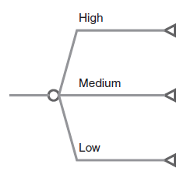
SIMPLE PROBABILITY TREE
Chapter 13
Copyright © 2013 John Wiley & Sons, Inc.

Slide 9
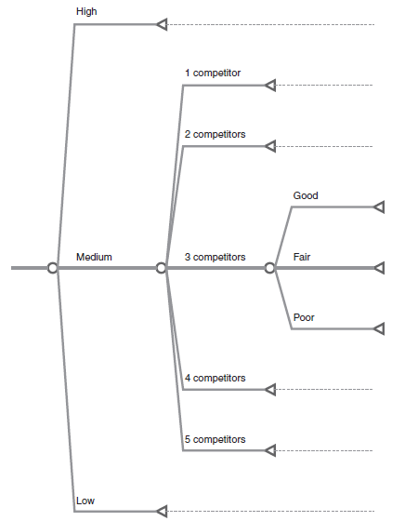
THREE CHANCE NODES IN TELEGRAPHIC FORM
Chapter 13
Copyright © 2013 John Wiley & Sons, Inc.

Slide 10
DECISION TREES
Decision-tree models offer a visual tool that can represent the key elements in a model for decision making under uncertainty and help organize those elements by distinguishing between decisions (controllable variables) and random events (uncontrollable variables).
In a decision tree, we describe the choices and uncertainties facing a single decision-making agent.
This usually means a single decision maker, but it could also mean a decision-making group or a company.
Chapter 13
Copyright © 2013 John Wiley & Sons, Inc.

Slide 11
REPRESENTING DECISIONS
In a decision tree, we represent decisions as square nodes (boxes), and for each decision, the alternative choices are represented as branches emanating from the decision node.
These are potential actions that are available to the decision maker.
In addition, for each uncertain event, the possible alternative states are represented as branches emanating from a chance node, labeled with their respective probabilities.
Chapter 13
Copyright © 2013 John Wiley & Sons, Inc.

Slide 12
ANALYZING THE DECISION TREE
Whereas we build the tree left to right, to reflect the temporal sequence in which a decision is followed by a chance event, we evaluate the tree in the reverse direction.
At each chance node, we can calculate the expected payoff represented by the probability distribution at the node.
This value becomes associated with the corresponding action branch of the decision node.
Then, at the decision node, we calculate the largest expected payoff to determine the best action.
This process of making the calculations is usually referred to as rolling back the tree.
Chapter 13
Copyright © 2013 John Wiley & Sons, Inc.

Slide 13
DECISION TREES: RISK PROFILES
The distribution associated with a particular action is called its risk profile.
The risk profile shows all the possible economic outcomes and provides the probability of each: It is a probability distribution for the principal output of the model.
This form reinforces the notion that, when some of the input parameters are described in probabilistic terms, we should examine the outputs in probabilistic terms.
After we determine the optimal decision, we can use a probability model to describe the profit outcome.
Chapter 13
Copyright © 2013 John Wiley & Sons, Inc.

Slide 14
DECISION TREES FOR A SERIES OF DECISIONS
Decision trees are especially useful in situations where there are multiple sources of uncertainty and a sequence of decisions to make.
For example, suppose that we are introducing a new product and that the first decision determines which channel to use during test-marketing.
When this decision is implemented, and we make an initial commitment to a marketing channel, we can begin to develop estimates of demand based on our test.
At the end of the test period, we might reconsider our channel choice, and we may decide to switch to another channel.
Then, in the full-scale introduction, we attain a level of profit that depends, at least in part, on the channel we chose initially.
Chapter 13
Copyright © 2013 John Wiley & Sons, Inc.

Slide 15
EXAMPLE
In the following example, we have depicted (in telegraphic form) a situation in which we choose our channel initially, observe the test market, reconsider our choice of a channel, and finally observe the demand during full-scale introduction.
Chapter 13
Copyright © 2013 John Wiley & Sons, Inc.

Slide 16
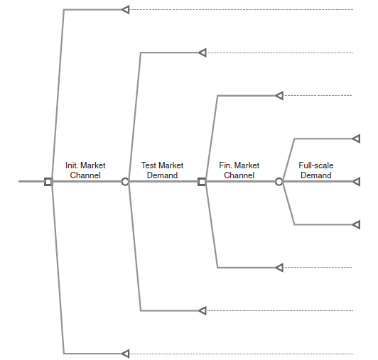
DECISION TREE WITH SEQUENTIAL DECISIONS
Chapter 13
Copyright © 2013 John Wiley & Sons, Inc.

Slide 17
PRINCIPLES FOR BUILDING
AND ANALYZING DECISION TREES
Determine the essential decisions and uncertainties.
Place the decisions and uncertainties in the appropriate temporal sequence.
Start the tree with a decision node representing the first decision.
Select a representative (but not necessarily exhaustive) number of possible choices for the decision node.
For each choice, draw a chance node representing the first uncertain event that follows the initial decision.
Select a representative (but not necessarily exhaustive) number of possible states for the chance node.
Continue to expand the tree with additional decision nodes and chance nodes until the overall outcome can be evaluated.
Chapter 13
Copyright © 2013 John Wiley & Sons, Inc.

Slide 18
ROLLBACK PROCEDURE FOR ANALYZING TREES
Start from the last set of nodes—those leading to the ends of the paths.
For each chance node, calculate the expected payoff as a probability-weighted average of the values corresponding to its branches.
Replace each chance node by its expected value.
For each decision node, find the best expected value (maximum benefit or minimum cost) among the choices corresponding to its branches.
Replace each decision node by the best value, and note which choice is best.
Continue evaluating chance nodes and decision nodes, backward in sequence, until the optimal outcome at the first node is determined.
Construct its risk profile.
Chapter 13
Copyright © 2013 John Wiley & Sons, Inc.

Slide 19
THE COST OF UNCERTAINTY
An action must be chosen before learning how an uncertain event will unfold.
The situation would be much more manageable if we could learn about the uncertain event first and then choose an action.
Chapter 13
Copyright © 2013 John Wiley & Sons, Inc.

Slide 20
IMPERFECT VS. PERFECT INFORMATION
When we have to make a decision before uncertainty is resolved, we are operating with imperfect information (uncertain knowledge) about the state of nature.
When we can make a decision after uncertainty is resolved, we can respond to perfect information about the state of nature.
Our probability assessments of event outcomes remain unchanged, and we are still dealing with expected values.
Chapter 13
Copyright © 2013 John Wiley & Sons, Inc.

Slide 21
EXPECTED VALUE OF PERFECT INFORMATION (EVPI)
The expected payoff with perfect information must always be at least as good as the expected payoff from following the optimal policy in the original problem, and it will usually be better.
The EVPI measures the difference, or the gain due to perfect information.
The calculation of EVPI can also be represented with a tree structure, where we reverse the sequence of decision and chance event in the tree diagram, just as we did in the calculations.
Chapter 13
Copyright © 2013 John Wiley & Sons, Inc.

Slide 22
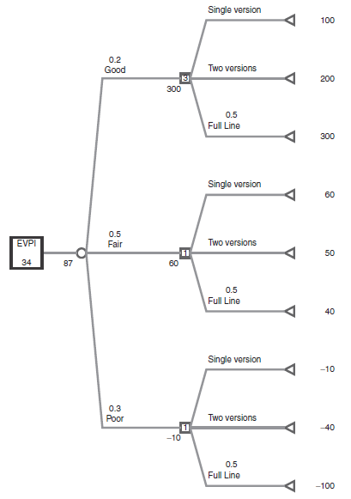
DECISION TREE FOR THE EVPI CALCULATION
Chapter 13
Copyright © 2013 John Wiley & Sons, Inc.

Slide 23
USING DECISION TREE SOFTWARE
It is often difficult to create a layout for the calculations that is tailored to the features of a particular example.
For that reason, it makes sense to take advantage of software that has been designed expressly for representing decision trees in Excel.
Decision Tree is a tool contained in Analytic Solver Platform for constructing and analyzing decision tree.
Chapter 13
Copyright © 2013 John Wiley & Sons, Inc.

Slide 24
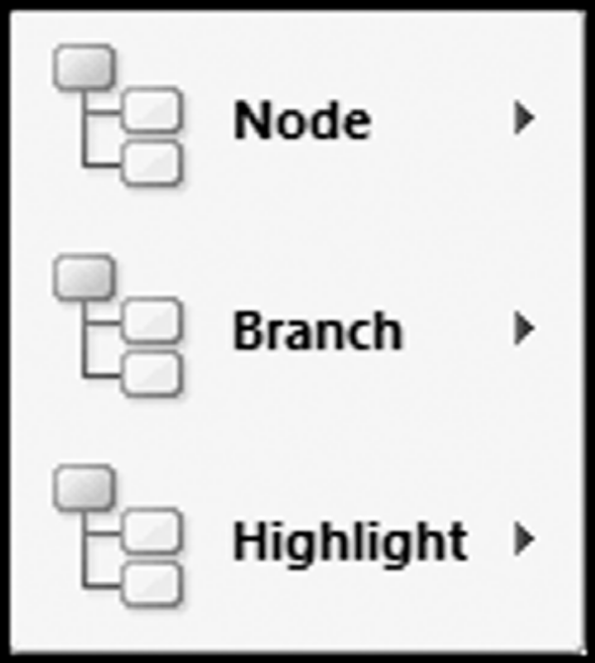
DECISION TREE MENU
Chapter 13
Copyright © 2013 John Wiley & Sons, Inc.

Slide 25
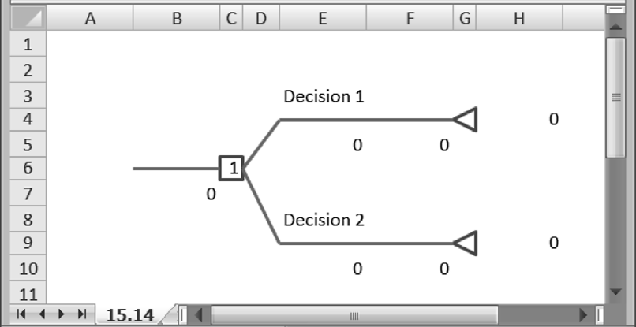
DEFAULT INITIAL TREE PRODUCED BY DECISION TREE
Chapter 13
Copyright © 2013 John Wiley & Sons, Inc.

Slide 26
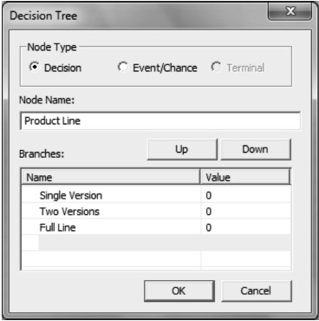
DETAILS FOR THE FIRST DECISION NODE
Chapter 13
Copyright © 2013 John Wiley & Sons, Inc.

Slide 27
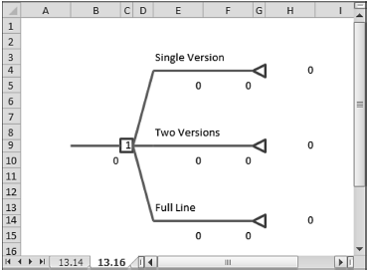
EXPANDED INITIAL TREE DIAGRAM
Chapter 13
Copyright © 2013 John Wiley & Sons, Inc.

Slide 28
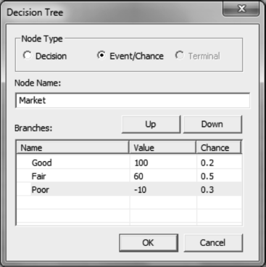
NODE WINDOW FOR THE FIRST EVENT NODE
Chapter 13
Copyright © 2013 John Wiley & Sons, Inc.

Slide 29
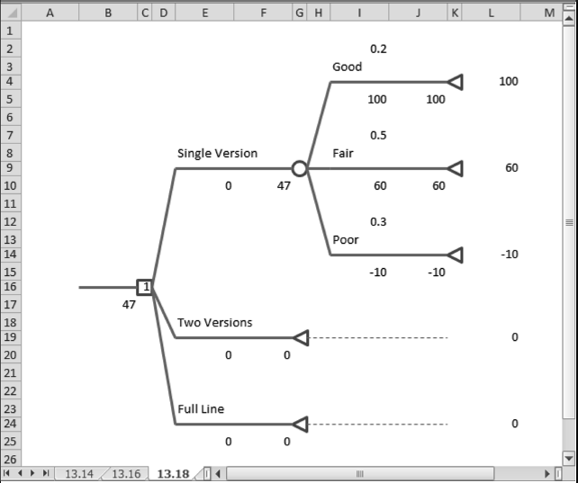
FIRST EVENT NODE PRODUCED BY DECISION TREE
Chapter 13
Copyright © 2013 John Wiley & Sons, Inc.

Slide 30
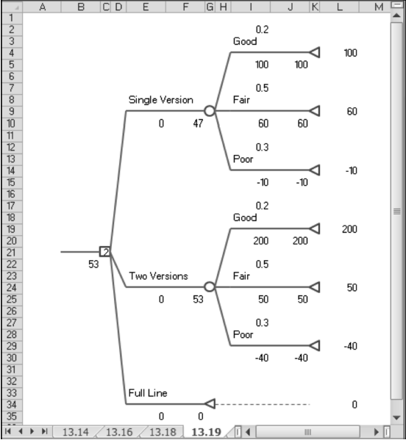
EXPANDED DIAGRAM WITH SECOND EVENT NODE COPIED
Chapter 13
Copyright © 2013 John Wiley & Sons, Inc.

Slide 31
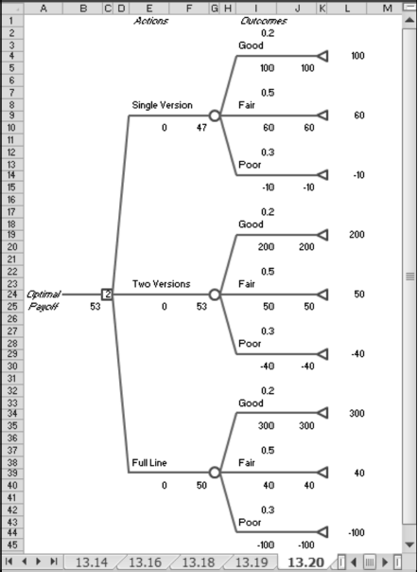
FULL DIAGRAM
Chapter 13
Copyright © 2013 John Wiley & Sons, Inc.

Slide 32
SENSITIVITY ANALYSIS WITH TREEPLAN
A decision-tree analysis retains the properties of a spreadsheet.
The worksheet produced by Decision Tree contains inputs, formulas, and outputs, just as in any well-designed model.
Thus, we can perform sensitivity analyses in the usual ways.
Chapter 13
Copyright © 2013 John Wiley & Sons, Inc.

Slide 33
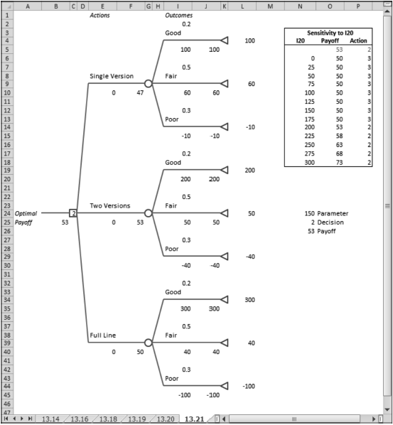
SENSITIVITY ANALYSIS FOR THE EXAMPLE MODEL
Chapter 13
Copyright © 2013 John Wiley & Sons, Inc.

Slide 34
MINIMIZING EXPECTED COSTS WITH DECISION TREE
We could just as easily apply Decision Tree to a problem involving the criterion of expected costs by treating all costs as negative profits and finding the maximum expected profit.
However, Decision Tree can accommodate costs in a more direct fashion and simply minimize expected cost.
To do so, we enter the task pane on the Model tab, select the root node (Decision Tree) in the main window, and in the table below, find the Decision Node parameter and use its pull-down menu to switch from Maximize to Minimize.
Chapter 13
Copyright © 2013 John Wiley & Sons, Inc.

Slide 35
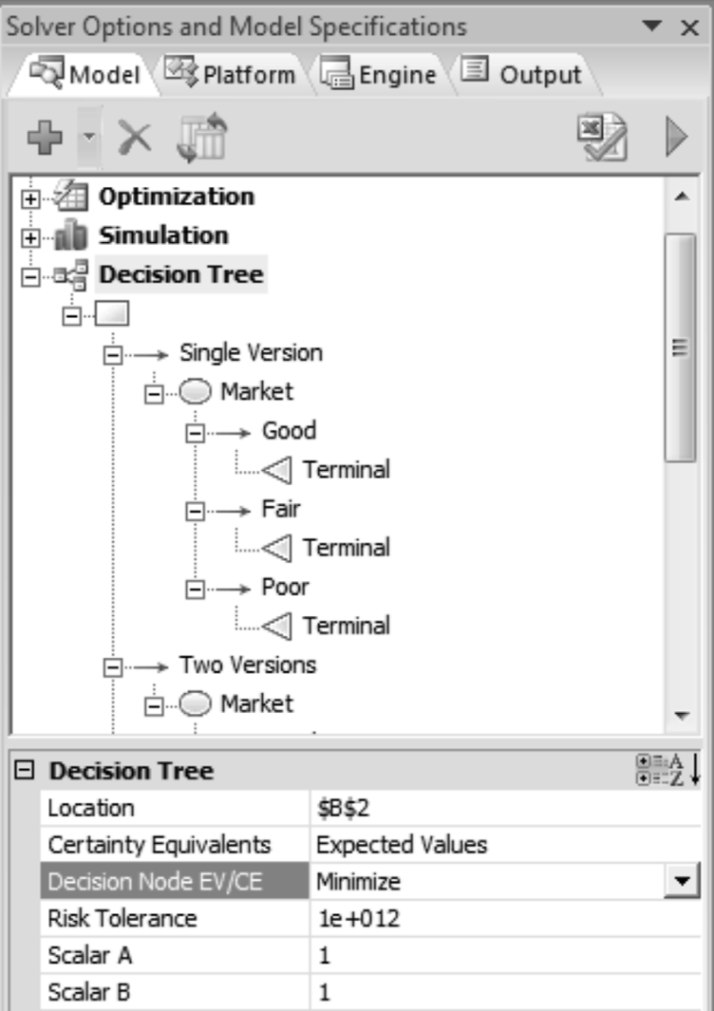
LOCATION OF THE MAXIMIZATION SETTING ON THE TASK PANE
Chapter 13
Copyright © 2013 John Wiley & Sons, Inc.

Slide 36
*MAXIMIZING EXPECTED UTILITY WITH DECISION TREE
What if we wish to incorporate some aversion to risk in our decision making?
Suppose that we could evaluate payoffs in some risk-adjusted manner—that is, with a measure that combines notions of monetary value along with the risk of an undesired outcome.
To contrast this measure with the measure of pure dollars unadjusted for risk, we’ll adopt the name utils for this new scale.
With this scale available, the decision maker can compute the value of a particular action in utils and select as the optimal decision the action with the largest such value.
The value of an action, measured in utils, incorporates both outcomes and probabilities, just as expected value does, but it also acknowledges risk.
We say that a decision maker who is behaving in this way seeks to maximize expected utility.
Chapter 13
Copyright © 2013 John Wiley & Sons, Inc.

Slide 37
EXPONENTIAL UTILITY FUNCTION
Although there are many ways of converting dollars to utils, one straightforward method uses an exponential utility function:
U = a – b exp (–D/R)
where D is the value of the outcome in dollars; U is the utility value, or the value of an outcome in utils; and a, b, and R represent parameters of the utility function.
Parameters a and b are essentially scaling parameters; R influences the shape of the curve and is known as the risk tolerance.
Chapter 13
Copyright © 2013 John Wiley & Sons, Inc.

Slide 38
ANALYSIS WITH UTILITIES
To carry out the analysis, we use this function to convert each monetary outcome from dollars to utils, and then we determine the action that achieves the maximum expected utility.
Although Decision Tree allows the flexibility of setting three different parameters, we usually advise setting a = b = 1.
This choice ensures that the function passes through the origin, so that our remaining task is finding a value of R that captures the decision maker’s preferences.
Chapter 13
Copyright © 2013 John Wiley & Sons, Inc.

Slide 39
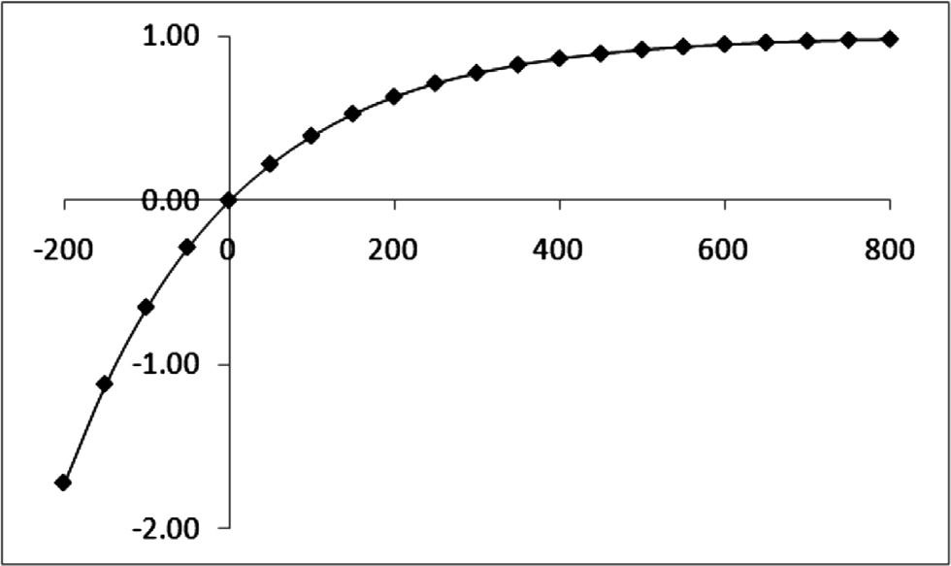
GRAPH OF UTILITY FUNCTION FOR THE EXAMPLE
Chapter 13
Copyright © 2013 John Wiley & Sons, Inc.

Slide 40
USING TREE PLAN WITH EXPONENTIAL UTILITY FUNCTION
In Decision Tree, it is necessary to specify the three parameters in the exponential utility function.
These three values must be entered in the task pane on the Model tab, along with designating the value for Certainty Equivalents to be the Exponential Utility Function.
After the user designates the use of Exponential Utility Function, Decision Tree displays additional calculations in columns B, F, and J. Immediately below the monetary payoffs the display shows the same figures converted to utils.
Chapter 13
Copyright © 2013 John Wiley & Sons, Inc.

Slide 41
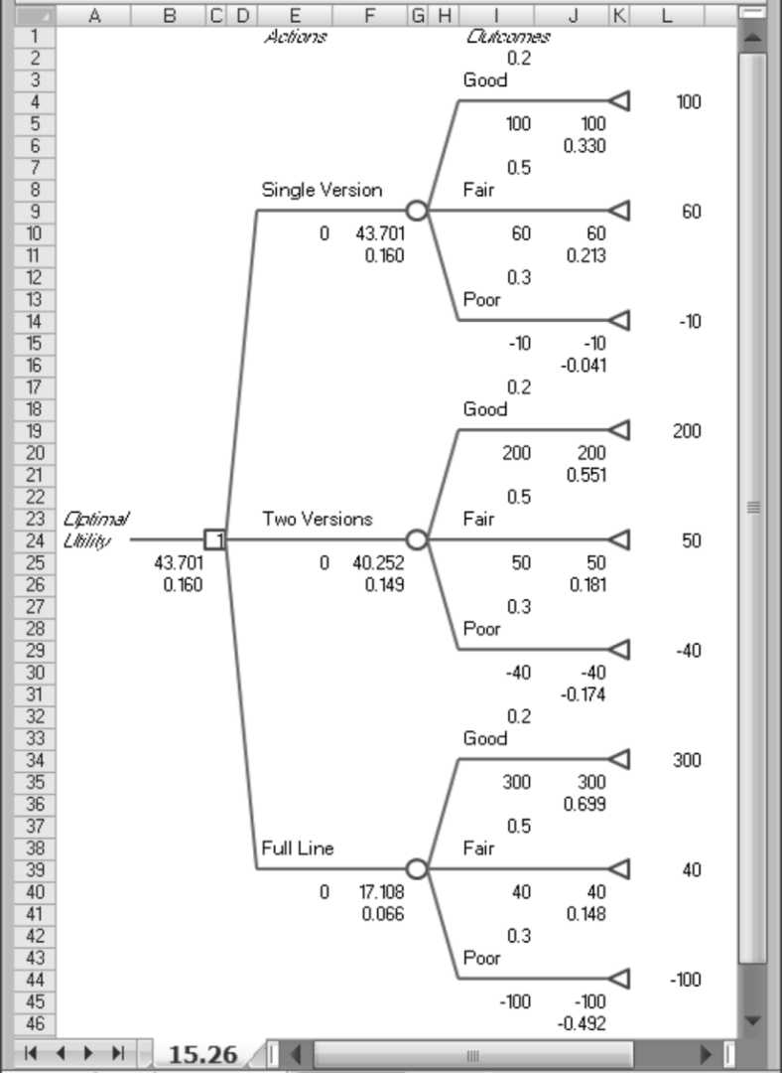
MODIFICATION OF THE EXAMPLE MODEL FOR EXPONENTIAL UTILITIES
Chapter 13
Copyright © 2013 John Wiley & Sons, Inc.

Slide 42
SUMMARY
A decision tree is a specialized model for recognizing the role of uncertainties in a decision-making situation.
Trees help us distinguish between decisions and random events, and more importantly, they help us sort out the sequence in which they occur.
Probability trees provide us with an opportunity to consider the possible states in a random environment when there are several sources of uncertainty, and they become components of decision trees.
The key elements of decision trees are decisions and chance events. A decision is the selection of a particular action from a given list of possibilities.
A chance event gives rise to a set of possible states, and each action-state pair results in an economic payoff.
In the simplest cases, these relationships can be displayed in a payoff table, but in complex situations, a decision tree tends to be a more flexible way to represent the relationships and consequences of decisions made under uncertainty.
Chapter 13
Copyright © 2013 John Wiley & Sons, Inc.

Slide 43
SUMMARY (CONT’D)
The choice of a criterion is a critical step in solving a decision problem when uncertainty is involved.
There are benchmark criteria for optimistic and pessimistic decision making, but these are somewhat extreme criteria. They ignore some available information, including probabilities, in order to simplify the task of choosing a decision.
The more common approach is to use probability assessments and then to take the criterion to be maximizing the expected payoff, which in the business context translates into maximizing expected profit or minimizing expected cost.
Using the rollback procedure, we can identify those decisions that optimize the expected value of our criterion. Furthermore, we can produce information in the form of a probability distribution to help assess the risk associated with any decision in the tree.
Decision Tree is a straightforward spreadsheet program that assists in the structuring of decision trees and in the calculations required for a quantitative analysis.
Chapter 13
Copyright © 2013 John Wiley & Sons, Inc.

Slide 44
COPYRIGHT © 2013 JOHN WILEY & SONS, INC.
All rights reserved. Reproduction or translation of this work beyond that permitted in section 117 of the 1976 United States Copyright Act without express permission of the copyright owner is unlawful. Request for further information should be addressed to the Permissions Department, John Wiley & Sons, Inc. The purchaser may make back-up copies for his/her own use only and not for distribution or resale. The Publisher assumes no responsibility for errors, omissions, or damages caused by the use of these programs or from the use of the information herein.

