Slide 1
CHAPTER 15 POWERPOINT
OPTIMIZATION IN SIMULATION

Slide 2
INTRODUCTION
We would like to marry the power of optimization to identify the best decision variables with the power of simulation to describe outcome distributions.
Unfortunately, the optimization approaches using Solver are all based on the premise that the objective function can be measured deterministically.
But in simulation models the objective function is the expected value or some other function of a random variable.
Analytic Solver Platform can optimize these models as well.
However, a number of issues arise that do not arise when optimizing deterministic models.
Chapter 15
Copyright © 2013 John Wiley & Sons, Inc.

Slide 3
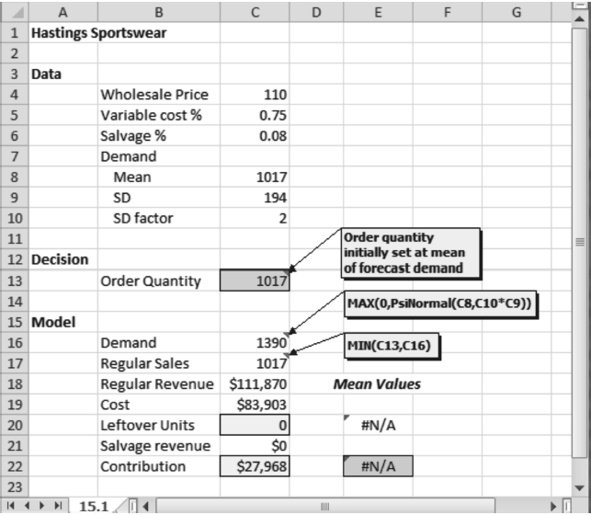
OPTIMIZATION WITH ONE OR TWO DECISION VARIABLES
Chapter 15
Copyright © 2013 John Wiley & Sons, Inc.

Slide 4
OPTIMIZATION WITH ONE OR TWO DECISION VARIABLES
Two outcomes of this model example are of particular interest: the profit contribution and the number of leftover units.
To record the mean contribution on the spreadsheet, place the cursor on cell C22. Then select Analytic Solver Platform►Simulation Model►Results►Statistics►Mean, and select the contribution cell (in this case, E22). This places the formula =PsiMean(C20) in cell E22.
Although both outcomes are important, we take the maximization of mean contribution as our primary objective.
Our approach is to maximize mean contribution subject to secondary consideration for the mean number of leftover units.
Chapter 15
Copyright © 2013 John Wiley & Sons, Inc.

Slide 5
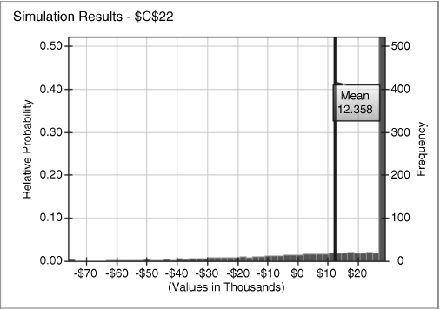
DISTRIBUTION OF PROFIT CONTRIBUTION
Chapter 15
Copyright © 2013 John Wiley & Sons, Inc.

Slide 6
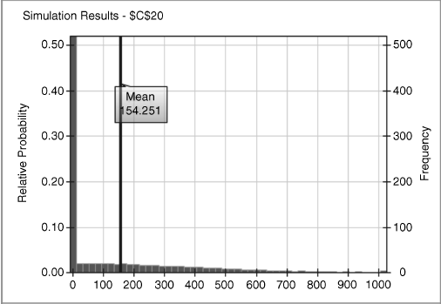
DISTRIBUTION OF LEFTOVER UNITS
Chapter 15
Copyright © 2013 John Wiley & Sons, Inc.

Slide 7
GRID SEARCH
In a grid search, we select a series of values we wish to test for a decision variable, and we run the simulation at each of these values.
When our model is particularly simple, there is an efficient approach to grid search.
The trick is to replicate the model for each value of the decision variable we wish to test.
Chapter 15
Copyright © 2013 John Wiley & Sons, Inc.

Slide 8
OPTIMIZING USING SIMULATION SENSITIVITY
Simulation sensitivity can be used for optimization when we have one or two decision variables.
In the example of an apparel order, we first plot the mean contribution over a range of order quantities, then display the minimum and maximum along with the mean.
Chapter 15
Copyright © 2013 John Wiley & Sons, Inc.

Slide 9
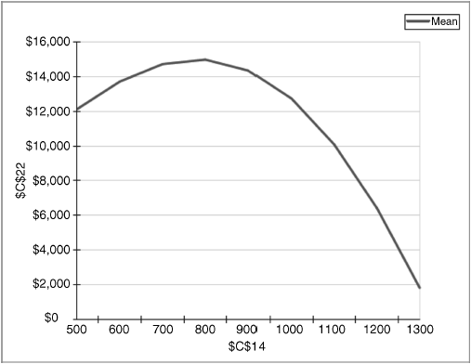
SENSITIVITY OF MEAN CONTRIBUTION TO ORDER QUANTITY
Chapter 15
Copyright © 2013 John Wiley & Sons, Inc.

Slide 10
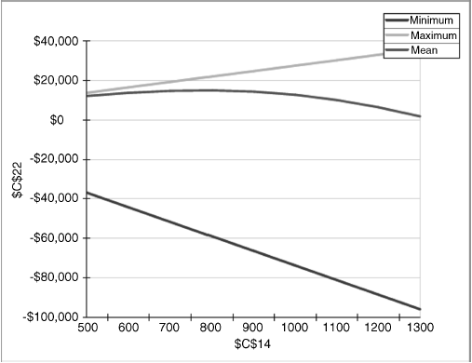
SENSITIVITY OF MEAN, MINIMUM AND MAXIMUM CONTRIBUTION TO ORDER QUANTITY
Chapter 15
Copyright © 2013 John Wiley & Sons, Inc.

Slide 11
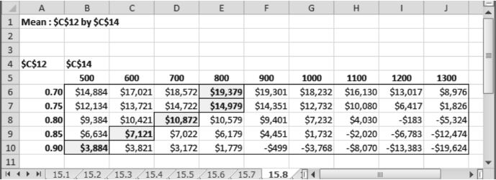
SENSITIVITY OF CONTRIBUTION TO ORDER QUANTITY AND PRICE
Chapter 15
Copyright © 2013 John Wiley & Sons, Inc.

Slide 12
OPTIMIZING USING SOLVER
If we want to determine the optimal order quantity with more precision than a coarse grid search provides, we have two options:
  Refine the grid (using simulation sensitivity with a larger number of Axis Points)
  Use optimization directly (invoking Solver).
Chapter 15
Copyright © 2013 John Wiley & Sons, Inc.

Slide 13
STOCHASTIC OPTIMIZATION
When the problem involves three or more decision variables, and possibly constraints as well, grid search has limited usefulness.
We then turn to more sophisticated methods for identifying optimal decisions when the objective function is based on probabilistic outcomes.
Solver offers us an alternative to using the PsiMean function.
We can designate the output cell as the objective.
This output cell contains a distribution, so we must tell Solver which aspect of the distribution we wish to maximize or minimize.
Chapter 15
Copyright © 2013 John Wiley & Sons, Inc.

Slide 14
CHANCE CONSTRAINTS
A chance contraint imposes a restriction on a tail probability in the simulated distribution, or on a function related to that probability.
We can enter a chance constraint into a Solver model by creating a cell to represent the 10th percentile of the distribution.
If the 10th percentile is negative, then more than 10 percent of the distribution falls below zero—that is, the probability of a loss is greater than 10 percent.
Chapter 15
Copyright © 2013 John Wiley & Sons, Inc.

Slide 15
TWO-STAGE PROBLEMS WITH RECOURSE
In a typical application of simulation, decisions must be made before the uncertain outcomes become known, however it’s possible that certain decisions can be made after some uncertainties have been resolved.
When decisions can be made after uncertainties are resolved, we are better off if we take those results into account.
If we ignore the option to act later with more complete knowledge, we must make our decisions based on all the uncertainties.
If we can make our decision after we know the outcome of an uncertain event or parameter, we can match our decision more closely to that outcome and eliminate some of the risks.
Chapter 15
Copyright © 2013 John Wiley & Sons, Inc.

Slide 16
SUMMARY
Simulation is primarily a way to describe the range of uncertainty in the results of a model.
Simulation models with one or two variables can be optimized using a variety of techniques.
Grid search is the general name for a procedure in which we evaluate the objective over a range of values of the decision variables.
Grid search can be automated easily using the Simulation Sensitivity tool.
To optimize simulation models with three or more decision variables requires the use of Solver.
Chapter 15
Copyright © 2013 John Wiley & Sons, Inc.

Slide 17
SUMMARY
Two-stage problems with recourse are characterized by a three-step sequence consisting of:
  Determining the value of strategic decision variables.
  Observing random outcomes.
  Determining the values of tactical decision variables.
In these problems, we first make decisions for the long run, then we learn how random occurrences are resolved, and finally, we make short-run decisions within the limitations imposed by our previous long-run decisions.
Chapter 15
Copyright © 2013 John Wiley & Sons, Inc.

Slide 18
COPYRIGHT © 2013 JOHN WILEY & SONS, INC.
All rights reserved. Reproduction or translation of this work beyond that permitted in section 117 of the 1976 United States Copyright Act without express permission of the copyright owner is unlawful. Request for further information should be addressed to the Permissions Department, John Wiley & Sons, Inc. The purchaser may make back-up copies for his/her own use only and not for distribution or resale. The Publisher assumes no responsibility for errors, omissions, or damages caused by the use of these programs or from the use of the information herein.
17 - <number>

