Slide 1
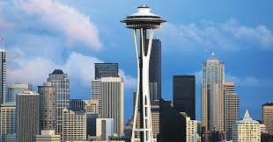
PREDICTING THE VALUE OF a HOUSE
Marjorie Blanco

Slide 2
Situation and Target
Bellevue is one of the hottest housing market in the country
Goal is to build a model to predict the real estate sales price of a house based upon various historical features about the house in Bellevue, WA

Slide 3
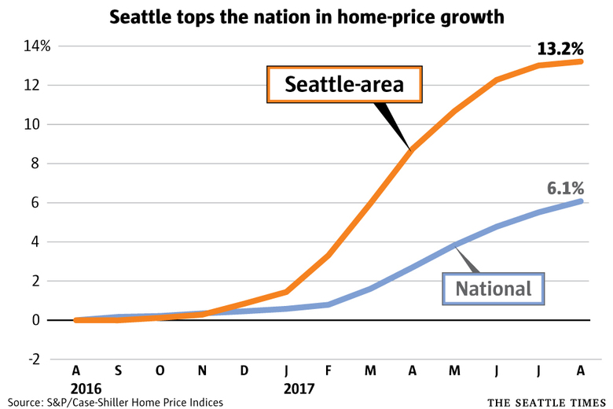
Seattle marks a full year as America’s hottest housing market, with no end in sight
Now, Seattle is an outlier — everywhere else is experiencing growth that’s slightly or moderately above average for that region, while prices here are increasing nearly three times as fast as the historical average.

Slide 4


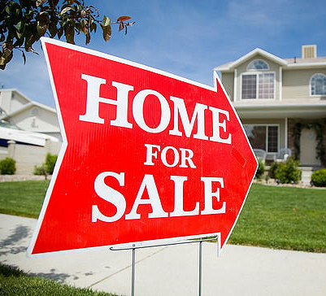
Stakeholders
Prospective home buyers/sellers
Real estate agents
Real estate investors
Banks

Slide 5
Preprocessing, Data Exploration & Modeling
Data Cleaning
Model Training and Evaluation
Select algorithm
Remove outliers
Data Exploration
Feature Selection
Drop Low Value Variables

Slide 6
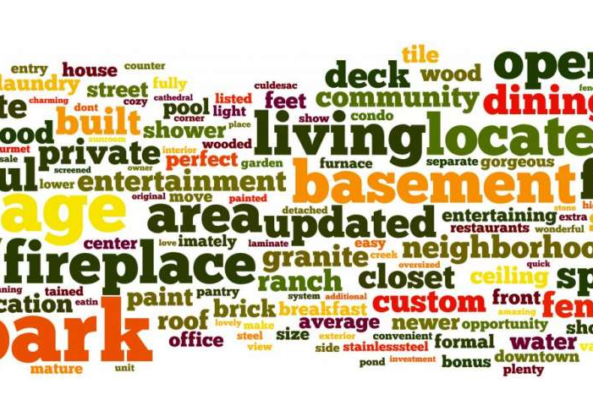
Feature Selection
Dependent Variables
PRICE
Explanatory Variables
BEDS
BATHS
SQUARE FEET
LOT SIZE
AGE

Slide 7
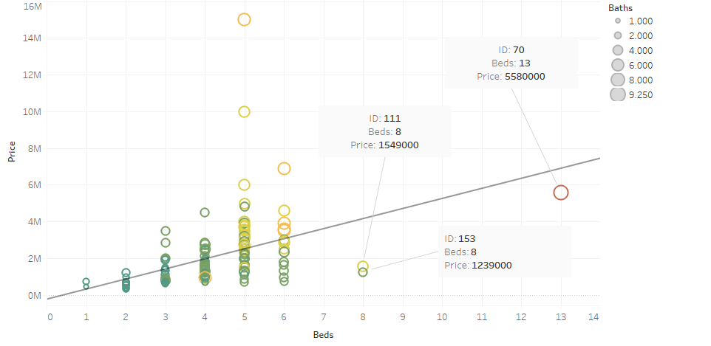
List Price vs. number of Beds

Slide 8
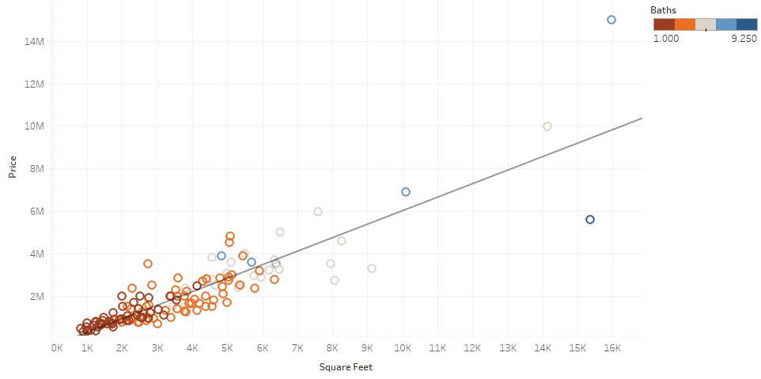
List Price vs. Square Feet

Slide 9

Low Predictive Value Variables
Baths
Lot Size
Age

Slide 10
Modeling
Base Model
Model 2
Final Model
81.7%
All variables
Removed Lot Size
Model 3
Removed Age
Model 4
Removed Baths
Square Feet and Beds
85.6%
81.6%
81.5%
81.4%
Removed outliers

Slide 11
Model Evaluation

Slide 12
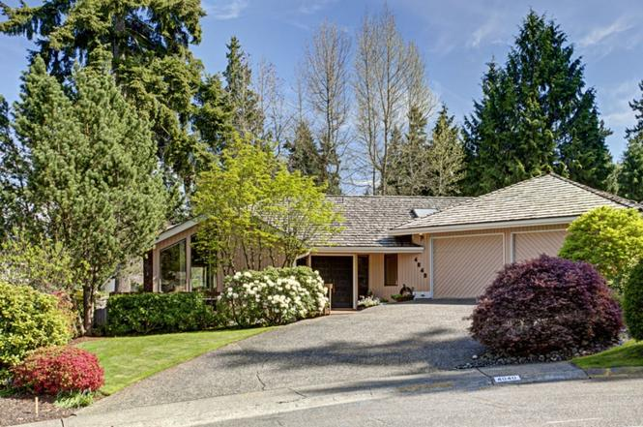

Predictive Demo
Beds: 3
Square Feet: 2,490
$$PRICE=32267.44−154666∗ BEDS + 700.8764 ∗ SQUARE FEET$$
Model: $1,313,452
Redfin: $891,375
Zillow: $904,453

Slide 13
Next Steps
Deployment
2
Further improving
1
Add other predictive variables
Increase observations
Removing additional outlier
Azure
AWS

Slide 14
Benefits
Simplicity
Easy to use
Easy to understand

Slide 15
Additional features
Zip code
Schools
Neighborhood
Parks and Green Spaces
Landmarks
Crime rate

Slide 16


