Slide 1
R Introduction
Marjorie Blanco
DA 320
W. Li and T. Kim

Slide 2

What is R?
R is a programming language for statistics and data visualization.
R is commonly used for computation, statistics, data mining, data analysis, and data discovery.

Slide 3

Why R?
R is free, open source
Easy to use
Interactive
Flexible
Fast
Active and helpful community
Thousands of free add-on packages
Increased in popularity
Widely used in academia
Growing in professional

Slide 4
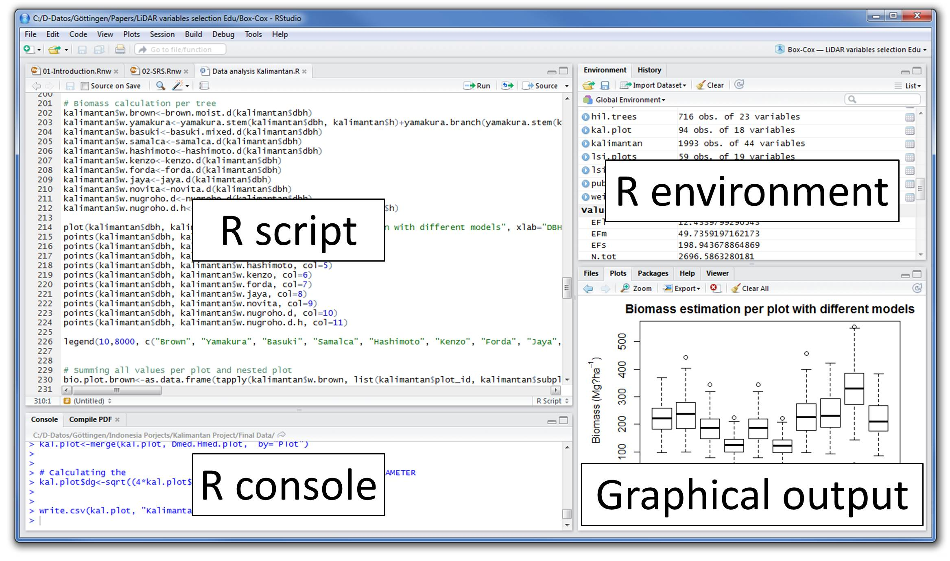

Slide 5
Demo: iris dataset
Load IRIS dataset
Summary statistics
Visualization with Basic R
Scatterplot
Histogram
Visualization with ggplot
Regression
install.packages("datasets")
library(datasets)
data(iris)
summary(iris)

Slide 6
R Base graphics
Most common
Conceptually simple
Building plots reflects thought process
Constructed step by step through function calls

Slide 7
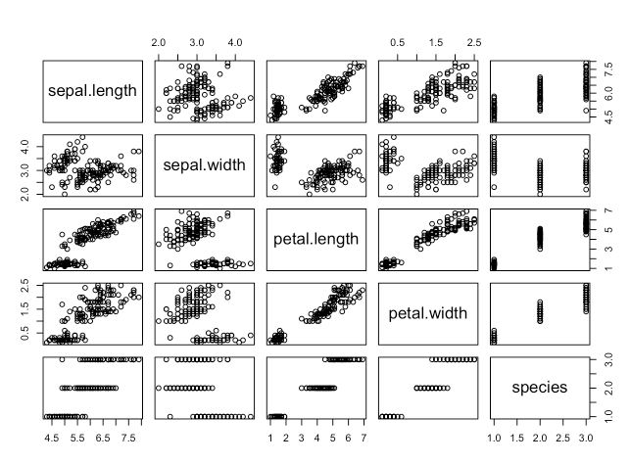
Visualization
Plot is a generic function for plotting of R objects.
plot(iris)

Slide 8
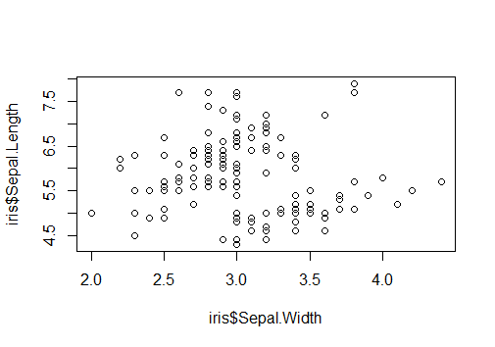
Scatterplot
plot(iris$Sepal.Width, iris$Sepal.Length)

Slide 9
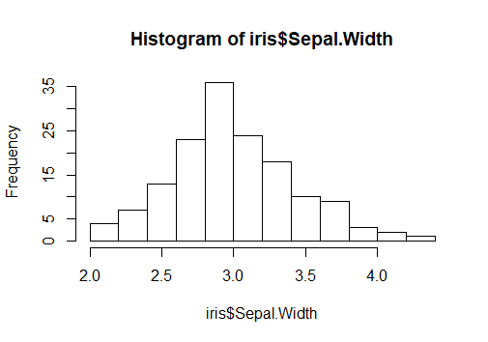
Histogram
hist(iris$Sepal.Width)

Slide 10
ggplot
Written by Hadley Wickham when he was a graduate student at Iowa State
Automatically deals with spacings, text, titles but also allows you to annotate by adding
Generally easier and more intuitive
Plots are built up in layers – Plot the data, overlay a summary, metadata and annotation

Slide 11
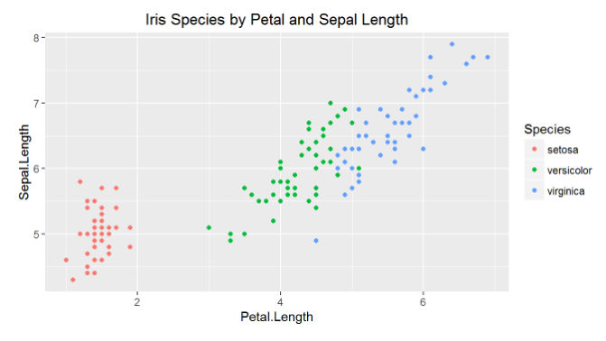
Scatterplot
install.packages("ggplot2")
library(“ggplot2”)
ggplot(iris, aes(x = Petal.Length, y = Sepal.Length, colour = Species)) +
geom_point() +
ggtitle('Iris Species by Petal and Sepal Length')

Slide 12
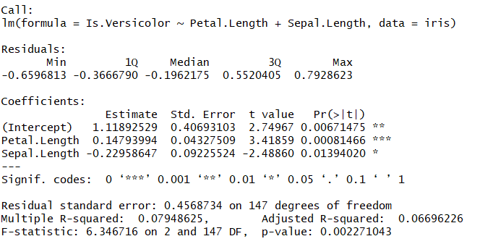
regression
iris[['Is.Versicolor']] <- as.numeric(iris[['Species']] == 'versicolor')
fit.lm <- lm(Is.Versicolor ~ Petal.Length + Sepal.Length, data = iris)
summary(fit.lm)

Slide 13
Comparison
Tool | Pricing | Data Source | Visualization
R | Open Source | Support for hundreds of data connector | R Basic ggplot lattice plotly and more
Power BI | Monthly Fee Desktop Free Pro (starting at $9.99) | Support for hundreds of data connector Heavily integrated with Microsoft’s portfolio | Create visualizations by asking queries with natural language through the Cortana personal digital assistant
Tableau | Monthly Fee Personal and Server (starting at $35) Professional Edition (starting at $70) Online (starting at $42) | Support for hundreds of data connector Offers better support for connecting to a distinct data warehouse, | 24 different types of baseline visualization

Slide 14
Tutorials
P. Kuhnert & B. Venables, An Introduction to R: Software for Statistical Modeling & Computing
J.H. Maindonald, Using R for Data Analysis and Graphics
B. Muenchen, R for SAS and SPSS Users
W.J. Owen, The R Guide
D. Rossiter, Introduction to the R Project for Statistical Computing for Use at the ITC
W.N. Venebles & D. M. Smith, An Introduction to R

Slide 15
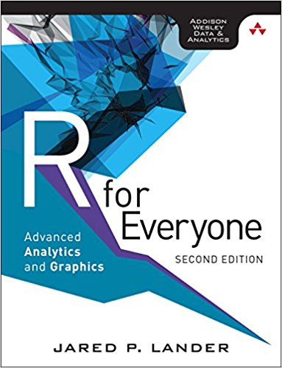
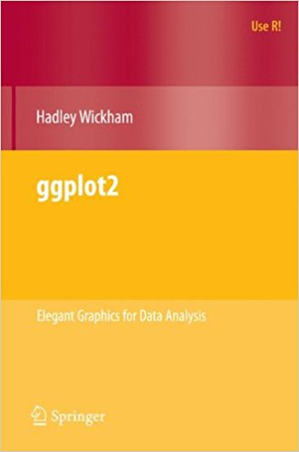
Recommended books

Slide 16
References
https://www.betterbuys.com/bi/tableau-vs-power-bi/
http://moderndive.com/3-viz.html
https://www.rstudio.com/wp-content/uploads/2015/03/ggplot2-cheatsheet.pdf
http://ggplot2.org/resources/2007-past-present-future.pdf
http://www.cookbook-r.com/Graphs/

