Slide 1
Machine learning & deep learning framework
Marjorie Blanco
DA 320
W. Li and T. Kim

Slide 2

What is Tensorflow?
A python-based toolkit for neural networks developed by Google.
Advantages?
Open source, visualizable, and many metaframeworks.

Slide 3
Pros and Cons
Pros:
Python + Numpy
Computational graph abstraction
Faster compile times than Theano
TensorBoard for visualization
Data and model parallelism
Cons:
Slower than other frameworks
Not many pretrained models
Computational graph is slow
No commercial support
Drops out to Python to load each new training batch
Not very toolable
Dynamic typing is error-prone on large software projects

Slide 4
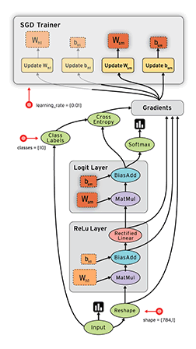
Nodes in the graph represent mathematical operations, while the graph edges represent the multidimensional data arrays (tensors) communicated between them. The flexible architecture allows you to deploy computation to one or more CPUs or GPUs in a desktop, server, or mobile device with a single API.

Slide 5
General Principle
To build a neural network with Tensorflow, you can follow the steps below:
1) Import the modules you need.
2) Define an add_layer function to construct layers.
3) Define the variables and initialize them.
4) Create a session to perform the operation.
5) Build the NN, and send data with placeholders and feed_dict.
6) Train and test the NN, and observe the results with Tensorboard.

Slide 6
Use Cases of TensorFlow
Voice/Sound Recognition
1
Text Based Applications
2
Image Recognition
3
Time Series
4
Video Detection
5

Slide 7
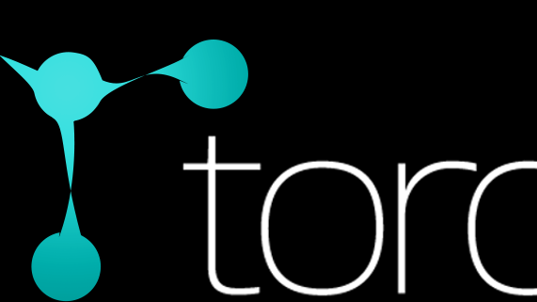
What is Torch?
Torch is a scientific computing framework with wide support for machine learning algorithms with strong CPU and CUDA backends.
Advantages?
Easy to use and efficient

Slide 8
Core features
Powerful N-dimensional array
Routines for indexing, slicing, transposing, and more
Interface to C, via LuaJIT
Linear algebra routines
Neural network, and energy-based models
Numeric optimization routines
Fast and efficient GPU support
Embeddable, with ports to iOS and Android backends

Slide 9
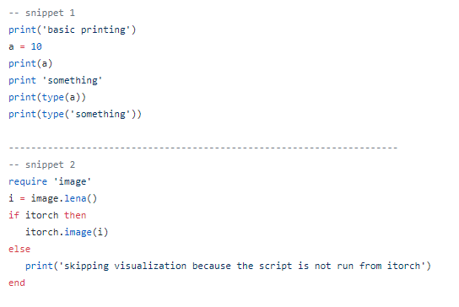
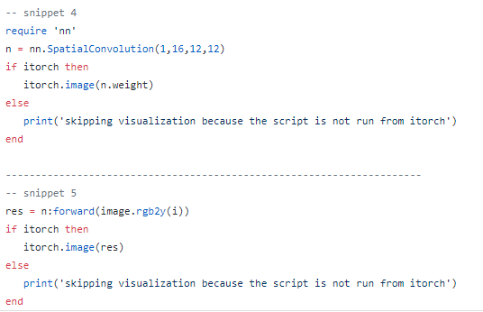
Example

Slide 10

What is Apache MXNet?
A flexible and efficient library for deep learning.
Advantages?
Easy to use and efficient

Slide 11
Use Cases of MXNet
Face recognition & detection
1
Object detection & classification
2
Optical character recognition
3
Machine translation
4

Slide 12
References
https://www.tensorflow.org/
https://www.digitaldoughnut.com/articles/2017/march/top-5-use-cases-of-tensorflow
http://www.deeplearning.net/software/theano/
https://mxnet.incubator.apache.org/

