Slide 1


ProCam Winter 2021
Martin Dahl
EE-550 Image and Video Processing

Slide 2
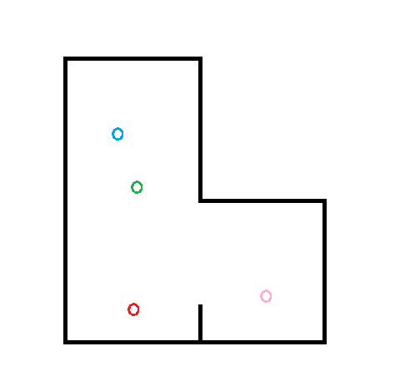
Problem

Slide 3
Problem
Many people in a room

Slide 4
Problem
Many people in a room
Requires more than one camera

Slide 5
Problem
Many people in a room
Requires more than one camera

Slide 6
Problem
Many people in a room
Requires more than one camera

Slide 7
Problem
Many people in a room
Requires more than one camera
Cameras should “know” if they look at the same person

Slide 8
Problem
Many people in a room
Requires more than one camera
Cameras should “know” if they look at the same person

Slide 9
Problem
Many people in a room
Requires more than one camera
Cameras should “know” if they look at the same person

Slide 10

Example
Data taken from Bruno Kessler Institute FBK TeV:
https://tev.fbk.eu/technologies/multi-camera-people-tracking-datasets

Slide 11
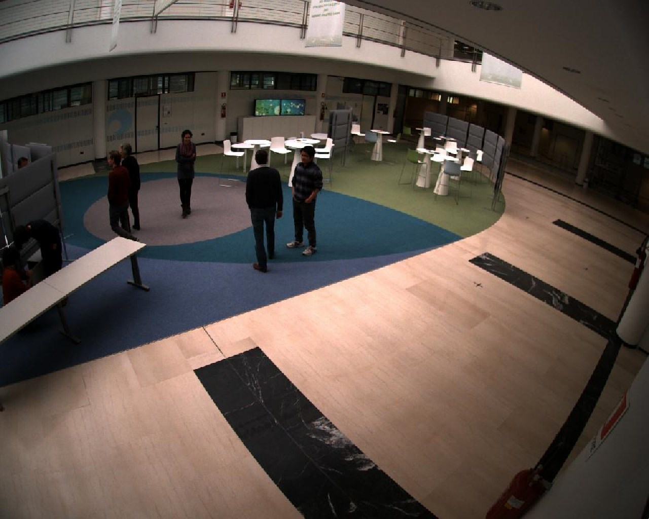
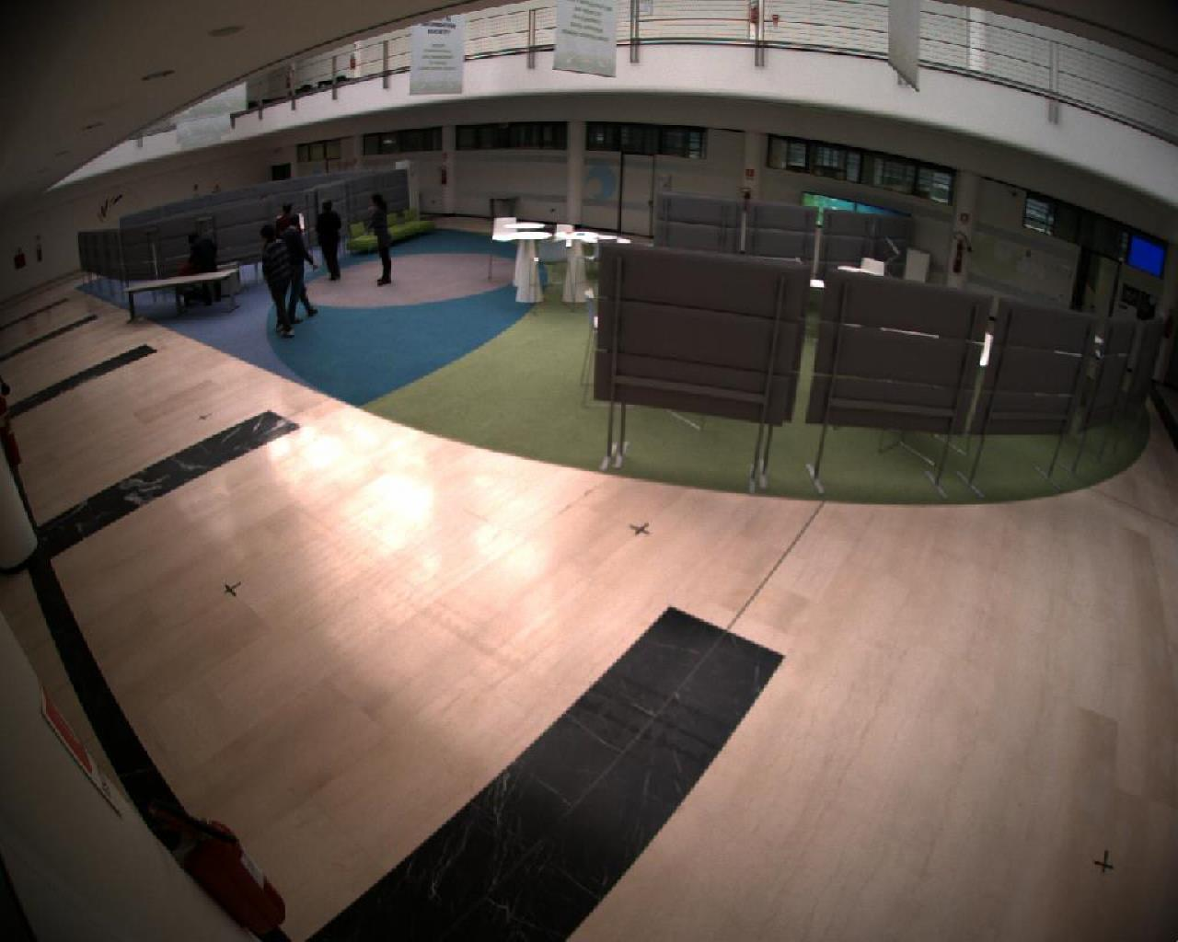
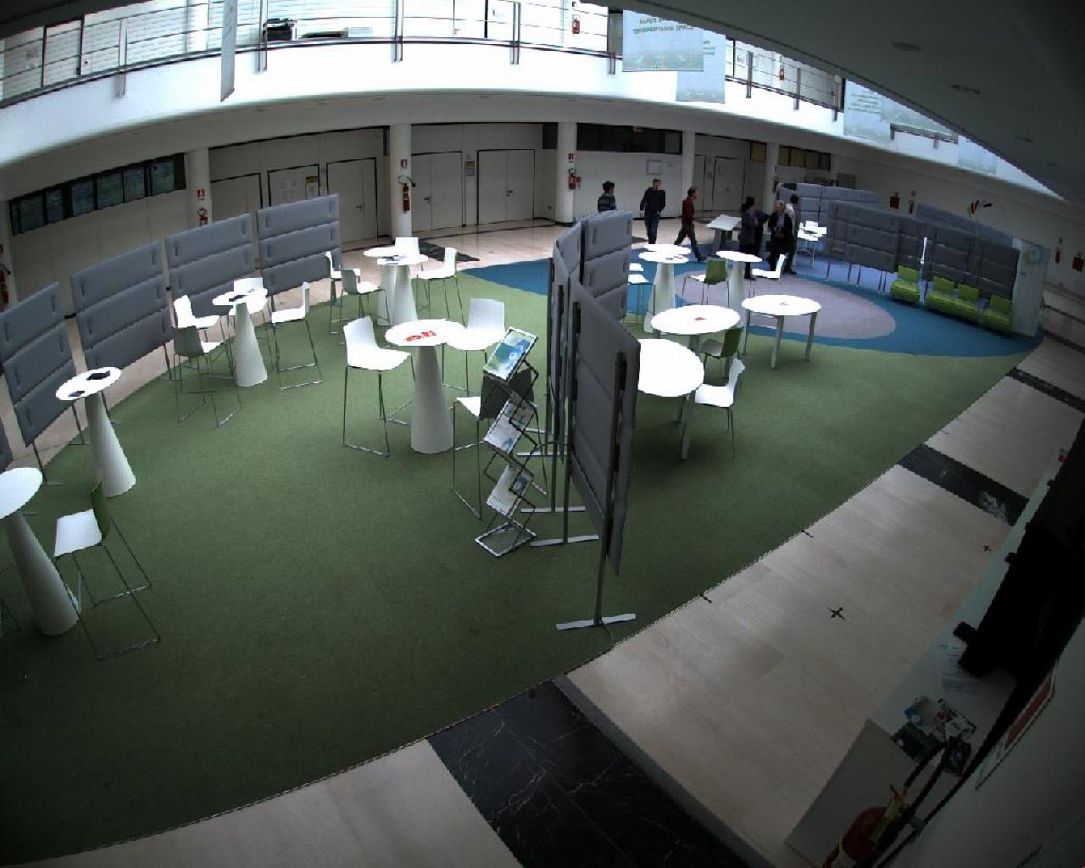
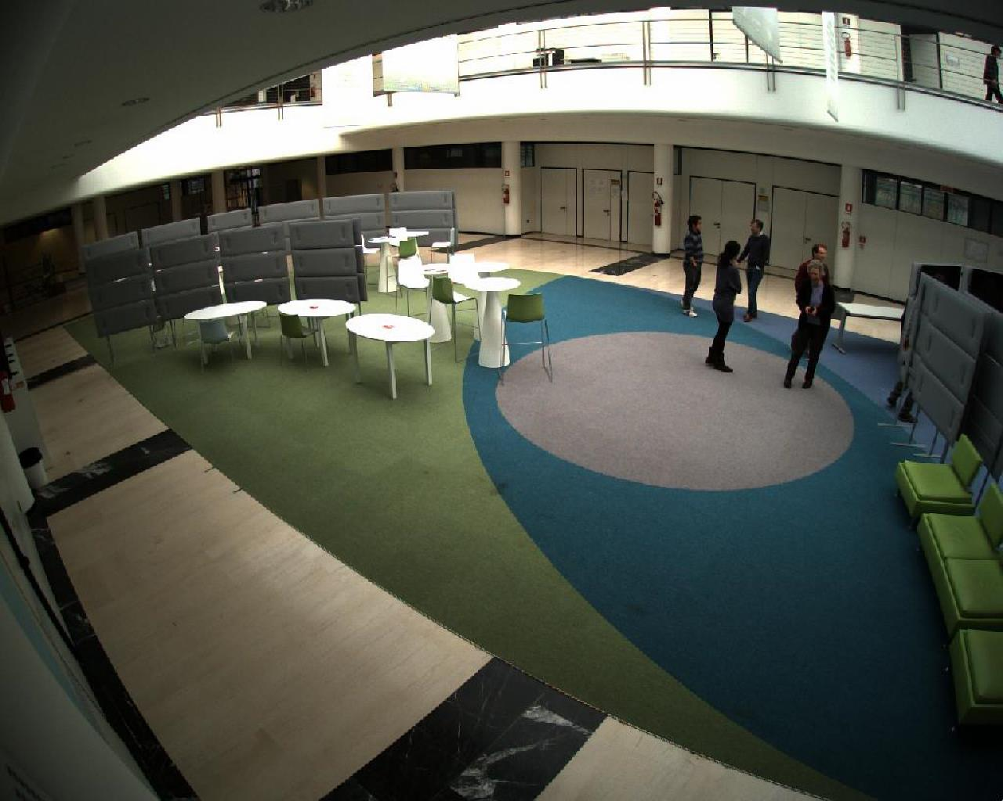
Example

Slide 12
Challenges

Slide 13
Challenges
Detecting persons

Slide 14
Challenges
Detecting persons
Recognizing persons

Slide 15
Challenges
Detecting persons
Recognizing persons
Recognition independent of pose and orientation

Slide 16
Challenges
Detecting persons
Recognizing persons
Recognition independent of pose and orientation
Lightning

Slide 17
Challenges
Detecting persons
Recognizing persons
Recognition independent of pose and orientation
Lightning
Visual obstructions

Slide 18


Challenges
Detecting persons
Recognizing persons
Recognition independent of pose and orientation
Lightning
Visual obstructions
Hard to get uniform data

Slide 19
ProCam Winter 2021
Martin Dahl
EE-550 Image and Video Processing

