Slide 1
OPTIONAL PRACTICAL TRAINING
(OPT) TUTORIAL
International Student & Scholar Services
Center for International Studies

Slide 2
Definition of OPT
Optional Practical Training (OPT)
“temporary employment for practical training directly related to the student’s major area of study”
It provides students with an opportunity to gain employment experience for one year following completion of their program of study.

Slide 3
Types of OPT
Pre-Completion OPT - is work authorization for a student who is enrolled full-time and has not yet completed their program of study. Students who are eligible to register for the next term may be approved to work for less than 20 hours per week (part-time) when school is in session and more than 20 hours per week (full-time) when school is not in session.
Post-Completion OPT - is work authorization for a student who has completed her/his program of study. Graduate students can apply and engage in Post-Completion OPT while they continue to work on their thesis, capstone paper or comprehensive examination.
STEM Extension – is an additional 17-month work authorization for Post-Completion OPT for certain eligible STEM (Science Technology Engineering and Mathematics) degree holders.

Slide 4
Eligibility for OPT
A student can apply for OPT if:
  The student is currently in valid F-1 status.
  The student has been lawfully enrolled on a full-time basis for one full academic year.
A student CANNOT apply for OPT if:
  The student is enrolled in an intensive English-language or certificate program.
  The student has exceeded 12 months of full-time CPT.
  The student has already received the benefit of OPT for their current program level.

Slide 5
Application Documents
Complete all sections of the application packet, which include the following:
  Optional Practical Training Request
  Original, signed Form I-765
  Original, signed Form G-1145
Copies of current and all previous forms I-20 (pages 1 & 3)
Two (2) U.S. style passport style photos (for information on passport style photos click here)
  Write your I-94 card number on the back
  Photos must be taken within 30 days of filing your application
    Please submit the photos in the envelope/folder from where they were taken
    Please submit the receipt of purchase (if possible)
I-94 Information Screen (retrieve here)
COLOR Copy of valid passport (biographical and extension pages)
Application fee: $380 (cost subject to change without notice)
  Money order is recommended, but you may use a personal check.
  Make payable to “U.S. Department of Homeland Security”
COLOR Copies of all previous Employment Authorization Documents (front and back, if applicable)
Student Health Insurance Petition for Refund (if applicable)

Slide 6
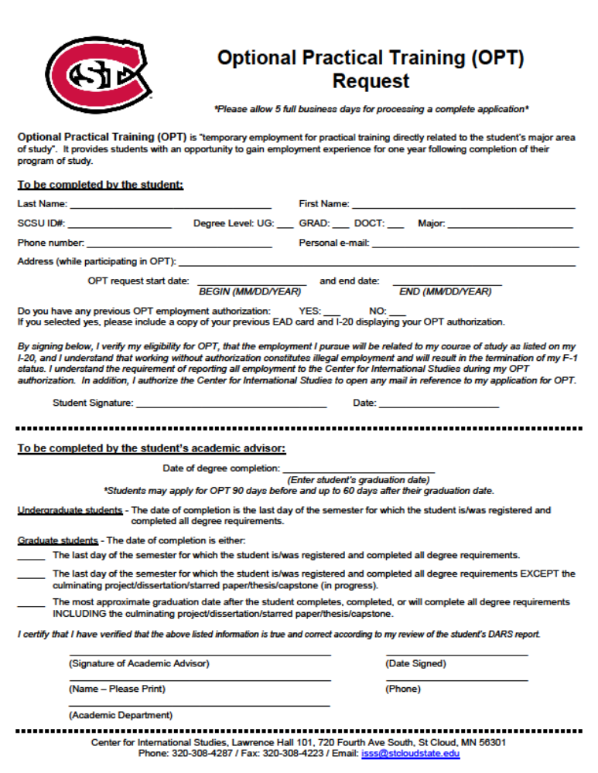

Slide 7
Choosing OPT Dates
Example: Graduating in Spring 2016
90 days 60 day grace period
2/5/2016 05/05/2016 7/4/2016
Earliest date to apply End of semester Last date to start OPT
Earliest date to start OPT is 05/06/2016
End date is 12 months after start date (ex: 5/6/2016 to 5/5/2017)
You will receive an additional 60-day grace period after the end of your OPT (each grace period is independent). You cannot work during your grace periods.
Due to application processing times, you should try to submit your OPT application approximately 90 days before your intended OPT start date.

Slide 8
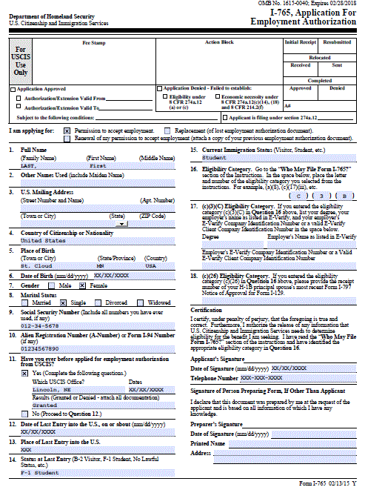


Do not write anything here.
Make sure this
box is checked.
Use YOUR address
or
C/O CIS
720 4th Ave S, LH 101
St. Cloud, MN 56301
Sign in blue ink
*Only if you have
previously applied
for employment
authorization*

Slide 9
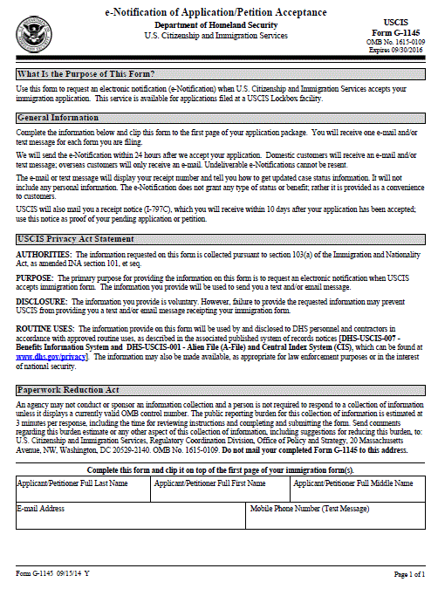

Slide 10
Drop-Off Procedures
In order to apply for OPT, the student must submit the following to the Center for International Studies:
  Optional Practical Training Request
    You must meet with your Academic Advisor to complete this form.
  Original, signed Form I-765
    USCIS uses special scanners to read forms submitted during immigration application processes.
    Handwritten forms often result in errors as these scanners are not able to read them accurately. In order to reduce the occurrence of errors, which may result delays in processing and adjudication of your OPT Application we now require that you download form I-765, type in the required information, print out the form, and sign using blue ink.
    Please note that the scanners will not read information that is greyed out, highlighted, or corrected using correction fluid or tape.
  Original, signed Form G-1145
    USCIS uses special scanners to read forms submitted during immigration application processes.
    Handwritten forms often result in errors as these scanners are not able to read them accurately. In order to reduce the occurrence of errors, which may result delays in processing and adjudication of your OPT Application we now require that you download form G-1145, type in the required information, print out the form, and sign using blue ink.
    Please note that the scanners will not read information that is greyed out, highlighted, or corrected using correction fluid or tape.

Slide 11
Next Steps
An advisor at the Center for International Studies will:
  Review the requested forms
  Request employment authorization in SEVIS and issue a new I-20 (if appropriate)
An advisor at the Center for International Studies will then email the student to notify them that their I-20 has been issued and that the student may gather the rest of the following documents to send as part of their application to USCIS: Copies of current and all previous forms I-20 (pages 1 & 3)
  Two (2) U.S. style passport style photos (for information on passport style photos click here)
    Write your I-94 card number on the back
    Photos must be taken within 30 days of filing your application
      Please submit the photos in the envelope/folder from where they were taken
      Please submit the receipt of purchase (if possible)
  I-94 Information Screen (retrieve here)
  COLOR Copy of valid passport (biographical and extension pages)
  Application fee: $380 (cost subject to change without notice)
    Money order is recommended, but you may use a personal check.
    Make payable to “U.S. Department of Homeland Security”
  COLOR Copies of all previous Employment Authorization Documents (front and back, if applicable)
  Student Health Insurance Petition for Refund (if applicable)

Slide 12
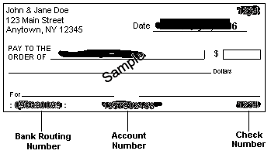
Payment Information
May be a personal check, money order or bank check ($380.00)
If you are using a friend’s check, write your name and I-94 number on the check in the "memo/for" section.
Sign the front of the check only, not the back.
Online payments to USCIS: CIS does NOT recommend using the "online payment” due to the delay you may encounter because of "onsite" biometric exams that are required in-person.
U. S. Department of Homeland Security
$380.00
Three hundred eighty dollars and 00/100
Sign Name Here

Slide 13
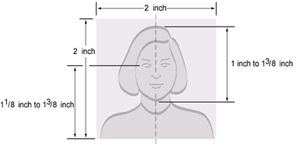

Photographs
Requirements
Must be taken within past 30 days
Cannot be same photo as in passport or visa
White background
Must be US passport size, not your home country passport size
Write your name & I-94 number on the back of each photo in pencil
Well-Composed Photos:

Slide 14
Mailing your OPT Application
The student must sign (in blue ink) the two sets of their new I-20 (one original to keep and one original to submit to USCIS) The student is responsible for mailing their own application packet to USCIS:
  For U.S. Postal Service (USPS)
    USCIS
    P.O. Box 21281
    Phoenix, AZ 85036
  For Express mail and courier service deliveries:
    USCIS
    Attn: AOS
    1820 E. Skyharbor Circle S
    Suite 100
    Phoenix, AZ 850

Slide 15
USCIS Authorization
You will receive a receipt notice within 3-4 weeks; may track status online at www.uscis.gov
Applications are adjudicated by USCIS within 3-4 months
Employment Authorization Document (EAD) issued by USCIS
You can not start working until you receive the EAD and/or until the date on the EAD. IMPORTANT: CHECK YOUR EAD CARD FOR ERRORS IN YOUR NAME, OPT DATES, etc.
If your OPT has been approved online for more than 3 weeks but you have not received your EAD card, contact CIS
If you do not yet have one, you can apply for a Social Security Number once the date of the EAD is valid/effective
EAD is valid for 12 months maximum
Please keep in mind that the processing time might take longer depending on USCIS and the date of application. Late spring and summer months are usually very busy.

Slide 16
Working During OPT
Starting work and unemployment periods:
  You may not begin working until you have received your EAD and the validity date is in effect
  Employment must be related to your program of study (major)
  Unemployment: You may not exceed 90 days of unemployment during your 12 months of OPT.
    Volunteering in your field of study for 20 hours/week or more may count as employment for this purpose. Volunteer work must be related to your program of study.
Changing employers while on OPT:
  This is fine as long as the new employment continues to be directly related to your field of study and commensurate with educational level. You must update your employer information on the CIS website for each employer (name and address) that you work for within 10 days of your start date.
Working for more than 1 employer:
  This is fine as long as all positions are related to your major field of study. You must notify CIS of each employer (name and address).

Slide 17
Taxes and Health Insurance on OPT
Taxes
  Question: “Can taxes be taken out of my weekly paycheck?”
  Answer: Students are exempted from paying Social Security and Medicare taxes during the first 5 years in the U.S.A. These taxes should not be withheld from the student’s pay while she/he maintains F-1 status. After 5 years students become “residents” for tax purposes only and are subject to paying all taxes.
  F-1 students are still subject to paying all federal, state, and local taxes as listed in your paychecks.
Health Insurance
  You are not required to purchase the MnSCU Health Insurance while on OPT. If you don’t have insurance and something occurs, you will be responsible for all medical and/or dental bills while on OPT. Under no circumstances is St. Cloud State University liable for any medical and/or dental bills that you incur while on OPT.
  You may purchase the MnSCU health Insurance while on OPT if you will be registered for at least one credit. Dependents are only eligible for health insurance if you are enrolled in at least one SCSU credit while on OPT.
  Health insurance refund: If you are graduating in December, you may apply for a refund of the remaining months of coverage if you choose to no longer use SCSU’s insurance.
  The Health Insurance Refund form can be found on the CIS website at: http://www.stcloudstate.edu/internationalstudents/students/documents/HealthInsuranceRefund.pdf

Slide 18
While on OPT, notify CIS…
If you change your address, name, or email
If you transfer to another degree program.
If you plan to leave the country and plan not to return.
If you change your immigration status (i.e. to H-1B). Fax change of status approval notice to CIS at 320-308-4223.
If you plan to take classes while on OPT. Non-degree classes are okay, however if you wish to start a degree program, you should transfer completely to that degree and obtain new I-20 which will cancel your OPT.

Slide 19
OPT Reporting
Any changes in employer. Must report name and address of employer upon starting work. https://www5.stcloudstate.edu/internationalstudies/opt/
Any periods of unemployment while on OPT
Reporting Information:
  U.S. Phone Number and Foreign Number
    I do not have a phone number
  OPT or STEM Extension (must select)
  Dates of Employment/Volunteer
  Place of Employment/Volunteer
    Self Employed
    Employer Name
    Employer EIN
    E-Verify Number (REQUIRED for STEM)
    Full-time or Part-time
    Job Title
    Supervisor First Name and Last Name
    Supervisor Email
    Supervisor Phone number
    How employment is related to student’s course of study
    Address(es)
**If you do not report your OPT Employment, the days will count towards your 90 days of unemployment. Once SEVIS counts 90 days, your SEVIS record will be automatically TERMINATED and you will be required to leave the U.S. immediately.**

Slide 20
Important Points to Remember
On-campus employment is terminated upon completion of degree requirements.
You are eligible for another 12 months of OPT once you complete your next degree level.
Employment is not permitted during either grace period.
Starting a new degree program: your OPT is automatically terminated when you transfer F-1 status to another school, or begin a new full-time academic program.
It is ok to travel after your OPT application is sent, however, return to the U.S. before your term ends and carry proof of enrollment.
Traveling outside the U.S. after the term has ended but before you receive your OPT card is not recommended without evidence to support your travel and employment plans.
To re-enter the U.S. while on OPT, you must have an I-20 recently signed for travel, a valid F-1 visa, and an EAD card. It is also strongly recommended that you carry proof of U.S. employment (job offer letter or most recent pay stub).
Traveling on an expired visa is ok only if returning to the U.S. from Canada, Mexico, or adjacent islands within 30 days. Otherwise, travel is not recommended on an expired visa.

Slide 21
QUESTIONS?

