Slide 1



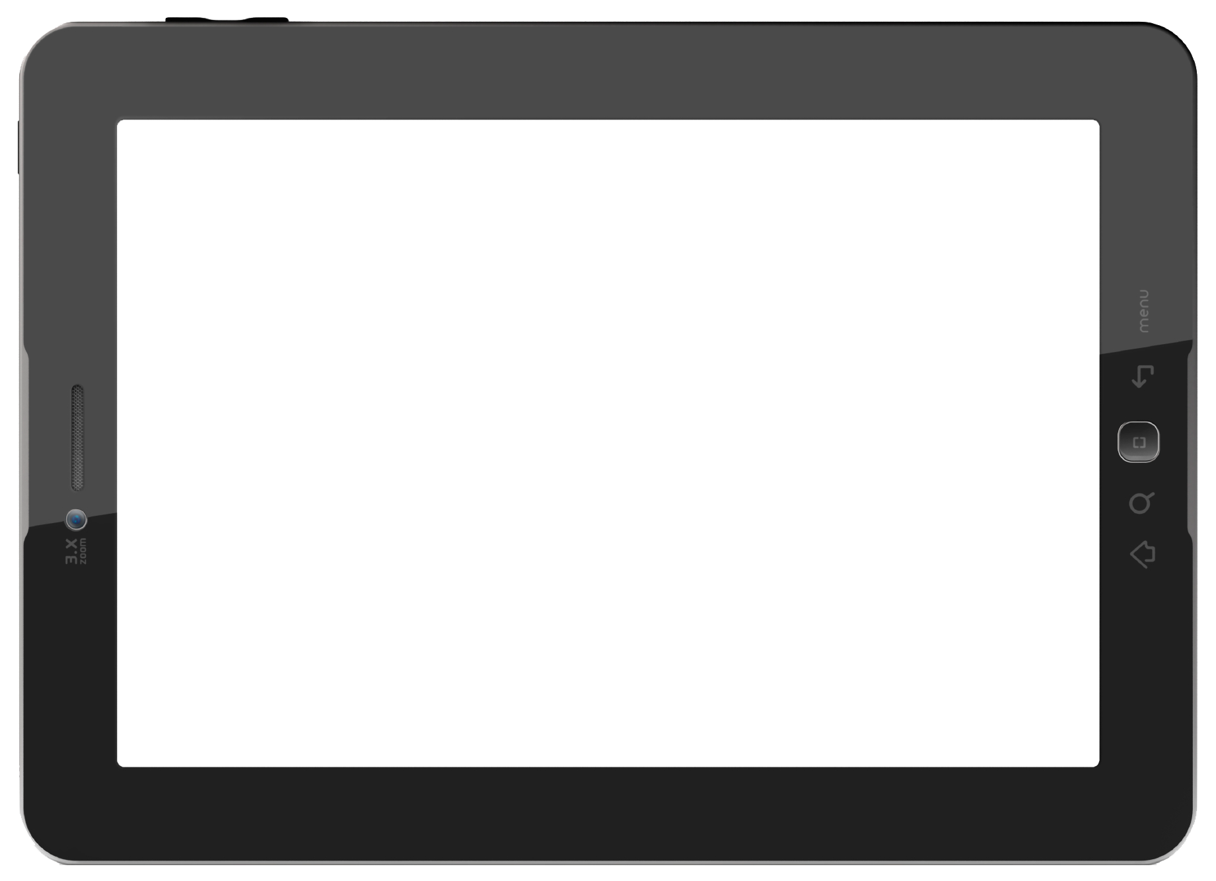


HTTP
nodeJS
Webserver
Raspberry PI
NodeJS
API
MySQL
MQTT über WLAN
Mosquitto
Broker
React JS
Visualierung
NodeMCU
HTTP
NFC

