Slide 1
Unit testing JUnit 4.11
Agile software development 24.10.2013 Michał Negacz 179120, Bartosz Skuza 179139

Slide 2
Goals of presentation
Introduce to unit testing using jUnit
Overview jUnit possibilities
Present additional tools that facilitate writing and reading tests
Introduce test doublers and mocking framework
Present good practices and patterns

Slide 3
Unit testing - definitions
In computer programming, unit testing is a method by which individual units of source code, sets of one or more computer program modules […] are tested to determine if they are fit for use. Intuitively, one can view a unit as the smallest testable part of an application. In procedural programming, a unit could be an entire module, but is more commonly an individual function or procedure. In object-oriented programming, a unit is often an entire interface, such as a class, but could be an individual method. Wikipedia

Slide 4
Unit testing – definitions (2)
Unit tests enable collective ownership. When you create unit tests you guard your functionality from being accidentally harmed. Requiring all code to pass all unit tests before it can be released ensures all functionality always works. Individual code ownership is not required if all classes are guarded by unit tests. Unit tests enable refactoring as well. After each small change the unit tests can verify that a change in structure did not introduce a change in functionality. Extreme Programming

Slide 5
Benefits from testing
Find problems early
Facilitates change
Design
Simplifies integration
Documentation

Slide 6
What unit test should be F.I.R.S.T
Fast
Independent
Repeatable
Self-Validating
Timely

Slide 7

JUnit - introduction
Unit testing framework
First version created by Erich Gamma and Kent Beck in 1997 during fly from Zurich to Atlanta
Open source, Common Public License
Easy integration with tools e.g. Maven, Ant

Slide 8
Unit testing framework alternatives
In java
TestNG
In other languages
xUnit
NUnit (.NET)
CPPUnit (C++)
PHPUnit (PHP)
http://en.wikipedia.org/wiki/List_of_unit_testing_frameworks

Slide 9
Simple study case
public class Calculator {
public int add(int firstNumber, int secondNumber) {
return firstNumber + secondNumber;
}
public int divide(int firstNumber, int secondNumber) {
return firstNumber / secondNumber;
}
}
public class CalculatorTest {
static Calculator calculator;
@BeforeClass
public static void setUp() {
calculator = new Calculator();
}

Slide 10
Simple study case (2)
@Test
public void shouldReturnTwoWhenDivideEightByFour() {
int result = calculator.divide(8, 4);
assertEquals(2, result);
}
@Test(expected = ArithmeticException.class)
public void shouldThrowExceptionWhenDivideByZero() {
calculator.divide(8, 0);
}
@Test
public void shouldFail() {
fail();
}
}

Slide 11
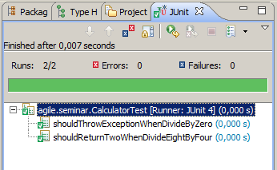
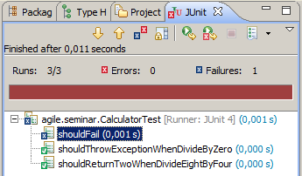
Test results
Green bar
Red bar

Slide 12
JUnit available elements
Annotations
@Test (expected = Throwable, timeout = long)
@Before
@After
@BeforeClass
@AfterClass
@Ignore(value = String)
@Rule
@FixMethodOrder(value = MethodSorters) (added in 4.11 version)
@RunWith(value = Runner)
@SuiteClasses(value = Class[])
@Parameters

Slide 13
JUnit available elements (2)
Asserts
assertTrue(String message, boolean condition)
assertFalse(String message, boolean condition)
fail(String message)
assertEquals(String message, Object expected, Object actual)
assertNotEquals(String message, Object unexpected, Object actual) (added in 4.11 version)
assertArrayEquals(String message, Object[] expecteds, Object[] actuals)
assertSame(String message, Object expected, Object actual)
assertNotSame(String message, Object expected, Object actual)
assertThat(String reason, T actual, Matcher<? super T> matcher)

Slide 14
Test suites
Suite – group of tests. A test suite is a convenient way to group together tests that are related. For example, if you don’t define a test suite for a test class, JUnit automatically provides a test suite that includes all tests found in the test class (more on that later). A suite usually groups test classes from the same package. Junit in Action

Slide 15
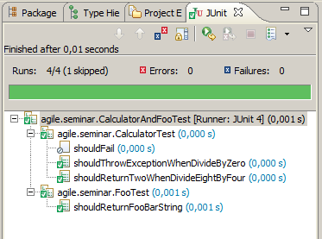
Test suite case study
@RunWith(Suite.class)
@SuiteClasses(value = {CalculatorTest.class, FooTest.class})
public class CalculatorAndFooTest {
}

Slide 16
Parameterized Test
The Parameterized test runner allows to run a test many times with different sets of parameters
Test class should have method that provide collection with arrays of test parameters
Test class should have a constructor with arguments list equals to mentioned above method array value

Slide 17
Parameterized test study case
@RunWith(Parameterized.class)
public class ParameterizedCalculatorTest {
static Calculator calculator;
int firstNumber;
int secondNumber;
int expectedResult;
public ParameterizedCalculatorTest(int firstNumber, int secondNumber, int expectedResult) {
this.firstNumber = firstNumber;
this.secondNumber = secondNumber;
this.expectedResult = expectedResult;
}
@BeforeClass
public static void setUp() {
calculator = new Calculator();
}

Slide 18
Parameterized test study case (2)
@Parameters
public static Collection<Object[]> getTestParameters() {
Collection<Object[]> parameters = Arrays.asList(new Object[][] {
{1, 2, 3}, // firstNumer, secondNumber, expectedResult
{0, 0, 0}, // firstNumer, secondNumber, expectedResult
{5, 5, 10} // firstNumer, secondNumber, expectedResult
});
return parameters;
}
@Test
public void shouldAddNumbers() {
int result = calculator.add(firstNumber, secondNumber);
assertEquals(expectedResult, result);
}
}

Slide 19
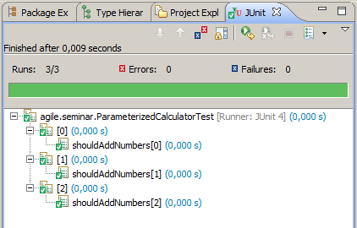
Parameterized test study case (3)

Slide 20
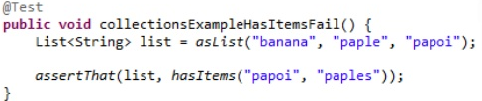

Hamcrest
JUnit
Hamcrest
boolean found = false;
for(Kitten kitten :cat.getKittens())
{
if(kitten.equals(someKitten))
found =true;
}
assertTrue(found);
assertThat(
cat.getKittens(),
hasItem(someKitten)
);

Slide 21
Common Hamcrest matchers
Core
anything - always matches, useful if you don't care what the object under test is
describedAs - decorator to adding custom failure description
Logical
allOf - matches if all matchers match, short circuits (like Java &&)
anyOf - matches if any matchers match, short circuits (like Java ||)
Object
equalTo - test object equality using Object.equals
instanceOf, isCompatibleType - test type
notNullValue, nullValue - test for null
sameInstance - test object identity
Collections
array - test an array's elements against an array of matchers
hasEntry, hasKey, hasValue - test a map contains an entry, key or value
hasItem, hasItems - test a collection contains elements
hasItemInArray - test an array contains an element
Number
closeTo - test floating point values are close to a given value
greaterThan, greaterThanOrEqualTo, lessThan, lessThanOrEqualTo - test ordering
Text
equalToIgnoringCase - test string equality ignoring case
equalToIgnoringWhiteSpace - test string equality ignoring differences in runs of whitespace
containsString, endsWith, startsWith - test string matching

Slide 22
FEST
FEST Assertions 2.0 is a Java library that provides a fluent interface for writing assertions. Its main goal is to improve test code readability and make maintenance of tests easier.
Assertion
Reflection
Mock
Swing

Slide 23
Fest’s assertions
// common assertions
assertThat(yoda).isInstanceOf(Jedi.class);
assertThat(frodo.getName()).isEqualTo("Frodo");
assertThat(frodo).isNotEqualTo(sauron);
// String specific assertions
assertThat(frodo.getName()).startsWith("Fro").endsWith("do") .isEqualToIgnoringCase("frodo");
// collection specific assertions assertThat(fellowshipOfTheRing).hasSize(9) .contains(frodo, sam) .excludes(sauron);

Slide 24
Fest’s assertions – data types
Fest provides assertions for the following data types:
Object
String
Date
Primitives (boolean, int, char, etc.)
BigDecimal
Iterable
Arrays of Object
Arrays of primitives
Map
Throwable
File and InputStream
BufferedImage

Slide 25
FEST - Swing GUI Testing
Fest provides also a simple and intuitive API for functional testing of Swing user interfaces, resulting in tests that are compact, easy to write, and read like a specification. Tests written using FEST-Swing are also robust. FEST simulates actual user gestures at the operating system level, ensuring that the application will behave correctly in front of the user.

Slide 26
FEST - finding the components
By Name
By Type
Custom Search Criteria GenericTypeMatcher<JButton> textMatcher = new GenericTypeMatcher<JButton>(JButton.class) { @Override protected boolean isMatching(JButton button) { return "OK".equals(button.getText()); } };
Common Component Matchers
DialogMatcher - Matches a Dialog containing the specified name, title or visibility
FrameMatcher - Matches a Frame containing the specified name, title or visibility
JButtonMatcher - Matches a JButton containing the specified name, text or visibility
JLabelMatcher - Matches a JLabel containing the specified name, text or visibility
JTextComponentMatcher - Matches a JTextComponent containing name, text or visibility

Slide 27
DSL-Oriented,"Fluent" API
Right-click a specific item in a Jlist: list("cats").item("Garfild").rightClick();
Show a JPopupMenu in a JTextField and select „Cut": textBox("name").showPopupMenu().selectItem("Cut")
Double-click a specific cell in a JTable: table("name").cell(row(0).column(3)).doubleClick();
Drag from list and drop in table frame.list("todo").drag("format disc"); frame.table("active").drop(row(2).column(0));

Slide 28
Test boundaries
What if tested method depends on
other methods
others objects
database availability
network availability
Solution are test doubles
Stubs
Mocks
Spies

Slide 29
Stub, mock and spy patterns
Test Double – a test specific replacement equivalent to a component on which the tested code depends
The terminology about the various kinds of test doubles is inconsistent, in this presentation we base on Gerard Meszaros's interpretation
Stub - replace an object with an test specific object that feeds the indirect inputs often with hard coded answers
eventuality state verification
ignores indirect outputs

Slide 30
Stub, mock and spy patterns (2)
Mock – replace an object with an test specific object that verifies it is being used correctly
behavior verification against expectations
Spy - capture the indirect output calls made to another component by the tested object for later verification

Slide 31
Simple stub study case
public class NewsletterSender {
private MailService mailService;
public void setMailService(MailService mailService) {
this.mailService = mailService;
}
public int sendNews() {
int deliveredMails = 0;
if (sendNewsToBob()) {
deliveredMails++;
}
if (sendNewsToAlice()) {
deliveredMails++;
}
return deliveredMails;
}

Slide 32
Simple stub study case (2)
public boolean sendNewsToBob() {
return mailService.sendMail("bob@bob.com", "Hello Bob!");
}
public boolean sendNewsToAlice() {
return mailService.sendMail("alice@alice.com", "Hello Alice!");
}
}
public interface MailService {
boolean sendMail(String email, String text);
}

Slide 33
Simple stub study case (3)
public class MailServiceImpl implements MailService {
public boolean sendMail(String email, String text) {
// Slow, vulnerable and complex method that using network to send email
boolean isSuccess = random() < 0.1;
if (isSuccess) {
System.out.println("Mail sent.");
} else {
System.out.println("Failure to send mail.");
}
return isSuccess;
}
}

Slide 34
Simple stub study case (4)
public class MailServiceStub implements MailService {
private int sentMailsCount;
public boolean sendMail(String email, String text) {
// ignore parameters values
sentMailsCount++;
return true; // hard coded return value
}
public int getSendMailCount() {
return sentMailsCount;
}
}

Slide 35
Simple stub study case (5)
@Test
public void shouldSendNewletters() {
MailServiceStub mailServiceStub = new MailServiceStub();
NewsletterSender sender = new NewsletterSender();
sender.setMailService(mailServiceStub);
int sentNews = sender.sendNews();
assertEquals(2, sentNews);
assertEquals(2, mailServiceStub.getSentMailsCount()); // eventuality state verification
}

Slide 36

Mockito
Mocking framework
Open source, MIT License
Created by Szczepan Faber
Simple and intuitive
Easy integration with JUnit
Alternatives
EasyMock
jMock

Slide 37
Mockito stub study case
@Test
public void shouldSendNewletters() {
MailService stub = mock(MailService.class);
when(stub.sendMail(anyString(), anyString()))
.thenReturn(true);
NewsletterSender sender = new NewsletterSender();
sender.setMailService(stub);
int sentNews = sender.sendNews();
assertEquals(2, sentNews);
}

Slide 38
Mockito mock study case
@Test
public void shouldSendNewletterToBob() {
MailService mock = mock(MailService.class);
when(mock.sendMail("bob@bob.com", "Hello Bob!"))
.thenReturn(true);
NewsletterSender sender = new NewsletterSender();
sender.setMailService(mock);
int sentNews = sender.sendNews();
assertEquals(1, sentNews);
verify(mock)
.sendMail(eq("bob@bob.com"), eq("Hello Bob!"));
}

Slide 39
Mockito spy study case
@Test
public void shouldSendNewletterToAlice() {
MailService mailService = new MailServiceImpl();
MailService spy = Mockito.spy(mailService);
NewsletterSender sender = new NewsletterSender();
sender.setMailService(spy);
int sentNews = sender.sendNews();
verify(spy)
.sendMail(eq("alice@alice.com"), eq("Hello Alice!"));
}

Slide 40
Mockito and GCM
Interactive conference system
Google cloud messaging
GCM is a service that allows to send data from server to Android-powered device
Communication through
Sending formated JSON document
Use library provided by Google that do this on her own
I want to test service that send notifications to users, and take some actions whether these notifications were delivered or not
Library provide Sender that has send method which take Message and return MulticastResult

Slide 41
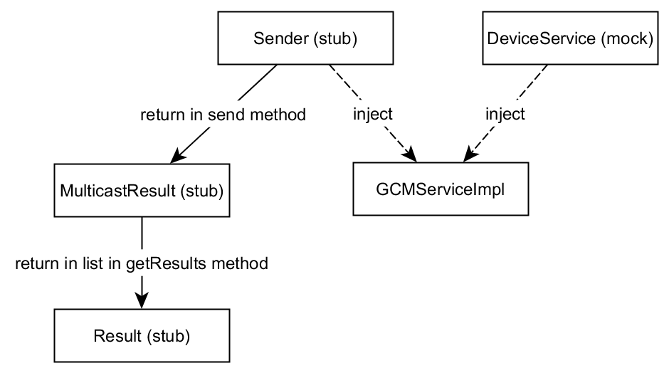
Mockito and GCM (2)
But MulticastResult and Result are both final with private constuctors and package access Builders

Slide 42
Mockito main limitations
Cannot mock final classes
Cannot mock static methods
Cannot mock final methods - their real behavior is executed without any exception

Slide 43

Powermock
PowerMock is a framework that extend other mock libraries such as Mockito and EasyMock
Uses custom classloader and bytecode manipulation to enable mocking of
static methods
constructors
final classes and methods
private methods
Open source, Apache License 2.0
Use with care, can change object behaviour

Slide 44
Powermock GCM study case
@RunWith(PowerMockRunner.class)
@PrepareForTest(value = { MulticastResult.class, Result.class })
@PowerMockIgnore({ "org.apache.commons.logging.*" })
public class GCMServiceImplTest {
// ...
@Before
public void setupTest() {
sender = mock(Sender.class);
deviceService = mock(DeviceService.class);
Whitebox.setInternalState(gcmServiceImpl, sender);
Whitebox.setInternalState(gcmServiceImpl, deviceService);
multicastResult = mock(MulticastResult.class);
result = mock(Result.class);
// ...
}

Slide 45
Powermock GCM study case (2)
@Test
public void shouldUnregisterDeviceLocalyWhenUnregisteredInGoogle() throws IOException {
//given
resultList.add(result);
when(sender.send(any(Message.class), eq(Collections.singletonList("regId1")), anyInt())) .thenReturn(multicastResult);
when(multicastResult.getResults())
.thenReturn(resultList);
when(result.getErrorCodeName())
.thenReturn(Constants.ERROR_NOT_REGISTERED);
// when
gcmServiceImpl.push("regId1", data);

Slide 46
Powermock GCM study case (3)
// then
verify(sender, times(1)).send(any(Message.class), anyListOf(String.class), anyInt());
verify(result, times(1)).getErrorCodeName();
verify(result, never()).getCanonicalRegistrationId();
verify(deviceService, times(1)).unregister("regId1");
verify(deviceService, never()).update(anyString(), anyString());
}

Slide 47
Testing private methods
Don’t test private methods
private method is an implementation detail that should be hidden
it breaks encapsulation
should be tested via another public method
private method so complex that it needs to be tested out of the context of its public callers, could be a code-smell
testing private methods may be an indication that those methods should be moved into another class

Slide 48
Testing private methods techiques
Use a nested static test class
mixed production code and test code in the same file
Use reflection
clean separation of test code and production code
refactoring problems
test code is far more verbose
Give the methods package access
breaking encapsulation

Slide 49
Test naming
Many conventions:
[MethodName_StateUnderTest_ExpectedBehavior] Parse_OnEmptyString_ExceptionThrown()
[describes a responsibility of the object] testAppendsAdditionalParameterToUrlsInHrefAttributes()
[suffix/prefix method name with Test] testCalculate()
Tips:
Use the word "should" in your test names
Your test class names should represent context
Write your test consistently
Test are deliverables too - respect them by refactoring and making it clean and readable

Slide 50
Builder pattern in testing
Consider an object with many fields (e.g. entity), which needed to be set and in each test some fields values slightly differ
public class Customer {
private Long id;
private String name;
private String address;
private String phoneNumber;
private CustomerType type;
// ...

Slide 51
Builder pattern in testing (2)
@Test
public void shouldValidateCustomer() {
CustomerValidator validator = new CustomerValidator();
Customer customer = new Customer();
customer.setId(1L);
customer.setName("Bob");
customer.setAddress("Beverly Hills 90210");
customer.setBalance(100.10);
customer.setPhoneNumber("691999555");
customer.setTwitter("bobino");
customer.setFacebook("bobski");
customer.setType(CustomerType.WOODEN);
boolean result = validator.validate(customer);
assertTrue(result);
}

Slide 52
Builder pattern in testing (3)
@Test
public void shouldValidateCustomer() {
CustomerValidator validator = new CustomerValidator();
Customer customer = aCustomer()
.likeSomeWoodenCustomer()
.build();
boolean result = validator.validate(customer);
assertTrue(result);
}

Slide 53
Builder pattern in testing (4)
@Test
public void shouldNotValidateCustomerWithBlankAddressAndPhoneNumber() {
CustomerValidator validator = new CustomerValidator();
Customer customer = aCustomer()
.likeSomeNegativeBalanceCustomer()
.but()
.withAddress("")
.and()
.withPhoneNumber("")
.build();
boolean result = validator.validate(customer);
assertFalse(result);
}

Slide 54


Test driven development
‘Red’ – write failing test
‘Green’ – make the test pass
‘Refactor’ – clean up your code
Kent Beck

Slide 55
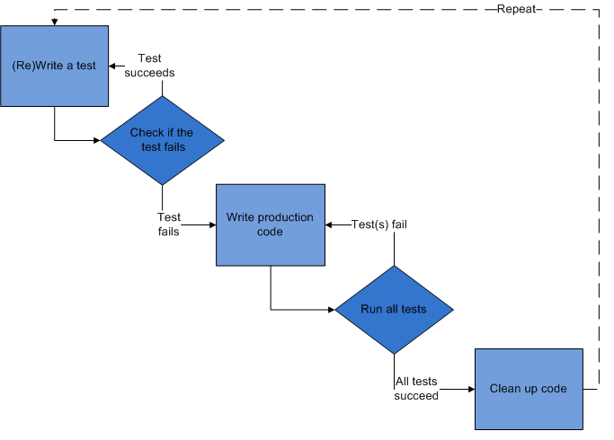
TDD- cycle

Slide 56

Bechavoiur driven development
Behavior Driven Development is a software development methodology that takes an outside-in approach to describe application behavior by encouraging intense customer involvement
Dan North

Slide 57
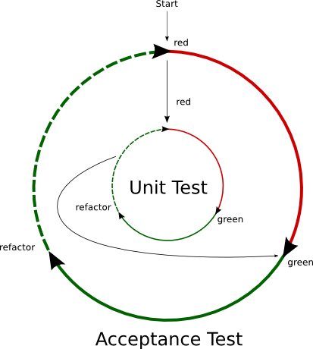
BDD- cycle

Slide 58
Behavioral specifications - user stories
Structure:
Title
Narrative
Acceptance criteria or scenarios
Given
When
Then
Example:
Story: Test login
As a registered user
I want to log in website
Scenario 1: Login Success and Failure
Given I navigate to the mock application
When I try to login with valid credentials
Then I should see that I logged in successfully

Slide 59

Cucumber
It is a tool that executes plain-text functional descriptions as automated tests. The language that Cucumber understands is called Gherkin.
Gherkin is a Business Readable, Domain Specific Language that lets you describe software's behavior without detailing how that behavior is implemented.

Slide 60
Cucumber – helloworld.feature
Feature: Hello World
Scenario: Say hello
Given I have a hello app with "Howdy"
When I ask it to say hi
Then it should answer with "Howdy World"

Slide 61
Cucumber – HelloStepdefs.java
public class HelloStepdefs {
private Hello hello;
private String hi;
@Given("^I have a hello app with \"([^\"]*)\"$")
public void I_have_a_hello_app_with(String greeting) { hello = new Hello(greeting); }
@When("^I ask it to say hi$")
public void I_ask_it_to_say_hi() {
hi = hello.sayHi(); }
@Then("^it should answer with \"([^\"]*)\"$")
public void it_should_answer_with(String expectedHi) { assertEquals(expectedHi, hi); }
}

Slide 62

JBehave
Jbehave is test automation framework
Open source, BSD style license
Quasi natural stories language, BDD style
Support Gherkin syntax
Scenario: multiply x by y
Given a calculator
Given a variable x with value 2
Given a variable y with value 4
When I multiply x by y with calculator
Then result should equal 8

Slide 63
JBehave case study
public class CalculatorSteps {
private Calculator calculator;
private int x;
private int y;
private int result;
@Given("a calculator")
public void givenCalculator() {
calculator = new Calculator();
}
@Given("a variable x with value $value")
public void givenXValue(@Named("value") int value) {
x = value;
}
@Given("a variable y with value $value")
public void givenYValue(@Named("value") int value) {
y = value;
}

Slide 64
JBehave case study (2)
@When("I multiply x by y with calculator")
public void whenImultiplyXByY() {
result = calculator.multiply(x, y);
}
@When("I add x to y with calculator")
public void whenIaddXToY() {
result = calculator.add(x, y);
}
@Then("result should equal $value")
public void thenXshouldBe(@Named("value") int value) {
assertEquals(value, result);
}
}

Slide 65
JBehave case study (3)
@RunWith(JUnitReportingRunner.class)
public class CalculatorJBehaveTest extends JUnitStories {
@Override
public InjectableStepsFactory stepsFactory() {
return new InstanceStepsFactory(configuration(), new CalculatorSteps());
}
@Override
protected List<String> storyPaths() {
return asList("agile/seminar/calculator.story");
}
}

Slide 66
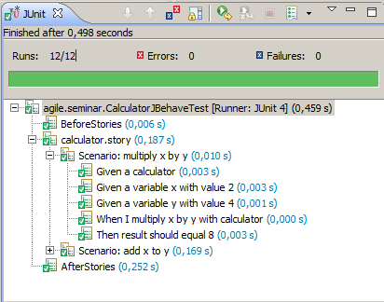
JBehave case study (4)

Slide 67
Examples
Examples from this presentation will be available at: http://github.com/mnegacz/agile-seminar

Slide 68
Sources
Martin Robert C. (2008) Clean Code: A Handbook of Agile Software Craftsmanship, Prentice Hall PTR
Tahchiev Petar, Leme Felipe, Massol Vincent, Gregory Gary (2010) JUnit in Action Second Edition, Manning Publications
http://www.martinfowler.com/bliki/Xunit.html
http://martinfowler.com/articles/mocksArentStubs.html
http://www.extremeprogramming.org/rules/unittests.html
http://xunitpatterns.com/Mocks,%20Fakes,%20Stubs%20and%20Dummies.html
http://www.artima.com/suiterunner/private.html
http://en.wikipedia.org/wiki/Unit_test
http://www.slideshare.net/DominikDary/functional-tests-withthefestframework
http://dannorth.net/introducing-bdd/
http://fest.easytesting.org
https://blog.codecentric.de/en/2012/06/jbehave-configuration-tutorial/

