Slide 1

Centralized Network Management
Project Presentation
on
Guide:
B.R.Mohan
Lecturer
Dept. ISE

Slide 2
Key Features…
MIB browser for accessing and navigating throw the agent MIB.
MIB Editor uses set-request mechanism for editing the values of the objects in the MIB.
Facility to view the services that were running in the host machine and the interface speeds and the print Queue status.
Centralized trap reporting mechanism that will listen for the traps and sends the report to the user.

Slide 3
Introduction To NMS
Network elements or nodes containing a processing entity called an agent, responsible for performing the management functions requested by the management station.
Management applications which monitor configure and control managed elements.
A management protocol used to communicate management information between the management stations and the agents in the network elements.
Management information.

Slide 4
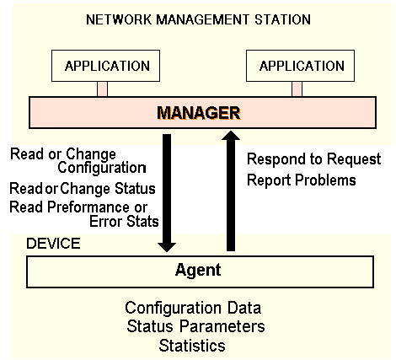
NMS Architecture

Slide 5
Management Information Base (MIB)
Each agent maintains its local state of operations as the set objects indicating
the its status.
The collection of the objects managed by SNMP is defined in the MIB.
MIB in each agent is classified in to Ten groups. These groups indicates the
information about the particular operation and the service in the agent.
Each object has the object ID from which it can be referred.
SNMP manager can access and modify the object values to control the
network operations.

Slide 6
MIB Groups
Group | #Objects | Description
System | 7 | Name, location, & description of the equipment.
Interfaces | 23 | Network interfaces and their measured traffic.
AT | 3 | Address translation
IP | 42 | IP packet statistics
ICMP | 26 | Statistics about ICMP messages received
TCP | 19 | TCP algorithms parameters & statistics
UDP | 6 | UDP traffic statistics
EGP | 20 | EGP traffic statistics
Transmission | 0 | Reserved for media specific MIBs
SNMP | 29 | SNMP traffic statistics

Slide 7
Messages to Operate on the MIB Objects
SNMP defines the following message types to access and modify the Objects.
GET used to get a specific object instance whose object ID is specified in the message.
GET-NEXT used to get the next-object that follows the Object ID given in the Message.
SET Used to set the value to the Object whose object ID is given.
TRAP Reports a trap event to the manager, from the Agent.

Slide 8
Abstract Syntax Notation- ASN
To make communication possible it is essential that the objects be defined in a
standard and vendor-neutral way.
A standardized way is needed encode them for transfer over a network.
To encode the information into a proper request a proper format, the entire
system uses the ISO standard language called Abstract Syntax Notation One
or ASN.1
The result is that an NMS on any computer supporting ASN.1 can easily
communicate with an agent on any other computer supporting ASN.1
SNMP translates messages into the ASN.1 Basic Encoding Rules (BER) tags.
The BER converts a specific message into network generic tags.
The resulting network generic tags consists of a class, format, and type of
data, a data length and data themselves .

Slide 9
Project Description
Unified Network Management is the SNMP Management Software which is developed using Java.
The project works under windows 2000/XP series platform under the control of the network administrator and analyzers
The scope of the project can also be limited to those systems which are running the SNMP service
This will be helpful for the network administrator to analyze the network operations at the single site.

Slide 10
System Design
Design of the project can be illustrated in two modules
Design of the Java SNMP view
  Design of the PDU
  SNMP context
  Encoding and the decoding mechanisms
Design of the data and control flow in the MIB Browser
  Design of the Request flow and Response flow

Slide 11
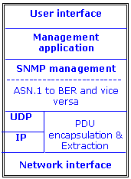
Java SNMP View
Deals with creating the PDU with data given by the user
Deals with Encoding and decoding of the PDU
Deals with Encapsulation the PDU in UDP Datagram and Creating the SNMP Context.
Deals with Transmitting the request PDU and Receiving the responses.

Slide 12
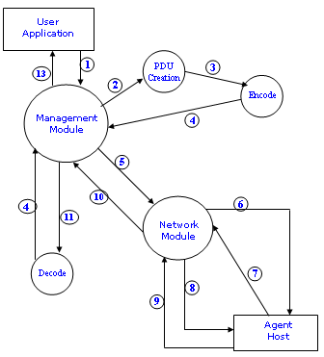
Design of Data & Control Flow

Slide 13
Data & Control flow
1. User supplies the data about the host ID and MIB group, the object ID and the type of request to be executed.
2. The management module creates sends these information to create the PDU.
3-4. The created PDU is encoded in to the ASN.1 notation and returned to the management module for further processing.
5. Management module sends the Host information and the encoded
PDU to the network module.
6-7. Network module creates SNMP context to the specified host.
8-9. Sends the PDU to the agent and waits for the response of the agent host.
  10. Returns the Response PDU to the management module for decoding.
  11-12. Management module sends the PDU for decoding & gets the
  Response variables.
  13. The response variables are displayed on the user interface for the
  user.

Slide 14
Request Flow
  (User Interface)
1
Select Data to Collect
2
3
Read from the MIB DB to Select Correct OID #
Get Correct SNMP PDU Format
  Get-Request
Get-Next Request
Set-Request
Add MIB & Local Data to SNMP PDU Format
  SNMP version
Community Name
Request Object ID #
Host Address
Pass the PDU to Encoding mechanism to create SNMP Tags
(Run through the BER to convert to ASN Notation)
  Network Interface

Slide 15
Steps in the Request Flow
The user working through the user interface selects the data he wants from the MDB on the network agent.
The network management module identifies the OIDs and selects the correct type of message based on the type of data being requested.
Combine the structure of PDU information and basic SNMP data requirements like SNMP version, community name, and host address.
To adjust the SNMP PDU to other platforms, run SNMP encoding mechanism on the PDU to create SNMP Tags. So that the SNMP request message can travel across the network to the agent.
The interpreted message is sent down the UDP/IP stack to the Network interface layer and onto the network

Slide 16
Response Flow
  Network Interface
1
8
Pass SNMP Tags through BER to create PDU
2
7
Check PDU for Correct SNMP PDU Format
  SNMP version
Community Name
Request Object ID #
Host Address
3
6
4
Load SNMP PDU Format
  Get-Request
Get-Next Request
Set-Request
Read from the MIB DB for current OID value
5
5
Return requested date

Slide 17
Steps in the Response Flow
The SNMP tags from the network must be run through the ASN.1 BER to translate them for use on the local system.
The agent separates the structured PDU information and basic SNMP data components.
The agent separates the PDU data field into individual MIB OID requests. It reads its database to get the value for each requested OID.
The agent builds a response using the correct PDU format with the request OIDs.

Slide 18
Implementation
Implementation is done in three levels
Implementing PDU
Assigning the Request variables, the request type and the information of the SNMP Context.
Implementing the Encoding and Decoding mechanism
Implementation of the user interface

Slide 19
PDU Implementation
We developed following classes to implement PDU operations.
Pdu: Base class fo all type of PDU. Contains the fields to describe
      The error information message type, SNMP Context information.
      includes the methods to add object id to be requested to the PDU.
      create the variable bindings to the response variables.
      call the encoding mechanism or the decoding mechanism.
      call the transmitter for the PDU.
getPdu: Inherits Pdu contains the static variable to specify the Get Request.
getNextPdu: Inherits Pdu contains the static variable to specify the Get-next Request.
SetPdu: Inherits Pdu contains the static variable to specify the Set Request.
TrapPdu: Inherits Pdu contains the fields to store the Trap Report.

Slide 20
Encoding and the decoding mechanism
The class AsnObject defines the ASN notations and the corresponding byte values for each type defined in ASN.1
When the PDU is to be encoded the Pdu class object instantiates the AsnEncoder class and passes PDU information to get the encoded byte sequence.
Similerly it calls the AsnDecoder class when it needed to decode the PDU.
When the PDU encoded and decode the request and the reponse variables were binded in the pair which represents the object ID and its value.This is created in the Varbind class.
The errors occurred in encoding and decoding mechanisms were handled by creating the Exceptions.

Slide 21
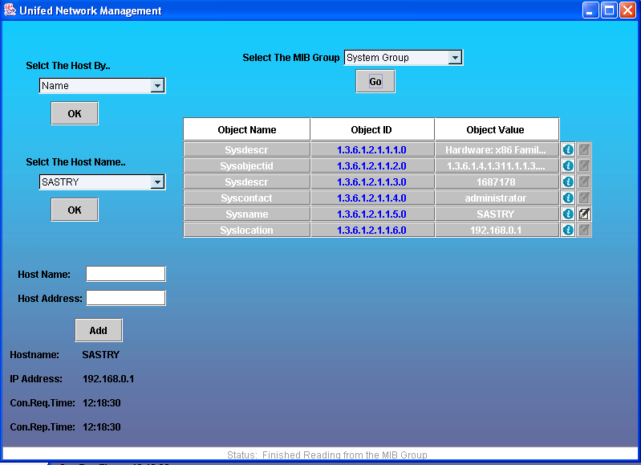
User Interface

Slide 22
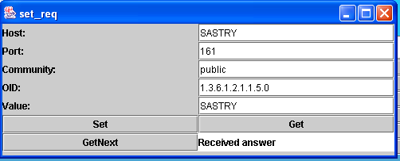
User Interface

Slide 23
Conclusions
Concluding about the Project the software we have developed
  Provides administrator the details of the management information through the get and get-next request.
  Provides good GUI for the user so he can select the required group easily to see the status of the network.
  To see the different services which are running on the managed host.
And we have implemented the java SNMP stack for the main operations on the SNMP framework

Slide 24
Thank You !

