Slide 1
Centralized Network Management
Presentation
on
By,
Manohar Shing Negi -1RV03IS402
Pratosh -1RV02IS026
Deepu -1RV02IS015
A.Balram Reddy -1RV03IS400
VIII Sem IS&E
Guide:
B.R.Mohan
Lecturer
Dept. IS&E

Slide 2

An Insight into the system …
A Framework and the implementation of the SNMP Manager in java.
That can centralize the management of SNMP Agents in the network with out concerning by which manager they are managed.

Slide 3
Introduction To NMS
(Network Management System)
Network Nodes containing a processing entity called an agent, responsible for performing the management functions requested by the management station.
Management Stations which monitor configure and control managed elements.
A Management Protocol used to communicate management information between the management stations and the agents in the network elements.
Management Information.
ASN (Abstract Syntax Notation) The ISO standard notation to define SNMP Messages in platform independent and vendor-neutral way, So that communication between SNMP entities becomes easy.

Slide 4
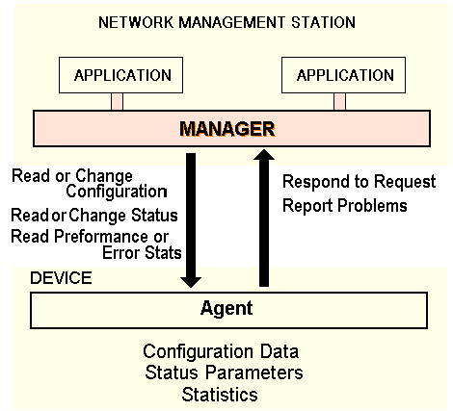
NMS Architecture

Slide 5
MIB
(Management Information Base)
Each agent maintains its local state of operations as the set objects indicating the its status.
The collection of the objects managed by SNMP is defined as the MIB.
MIB in each agent is classified in to Ten groups. These groups indicates the information about the particular operation and the service in the agent.
Each object has the object ID from which it can be referred.
SNMP manager can access and modify the object values to control the network operations.

Slide 6
SNMP Messages
SNMP defines the following message types to access and modify the Objects.
GET used to get a specific object instance whose object ID is specified in the message.
GET-NEXT used to get the next-object that follows the Object ID given in the Message.
SET Used to set the value to the Object whose object ID is given.
TRAP Reports a trap event to the manager, from the Agent.

Slide 7
Project Description
Unified Network Management is the SNMP Management Software which is to be developed using Java.
The project will work under the control of the network administrator and analyzers
The scope of the project can be limited to those systems which are running the SNMP service
This will be helpful for the network administrator to analyze the network operations at the single site.

Slide 8
Project Description
Implementing MIB browser for accessing and navigating throw the agent MIB.
MIB Editor will be uses set-request mechanism for editing the values of the objects in the MIB.
Providing the facility to view the following information from the remote agent:
Interface properties and Their status.
Services running.
Processes running.
Application software installed
User details.

Slide 9
Thank You !

