Slide 1


Data Analytics for Social Buzz

Slide 2


Today's agenda
Project recap
Problem
The Analytics team
Process
Insights
Summary

Slide 3

Social Buzz is a fast growing technology unicorn that need to adapt quickly to its global scale. Accenture has begun a 3 months POC focusing on these tasks: - An audit of their big data practice
- Recommendations for a successful IPO
- An analysis of their content categories that highlights the top 5 categories with the largest aggregate popularity
Project Recap

Slide 4

Problem
Over 100000 posts per day
36,500,000 piece of content per year!
How to analyze this huge amount of data?
Analyze and find Social Buzz’s top 5 popular categories of content

Slide 5



Andrew Fleming
Chief Technical Architect
The Analytics team
Marcus Rompton
Senior Principle
Mohammad Mohamma Nejad Pahmedani
Data Analyst

Slide 6
Process
1
Data Understanding
2
Data Cleaning
3
Data Modelling
4
Data Analysis
5
Uncover Insights

Slide 7

Insights
16
Unique Categories
1897
Reactions to « ANIMAL » posts
January
Month with the most posts

Slide 9
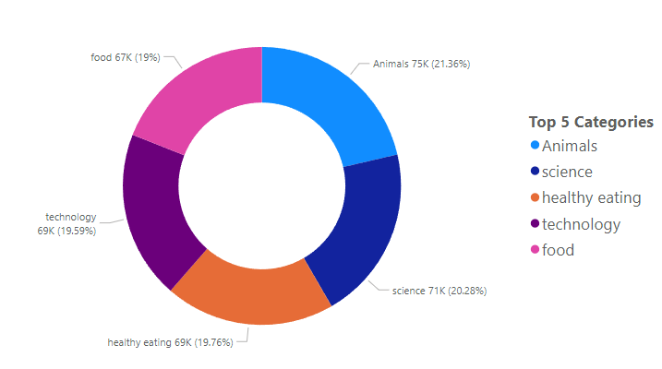

Slide 10

We have 16 categories and the most pupular ones are animals and science. Showing that people enjoy real-life and factual contents the most! This insight shows that cooperation with companies that provie animal accessories and foods could attract more users and there is a great potential for advertising in this domain.
Food also is a common theme in the top popular categories with « healthy food » standing in the third and « food » in the fifth place! You could use this insight to work with healthy eating brands to boost user engagement!
Also in january, you have the most posts, so you can expect a rise in user activities in this month and take advantage of it!
Summary

Slide 11
Thank you!
ANY QUESTIONS?

