Slide 1
Prediction of crypto currency closed price
Course "Information Retrieval(English)(1),25/26-R
Students:
Mykyta Medvediev
Ruslan Dzhubuev
Manasa Shantraj
Neha Dinesh Naik
Professor:
Padmaraj Nidagundi

Slide 2
Introduction
The cryptocurrency market has become one of the most influential sectors in global finance in recent years.
Predicting crypto prices is a complex but valuable task that can help traders, investors, and institutions make informed decisions.
Objective:
Try to predict next closed price for 1-hour timeframe using machine learning and sentiment analysis techniques.

Slide 3
Project Benefit
The closed price is the final price of a cryptocurrency at the end of a specific time interval.
Predicting the next closed price provides traders with
estimation of where the market may move in the next hour.
potential improvement profitability
reducing risks

Slide 4


Dataset preparation
Dataset preparation was split into two separate data collection streams: historical prices + news sentiment.
Polygon.io was used to collect historical prices of Ethereum coin. Historical data includes OHLCV features (Open, High, Low, Close, Volume).

Slide 5
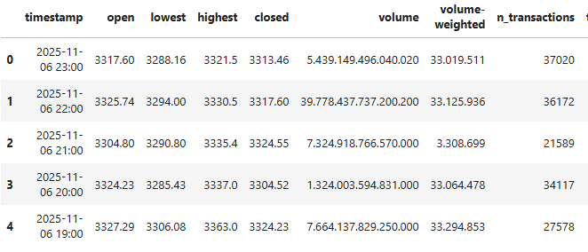
Historical prices dataset
Number of rows:
21608
Number of features:
8

Slide 6
Historical prices dataset preprocessing
Conversion of data types (strings -> numbers)
Cleaning corrupted values
Cleaning blank, Nan values.

Slide 7
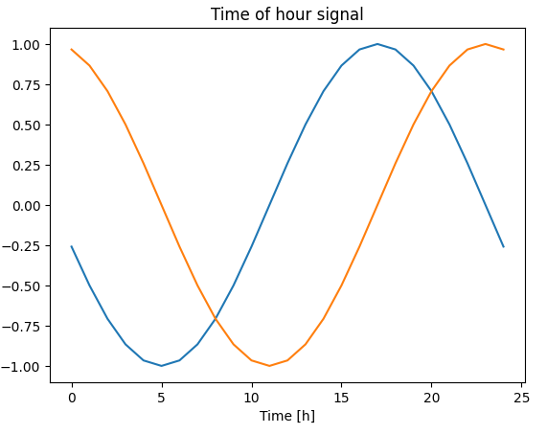
Time-series preprocessing
Conversion to cyclic values instead of just line :
  hour_sin
  hour_cos
  dow_sin
  dow_cos
Better model performance

Slide 8
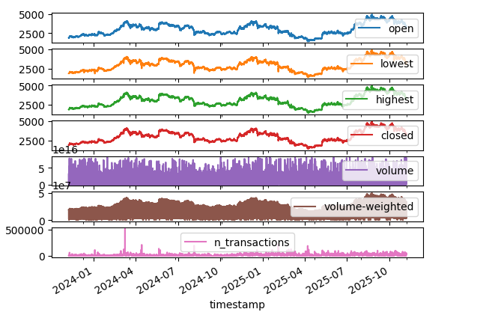
Evolution of Ethereum OHLCV changes
Data is relative stable
Frequent short-term fluctuations
Generally increases

Slide 9
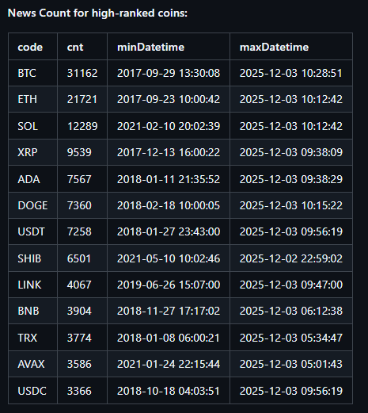

News dataset preparation
Lack of free options to get historical news.
More than 25 options were studied.
248k Cryptocurrency news fetched from Cryptopanic.com - the most well-known service focusing specifically on crypto news.

Slide 10


Sentiment Score Calculation
VADER (Valence Aware Dictionary and sEntiment Reasoner) was used to compute sentiment score of news.
Lexicon and rule-based sentiment analysis tool that is specifically attuned to sentiments expressed in social media.
P.s

Slide 11
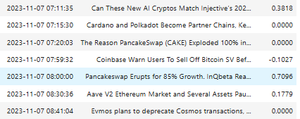
Sentiment Score calculation example
The more positive news, the higher sentiment score.
Range is [-1;1]
“Ethereum 2.0 Upgrade Successfully Launches, Promising Faster Transactions and Lower Fees” -> +0.8 (strongly positive)
"Ethereum Prices Plummet Amid Market Uncertainty and Regulatory Concerns" -> -0.7 (strongly negative)

Slide 12
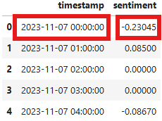
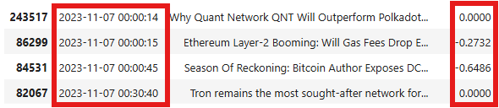
News Dataset Preprocessing
Raw data represents news at publication date.
Grouping of data by 1 hour unit is necessary.
OHLCV dataset + News dataset = Broad feature range.
Calculated as average or mean.

Slide 13
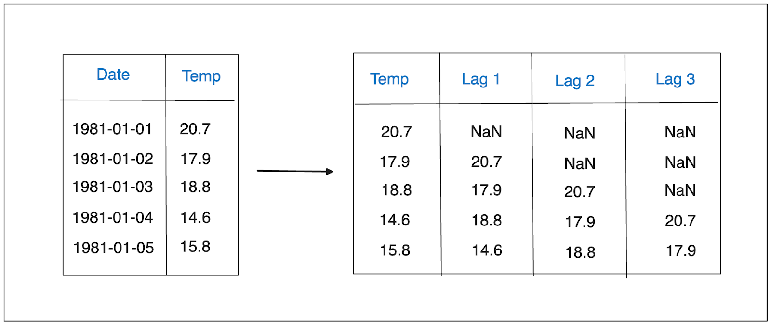
Shifting of data and concept of Lag
Price of crypto coin is driven by many factors. It includes different events in the world, fall of economics, general worrying and even personal life.
All of the factors do not influence on crypto coin price immediately
Lag - delay between an observed data point and its preceding values

Slide 14
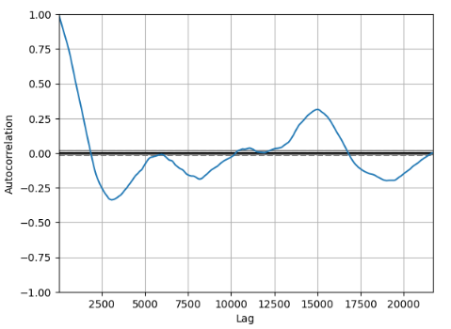
Selection of Lag
Selecting the optimal lag is crucial to ensure accurate forecasting.
Option 1: Autocorrelation plot
  helps to see how each point in the series correlates with previous points
  window sizes were determined using autocorrelation plot with 95% confidence score.
  Correlation stays strong up to 1000-2000 lags
  High persistence – typical for financial time series

Slide 15
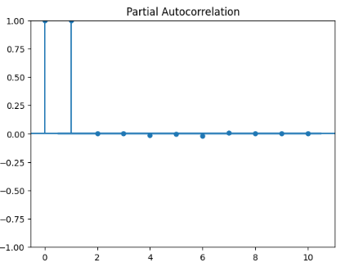
Final dataset inspection
Option 2: Partial Autocorrelation
helps to see the direct relationship between an observation and a lagged observation
The time series strongly depends on its first lag.
There is no significant correlation with deeper lags.
So that’s why it is necessary to add lag_1 feature with step 1.
lag_1 = target_closed_price

Slide 16
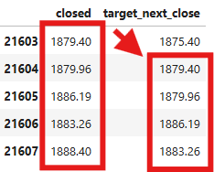
Lag implementation
The close_price column was shifted by one step to create the target_close_price, enabling the model to predict the next time-step price.
Implementation of lag for news is trick as it based on personal feelings.
What if some patterns are there?

Slide 17
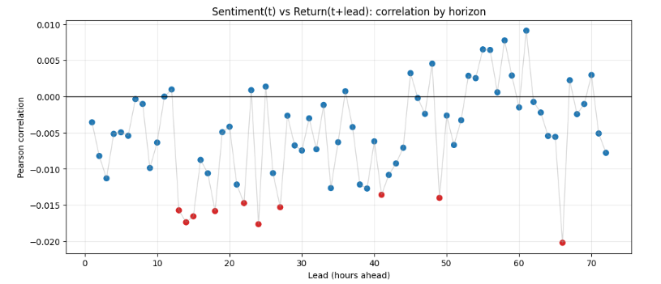
Concept of Lead
Future values is aligned with present
Not appropriate as input feature (data leakage)
Determining the lead – lag is can be found.
Correlation vs Time show slight price changes affected by news.
Affect can be considered as a noise or slight non-linear affect

Slide 18
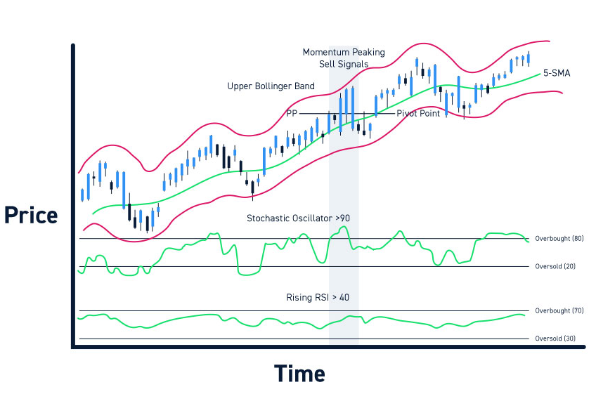
Feature augmentation with Trading Indicators
Ethereum has short cycles and usually all major changes are happening in in short time periods. (Wątorek & Skupień, 2023)
In order to analyse carefully the market, traders rely on technical trading indicators.
Several technical indicators were also calculated using short time windows, consistent with Ethereum’s short-cycle behavior
  Simple moving average (SMA)
  Relative Strength Index (RSI)
  On-Balance Volume (OBV)
  Average True Range (ATR)

Slide 19
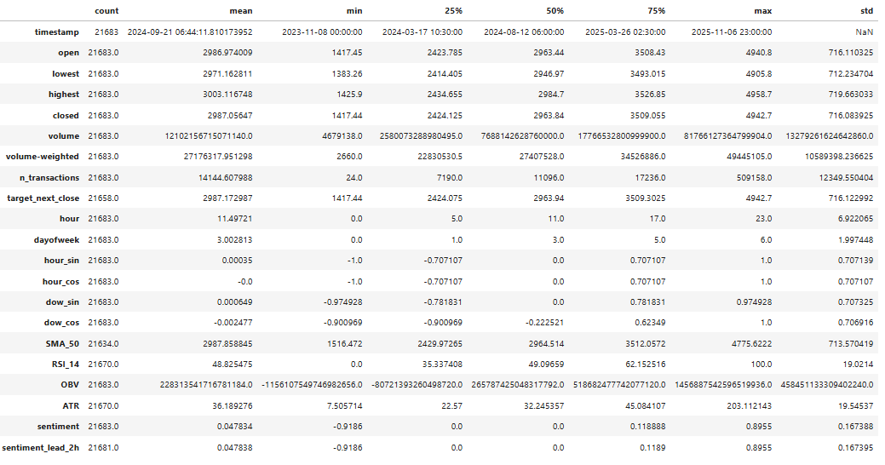
Final dataset inspection
High volatility
In big swings

Slide 20
Model Training

Slide 21
Feature cleaning
Data Leakage:
target_next_close_price is not appropriate as input feature for training.
Introducing future information into your training process that would not be available at prediction time
Unimportant features: (may go after actual training)
Were not identified
Basic implementation of Genetic Algorithms may help

Slide 22
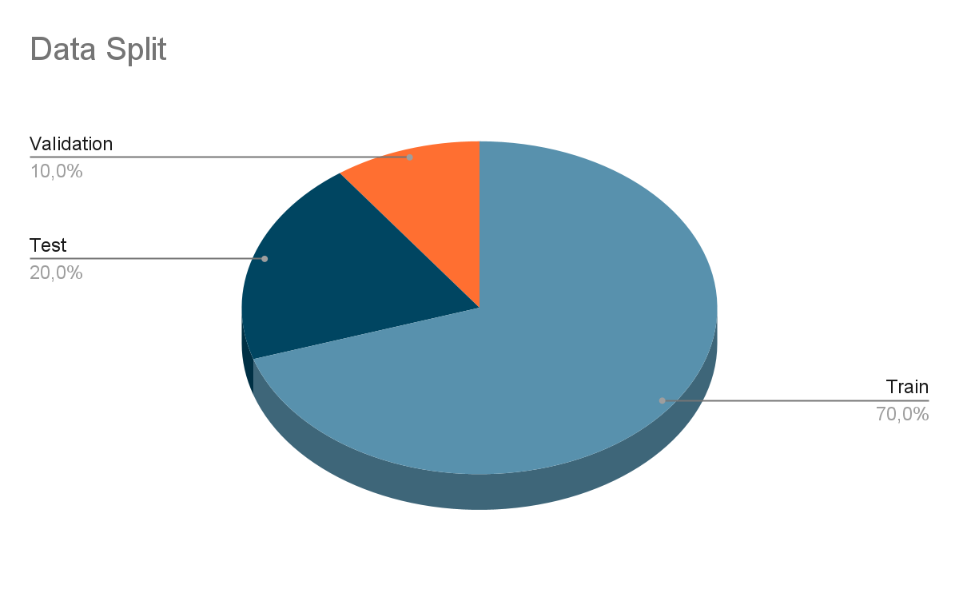
Split
Data must stay ordered by timestamp.
No random shuffles
Training Set: 70%
Test Set: 20%
Validation Set: 10%

Slide 23
Normalization
Same scaler across training, test and validation sets
No access for test and validation sets
Mean and Standard Deviation must be calculated using training dataset only.

Slide 24
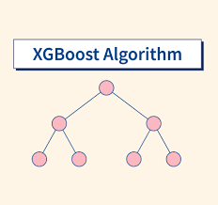
Model
Xgboost (eXtreme Gradient Boosting) - optimized distributed gradient boosting library designed for efficient and scalable training
Handles nonlinear relationships
Flexible for features
Model multiple horizons (next hour, day or any target)
Lightweight
Selection of hyperparameters was support by implementing Grid Search algorithm.

Slide 25
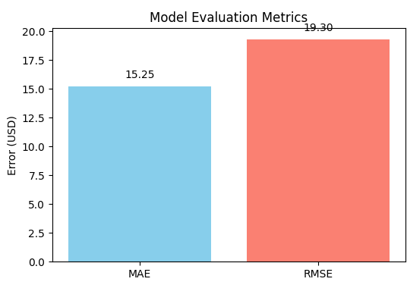
Model evaluation
MAE:
  15.25 USD → 0.5% error
RMSE
  19.30 USD → 0.64% error

Slide 26
Frontend implementation

Slide 27

Implementation details & Functionallity
Single-page React application.
Built according to crypto style using CSS.
Makes API callouts to backend Fast API to get prediction.
Allows to select a currency, crypto coin.

Slide 28
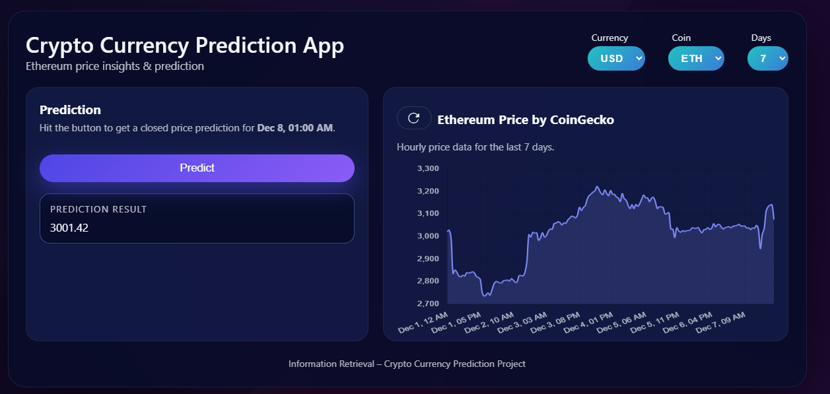
User Interface

Slide 29
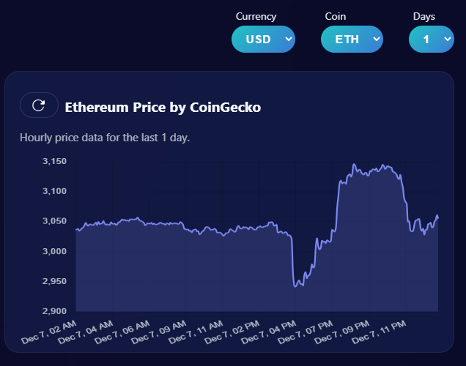

Ethereum real-time prices
Real time crypt graph prices are taken calling CoinGecko API.
Graph is adjusted in real time on user dropdown values selection.

Slide 30
Backend implementation

Slide 31


Fast API (Python)
Implemented using Fast API Uvicorn.
Exposes public /predict endpoint.
Enables CORS inside internal network only for frontend application.
Loads XGBoost model and sklearn Scaler to normalize input data before prediction.

Slide 32
Libraries used
fastapi
pandas
joblib
python
requests
motor
uvicorn
pydantic
xgboost
scikit
numpy

Slide 33
Preparation of input data
The input data must have 18 features according to training approach.
Real-Time call to Polygon.io API taking ETH prices for last 50 hours.
Calculates technical trading indicators (SMA, RSI, ATR, OBV).
Converts timestamp into cyclic data (hour_sin, hour_cos, dow_sin, dow_cos).
Get News headers from Cryptopanic.com and calculates sentiment score using VADER.
Gets prediction based on input data.
Stores prediction in MongoDB.

Slide 34

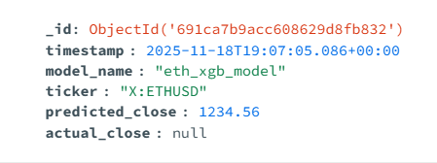
Data storage
All the predictions are stored in NoSQL format inside MongoDB.
The following schema is defined for Mongo DB database:

Slide 35



Deployment
All services are wrapped in Docker containers and managed by docker-compose file.
GitHub was selected for versioning and GitHub Action for CI/CD.

Slide 36
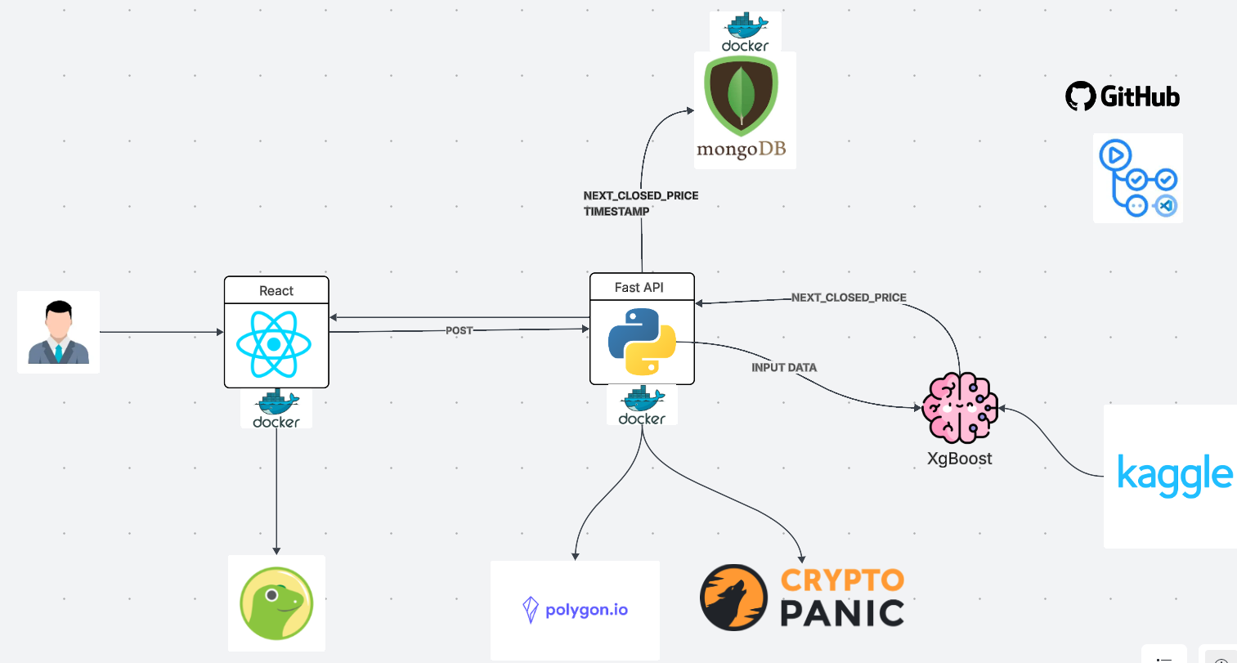
Architecture

Slide 37
Further improvements
Deployment to cloud service providers
Consideration of deep learning time-series models GRU/LSTM.
Including different currencies (EUR, GBP) and crypto coins (BTC, SOL, TON)
Different languages support.

Slide 38
Bibliography
cjhutto. VADER-Sentiment-Analysis. [Source Code] https://github.com/cjhutto/vaderSentiment?tab=readme-ov-file#introduction
soheilrahsaz. Crypto News Dataset [Source Code] https://github.com/soheilrahsaz/cryptoNewsDataset
Polygon.io API Documentation https://massive.com/docs/rest/crypto/aggregates/custom-bars
XgBoost Implementation https://xgboost.readthedocs.io/en/stable/
Coin Gecko API https://www.coingecko.com/en/api
25 technical trading indicators https://blog.elearnmarkets.com/best-25-technical-indicators/

Slide 39
References
mnek1t. CryptoCurrencyPrediction. GitHub [Source Code] https://github.com/mnek1t/CryptoCurrencyPrediction
Mykyta Medvediev Kaggle Notebook [Source Code] https://www.kaggle.com/code/mykytamedvediev/cryptocurrencypredictionmodel/edit

Slide 40
Thank you!

