Slide 1
Temporal Difference Learning
applied to
Backgammon
Joshua Salisbury

Slide 2
Overview
Neural network
  One hidden layer, variable # of nodes
Four outputs: probabilities of outcome
Depending on network, 3-5 seconds/game

Slide 3
Temporal Difference Learning
Each prediction is compared with the next
Learns to be internally consistent
Slowly changing environment is best
  Example: predicting the weather
  Dealing with volatility

Slide 4
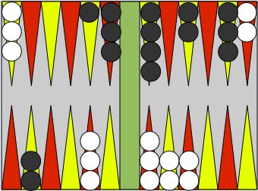
Elements of Backgammon
Advantage shifts gradually
Pieces must pass each other
Single pieces are vulnerable
Blockades impede opponent's progress
Element of chance

Slide 5


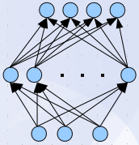


Learning Algorithm
Game Positions
Predictions
Network
Updated
Network
Time
Game Outcome

Slide 6
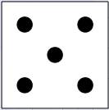
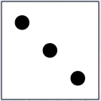
Playing Algorithm
Select
Best Move
+
Predict
Outcomes
List Possible
Moves
Encode
. . .

Slide 7
Encoding Scheme
Raw encoding
Discontinuity of meaning
Separate by color
Separate by number
Add extra features

Slide 8
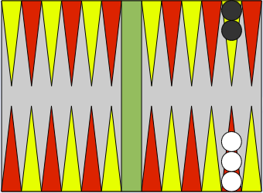
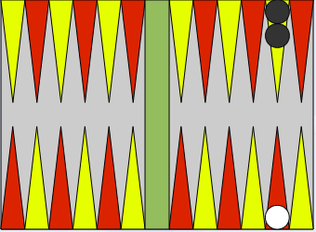
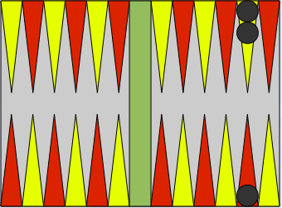
Encoding Scheme
vs
Discontinuity of Meaning

Slide 9
Issues
Self-consistent but bad performance
  Observing while controlling
Knowledge-free vs. handcoded features
Overfitting via self-play: possible?
Absolute vs. relative accuracy
  Accurate predictor, or good player?
Move | True Prob | Network 1 | Network 2
A | 0.846 | 0.842 | 0.719
B | 0.840 | 0.843 | 0.621

Slide 10
Results
Type 3 does not improve
  Bad initial values: local optimum?
  Expected for random: ~150

Slide 11
Results
Type 4 does not improve

Slide 12
Results
Generally good performance

Slide 13
Results
Possible overtraining at 80000 games

Slide 14
Results
1000 training games
Size controls speed of training
Simple network improves more rapidly at first

Slide 15
Example: player 1 “@”
+
+ + @ + @
BAR 1 2 3 4 5 6 7 8 9 10 11 12 13 14 15 16 17 18 19 20 21 22 23 24 BAR
Predictions:
6.0305e-01
3.9679e-01
1.5723e-04
7.5259e-06
Rolled: 3 and 4
+ +
+ + @ @
BAR 1 2 3 4 5 6 7 8 9 10 11 12 13 14 15 16 17 18 19 20 21 22 23 24 BAR
Predictions:
5.6717e-01
4.3272e-01
1.0682e-04
4.6945e-06

Slide 16
Example: player 1 opening
@ + @ +
@ + @ +
@ @ + @ + +
+ @ @ + @ + + @
+ @ @ + @ + + @
BAR 1 2 3 4 5 6 7 8 9 10 11 12 13 14 15 16 17 18 19 20 21 22 23 24 BAR
Predictions:
0.0111560
0.0173187
0.9685170
0.0030084
Rolled: 1 and 2
@
@ + @ +
@ + @ +
@ + @ + +
+ @ @ + @ + +
+ @ @ + @ + + @ @
BAR 1 2 3 4 5 6 7 8 9 10 11 12 13 14 15 16 17 18 19 20 21 22 23 24 BAR
Predictions:
0.0262703
0.0503247
0.9220153
0.0013896

Slide 17
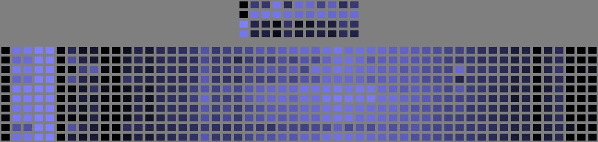
Weight Tables
# p1 # p2
p1
p2
Output
Hidden
p1 (-) p2 (+)
Signs of each player's pieces
Symmetry

Slide 18
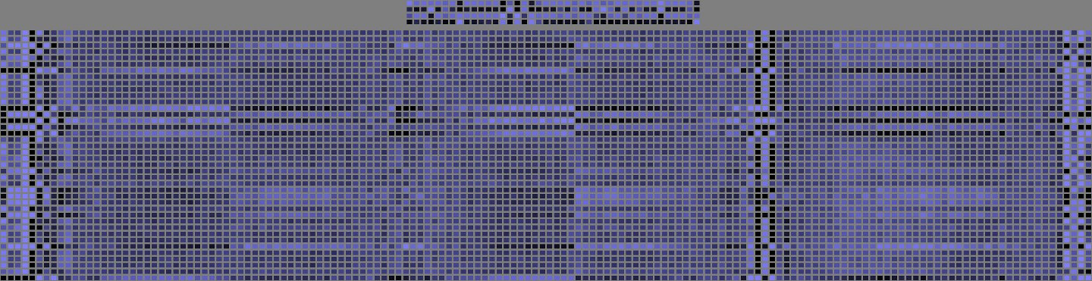
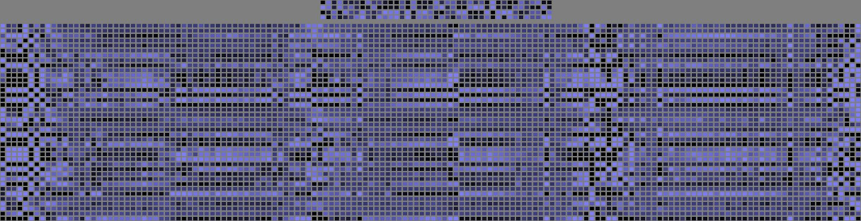
Weight Tables
Blots (p1)
Blots (p2)
Doubles (p1)
Doubles (p2)
Over 2 (p1)
Over 2 (p2)

Slide 19
Videos
10 hidden nodes, type 1 encoding
40 hidden nodes, type 4 encoding

Slide 20
References
G. Tesauro, “Temporal Difference Learning and TD-Gammon,” Comm. of the ACM, vol. 38, no. 3, pp. 58, 1995.
G. Tesauro, “Practical Issues in Temporal Difference Learning,” Machine Learning, vol. 8, no. 3-4, pp. 257-277, 1992.
T. Keith (April 2006). Backgammon: How to Play the Opening Rolls [Online]. Available HTTP: www.bkgm.com/openings.html

