Slide 1
We.eXplained
European Ruby Conference 2005, Munich
Concepts and Internals
Michael Neumann
mneumann@ntecs.de

Slide 2
What the hell...
Decorations
Components
Snapshots
Callbacks
Continuations
Backtracking
Stateful

Slide 3
What the hell...
?
Decorations
Components
Snapshots
Callbacks
Continuations
Backtracking
Stateful

Slide 4
Introduction
What is Wee?
  A component oriented, stateful web engine, largely inspired by Seaside2 and Avi Bryant.
  See the demo.
Continuations
WebObjects
IOWA
Seaside2
Borges
Wee

Slide 5
Hello W(ee)orld
require 'wee'
class HelloWorld < Wee::Component
def render; r.text „Hello World“ end
end
Wee.run(HelloWorld)
# => http://localhost:2000/app
require 'wee'
class HelloWorld < Wee::Component
def render
r.h1.onclick_callback { @v = !@v }.with {
r.text(@v ? "Bye bye world" : "Hello world")
}
end
end
Wee.run(HelloWorld)

Slide 6
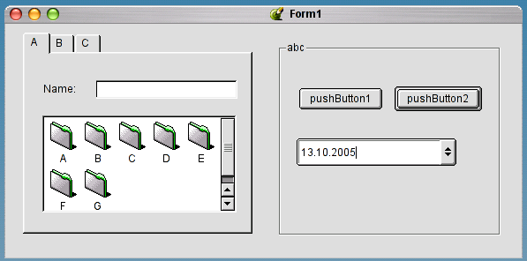
Analysing GUIs
Modern GUIs are constructed out of individual components (or „widgets“).
TextInput
Dialog
GroupBox
TabControl
PushButton
IconView
DateInput
ScrollBar

Slide 7
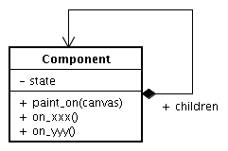
Analysing GUIs - State
Each component stores it's own current visual UI state, e.g.
  selected item
  collapse info of a TreeView
Notes:
Possible questions:
What's the difference between UI state and „model“ state?
Why not MVC?

Slide 8
Analysing GUIs - Display
A component can paint itself onto something (called a canvas here).

Slide 9
Analysing GUIs - Callbacks
Interaction from outsite can solely happen through explicitly exposed callbacks which are bound to specific events. They modify state!

Slide 10
Analysing GUIs - Composition
Composition is used to build more complex components.
Parents...
  ... can intercept events sent to their children. (?)
  ... are responsible to paint their children. (?)

Slide 11
UIs in Wee
Except paint is now called render, and the output is text/html, everything applies ;-)
An application in Wee is constructed out of commponents. Thus:
  You can reuse components!
  BUT:

Slide 12
Reusable Components
More a dream than reality!
  It's hard to build reusable components.
Customization through:
  Subclassing (overwrite methods)
  CSS

Slide 13
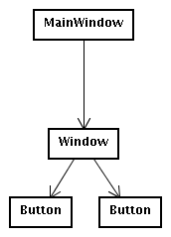
A Compositional Problem
Wrap Window inside a GroupBox!?
  (Or draw a a border around the Window)

Slide 14
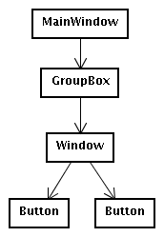
„Simple“ Solution
Modify Tree
Initial Setting
No Decorations
BUT: What if the parent is unknown?

Slide 15
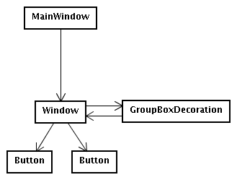
The „decorative“ Solution
Add Decoration
Initial Setting
With Decorations
Advantage: No need to modify the tree!

Slide 16
Decorations
Changing the look and/or behaviour of components without modifying the compositional relation.
Examples:
  draw header/footer around them
  intercept callback processing (e.g. LoginDecoration)

Slide 17
Uses of Decorations
WrapperDecoration, PageDecoration, FormDecoration
LoginDecoration
Delegate, AnswerDecoration

Slide 18
WrapperDecoration
class HeaderFooter < Wee::WrapperDecoration
def render_wrapper
r.text „header“
yield # render the component
r.text „footer“
end
end
c = MyComponent.new.add_decoration(HeaderFooter.new)
Renders a header and footer around a component.

Slide 19
PageDecoration
class Wee:PageDecoration < Wee::WrapperDecoration
def initialize(title='')
@title = title
super()
end
def global?() true end
private
def render_wrapper
r.page.title(@title).with { yield }
end
end
<html>
<head>
<title>...</title>
</head>
<body>
...
</body>
</html>

Slide 20
FormDecoration
Simply renders a <form> tag around a component.
Why? By wrapping a set of components inside of one form tag, the entered values will not get lost upon submit!
Form 1
... loose that
Form 1
Name:
Name:
Name:
Form 2
Click here and ...
Name:
Click here ...
... don't loose that!
Multiple Form Tags
One Form Tag

Slide 21
FormDecoration
Simply renders a <form> tag around a component.
Why? By wrapping a set of components inside of one form tag, the entered values will not get lost upon submit!
Today: Use AJAX!?
Form 1
... loose that
Form 1
Name:
Name:
Name:
Form 2
Click here and ...
Name:
Click here ...
... don't loose that!
Multiple Form Tags
One Form Tag

Slide 22
LoginDecoration
Redirect all requests to a Login page unless logged_in?
Else: Pass all requests through
See: login_page.rb

Slide 23
Delegate decoration
Like LoginDecoration, but unconditionally.
Introduced later (together with AnswerDecoration) when we look at the call/answer mechanism.

Slide 24
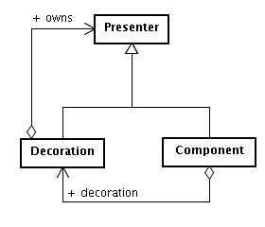
Implementation of Decorations
(1) The component will pass control to it's
first decoration in the chain.
(2) A decoration owns all „following“
decorations. It might proceed or stop here.
(3a) The next decoration is in control.
Proceed with (2).
(3b) We reached „self“ (the initial component).
We're ready!
(2)
(3a)
(3b)
(1)
Note that Decoration and Component share a similar interface. That's why 'decoration' can point back to self.
Notes:
Two different sets of methods:
draw a component with all it's decorations (xxx_chain)
draw the component (e.g. do_render).

Slide 25
call/answer mechanism
Think of a „procedure call stack“ (call/return).
Demo
class Counter < Wee::Component
def initialize; @cnt = 0; super end
def render
r.anchor.callback(:dec).with('--')
r.text „ #{ @cnt } “
r.anchor.callback(:inc).with('++')
end
def dec
if @cnt == 0
call MessageBox.new('Go Negative?'),
proc {|cond| @cnt -= 1 if cond }
else
@cnt -= 1
end
end
def inc; @cnt += 1 end
end
class MessageBox < Wee::Component
def initialize(title)
@title = title; super()
end
def render
r.form do
r.h1 @title
r.submit_button.value('YES').
callback(:answer, true)
r.submit_button.value('NO').
callback(:answer, false)
end
end
end

Slide 26
call/answer (cont')
Components can replace themself temporaryly with another component (call), until the called component gives control back to the calling component (answer).

Slide 27
Implementation of call
Simply add a Delegate decoration to the calling component:
def call(component, on_answer=nil)
delegate = Delegate.new(delegate_to=component)
self.add_decoration(delegate)
...
But that's not enough. We need an AnswerDecoration as well.
...
answer = AnswerDecoration.new
answer.on_answer = on_answer
component.add_decoration(answer)
...

Slide 28
Implementation of call (2)
Why an AnswerDecoration?
  To be able to use a component calling answer like any other component.
  „return without call“!

Slide 29
Implementation of call (3)
Still not enough!
...
throw :wee_abort_callback_processing
end
Only slightly different in the „continuation“ case, but usage is much easier:
class Counter < Wee::Component
...
def dec
@cnt -= 1 if @cnt > 0 or call MessageBox.new('Go Negative?')
end
...
end

Slide 30
Implementation of answer
Simply removes the Delegate decoration from the calling component and invokes the on_answer callback.

Slide 31
URLs in Wee
You'll never have to touch them manually.
  http:// hostname / mount-point / info-part / separator / session-id / page-id ? callbacks
  http://localhost/demo/arbitrary/info/___/b2fb...7cb/1
Page-Id will increase after every „action“ (see Backtracking).

Slide 32
A Wee Cycle
Imagine following code:
def render
r.form do
r.text_input.value(@name).callback {|@name|}
r.submit_button.value(„OK“).callback { p @name }
end
end
This will generate HTML like this:
<form method=“GET“ action=“/..../___/sid/120“>
<input type=“text“ value=““ name=“1“ />
<input type=“submit“ value=“OK“ name=“2“ />
</form>

Slide 33
A Wee Cycle (cont')
Upon form submission the following happens:
  The Page-id is extracted from the submitted URL.
    http://...../___/sid/120?1=blah&2=OK
  Lookup the page with that id from the PageStore. A page is just the snapshot of a certain state of the components tree + registered callbacks.
  Restore the components tree to that state.
  Invoke the supplied callbacks.
    All input callbacks (e.g. text-fields) before the final action callback (submit-button, anchor).
  Generate new Page-Id. Take a snapshot of the whole components tree and store it under that id.
  Redirect to the new Page-id excluding the callbacks:
    http://...../___/sid/121
Modifies State!
@name = „blah“
p @name

Slide 34
A Wee Cycle (cont')
The client follows the redirect (http://...../___/sid/121):
  Lookup page 121 and apply it's state to the components tree.
  Render the components tree.
    Callbacks are registered and stored in the page object of id 121.
    All generated URLs include the current page id (121), or in other words, the context in which the callbacks should be invoked.
Side-Effect free!
def render
r.form do
r.text_input.value(@name).callback {|@name|}
r.submit_button.value(„OK“).callback { p @name }
end
end

Slide 35
Backtracking
„Undo/Redo“-Facility.
You can use the back-button again!
See the demo.

Slide 36
Backtracking - Implementation
Simply take a snapshot of all the objects that are of interest (e.g. the current value of a counter).
Later, restore them!
Page-id's to make unique URLs and to reference the snapshots.

Slide 37
Continuations
Try the same without continuations... you need a state machine!
...
def action
loop do
if (call MessageBox.new('2 + 3 = 5?')) and
(call MessageBox.new('3 + 4 = 7?')) then
call TextBox.new('Genius!')
break
else
call TextBox.new('Please try again!')
end
end
end
...
end
But: In some (rare?) situations, continuations leak memory! Be careful.
And: You need one thread per session!

Slide 38
Is Wee for me?
Maybe if...
  your application is very dynamic.
  you can easily recognize and extract parts of the page as components (it has a „regular“ structure).
  you need to operate on very complex in-memory objects.
  you don't like Javascript ;-)
  your application is more complex than just CRUD.
  bookmarkable URLs are not a requirement.
  you think backtracking is a nice thing.
  you really want to use continuations.
  you hire me to continue Wee's development ;-)

Slide 39
Reasons why not
No community. Development stalled.
URLs are not bookmarkable (this is just impossible due to it's dynamic nature).
It's stateful.
Maybe too dynamic for you ;-)
It's easy to introduce inconsistencies when using Og (ORM) due to object caching. Solution: Disable caching or manually reload the domain objects.

Slide 40
Questions?

Slide 41
Thank you!

Slide 42
Resources
Wee: http://rubyforge.org/projects/wee
Seaside2: http://www.seaside.st/
Borges: http://borges.rubyforge.org/
IOWA: http://enigo.com/projects/iowa/

