Slide 1

HAMMER File System
Efficient Log-less Master to Multi-Slave Replication
Michael Neumann <mneumann@ntecs.de>

Slide 2
Oustanding Features
Fine-grained automatic snapshots
Master to Multi-Slave Replication

Slide 3
Fine-grained automatic snapshots
Every flush to disk (about every 30 seconds) creates a new version of the file system.
FS never forgets data unless explicitly told.
undo can be used to restore old versions of files.
Files can be accessed „as-of“ by appending @@transaction-id to the filename (transaction_id via hammer synctid).

Slide 4
Master-Slave Replication
A master filesystem can be incrementally replicated locally or remote (via ssh) to one or more read-only slave filesystems:
  masterhost> hammer pfs-master /www # create master filesystem
  masterhost> hammer -b 100k mirror-stream /www slavehost:/www &
  slavehost> hammer -b 1m mirror-stream masterhost:/www /www &
mirror-stream runs in the background and transfers changes as soon as they happen.
Limit bandwidth

Slide 5
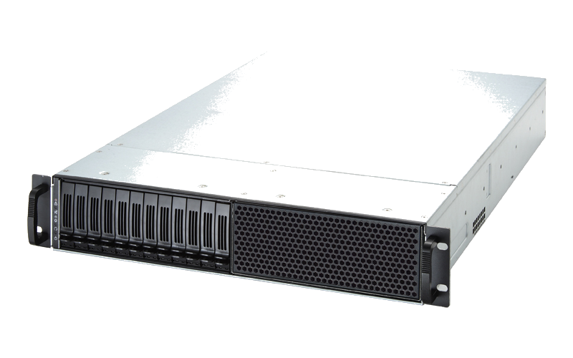

Live Replication Demo
Src: Chenbro.eu
Upload
Replicate in real-time
You

Slide 6
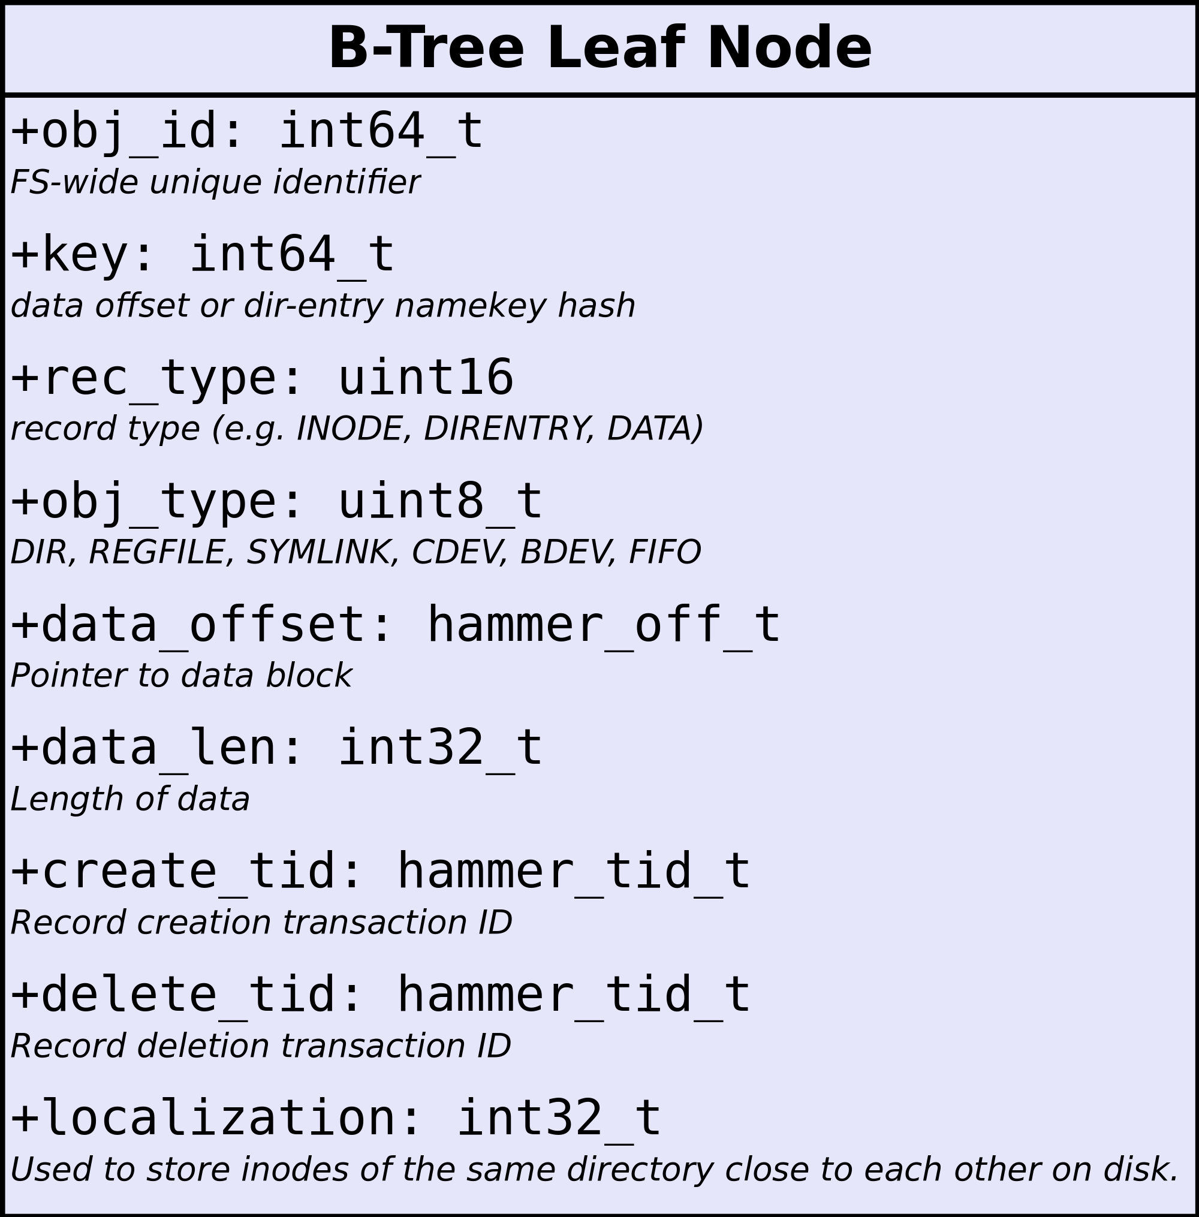
B+Tree Representation
ORDER BY (localization, obj_id, key,
create_tid)

Slide 7

B+Tree Representation
obj_id | key | rec_type | obj_type | data
1 | - | INODE | DIR | {uid, gid, mode, mtime, ...}
1 | hash(„dir“) | DIRENTRY | - | {obj_id: 2, name: „dir“}
1 | hash(„a“) | DIRENTRY | - | {obj_id: 3, name: „a“}
1 | hash(„b“) | DIRENTRY | - | {obj_id: 3, name: „b“}
2 | - | INODE | DIR | {uid, gid, ...}
3 | - | INODE | REGFILE | {uid, gid, ...}
3 | 0 | DATA | - | Data @offset 0
3 | 65536 | DATA | - | Data @offset 64k

Slide 8
B+Tree Representation
obj_id | key | rec_type | obj_type | data
1 | - | INODE | DIR | {uid, gid, mode, mtime, ...}
1 | hash(„dir“) | DIRENTRY | - | {obj_id: 2, name: „dir“}
1 | hash(„a“) | DIRENTRY | - | {obj_id: 3, name: „a“}
1 | hash(„b“) | DIRENTRY | - | {obj_id: 3, name: „b“}
2 | - | INODE | DIR | {uid, gid, ...}
3 | - | INODE | REGFILE | {uid, gid, ...}
3 | 0 | DATA | - | Data @offset 0
3 | 65536 | DATA | - | Data @offset 64k

Slide 9
B+Tree Representation
obj_id | key | rec_type | obj_type | data
1 | - | INODE | DIR | {uid, gid, mode, mtime, ...}
1 | hash(„dir“) | DIRENTRY | - | {obj_id: 2, name: „dir“}
1 | hash(„a“) | DIRENTRY | - | {obj_id: 3, name: „a“}
1 | hash(„b“) | DIRENTRY | - | {obj_id: 3, name: „b“}
2 | - | INODE | DIR | {uid, gid, ...}
3 | - | INODE | REGFILE | {uid, gid, ...}
3 | 0 | DATA | - | Data @offset 0
3 | 65536 | DATA | - | Data @offset 64k
obj_id | key | rec_type | obj_type | data
1 | - | INODE | DIR | {uid, gid, mode, mtime, ...}
1 | hash(„dir“) | DIRENTRY | - | {obj_id: 2, name: „dir“}
1 | hash(„a“) | DIRENTRY | - | {obj_id: 3, name: „a“}
1 | hash(„b“) | DIRENTRY | - | {obj_id: 3, name: „b“}
2 | - | INODE | DIR | {uid, gid, ...}
3 | - | INODE | REGFILE | {uid, gid, ...}
3 | 0 | DATA | - | Data @offset 0
3 | 65536 | DATA | - | Data @offset 64k

Slide 10
B+Tree Representation
obj_id | key | rec_type | obj_type | data
1 | - | INODE | DIR | {uid, gid, mode, mtime, ...}
1 | hash(„dir“) | DIRENTRY | - | {obj_id: 2, name: „dir“}
1 | hash(„a“) | DIRENTRY | - | {obj_id: 3, name: „a“}
1 | hash(„b“) | DIRENTRY | - | {obj_id: 3, name: „b“}
2 | - | INODE | DIR | {uid, gid, ...}
3 | - | INODE | REGFILE | {uid, gid, linkcnt=2, ...}
3 | 0 | DATA | - | Data @offset 0
3 | 65536 | DATA | - | Data @offset 64k

Slide 11
B+Tree Representation
obj_id | key | rec_type | obj_type | data
1 | - | INODE | DIR | {uid, gid, mode, mtime, ...}
1 | hash(„dir“) | DIRENTRY | - | {obj_id: 2, name: „dir“}
1 | hash(„a“) | DIRENTRY | - | {obj_id: 3, name: „a“}
1 | hash(„b“) | DIRENTRY | - | {obj_id: 3, name: „b“}
2 | - | INODE | DIR | {uid, gid, ...}
3 | - | INODE | REGFILE | {uid, gid, linkcnt=2, ...}
3 | 0 | DATA | - | Data @offset 0
3 | 65536 | DATA | - | Data @offset 64k
0k
16k
32k
48k
64k

Slide 12
Adding History
obj_id | key | rec_type | obj_type | data | create_tid | delete_tid
1 | - | INODE | DIR | {uid, gid, mode, mtime, ...} | 100 | 0
1 | hash(„dir“) | DIRENTRY | - | {obj_id: 2, name: „dir“} | 100 | 0
1 | hash(„a“) | DIRENTRY | - | {obj_id: 3, name: „a“} | 100 | 0
1 | hash(„b“) | DIRENTRY | - | {obj_id: 3, name: „b“} | 100 | 0
2 | - | INODE | DIR | {uid, gid, ...} | 100 | 0
3 | - | INODE | REGFILE | {uid, gid, linkcnt=2, ...} | 100 | 0
3 | 0 | DATA | - | Data @offset 0 | 100 | 0
3 | 65536 | DATA | - | Data @offset 64k | 100 | 0

Slide 13
Adding History
obj_id | key | rec_type | obj_type | data | create_tid | delete_tid
1 | - | INODE | DIR | {uid, gid, mode, mtime, ...} | 100 | 0
1 | hash(„dir“) | DIRENTRY | - | {obj_id: 2, name: „dir“} | 100 | 0
1 | hash(„a“) | DIRENTRY | - | {obj_id: 3, name: „a“} | 100 | 101
1 | hash(„b“) | DIRENTRY | - | {obj_id: 3, name: „b“} | 100 | 0
2 | - | INODE | DIR | {uid, gid, ...} | 100 | 0
3 | - | INODE | REGFILE | {uid, gid, linkcnt=2, ...} | 100 | 101
3 | - | INODE | REGFILE | {uid, gid, linkcnt=1, ...} | 101 | 0
3 | 0 | DATA | - | Data @offset 0 | 100 | 0
3 | 65536 | DATA | - | Data @offset 64k | 100 | 0
remove(„a“)

Slide 14
Adding History
obj_id | key | rec_type | obj_type | data | create_tid | delete_tid
1 | - | INODE | DIR | {uid, gid, mode, mtime, ...} | 100 | 0
1 | hash(„dir“) | DIRENTRY | - | {obj_id: 2, name: „dir“} | 100 | 0
1 | hash(„a“) | DIRENTRY | - | {obj_id: 3, name: „a“} | 100 | 101
1 | hash(„b“) | DIRENTRY | - | {obj_id: 3, name: „b“} | 100 | 0
2 | - | INODE | DIR | {uid, gid, ...} | 100 | 0
3 | - | INODE | REGFILE | {uid, gid, linkcnt=2, ...} | 100 | 101
3 | - | INODE | REGFILE | {uid, gid, linkcnt=1, ...} | 101 | 0
3 | 0 | DATA | - | Data @offset 0 | 100 | 102
3 | 0 | DATA | - | Data @offset 0 | 102 | 0
3 | 65536 | DATA | - | Data @offset 64k | 100 | 0
0k
16k
32k
48k
64k
write(file=„b“, pos=0, some_bytes);

Slide 15
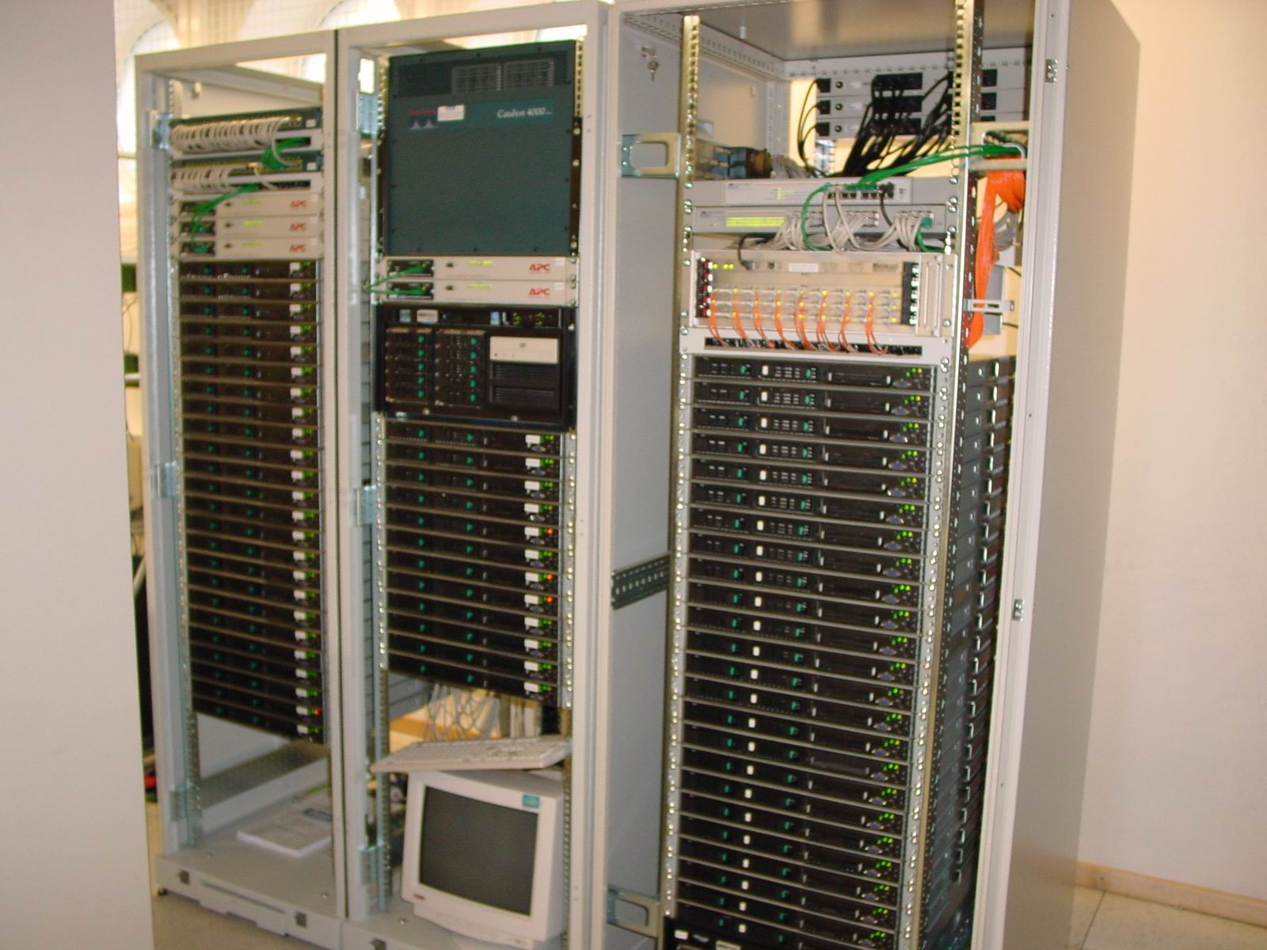
Ultimate Goal of DragonFlyBSD
Single-System-Image Clustering
  Cluster of machines that appears to be a single system
  → Single process space
  → Single view of the file system
Src: www.staff.tugraz.at/mlang/cluster

Slide 16
Single View of File System
Central Networked File System
    Single Point of Failure
    Not Scalable
Central
NFS

Slide 17
Single View of File System
Master-Slave Replicated File System
    HAMMER supports this.
    Does not allow true SSI operation.
Local
FS
Local
FS
Local
FS
Master (r/w)
Slave (r/o)
Slave (r/o)

Slide 18
Single View of File System
Multi-Master Replicated File System
    Scalable and Fault-Tolerant
    Not trivial to implement Cache Coherency Management System (CCMS).
    HAMMER is designed to support this in the future!
CCMS
Local
FS
Local
FS
Local
FS
Master (r/w)
Master (r/w)
Master (r/w)

Slide 19
Literature
http://kerneltrap.org/HAMMER
http://www.dragonflybsd.org/hammer/

Slide 20
Backup Slides

Slide 21
Explicit snapshots
In order to remove „old“ data, HAMMER must be told which snapshots to keep.
A snapshot is a special B-Tree node containing the transaction-id and a description.
  Creating a snapshot as-of-now:
  hammer snap /fs „description“
  Listing available snapshots:
  hammer snapls /fs

Slide 22
Cleaning up
HAMMER filesystems must be large enough (40+ GB) in order to not fill up too quickly.
hammer cleanup will get rid of all versions in-between explicit snapshots. It involves:
    Pruning: Removing old versions from the B-Tree; does not actually delete data!
    Rebalance the B-Tree
    Reblock: Defragment bigblocks
The frequency and duration of each operation, e.g. rebalance 5 minutes every day, can be set up for each pseudo-filesystem individually.

Slide 23
Incremental Replication
Each slave FS stores last_seen_tid.
SELECT * FROM Records WHERE
create_tid > last_seen_tid;
UPDATE last_seen_tid;
This is further optimized by storing max(create_tid, delete_tid) of the left and right subtrees in each internal node, allowing to skip whole subtrees.

