Slide 1
Michael Neustadter
Data Analyst
Financial analyst
SQL
Python
PowerBi
Tableau
https://github.com/mneustadts
https://www.linkedin.com/in/michael-neustadter-8423851bb/
Michael Neustadter is a Data analyst that specializes in financial data and is based in Minneapolis Minnesota.
The following presentation showcases a small portion of his capabilities manipulating data.
Fantasy Football 2024 Analysis

Slide 2
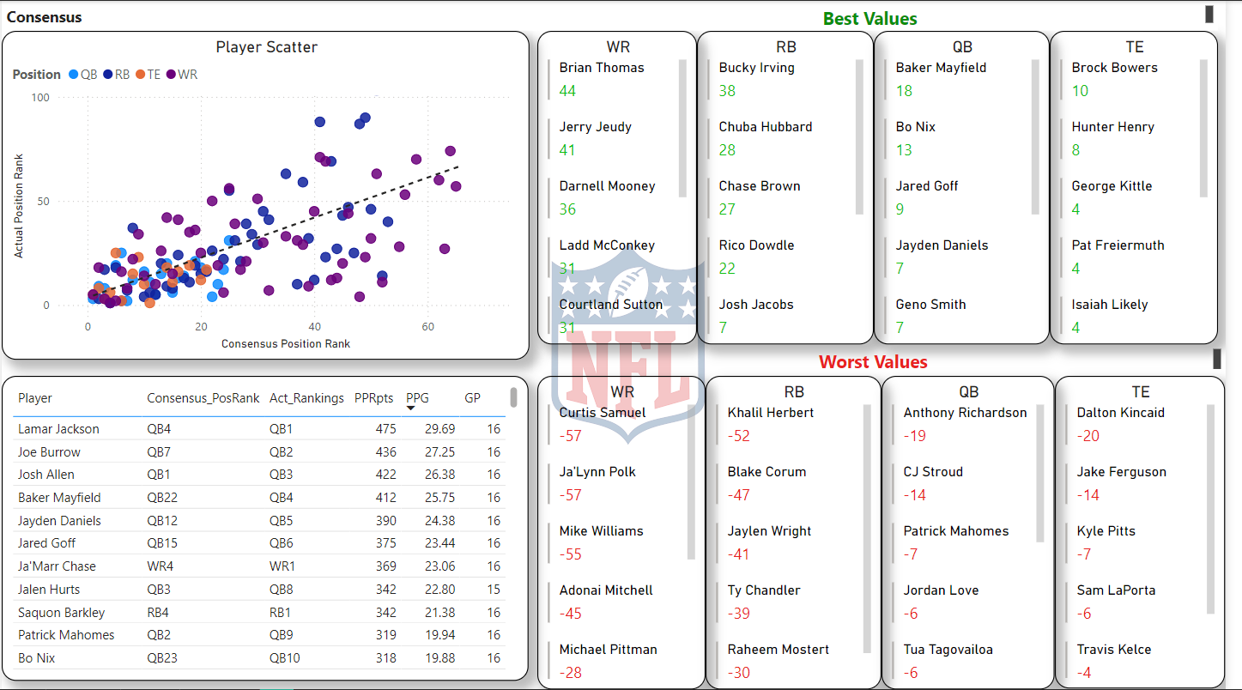

Slide 3
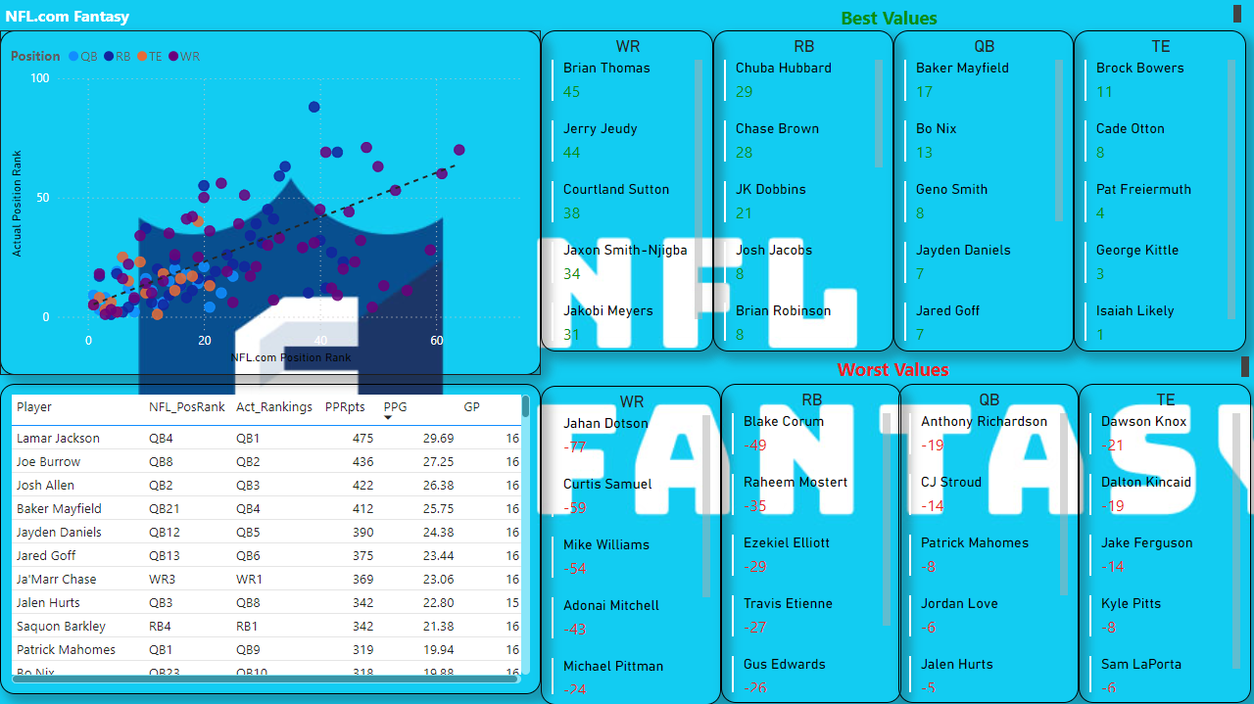

Slide 4
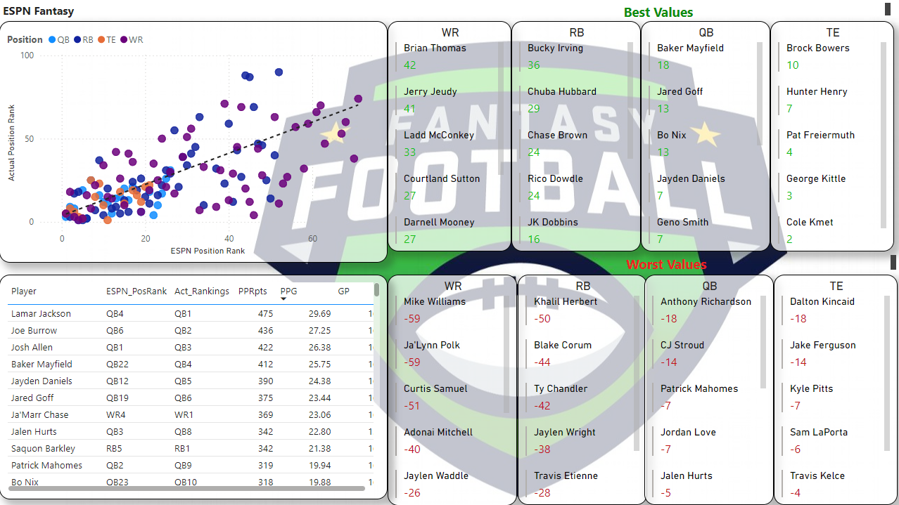

Slide 5
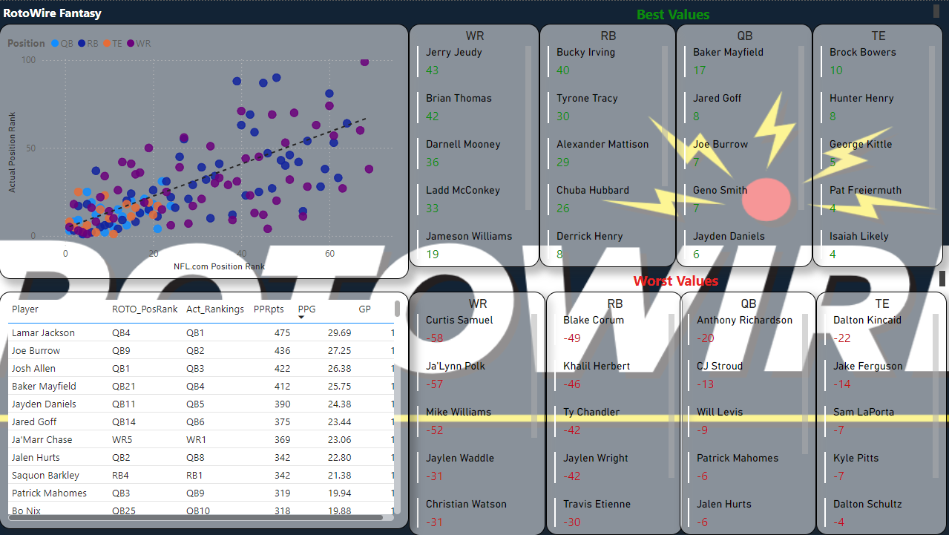

Slide 6
Thank You!
Data Analyst
Financial analyst
SQL
Python
PowerBi
Tableau
https://github.com/mneustadts
https://www.linkedin.com/in/michael-neustadter-8423851bb/

