Slide 1
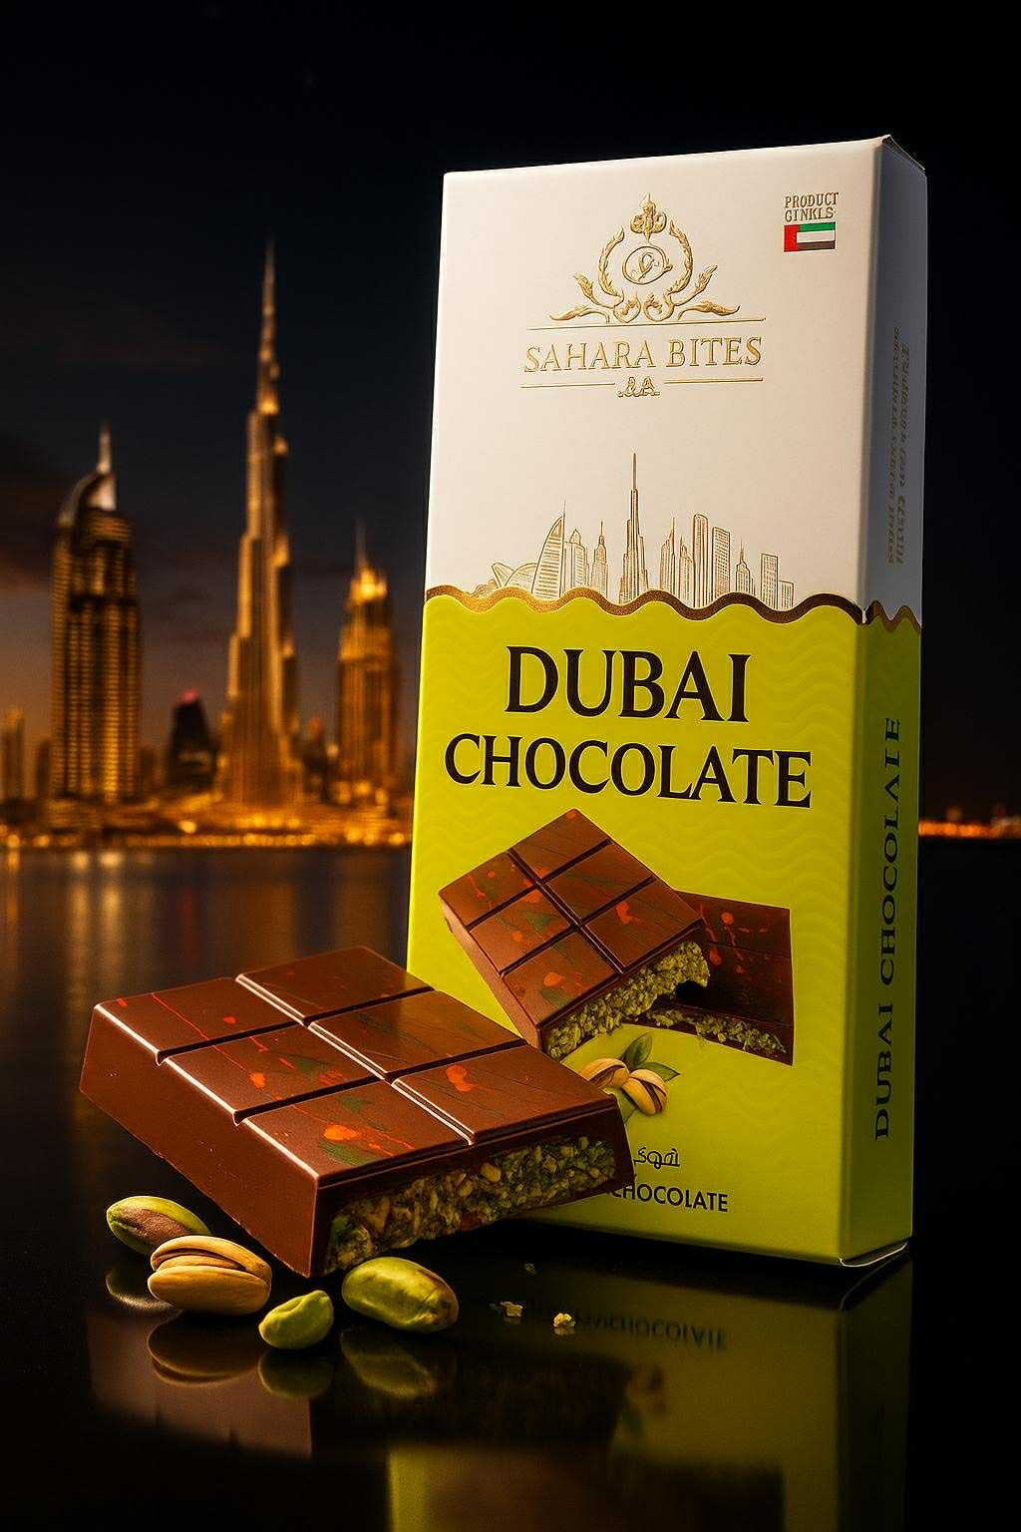
WELCOME TO
SAHARA BITES
DUBAI CHOCOLATE
Authentic · Premium · 4 Flavors · Multiple Sizes
You're at the right table — come say hello.

Slide 2
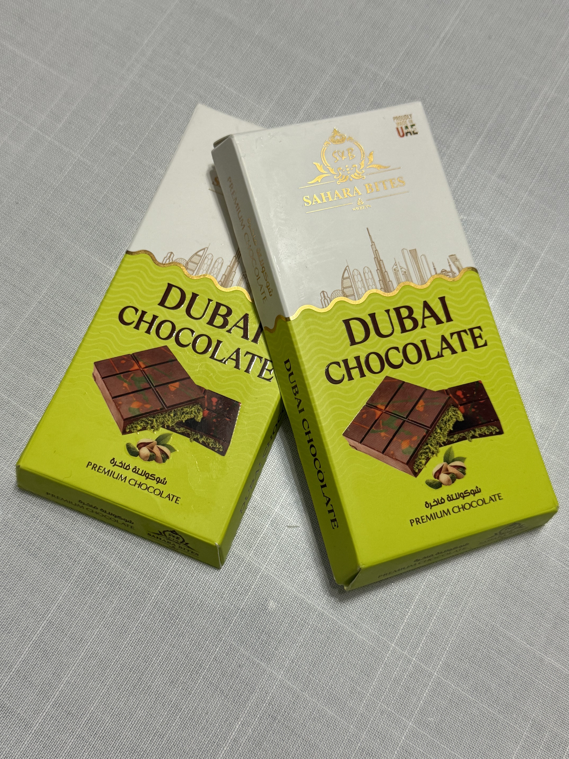
FLAVORS & PRICES
Dubai Chocolate
PISTACHIO
55g $5 · 100g $8 · 120g $10 · 200g $12
2-for deals: $9 · $15 · $18 · $20
BISCOFF / LOTUS
⭐ Best Seller · Large 200g — $12 · Buy 2 for $20
DARK
Large 200g — $12 · Buy 2 for $20
MANGO
Large 200g — $12 · Buy 2 for $20
* 2-for deals: both bars must be same size

Slide 3
TONIGHT'S DEAL
2 FOR
$20
On any Large 200g bar
Pistachio · Biscoff / Lotus · Dark · Mango · Regular $12 each
Don't leave without one.

Slide 4
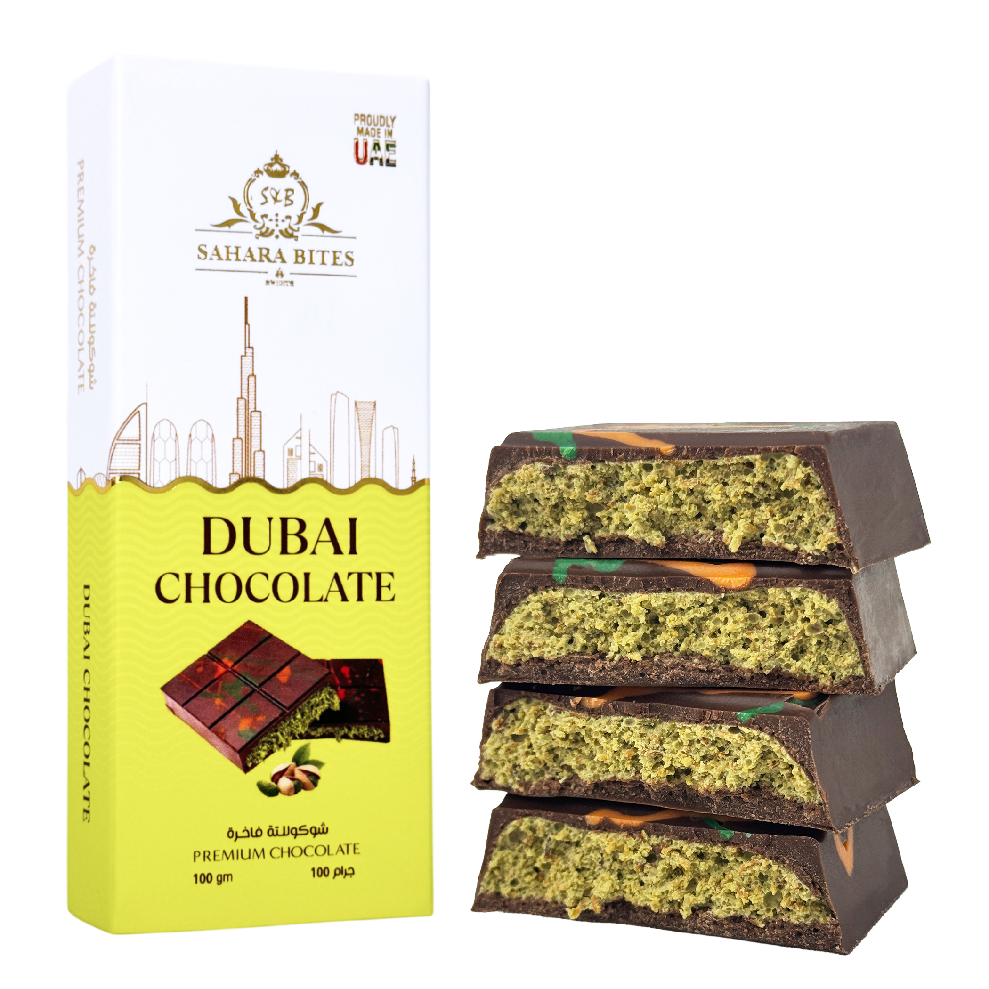
WHY SAHARA BITES?
Dubai Chocolate — the real thing.
THE REAL THING
Authentic Dubai Chocolate — no shortcuts, no imitations.
4 FLAVORS
Pistachio · Biscoff / Lotus · Dark · Mango
EVERY SIZE
From 55g minis to 200g large — pick what fits you.
ONLY TONIGHT
Right here at this table — limited supply.
Come taste the difference. You won't regret it.

Slide 5


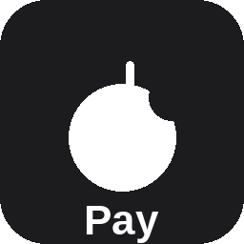
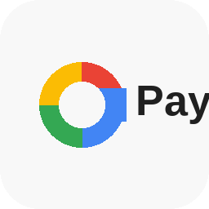


FIND US ON INSTAGRAM
@premiumdubaichocolate
Text us: 424-362-9312
WE ACCEPT
ZELLE
CASH APP
APPLE PAY
Mohamad Fadawi · (424) 362-9312
$HamoushiLushi · (424) 362-9312
Tap to pay at the table
GOOGLE PAY
CREDIT / DEBIT
CASH
Tap to pay at the table
via Square · Tap to pay
Hand it to us at the table
ICH Fun Fair · Islamic Center of Hawthorne · Friday, October 2, 2026 · 5:00 – 10:30 PM

