Slide 1

Reading MODFLOW Output Into PEST

Slide 2
Overview
TARGPEST—built-in reading through Groundwater Vistas
MOD2OBS—PEST utility to read binary MODFLOW output
MODFLOW-2000/2005 Observations Process
  HOB—head observations
  RVOB—river package observations
  DROB—drain package observations
  GBOB—general-head boundary related observations
  CHOB—Constant Head observations
HYDMOD
Custom Codes—FORTRAN techniques for reading files.
flopy

Slide 3
TARGPEST Basics
TARGPEST is the utility built in to Groundwater Vistas. This generally operates behind-the-scenes and is intended to be used when running PEST within Vistas.
Features
  Interpolates in space to well location
  Interpolates in time to measurement time
Implementation
  Created automatically when instructing Vistas to make PEST input files. It uses the targets identified in the GUI to create its input files.
  input file: targpest.dat
  executable file: targpest.exe
  output file: targpest.out
  NOTE: the name “targpest.dat” cannot be changed!

Slide 4
TARGPEST
Advantages to using TARGPEST:
  Automatic generation in Vistas is efficient for relatively straightforward problems.
  Vistas creates the instruction file required by PEST to read the results.
  Fewer options but also fewer requirements than MOD2OBS.
Disadvantages to using TARGPEST:
  The TARGPEST application is not documented, so if external modification of the input or interpretation of the output is required, it is not possible to document the changes made.
  The names of parameters are not editable which can make a challenge for archiving and interpretation of input/output files.
  If more than one MODFLOW model is included in a batch file, the targpest.dat file must be copied multiple times.

Slide 5
MOD2OBS Basics
MOD2OBS is part of the groundwater utilities included with the standard PEST distribution.
Setting up MOD2OBS is a bit involved, but hackable
MOD2OBS is called at the command line, so all prompts must be piped in from a text file.
mod2obs < mod2obs_model_x.in > nul
Differs from MOD2SMP due to interpolation
Several additional files are required (discussed next)
  Settings file: settings.fig
  Grid specification file: model.spc
  Bore coordinates file: model_x_coords.crd
  Bore listing file: model_x_coords_lst.crd
    Note: the listing file can be the same as or a subset of the
    coordinates file
  Bore sample file: model_x_obs.smp

Slide 6
MOD2OBS example input file
All the prompts required by MOD2OBS can be contained in a text file: mod2obs_model_x.in
model.spc | Model specifications file: details to follow
model_x_coords.crd | Bore (well) coordinates file: details to follow
model_x_coords_lst.crd | Bore (well) listing file : details to follow
observe_model_x.smp | Bore (well) sample file : details to follow
Model_x.hds | Binary MODFLOW/MT3D output file
f | “f” for flow, “t” for transport
1e30 | Inactive threshold—good to be a large value
d | Time units: y/d/h/m/s
1/1/2000 | Starting date: arbitrary if steady-state
0:0:0 | Starting time: arbitrary is steady-state
6 | Number of model layers
1e10 | Extrapolation limit: 1e10 is a good default
model_x_heads.smp | Output file name

Slide 7
Settings file: settings.fig
The settings file must be called settings.fig
date=mm/dd/yyyy
colrow=no
date: Indicates expected date format. Two options are:
mm/dd/yyyy or dd/mm/yyyy
colrow: Some groundwater PEST utilities write out arrays of real numbers or integers. colrow indicates whether a one-line header should be included. Two options are:
yes or no
The settings.fig file must be in the same directory where MOD2OBS will be run.
This file is created automatically by Groundwater Vistas is using the GUI.

Slide 8
MOD2OBS Model Spec. File
A simple file containing basic model information
NROWS NCOLS
EASTING NORTHING ROTATION
delc
delr
NROWS: number of rows NCOLS: number of columns
EASTING and NORTHING: coordinates of upper-left model cell
delc: column spacing delr: row spacing
Delc and delr can be written in two ways:
50 50 50 … 50 100 100 … 100 → each value written out
10*50 20*100 → multipliers

Slide 9
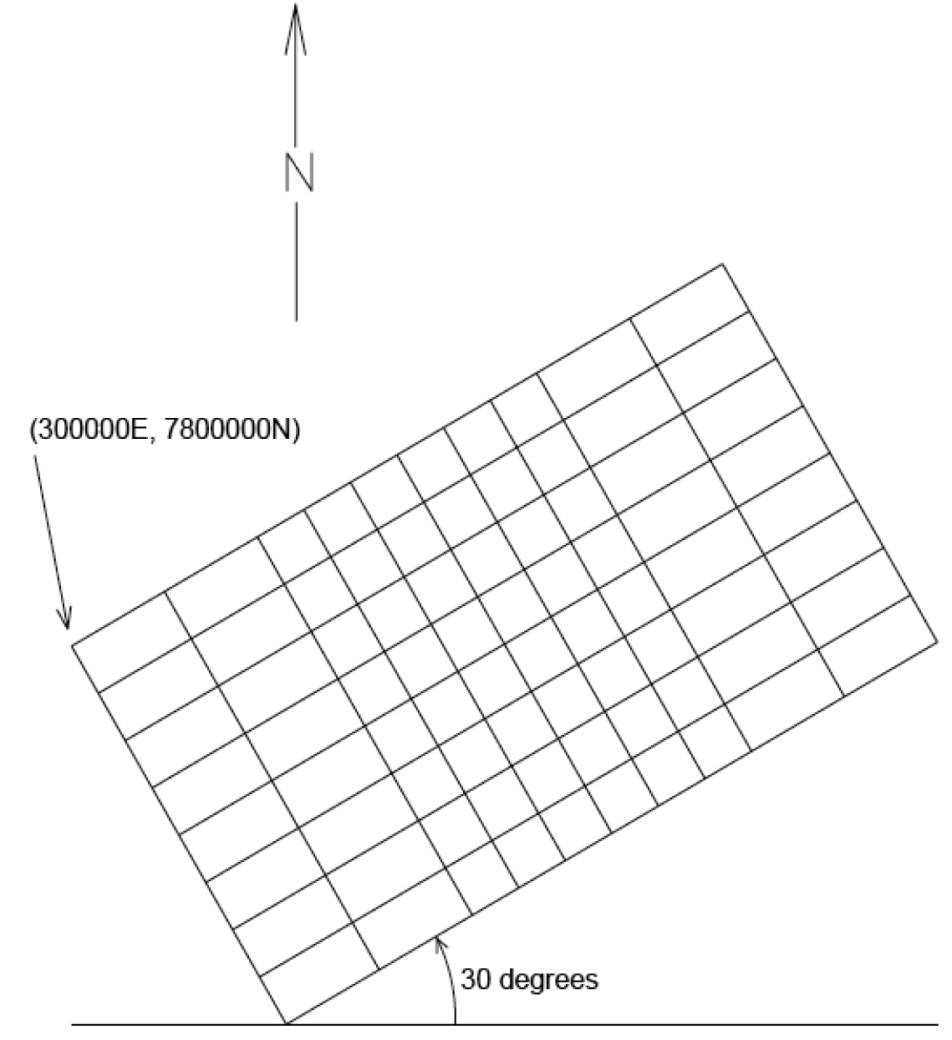
Model Spec. File Example
8 10
300000.0 7800000.0 30.0
2*100 6*50 2*100
50 50 50 50 50 50 50 50

Slide 10
Bore (Well) Coordinates File
A file containing coordinates of targets
Well_ID X-COORD Y-COORD MODEL_Layer
…
Each line has information about one target
Well_ID: Unique well identifier—up to 10 characters
X-COORD and Y-COORD: Easting and northing of the well in model units (e.g. feet or meters, not rows and columns)
MODEL_Layer: Model layer in which sample occurs
Wells can be listed in any order, but duplicate listings are not allowed.

Slide 11
Bore (Well) Listing File
A file containing a list of targets appearing in the sample file
Well_ID
…
Each line has the name of one of the wells
Well_ID: Unique well identifier—up to 10 characters

Slide 12
Well (Bore) Sample File
A file containing times and values of targets
Well_ID DATE TIME TARGET_Value
…
Each line has information about one target
Well_ID: Unique well identifier—up to 10 characters
DATE: format as mm/dd/yyyy or dd/mm/yyyy
(defined in settings.fig)
TIME: sample time in format: hh:mm:ss
For each well, sample times must be in increasing order
All samples for each well must be listed contiguously
A dummy time (like 00:00:00) can be used if actual times are not available.

Slide 13
MODFLOW Utilities
MODFLOW-2000 included parameter-estimation capabilities with observations wrapped inside.
MODFLOW-2005 abandoned the parameter-estimation capabilities but retains the observation process.
Files must be custom-made like with MOD2OBS
Documentation of both found at:
MODFLOW-2000
http://pubs.er.usgs.gov/usgspubs/ofr/ofr00184
MODFLOW-2005
http://water.usgs.gov/nrp/gwsoftware/modflow2005/OBS.pdf
HYDMOD
http://water.usgs.gov/nrp/gwsoftware/modflow2005/Hydmod7.pdf

