Slide 1
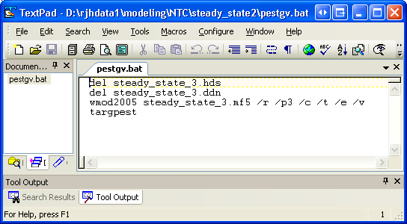
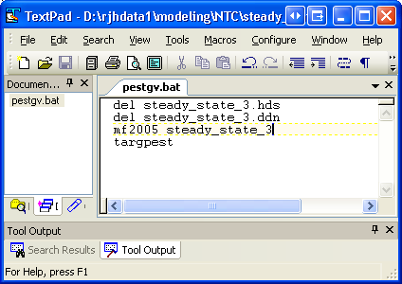

Create and modify the PEST input files
In GWV: MODEL->Pest->Create Datasets
will create:
PEST Control File (.pst)
Template Files (.tpl)
Run Batch File (pestgv.bat)
Instruction Files for Targpest Output (.ins)
Targpest Run File (targpest.dat)
modify for stock MF2K5

Slide 2

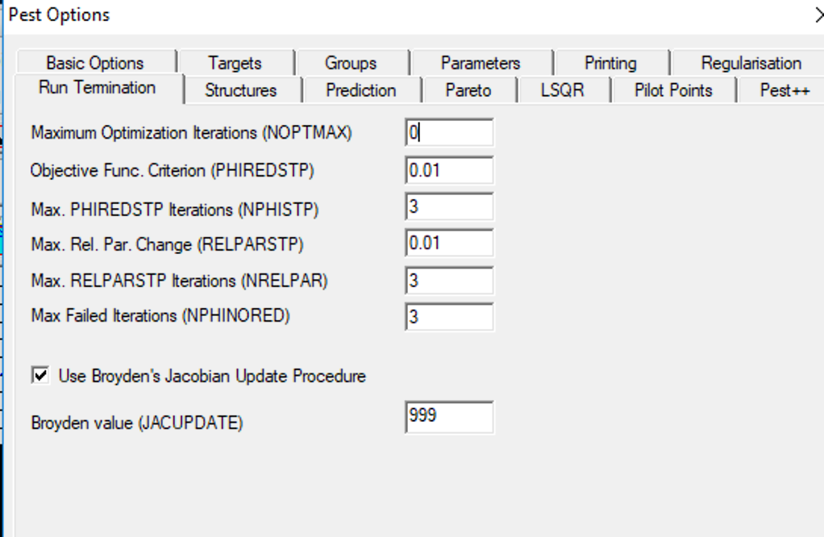


PEST Control File: CONTROL DATA SECTION
pcf
* control data
restart estimation
1 283 1 0 1
1 1 single point 1 0 0
1.000000e+001 2.000000e+000 3.000000e-001 1.000000e-002 7 999
1.000000e+001 1.000000e+001 1.000000e-003
1.000000e-001 noaui
0 1.000000e-002 3 3 1.000000e-002 3
0 0 0
Set NOPTMAX to 0
In GWV:
Models->PEST->Options

Slide 3
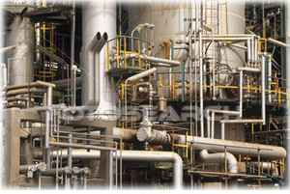

PEST Control File: NOPTMAX Typical Order
NOPTMAX = 0: Runs the forward model once, obtaining all output. “tests the plumbing”
NOPTMAX = -1: Sensitivity analysis run.
Calculates the Jacobian matrix and associated
statistics in ancillary files. Also performs a “final” run with base parameters so all input files correspond to pst file.
NOPTMAX = -2: Sensitivity run. Only calculates the Jacobian matrix without final associated statistics.
NOPTMAX > 1: Runs the estimation problem with NOPTMAX indicating a maximum number of optimization iterations
either or

Slide 4
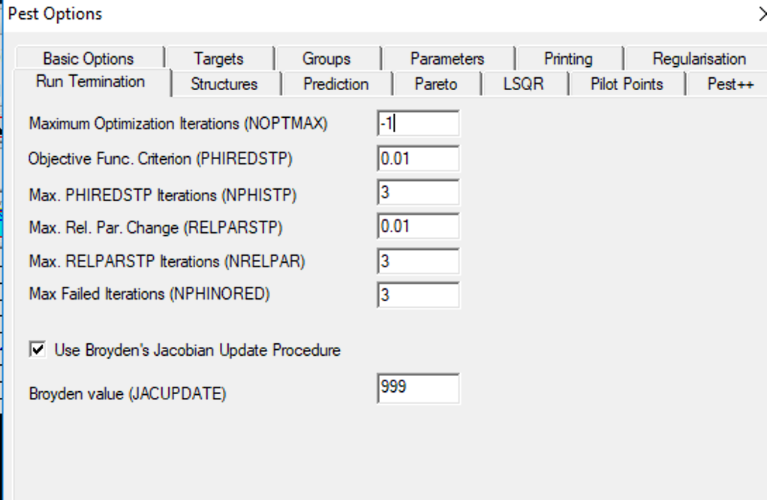
PEST Control File: CONTROL DATA SECTION
pcf
* control data
restart estimation
1 283 1 0 1
1 1 single point 1 0 0
1.000000e+001 2.000000e+000 3.000000e-001 1.000000e-002 7 999
1.000000e+001 1.000000e+001 1.000000e-003
1.000000e-001 noaui
-1 1.000000e-002 3 3 1.000000e-002 3
0 0 0
In GWV:
Models->PEST->Options
Set NOPTMAX to -1:

Slide 5
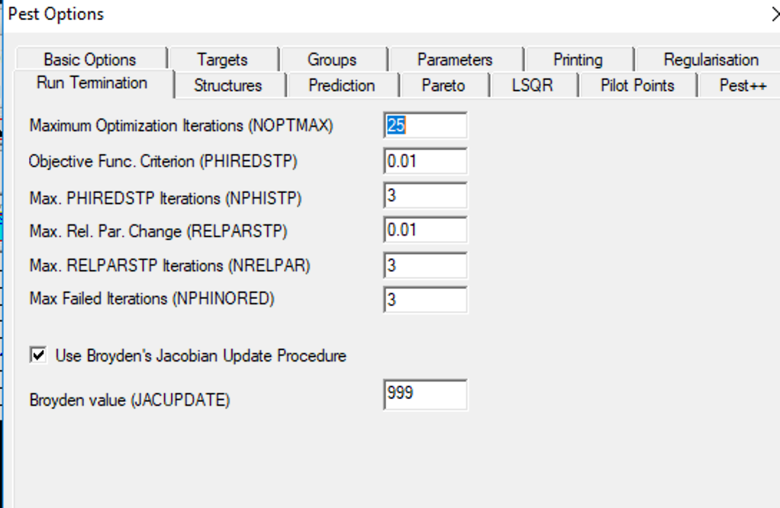
PEST Control File: CONTROL DATA SECTION
pcf
* control data
restart estimation
1 283 1 0 1
1 1 single point 1 0 0
1.000000e+001 2.000000e+000 3.000000e-001 1.000000e-002 7 999
1.000000e+001 1.000000e+001 1.000000e-003
1.000000e-001 noaui
25 1.000000e-002 3 3 1.000000e-002 3
0 0 0
Set NOPTMAX to 25:

