Slide 1
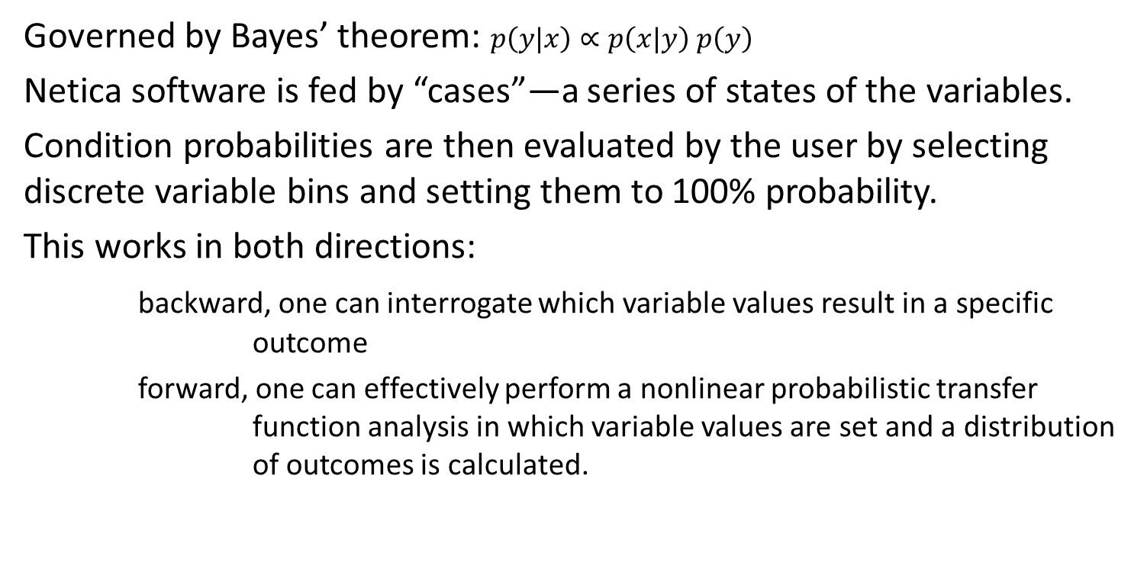
Bayesian Decision Network: Netica
Governed by Bayes’ theorem: $p\left(y|x\right)∝p\left(x|y\right)$ $p\left(y\right)$
Netica software is fed by “cases”—a series of states of the variables.
Condition probabilities are then evaluated by the user by selecting discrete variable bins and setting them to 100% probability.
This works in both directions:
backward, one can interrogate which variable values result in a specific outcome
forward, one can effectively perform a nonlinear probabilistic transfer function analysis in which variable values are set and a distribution of outcomes is calculated.

Slide 2
Transfer Function Approach: High Entrainment
More variability (from left to right, introduction of variable Q and competition with storage) results in more smeared output probabilities.
Steady with Fixed Q in Wells
Steady with Variable Q in Wells
Transient with Variable Q in Wells

Slide 3
Transfer Function Approach: Low Entrainment
Even more smearing of the output at the right.
Steady with Fixed Q in Wells
Steady with Variable Q in Wells
Transient with Variable Q in Wells

Slide 4
Interrogative Approach: Low Entrainment
Let’s reverse the process and see what inputs result in the lowest entrainment. No big surprises, but note that in the transient case there are way fewer 0 entrainment values and smearing is more evident. Also, more output bins so granular.
Steady with Fixed Q in Wells
Steady with Variable Q in Wells
Transient with Variable Q in Wells

Slide 5
Next Steps
We really need to consider the distributions for the input variables.
Examine the windowing for parameter definitions (T and Recharge, for example)
More sampling—slouching toward ergodicity.
I need a beer now.

