Slide 1

THE TRUTH GUARD: FOR RELIABLE NEWS CLASSIFICATION.
Team 1:
Kanchan Sharma
Geethasree Madiraju Nagaraju
Pothineni Lahari Priya
Zhexin Zhang
Roshita Seelam

Slide 2


PROBLEM STATEMENT
PROJECT SUMMARY
Data Preparation
Nowadays, news spread through many channels resulting in a surge in the spread of misleading news content. Fake news can mislead public opinion and harm policymaking, public security, and citizens’ property.
Gatekeepers: inefficient, expensive, likely to be biased.
Our group aims to build a model that can classify news articles as "real" or "fake"
Data Exploration
Text Parsing
Text Filtering
Text Clustering
Text Topic
Final Model
Analysing Model Interpretability
Text Only
Title Only
Model Comparison
Recommendation

Slide 3

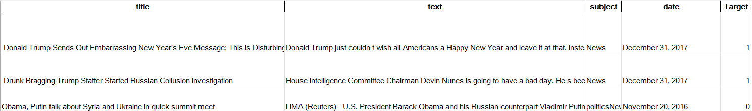

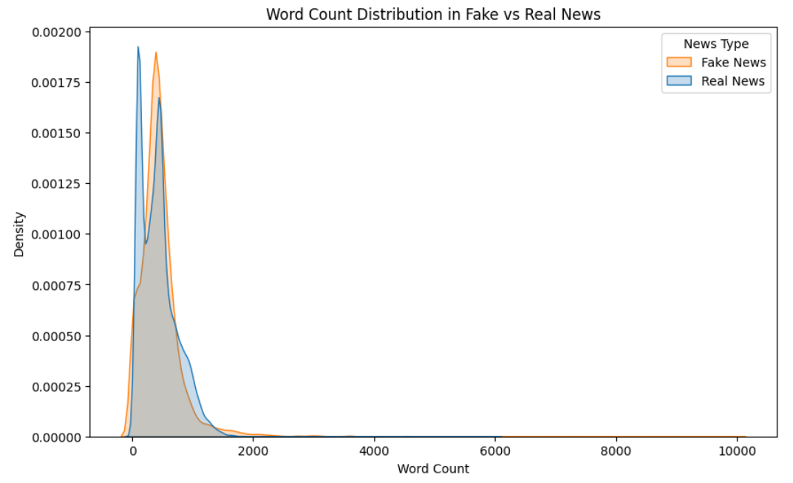
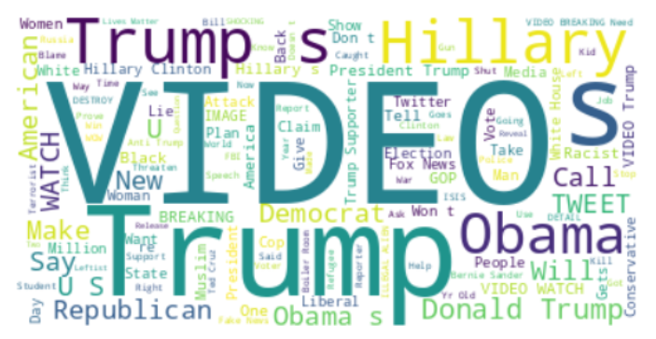
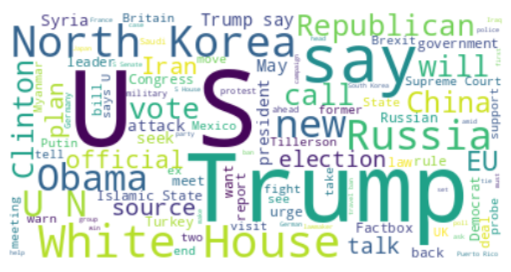
DATA PREPARATION & EXPLORATION
(Link: https://www.kaggle.com/datasets/clmentbisaillon/fake-and-real-news-dataset )
Data Preparation
Merged Data (Fake csv & Real csv)
No missing value
Created Target Variable ( Fake News detected when Target=1)
Fake News Titles
Real News Titles

Slide 4

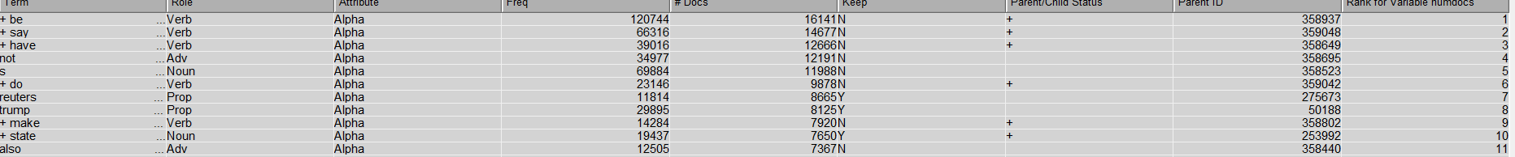
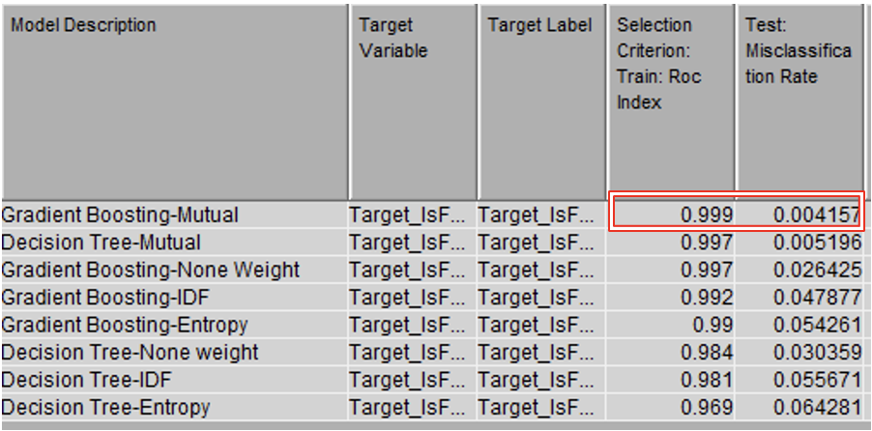
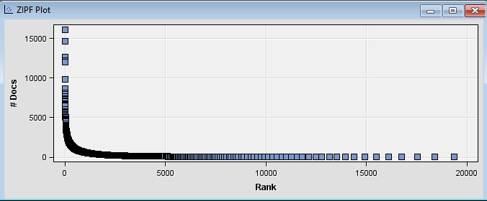
DATA PREPROCESSING
TEXT PARSING & FILTERING
hbkbh
Findings
Best parameters:
Binary as
Frequency wt.
Mutual
Information as Term wt.
The top-ranked term is “Be”: 16000 docs
The most infrequent term is ‘max’: 12 docs

Slide 5
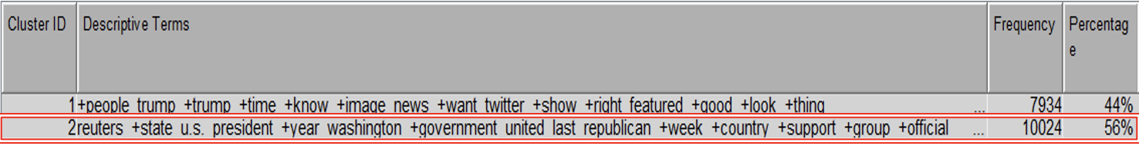
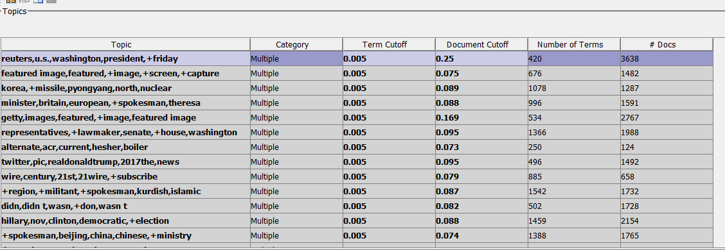
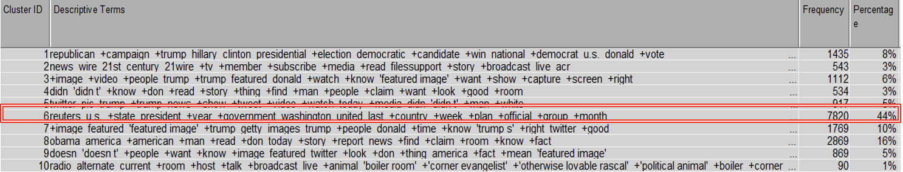
DATA PREPROCESSING
TEXT CLUSTERING
TEXT TOPIC
Number of clusters = 2, SVD= 30, Resolution= High:
Number of clusters = 10, SVD = 30, Resolution = High:
Findings
The highlighted clusters have similar terms.
Those two combination has same performance.

Slide 6

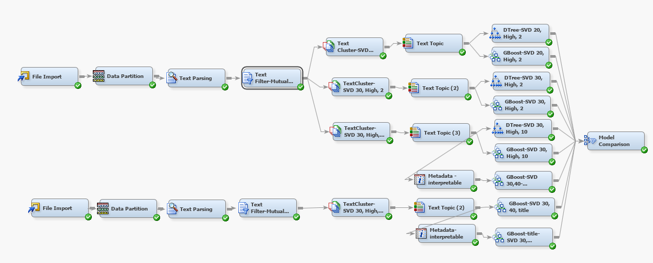
FINAL MODEL

Slide 7

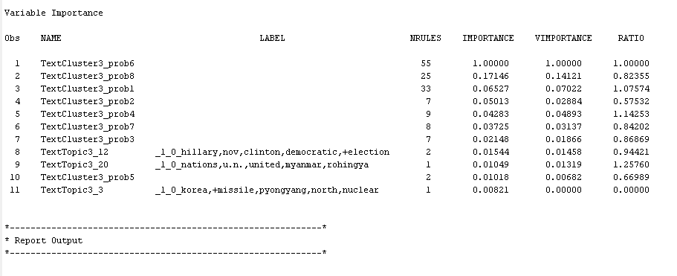
ANALYSING INTERPRETABILITY
Using ‘Text’ alone

Slide 8
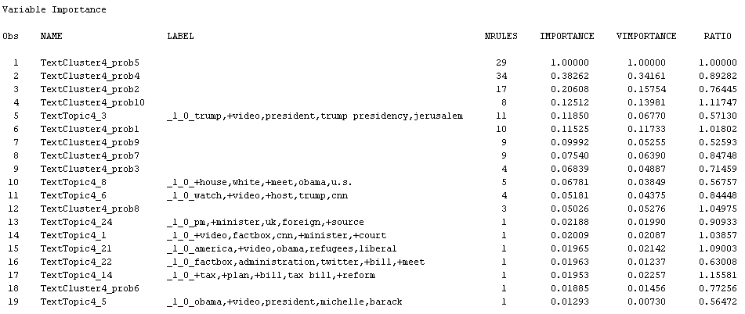
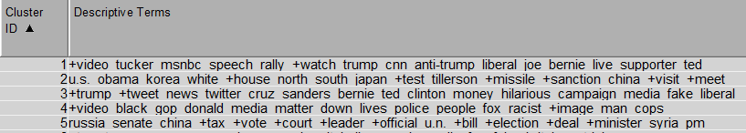
ANALYSING INTERPRETABILITY
Using ‘Title’ alone

Slide 9

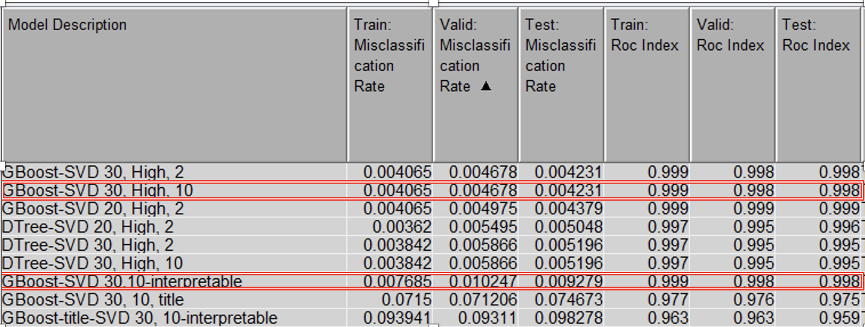
MODEL COMPARISON
BEST MODEL: Gradient Boost, 10 clusters, 30 SVD - Actual vs Interpretable.
Interpretable model - Better for Business Insights, continuous monitoring.

Slide 10


RECOMMENDATIONS
RECOMMENDATIONS
BENEFITS
Dynamic Feature Engineering
Human in the Loop validation
User feedback Mechanism
Enhanced User trust
Brand Protection
Compliance with Regulation
Strategic Advantage

