Slide 1
Word2Vec

Slide 2
Distributional Hypothesis
terms with similar distributions have similar meanings
I got in my car to drive to the store
I got in my automobile to drive to the store

Slide 3
A man has known chronic hepatitis
One-Hot encoding
1 | 0 | 0 | 0 | 0 | 0
0 | 1 | 0 | 0 | 0 | 0
0 | 0 | 1 | 0 | 0 | 0
0 | 0 | 0 | 1 | 0 | 0
0 | 0 | 0 | 0 | 1 | 0
0 | 0 | 0 | 0 | 0 | 1

Slide 4
A man has known chronic hepatitis
Meaning-based encoding
.23 | 1.345 | 504 | 890 | -12 | 42
123 | 9901 | 0.1 | 3.14159 | .3 | -0.02
40 | 323 | .00002 | 22 | 55 | 11

Slide 5
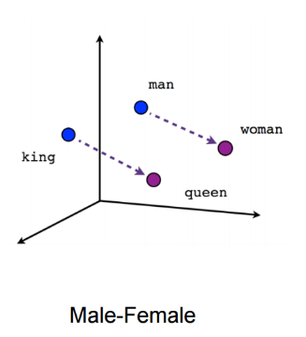
Quality metrics

Slide 6
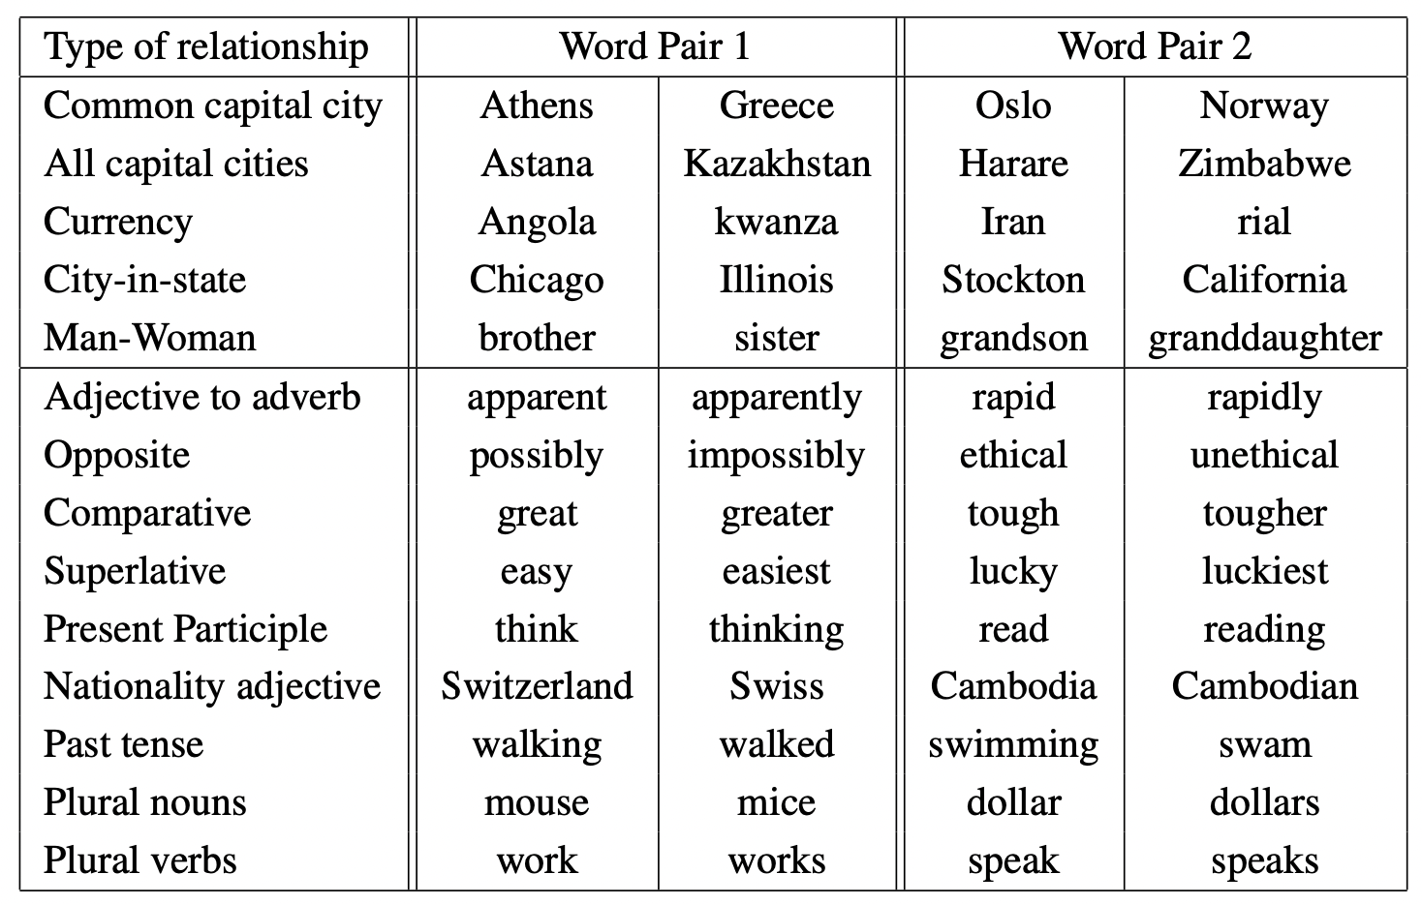

Slide 7
Corpus
Google news: 6B tokens
1M most frequent tokens
Varying embedding dimension

Slide 8
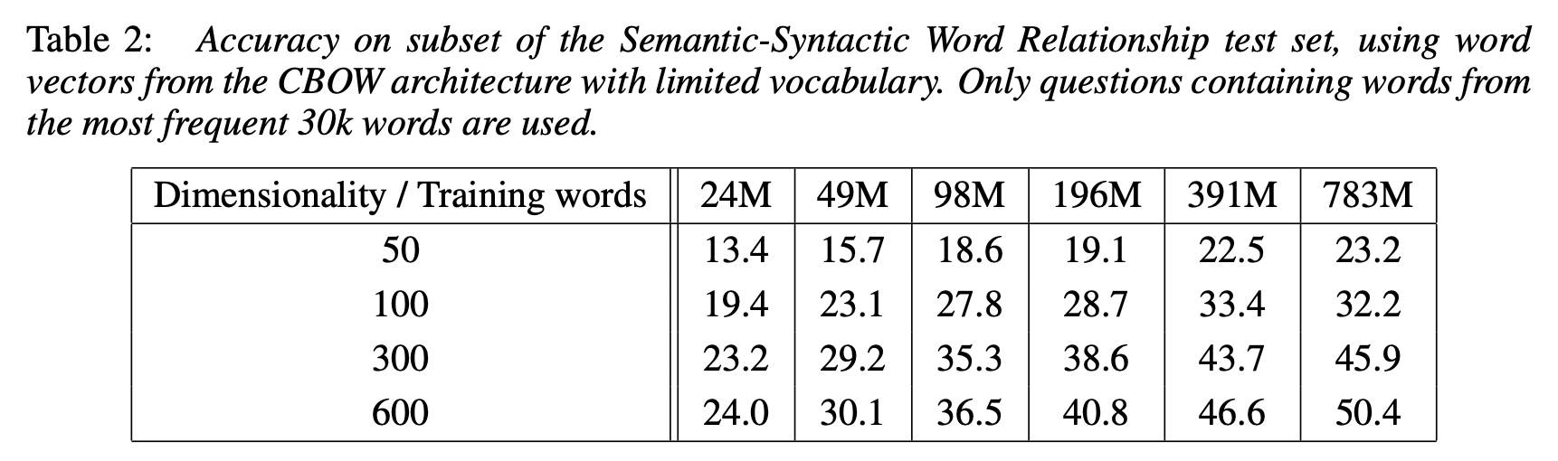

Slide 9
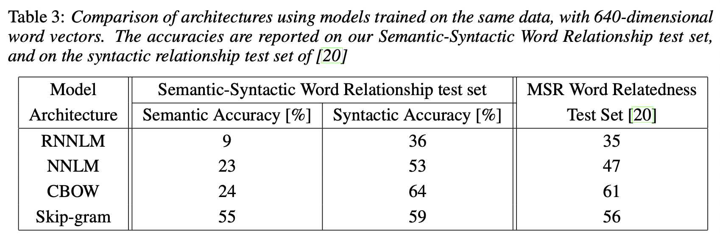

Slide 10
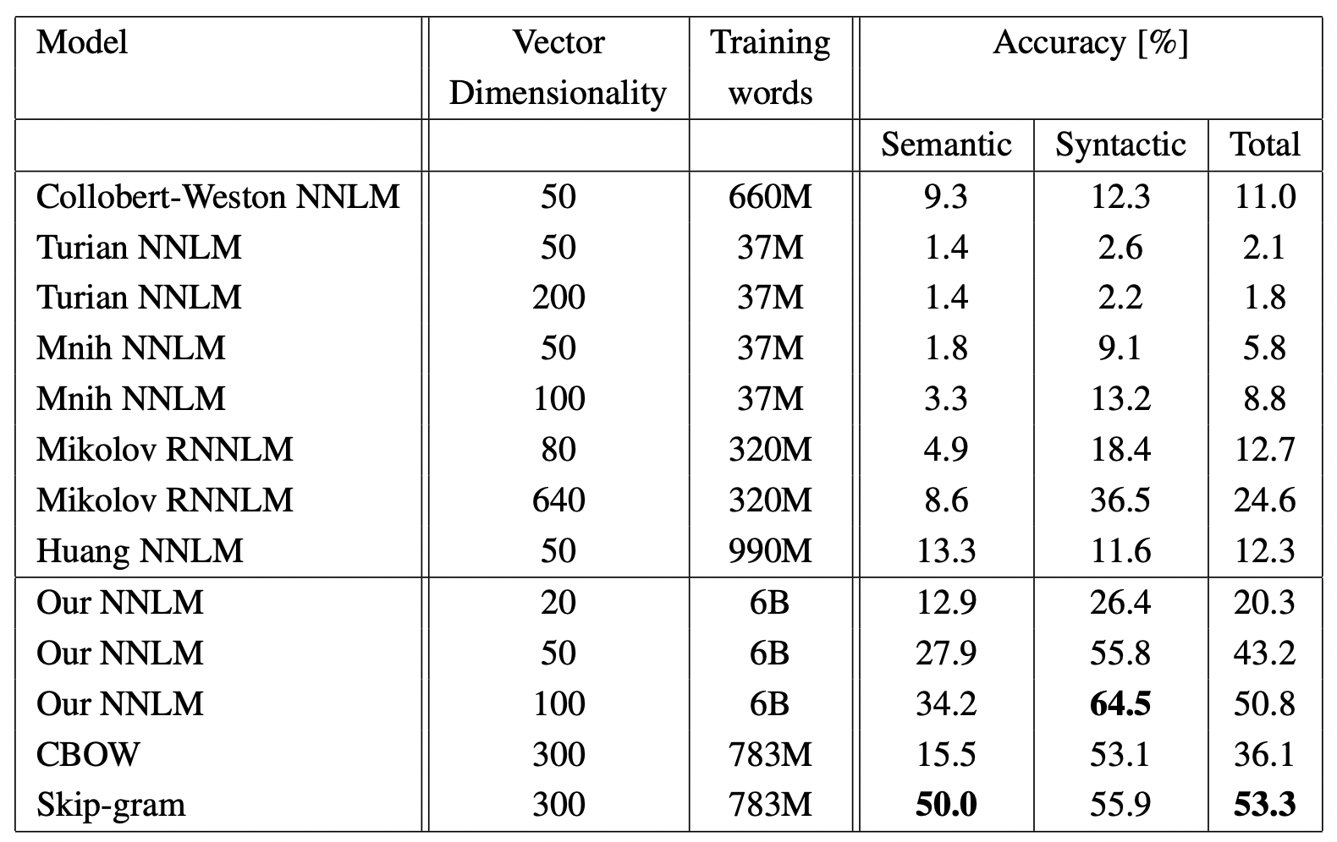

Slide 11
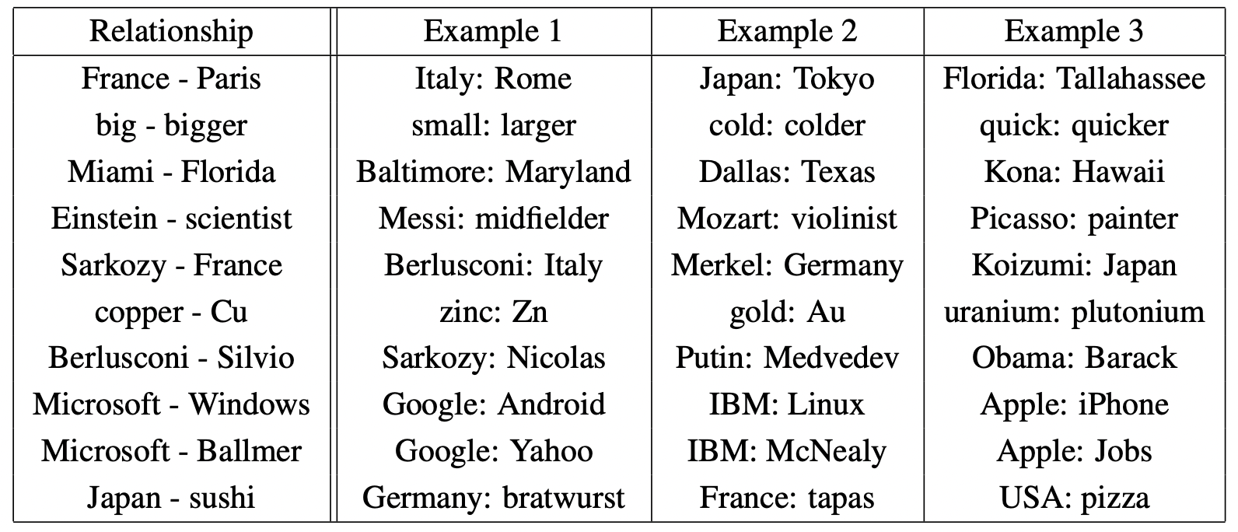

Slide 12
Conclusion
Intuitively simple algorithm
Lots of pretrained models

