Slide 1




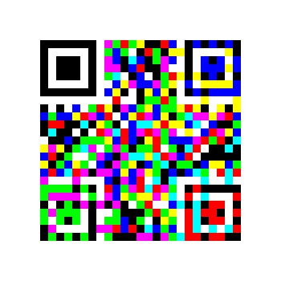
Split into 3 colour channels
Rotate -90 degrees
Rotate +90 degrees
Merge 3 channels

Slide 2
Split into 3 colour channels
Rotate -90 degrees
Rotate +90 degrees
Merge 3 channels

Slide 3
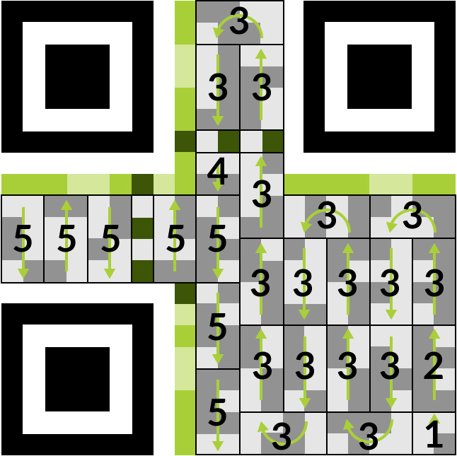
Finder
Patterns
Format and
Timing
Patterns
Data
bytes
Quiet
Zone

Slide 4
