Slide 1
contexta
PARTNER DECISION DECK
Music Session
Continuity
From promising concept to a focused 90-day proof
Decision required
Approve the product route, MVP boundary and validation gates
September 2026
Notes:
This deck updates the original Contexta concept for a partner decision. It narrows the first use case to Music Session Continuity and proposes a staged route with explicit validation gates.

Slide 2
BRIEF RECAP
The first wedge is brutally specific
Contexta preserves the decisions, experiments and intent that disappear between music sessions.
01
02
03
Before
During
Next session
A project reopens with files, but no usable memory of why choices were made.
Contexta captures selected evidence and structures moments without interrupting flow.
A cited briefing returns the creator to the exact creative edge in under two minutes.
THE TEST
Can a musician reopen one representative project and recover the last session’s state, reasoning and next moves in under two minutes?
Contexta | Music Session Continuity
02
Notes:
The product is still a continuity layer, not another chatbot. The wedge is one repeatable job: reopen a music project and recover what matters quickly. The under-two-minute target is the central MVP success criterion.

Slide 3
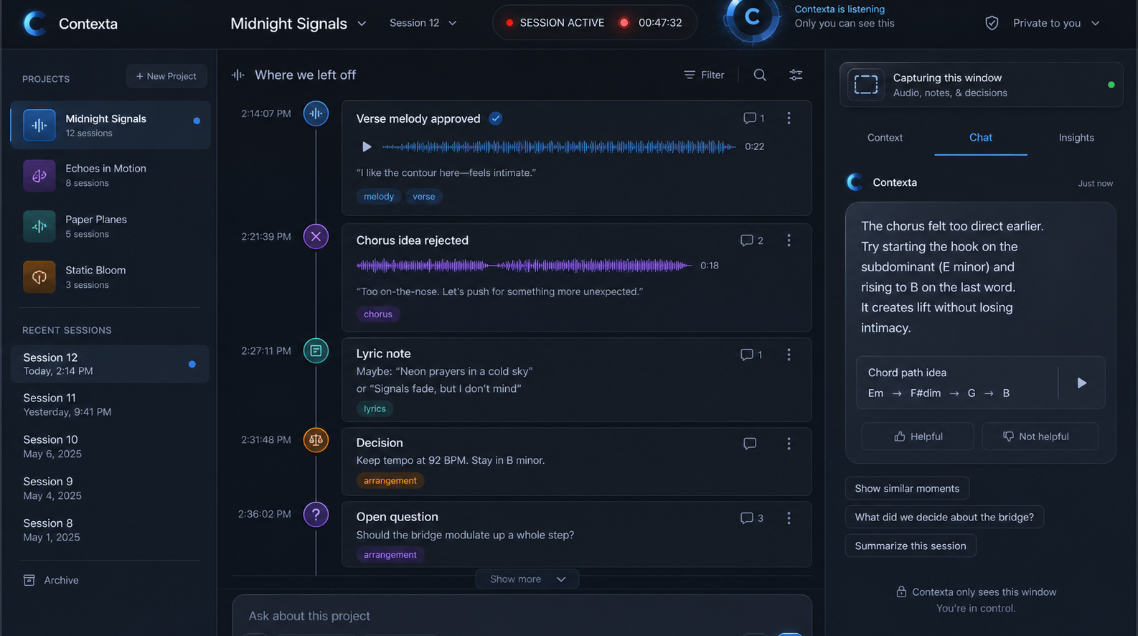
PRODUCT EXPERIENCE
A workspace first, chat in support
The interface should feel like a session desk, not a character and not a blank prompt box.
1
Timeline is primary
Evidence, decisions and changes remain inspectable.
2
Briefing is actionable
Resume state, unresolved questions and next moves.
3
Chat is contextual
A compact rail to query or correct the active memory.
4
Presence is quiet
An abstract signal shows status without becoming a mascot.
Contexta | Music Session Continuity
03
Notes:
First impression: Contexta should not imitate ChatGPT or present a character. The core object is the project session and its evidence timeline. Chat is valuable as a secondary control surface for asking, correcting and retrieving.

Slide 4
HOW IT WORKS
The continuity loop is the product
Every stage must preserve provenance and give the creator control over what leaves the device.
1
Capture
2
Process locally
3
Privacy gate
Selected audio, transport, markers and notes
Transcribe, index, classify and redact
Apply policy and ask before cloud use
4
Reason
5
Write memory
6
Resume
Use local or paid AI based on task need
Store decisions with source and confidence
Brief the next session and cite the evidence
Design rule
No summary without sources. No cloud task without a visible policy decision.
Contexta | Music Session Continuity
04
Notes:
This workflow is the system boundary. Capture is selective, local preprocessing happens first, the privacy gate decides whether any external model is needed, and every stored memory retains its evidence. Local capability references: https://developer.apple.com/documentation/CoreML and https://developer.apple.com/documentation/FoundationModels

Slide 5
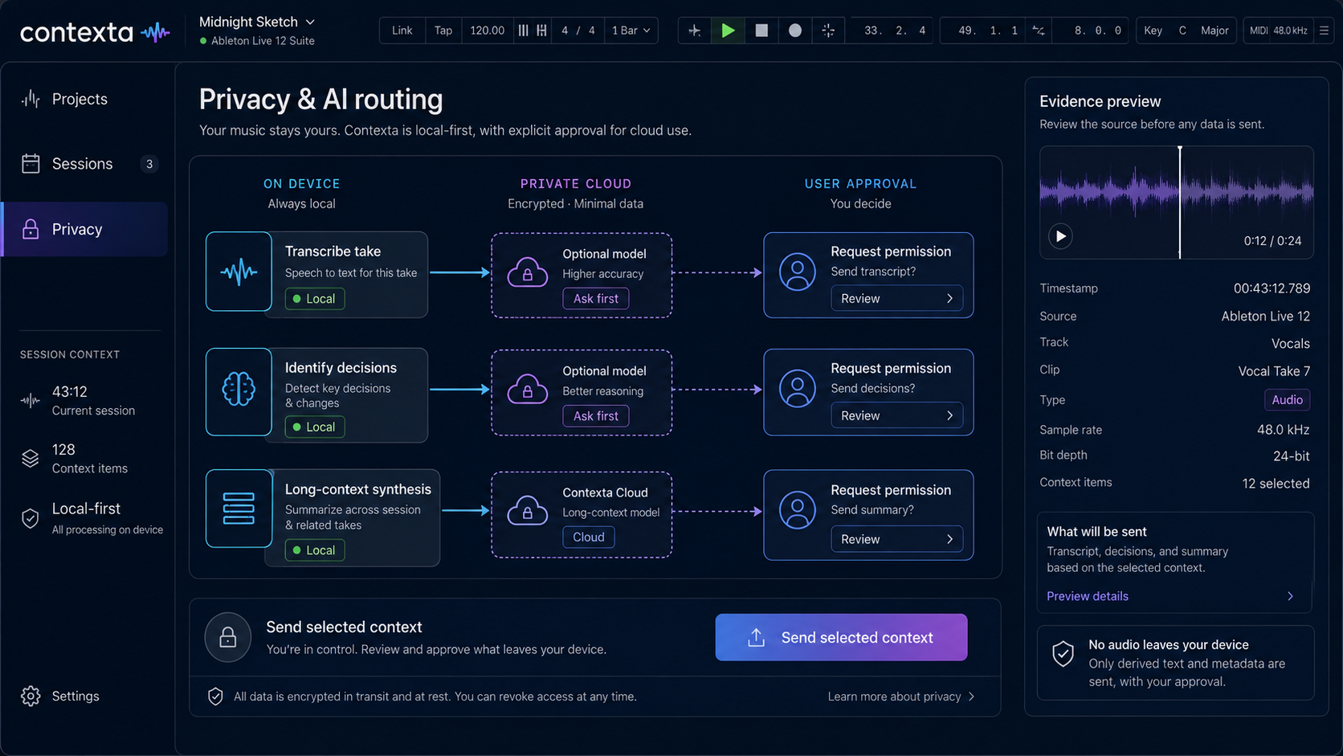
PRIVACY AND AI ROUTING
Local by default, cloud by exception
Complexity, sensitivity, urgency and user preference determine the route.
On device
Capture controls
Transcription and indexing
Redaction and search
Short summaries
Cloud, when approved
Long-context synthesis
Hard reasoning
Optional multimodal analysis
Provider selected by policy
RAW AUDIO STAYS LOCAL
Contexta | Music Session Continuity
05
Notes:
The MVP should not depend on one AI provider. It should route tasks, not consumer subscriptions. User subscriptions do not automatically grant API access, so provider connections should be explicit BYOK integrations later. Core ML and Apple Foundation Models support on-device execution for suitable tasks: https://developer.apple.com/documentation/CoreML and https://developer.apple.com/documentation/FoundationModels

Slide 6
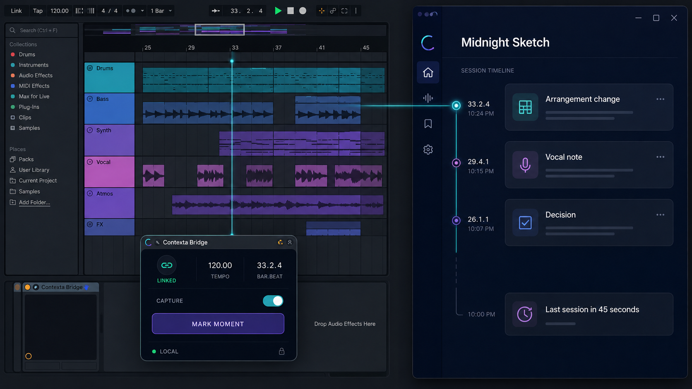
ABLETON AND ENDLESSS
Desktop memory, Link timing, thin plugin bridge
Do not make the plugin carry the whole product. Keep memory and privacy in the companion app.
Desktop core
Owns encrypted memory, search, routing and session briefings
Ableton Link
Shares tempo, beat, phase and optional start or stop state
VST3 or AU bridge
Adds host transport anchors and a manual mark-moment control
Recommended order
Core + Link first. Plugin after the workflow proves useful.
Contexta | Music Session Continuity
06
Notes:
Ableton Link synchronizes tempo, beat, phase and start or stop state across peers, but it does not transmit project memory: https://ableton.github.io/link/. Ableton Live supports VST3 and Audio Unit plug-ins: https://www.ableton.com/en/manual/working-with-instruments-and-effects/. Endlesss Studio supports Link in standalone mode and follows host transport in plug-in mode: https://static.endlesss.fm/assets/docs/Endlesss%20Studio%20User%20Guide%201.3.0.pdf

Slide 7
DECISION ROUTES
Three possible routes, one recommended
Choose the smallest route that proves continuity before expanding integration surface area.
Route | What ships | Time | Cost shape | Risk | Best use
A Desktop only | Session capture, memory, briefing | 6 to 8 wks | Lowest | Medium | Fastest workflow test
B Core + Link | Desktop route plus beat and tempo sync | 10 to 12 wks | Controlled | Lowest | Recommended MVP
C Full platform | Desktop, plugin, mobile, multi-provider | 6 to 12 mos | Highest | Highest | Only after product proof
RECOMMENDATION
Fund Route B with two hard gates: continuity value at week 6 and reliable Link sync at week 10.
Contexta | Music Session Continuity
07
Notes:
Route B creates a meaningful musical advantage without taking on the cost and compatibility burden of a full plug-in ecosystem. The durations are planning ranges for a focused founder-led proof and should be converted into a budget only after team capacity is agreed.

Slide 8
MILESTONES
A 90-day proof with decision gates
Ship one end-to-end loop, test it in a representative project, then earn the right to broaden scope.
Weeks 1–2
Weeks 3–6
Weeks 7–10
Weeks 11–13
Instrument
Prove continuity
Add musical sync
Validate
Define memory schema
Wire capture controls
Set lock and sleep behavior
Local transcript and events
Evidence timeline
Resume briefing
Ableton Link peer
Beat-aware anchors
Endlesss compatibility test
Five repeat users
Measure resume time
Decide plugin investment
< 2 min
median time to useful resume
> 70%
briefings accepted with minor edits
5 users
repeat across three sessions each
0 leaks
cloud sends without approval
Gate at day 90: continue only if repeat use and resume-time targets are met.
Contexta | Music Session Continuity
08
Notes:
The milestone plan prioritizes observable user value. A representative session means one real Ableton or Endlesss project that is used repeatedly across at least three sessions, with enough changes and decisions to test whether Contexta can reconstruct the state accurately.

Slide 9
PARTNER COMMITMENT
The decision to make today
Approve the proof, define the boundary and name the owners.
01
Product route
Desktop core + Ableton Link. Defer the plugin until the continuity loop is validated.
02
MVP boundary
One Mac, one representative project, selected-window capture, local-first processing.
03
Operating model
Name product and engineering owners, agree a budget ceiling, review demos weekly.
04
Go or stop gate
Day 90 decision based on repeat use, resume time, briefing acceptance and privacy.
Recommended motion: approve Route B and begin the 90-day proof with weekly partner reviews.
Contexta | Music Session Continuity
09
Notes:
The meeting should end with named owners, an agreed budget ceiling and access to one representative project. Do not broaden into mobile, enterprise, a multi-provider marketplace or a full plug-in ecosystem during the proof.

