Slide 1
Earth Day Presentation
Organization Name

Slide 2
Introduction
Earth Day is a day that we take the time to treat the Earth with all the respect that it should be getting.
We will be going over:
About Earth Day.
The History of Earth Day.
Giving ourselves an Earth Day Activity.
How we can get the Word Out about Earth Day.
Now let’s get started.

Slide 3
What is Earth Day?
Earth Day was founded by Senator Gaylord Nelson and first held on April 22, 1970.
World Environment Day, celebrated on June 5 in a different nation every year.
According to Senator Nelson, the moniker "Earth Day" was "an obvious and logical name" suggested by "a number of people.“
Project Survival, an early environmentalism-awareness education event, was held at Northwestern University on January 23, 1970.
The 1960s had been a very dynamic period for ecology in the US.

Slide 4
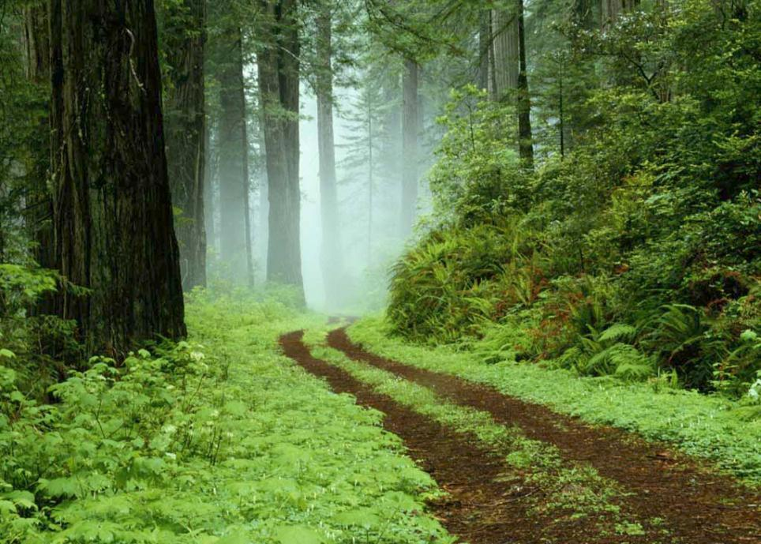
Earth Day Activity
How many of us have sat down and watched the Disney movies that took place within the rainforest or any type of forest for that?
How about all the animals that are seen within the movie the Jungle Book, all of those animals come from a rainforest.
Rainforests are the home of species that we all know and some that have yet to be discovered but more and more we are losing sight and not seeing the bigger picture.
Our focus needs to stop the degradation of one and all of the Rainforests.
Earth Day believes that environmental education is important in saving the rainforest.
If we can get together and read and learn about rainforests then we can teach the future generation to help preserve these wonderful places in our world.

Slide 5
Getting the Word Out about Earth Day
Social Networking:
Facebook
Twitter
Taking the time on this special day to Blog about it in our Blogs.
Listen to the song by Jack Johnson called “The 3 R’s” and follow his steps:
Reduce
Reuse
Recycle

