Slide 1

Training Day
Craig Stronin
Thursday, April 21, 2011

Slide 2
Training Orientation
Learn your assignments
Familiarizing yourself with your area
Meeting new colleagues

Slide 3
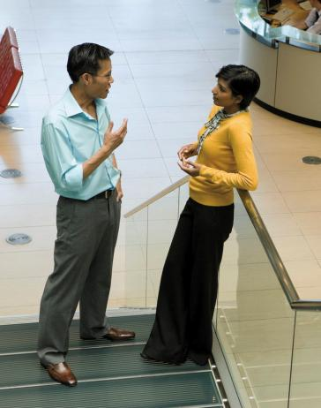
Things To Learn
Technology
Adapting to changes
Learning Curves
Procedure
Policies
Benefits
Health Plans

Slide 4
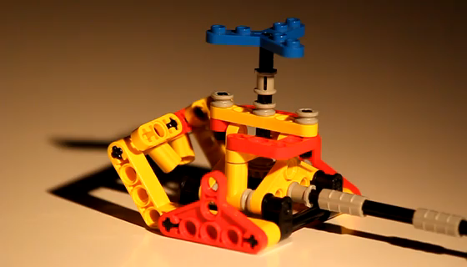
Technology

Slide 5

Technology
Is Always Changing

Slide 6
Who’s Who
Lead | Contact information
Craig Stronin | CraigStronin@FusionTomo.com
Rachel Lee | RLee@FusionTomo.com
Hideki Tomo | Hideki.Tomo@FusionTomo.com
John Doe | JDoe@FusionTomo.com

Slide 7
Working Toward Mastery
Achieve Mastery
Get Experienced
Projects Worked On
Get Familiar
Time Spent

Slide 8

Doing Your Best Work
Working from home
Working offsite
Technology requirements

Slide 9
Questions?
Any challenges?
Technological as well as personal
Any realistic expectation?
Mastery is not achieved overnight
Keep your eye on the goal
Mentorship programs

