Slide 1
My Day
By Craig Stronin

Slide 2
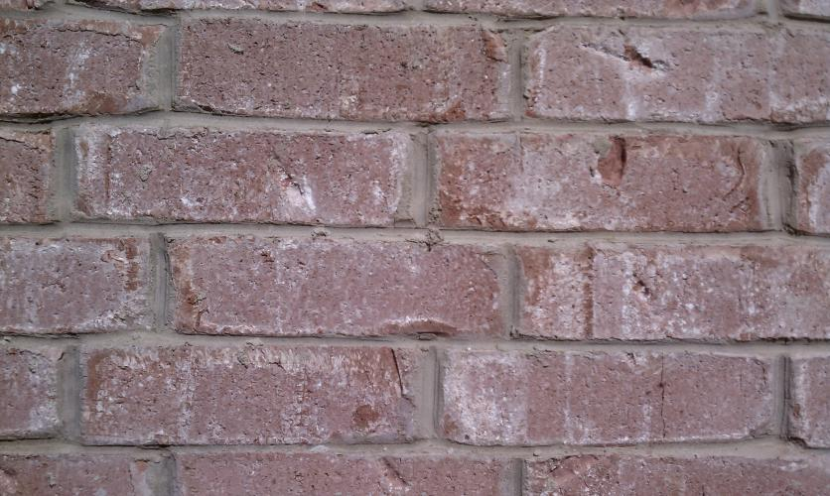
Bricks

Slide 3
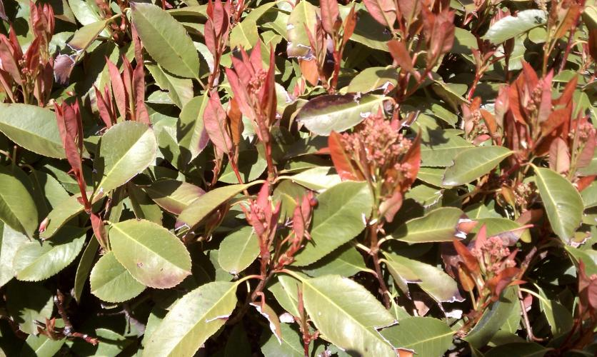
Red and Green

Slide 4
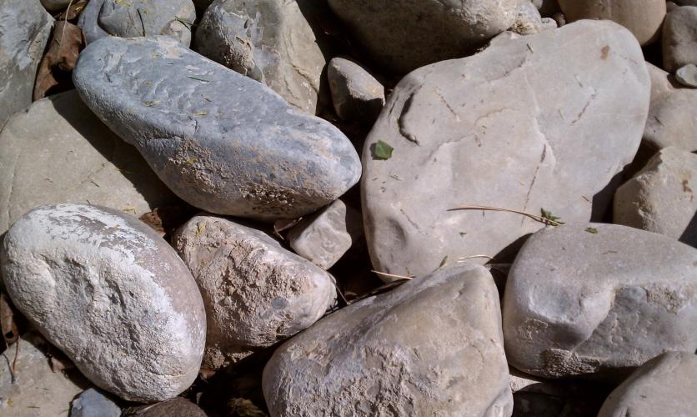
Riverbed

