Slide 1
Natural Language Processing Project
Lighthouse Labs Mini Project V
Melissa Nielsen
January 2023

Slide 2
Objective
Predict whether quora questions are duplicates

Slide 3
Data
~ 400,000 rows of uncleaned quora questions

Slide 4
01.
Cleaning

Slide 5
Cleaning Steps
Lemmatized
Tokenized
used WordNetLemmatizer
use on all pos’s
used .split
01
02
03
04
Removed Punctuation
Removed Stopwords
used .join and list comprehension
used nltk’s english stopwords

Slide 6
Cleaning Challenges
punctuation removal
removed hyphens, which resulted in weird word combinations
stemming
resulted in non-words
questions with no words
example: “????”

Slide 7
02.
Feature Engineering

Slide 8
Feature Engineering Steps
Calculate number of words in both questions
word2vec Cosine Similarity Feature
01
02
03
04
tf-idf Cosine Similarity Feature
Counted words in each question

Slide 9
word2vec
created vector of each unique word
summed all vectors to approximate meaning
took cosine similarity between words

Slide 10
03.
Modelling

Slide 11
Models tried:
Random Forest Classifier
XGBoost

Slide 12
03.
Results

Slide 13
Models tried:
Model | Test Accuracy
XGBoost | 71.2%
Random Forest Classifier | 71.4%
Random Forest Classifier performed slightly better

Slide 14
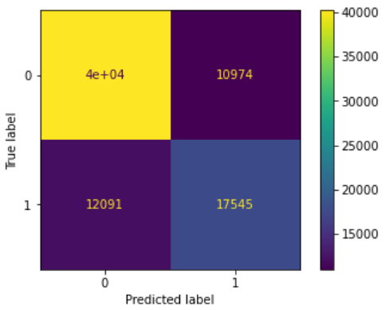
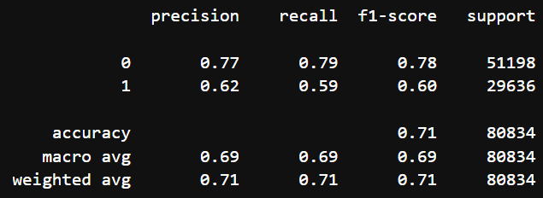
Results
Confusion Matrix
Classification Report

Slide 15
Classification Report Analysis
Better at catching those which WERE NOT duplicates than those which WERE duplicates

Slide 16
Challenges
stemming
Stemming often resulted in non-words
word2vec
Understanding word2vec and using cosine similarity was confusing
Questions with zero tokens caused issues
overfitting
Train accuracy was 95% while test accuracy only 71%

Slide 17
Next Steps
try LSTM
hyperparameter tuning
create pipeline

Slide 18
Questions?
Melissa Nielsen
m.nic.nielsen@gmail.com
Please keep this slide for attribution

