Slide 1

Project 1 – Ecommerce Database
By Melissa Nielsen

Slide 2
Getting to Know Data
Determined that all info I needed was in all_sessions
Only 81 rows had ‘totaltransactionrevenue’ not null, so focused on these as the sales
Returned distinct count for all columns and stored this data in excel – this was very helpful for understanding the data
Determined that other tables did not contain data which would help me look at sales by city, country, etc
Notes:
30s

Slide 3
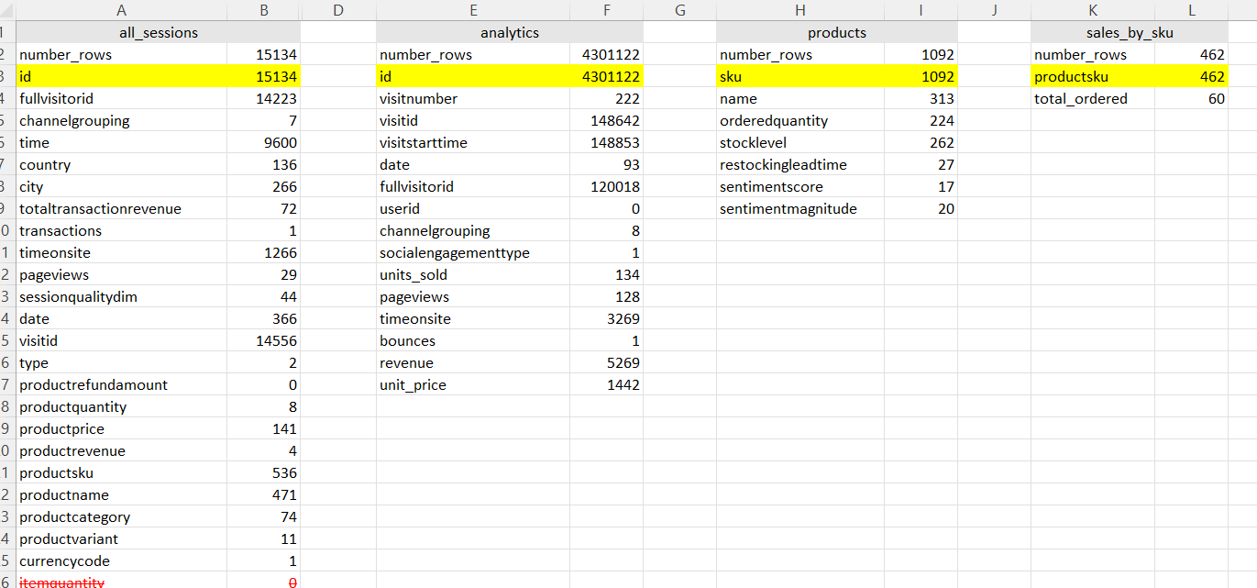
Count of Distinct Values in Each Table

Slide 4
Scope Determination
Investigate behaviour and demographics (e.g. location) of site visitors who had viewed and purchased products
Notes:
15 seconds
Using ‘starting_with_questions’ as a starting point, I determined that the scope of this analysis would be to investigate the behaviour and demographics (e.g. location) of site visitors who had viewed and purchased products

Slide 5
Key Assumptions
Only rows with a transaction revenue not equal to zero had purchased products
Notes:
15s

Slide 6

Data Cleaning
Found over 3 million rows of duplicate data in analytics! But decided that this dataset was not helpful to me
Updated currency code based on country
Divided all financial figures by 1,000,000
Fixed location info for visitors who had made sales (81 rows only)
Updated product categories
Some cities missing and indicated ‘not available in demo dataset’ these were not included in city analyses
Notes:
30s

Slide 7
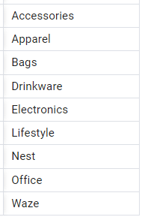
Data Cleanup – Product Categories
Updated product categories to list on right
Mostly used ‘LIKE’ operator with ‘%value%’
Focused on rows where totaltransactionrevnue not null
Notes:
30s

Slide 8

Sometimes the product category is ambiguous! Are Waze dress socks apparel or waze? Who buys waze dress socks anyway?!?
Data Cleanup
Notes:
15s

Slide 9
Key Data Cleanup Takeaway
Product quantities were unusable
Only 18 transactions included product quantities and they were not correlated to transaction revenue by their quantities and product prices

Slide 10
Results (starting_with_questions)
Q1 - Which cities and countries have the highest level of transaction revenues on the site?
United States had most transaction revenue by far - $13K out of $14K total revenue was from the United States
Atlanta had the most transaction revenue ($850)
Q2 –What is the average number of products ordered from visitors in each city and country?
Data was insufficient to answer this question (most product quantities missing)
Q3 – Is there any pattern in the types (product categories) of products ordered from visitors in each city and country?
United States was the only country with more than one transaction
The most commonly purchased categories in the United States were
Apparel (27 out of 77)
Nest (27 out of 77)

Slide 11
Results (starting_with_questions)
Q4 - What is the top-selling product from each city/country? Can we find any pattern worthy of noting in the products sold?
The top-selling product in the United States is 'Nest® Learning Thermostat 3rd Gen-USA - Stainless Steel' with seven transactions. All other countries have only one transaction
There were no instances of an item being purchased twice in any one city.
Question 5: Can we summarize the impact of revenue generated from each city/country?

Slide 12

Additional Investigations
How many visitors viewed or purchased more than one product?
Did these visitors come back on multiple days?
How much time did visitors spend on the site?

Slide 13
Results (additional questions)
I chose to answer the following questions:
Q1 - Find the number of visitors who viewed more than one product type.
Q2 - Find the number of visitors who purchased more than one product type.
Q3 - How much time did visitors spend on the site who DID purchase items vs those who did not?
Q4 - How many users spent less than 1 minute seconds on the site?
Q5 - For visitors who viewed more than 1 product, did they come back to the site on a different day?

Slide 14
Visitors who viewed and purchased more than one item
Interaction Type | One Item Only | More than One Item
Viewed | 13,429 | 805
Purchased | 79 | 1

Slide 15
For visitors who viewed more than 1 product, did they come back to the site on a different day?
Majority of visitors who viewed more than one product visited the site on one day only
805 viewed more than once
566 of these viewed site on one day only

Slide 16
Time on Site
Interaction Type | Average Time on Site
Viewed Only | 3.7 minutes
Purchased | 9.4 minutes
3,729 visitors spent less than one minute on the site.
Note: I assumed that time on site was measured in seconds – these average site visit times seem surprisingly long!

Slide 17
QA Process
Key numbers that I used in the QA process were:
Process typically involved wrapping my code in a subquery, summing my results column(s) and ensuring that the number of results added up to the appropriate count in the table above.
Description | Count
Count of all rows | 15,134
Count of unique fullvisitorid | 14,223
Count of unique visitid | 14,556
Count of sales | 81

Slide 18

Future Work
I focused on cleaning the data for the rows that had an associated revenue (ie. rows where there were sales)
Especially for the location data and the product categories, since these rows were more difficult to clean
Future investigations:
Understand product quantities – is this data available elsewhere?
What is the difference between visits that DID turn into a sale vs those that DID NOT?
Would require a more thorough cleaning of location and product category data for all rows
How did the visitors get to the site? (investigate channelgrouping column)
Were product ratings (in the products table) associated with better selling products?

