Slide 1
FINANCIAL BANKING TRANSACTIONS
LHL MINI PROJECT - CLUSTERING
Melissa Nielsen & Vivien Ho

Slide 2
OVERVIEW
This project used unsupervised learning on banking information about different financial transactions to create customer segmentations based on demographics and their banking behaviours.

Slide 3
OBJECTIVES
Cluster customers based on:
Demographics
Banking behaviour
This type of analysis could we used for insight into:
Credit trustworthiness
Targeted marketing and promotions

Slide 4
process flow
Feature Engineering
Categorical Encoding (one hot encoding, dummy encoding)
Create features
Feature scaling
Import Data
Data cleaning and exploration
Selected features
Data Visualization
radar charts
scatter plots
Dimensionality Reduction using PCA
K-means Clustering

Slide 5
Part 1A: Demographics

Slide 6
1A: Features used
Feature | Feature Engineering (including scaling) | Notes
Customer ID | N/A
Income | MinMax Scaled
Age (years) | MinMax Scaled
Years customer stayed with bank | MinMax Scaled
Number of children per customer | MinMax Scaled
Gender of customer | Dummy Encoding | Male or female
Customer’s marital status | Dummy Encoding, Split into new Columns | (classified as 1, 2, 3, or 4)

Slide 7
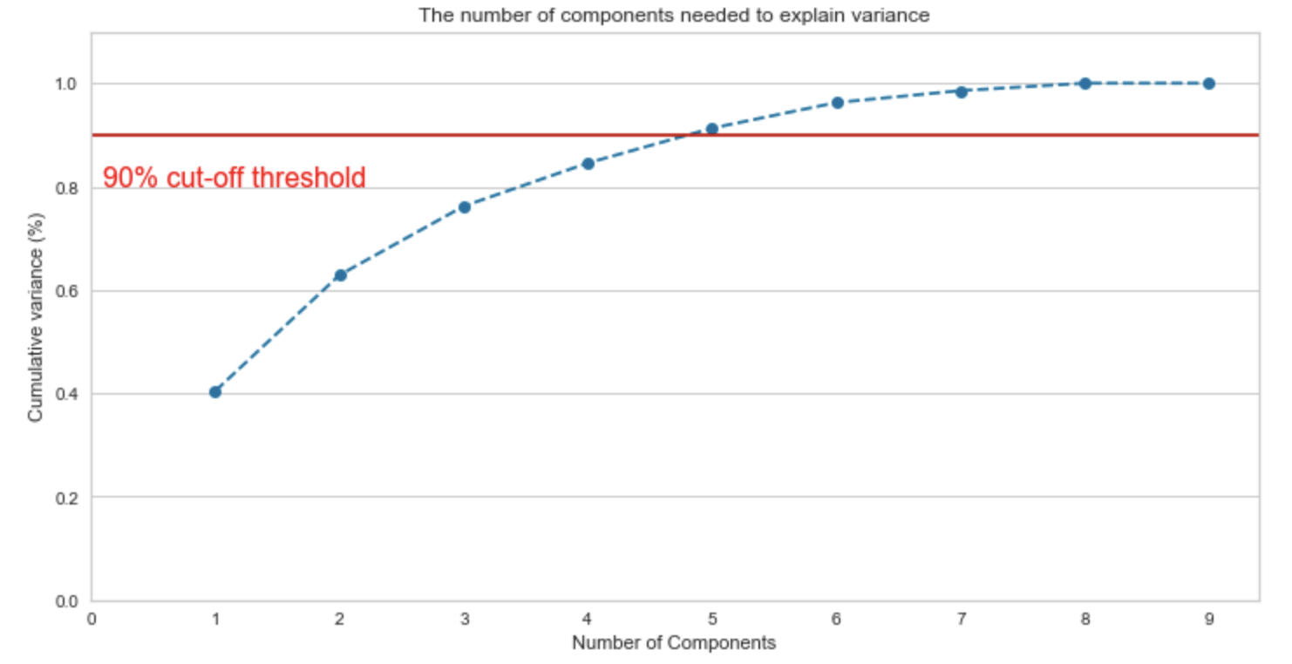
1A: choose number of Principal components
4 PCAs represent ~85% of the variation in the data.

Slide 8
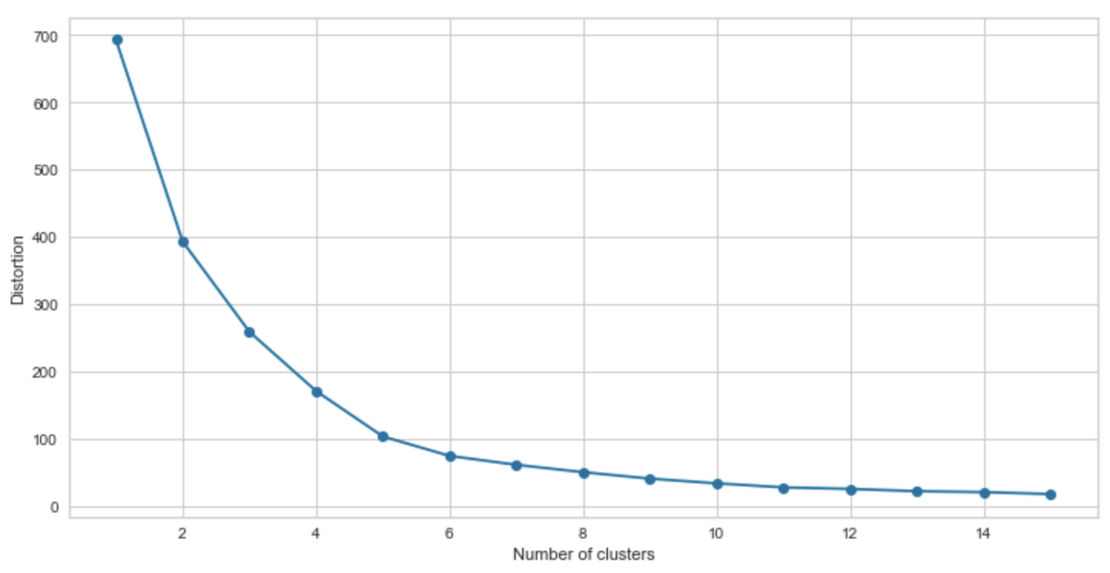
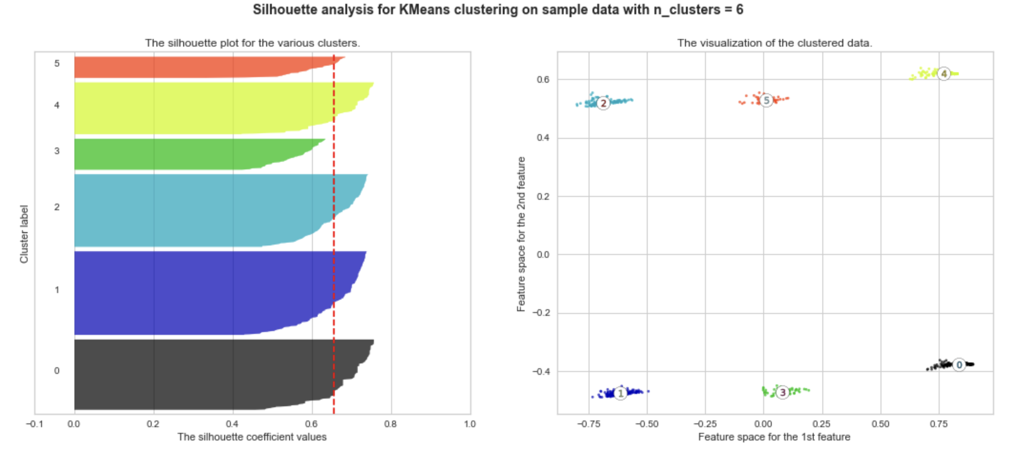
1A: K-Means Clustering
Elbow Method
Number of clusters = 5
Silhouette Analysis
Number of clusters = 6
(normalized scaling)

Slide 9
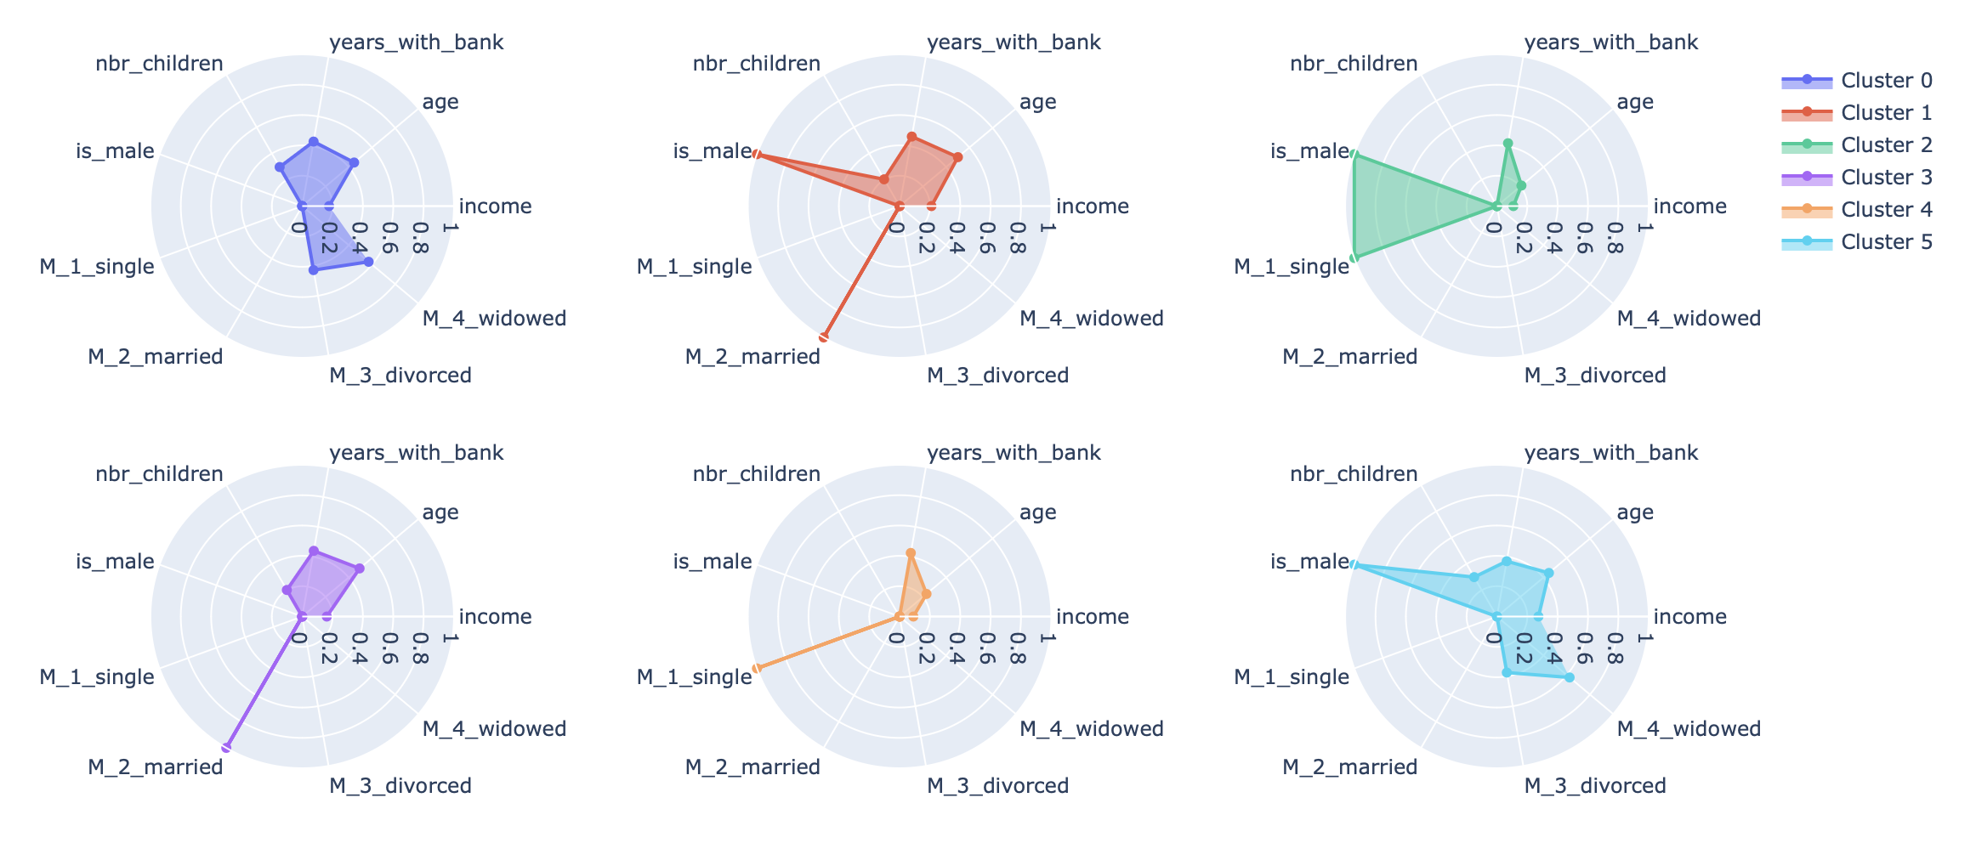
1A: Customer demographics radar CHART
Clusters weighted on binary features (e.g., gender and marital status)

Slide 10
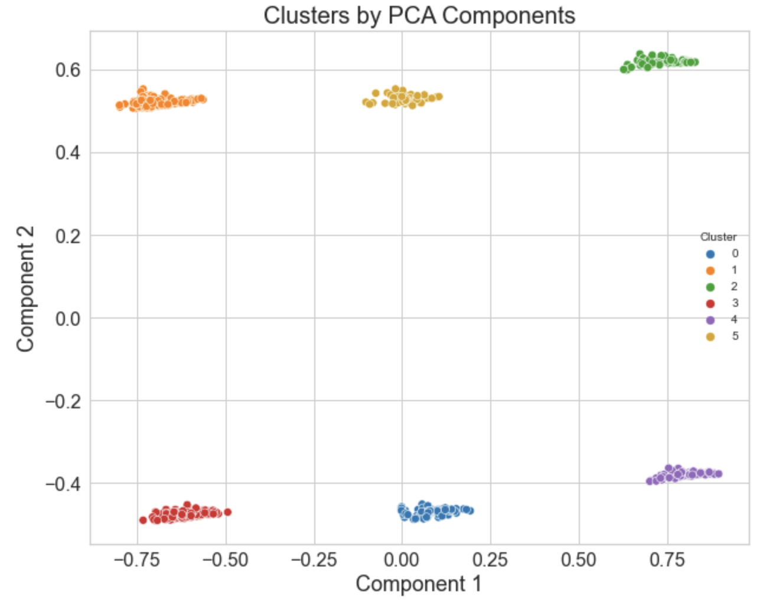
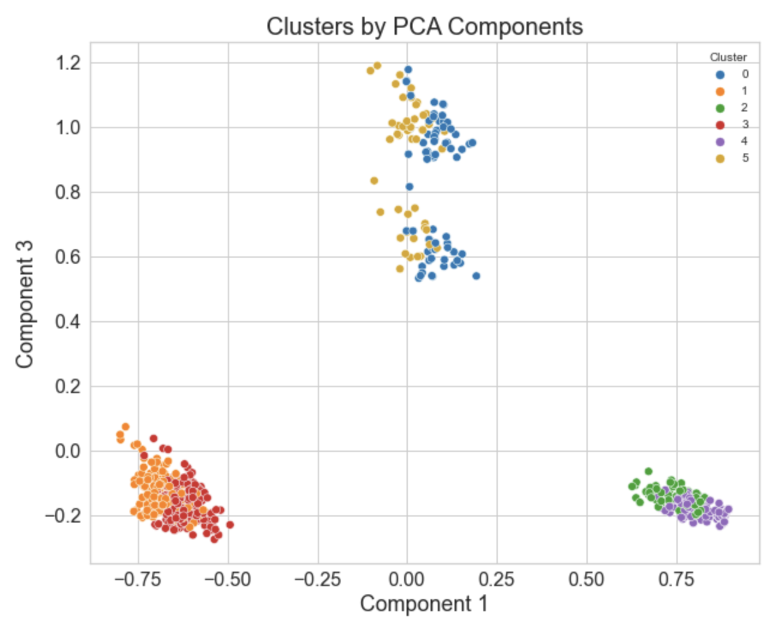
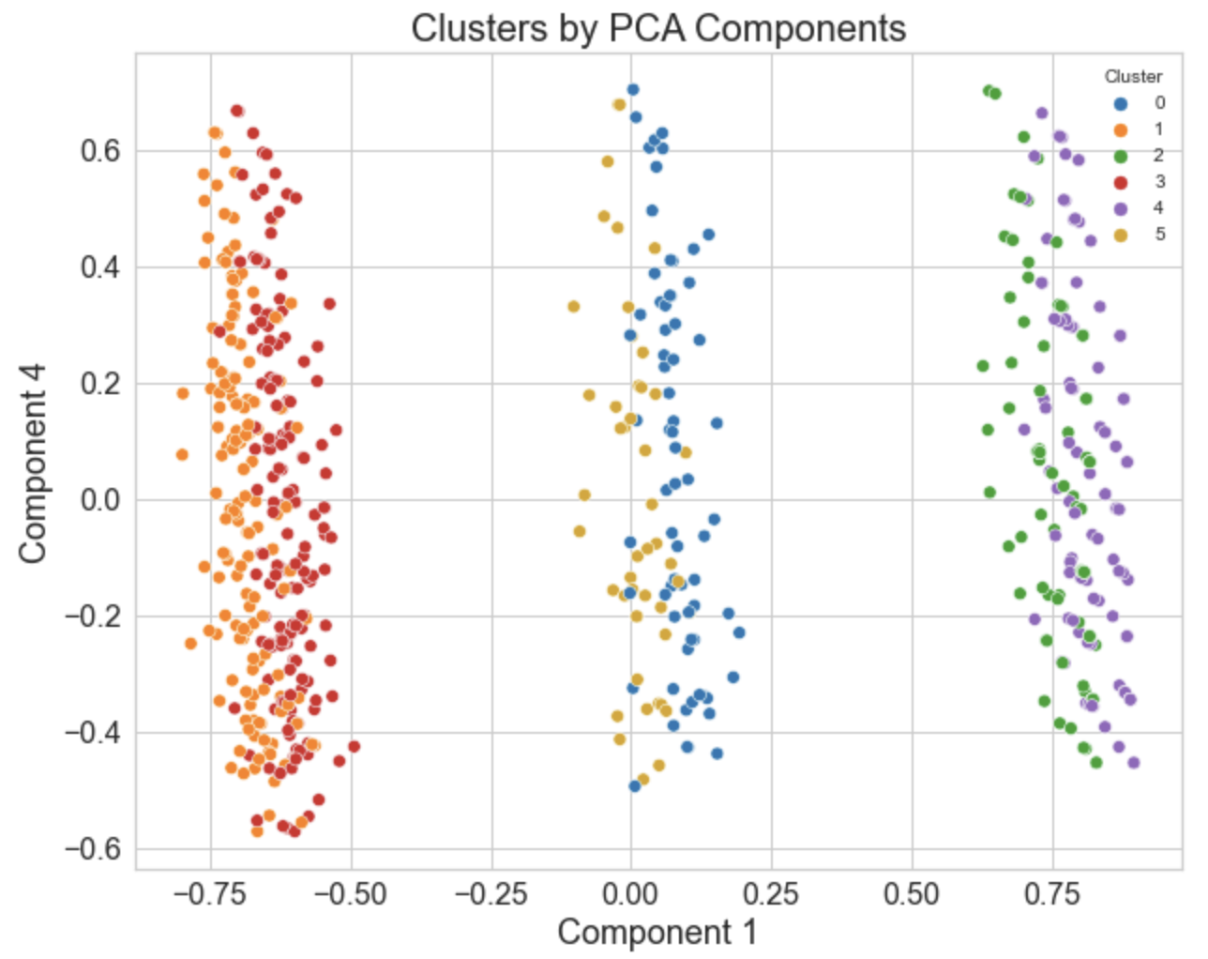
1a: Customer demographics SCATTER PLOTs
PC1 vs. Pc2
PC1 vs. Pc3
PC1 vs. Pc4

Slide 11
Part 1B: Banking Behaviour

Slide 12
1b: Feature Selection
Table | Feature for Investigation
Overall account information | Do customers have each type of account?
Specific account information | What is the average balance in each account type?
Transaction information | How many transactions were made from each account? split into transactions <= $50 and transactions > $50

Slide 13
1b: Feature ENGINEERING
Scaled all values
Tried both MinMaxScaler() and Standard Scaler()
Considered binning values
But k-means clustering doesn’t work well with categorical features

Slide 14
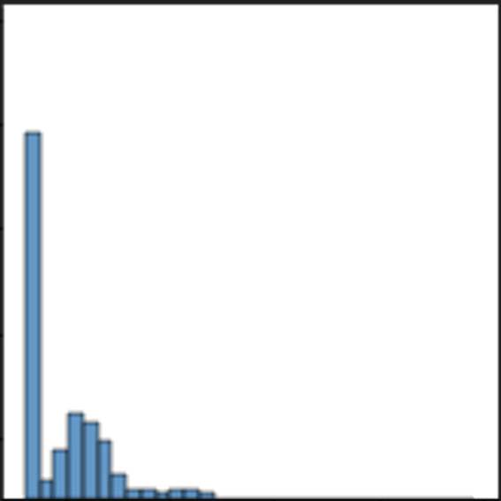
1b: Feature selection challenges
Null values (replaced with zeros) skewed the mean downwards
MinMaxScaler was used because it is not affected by the mean
Not every customer had every account type, therefore there were many nulls.
Nulls replaced with zeros.
TYPICAL DISTRIBUTION FOR ACCOUNT FEATURE
(e.g., account balance, number of transactions, etc.)

Slide 15
1b: PCA and Clusters
Using the same method in 1A Demographics:
4 PCs to preserve ~85% of the data
4 k-means clusters

Slide 16
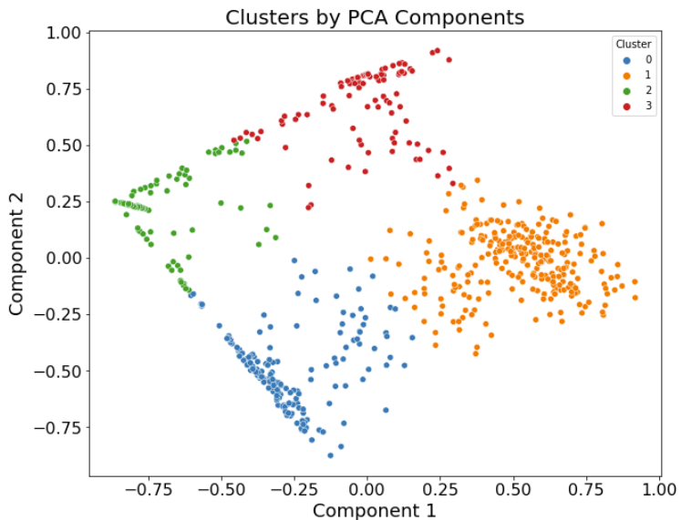
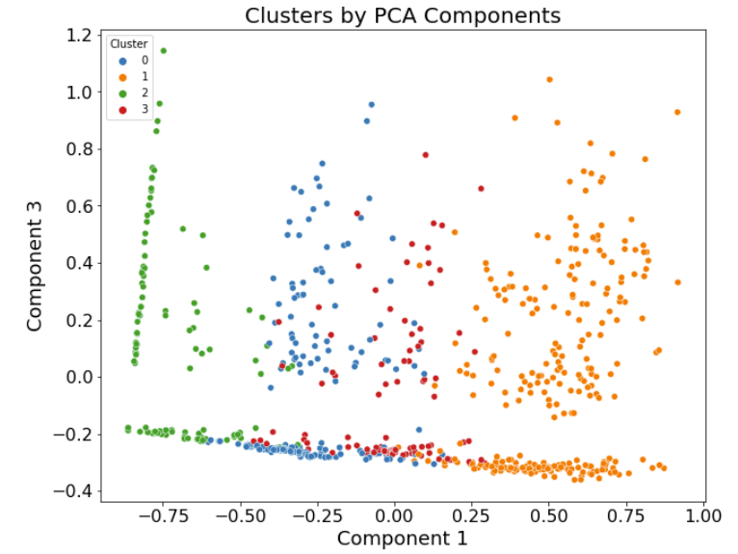
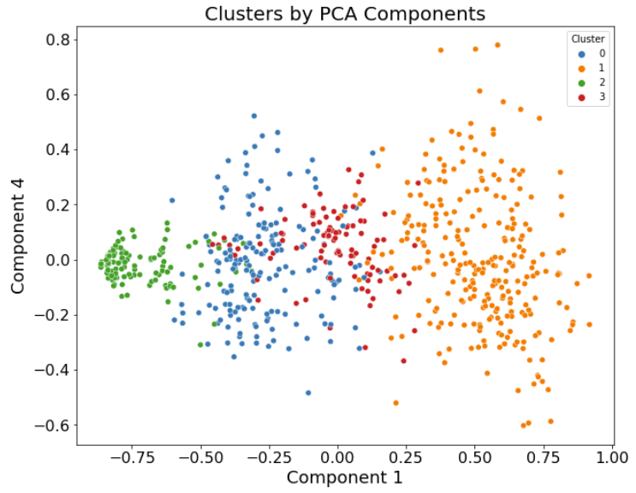
1b: PCA Scatterplots for four clusters
All PCs
PC1 vs PC2
PC1 vs PC3
PC1 vs PC4

Slide 17
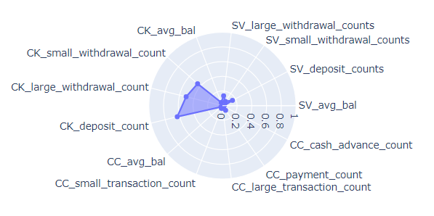
1B: Kmeans cluster radar charts
Savings Account Activity
Checking Account Activity
Credit Account Activity

Slide 18
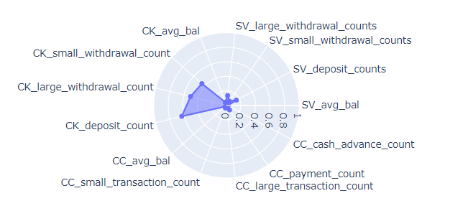
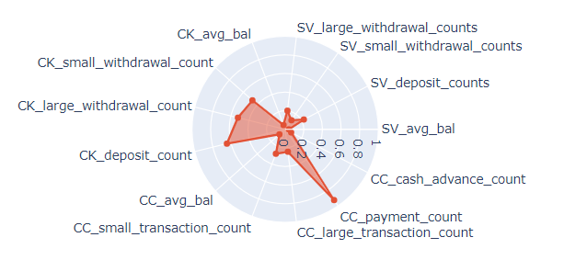
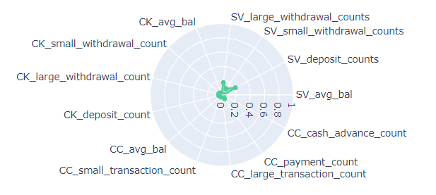
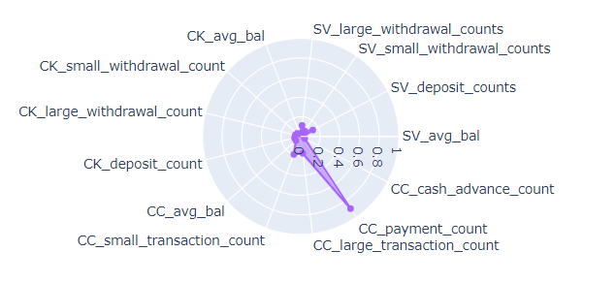
Cluster 0
Cluster 1
Primarily checking account users
Primarily credit and checking account users
Cluster 2
Cluster 3
Some saving account usage
Primarily credit account users

Slide 19
NEXT STEPS
Look at account types separately from one another
Look at account activity in combination with demographics
Explore different clustering algorithms (e.g. k-modes)

