Slide 1
~TITLE NEEDED~
By: Bradley Miller, Matt Nicol and James Merrill

Slide 2
Idea
Take two Images
Have user draw a box around an object in one image
Auto cut out that object from inside the box
Place the object in the second image and blend it

Slide 3
Motivation
Challenging Project
Used ideas that we had learned all semester
Make for stream lined segmentation and blending

Slide 4
Method
Pick 2 Images
User Draws Box Around object in Image 1
Segment the object from inside the box
User places the object in second image
Blend object into second image

Slide 5
Matts Part different title here

Slide 6
Image Segmentation
Methods thought about using:
K-Means
Simple Distance between two pixels Algorithm
K-Means between foreground and background gorupings

Slide 7
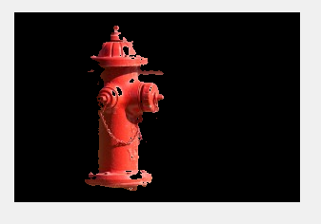
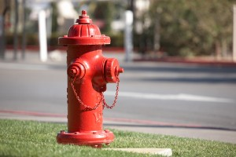
K-means

Slide 8
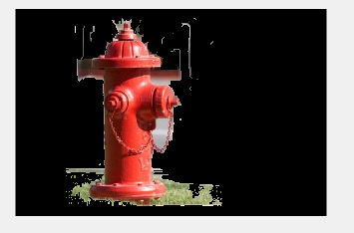
Two Pixel Distance

Slide 9
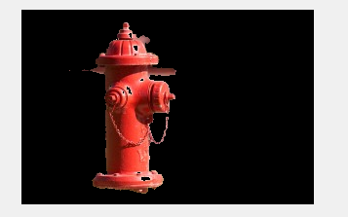
K-means with foreground and background
Find the K-means for both foreground and background
Background is outside of user drawn box
For each K-mean in the foreground measure the distance from the center of it to the center of the K-means in the background
If the K-mean is within a certain distance then add it to background
Repeat until desired result

Slide 10
James part, needs new title

Slide 11
Results???

