Slide 1
Partial Image Placement Software (PIPS)
By: Bradley Miller, Matt Nicol and James Merrill

Slide 2
Idea
Take two Images
Have user select an object in one image
Auto cut out the selected image
Place the object in the second image and blend it

Slide 3
Motivation
Challenging Project
Used ideas that we had learned all semester
Make for stream lined segmentation and blending

Slide 4
Method
Pick 2 Images
User Selects area from Image 1
Segment the object that was selected
User places the object in second image
Blend object into second image

Slide 5
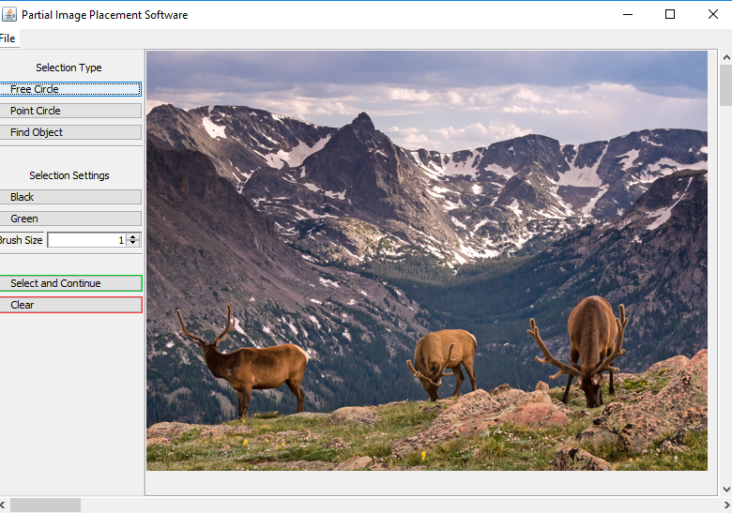
GUI For Selecting
User selects part of an image that they want to move to another image
That part of the image is then cut out and sent to be refined and later placed

Slide 6
Selection Methods
Free draw circle

Slide 7
Selection Methods
Free draw circle
Point Circle

Slide 8
Selection Methods
Free draw circle
Point Circle
Find Object (Box Around)

Slide 9
Image Segmentation
Methods thought about using:
K-Means
Simple Distance between two pixels Algorithm
K-Means between foreground and background groupings

Slide 10
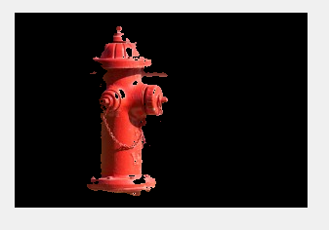
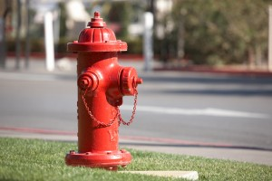
K-means

Slide 11
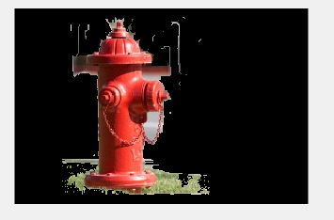
Two Pixel Distance

Slide 12
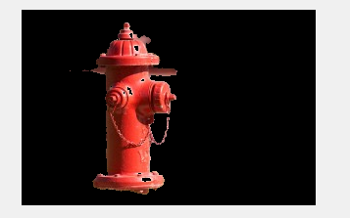
K-means with foreground and background
Find the K-means for both foreground and background
Background is outside of user drawn box
For each K-mean in the foreground measure the distance from the center of it to the center of the K-means in the background
If the K-mean is within a certain distance then add it to background
Repeat until desired result

Slide 13
Poisson Blending
We need to add our image to the background and make the edges of our spliced image less obvious.
Solution: Use Poisson blending to preserve the pixel gradients of the image
For more information on Poisson Blending see Poisson Image Editing by Pérez, et al.

Slide 14
Poisson Blending
For each pixel from the source image, we must solve an equation where the difference between the pixel and its neighbors is the same as the difference between the target pixel and its neighbors. We use a Laplacian filter to compute this difference.
That’s a lot of equations with a lot of unknowns.
Luckily we can use a matrix to solve all of the equations at once. It’s a big matrix though.
It all boils down to A*x = b where A shows adjacency, b shows our known coefficients and x shows our resulting pixels.

Slide 15

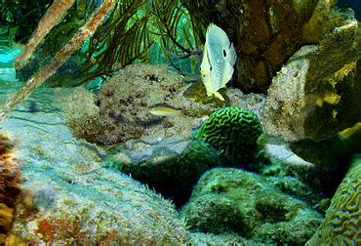
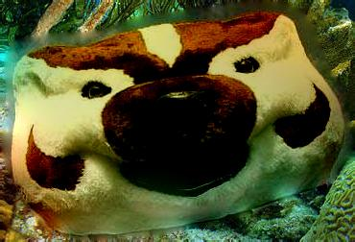

Poisson Example
Poisson Blend Result Cutout
Target Cutout
Source Cutout and Mask

Slide 16
Moving Forward
Combine selection, segmentation and blending into a single user-friendly program.

