Slide 1

Umbrella
Integrating the way you shop..Team: HackHers
Notes:
Talk about Umbrella...

Slide 2
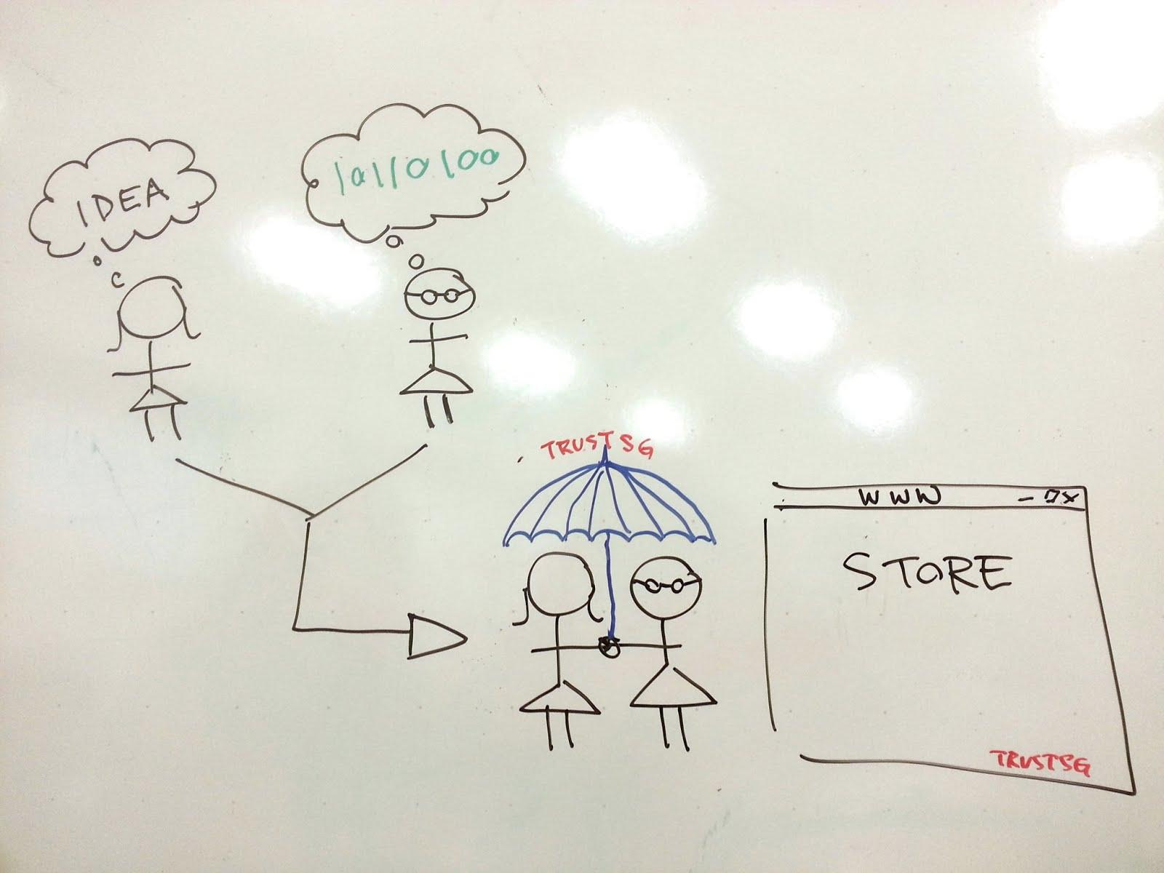
How can Umbrella help bring the community together?
Notes:
Bringing skilled women together.

Slide 3
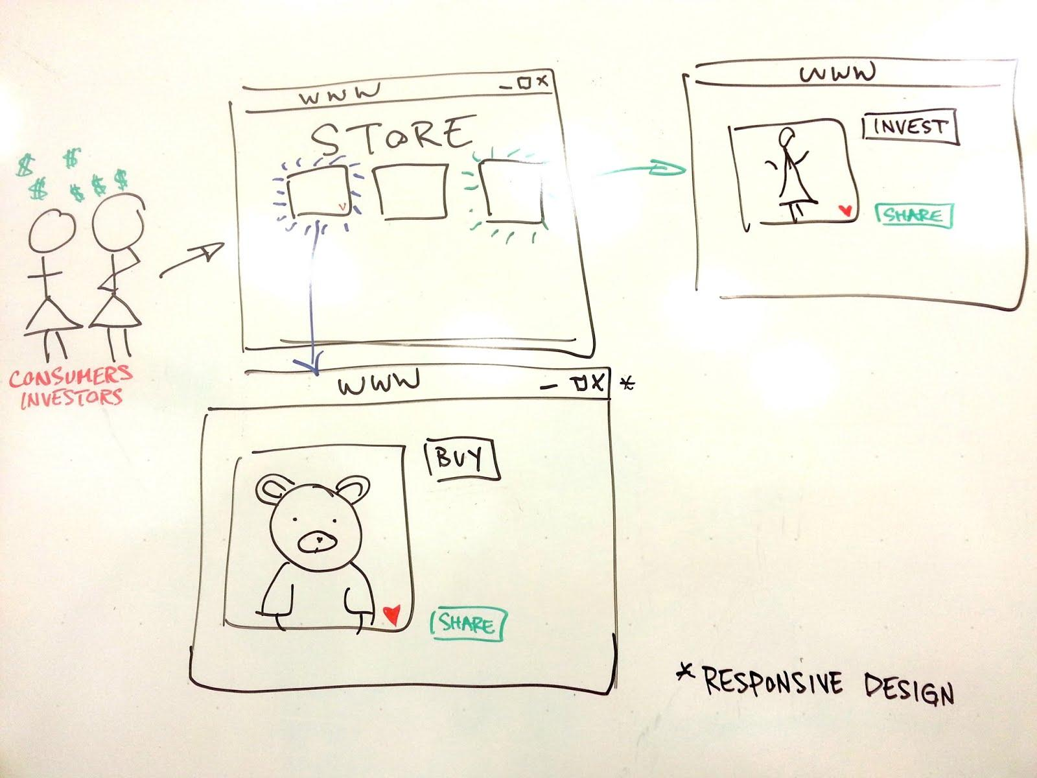
How does Umbrella promote e-buying?

Slide 4
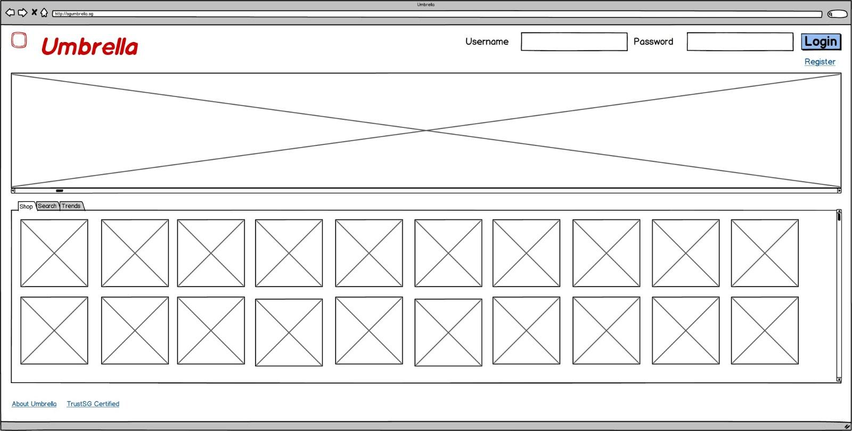
Featured shops
Trust SG Certified - regularly audited
Notes:
homepage

Slide 5
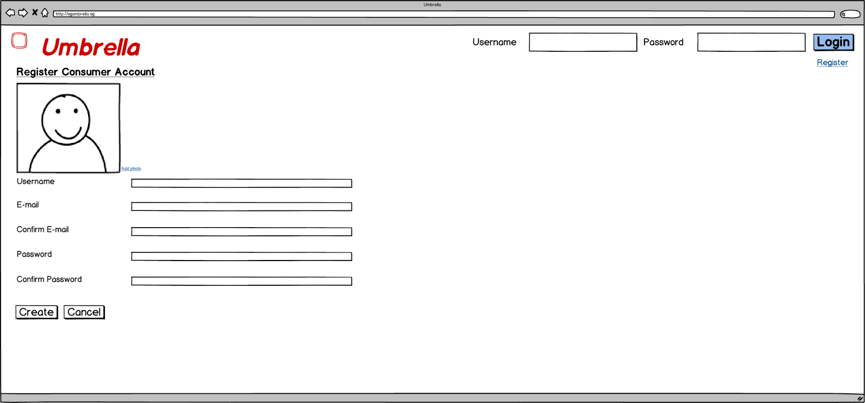
Notes:
create user profile

Slide 6
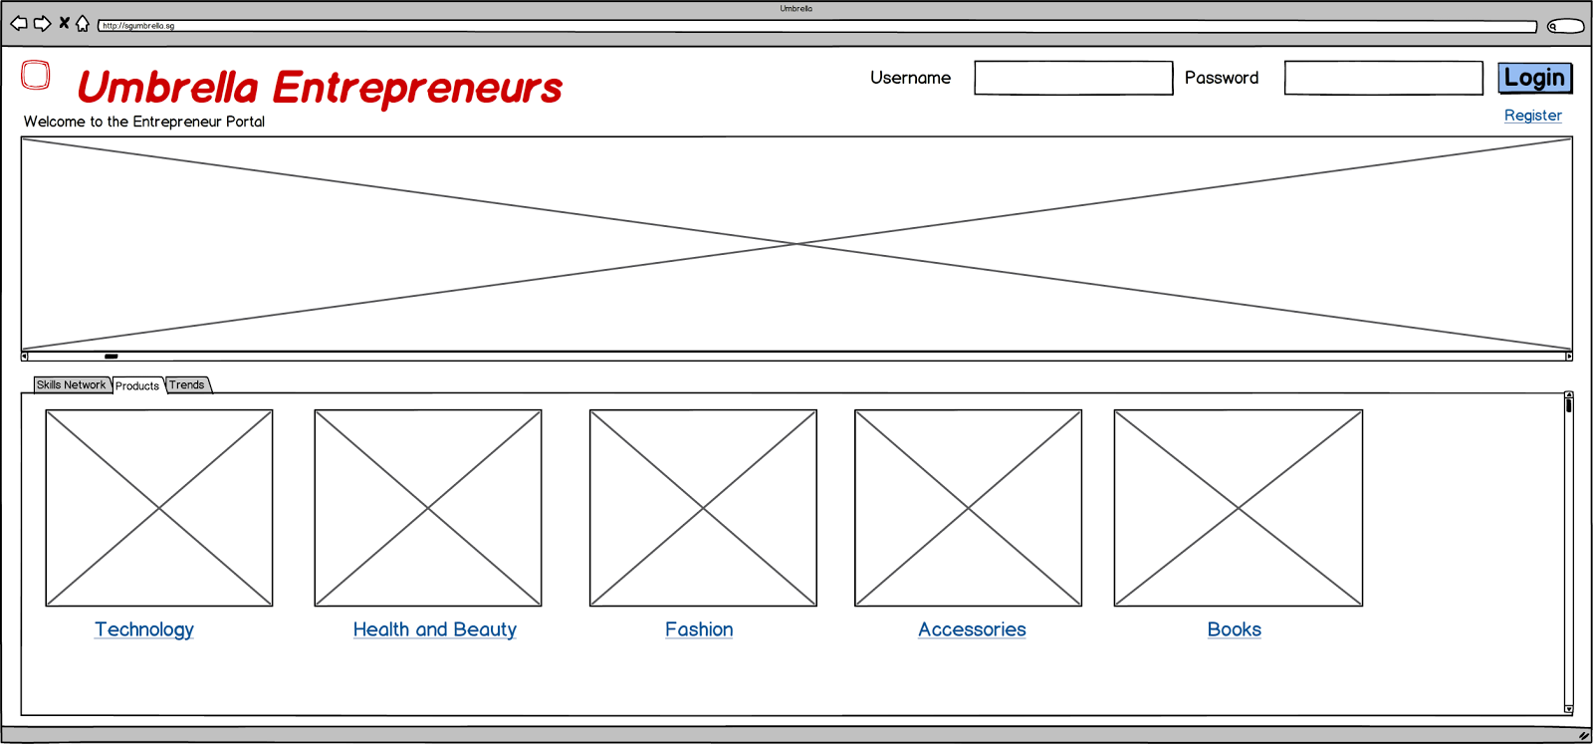
Notes:
entreprenuerial network

Slide 7
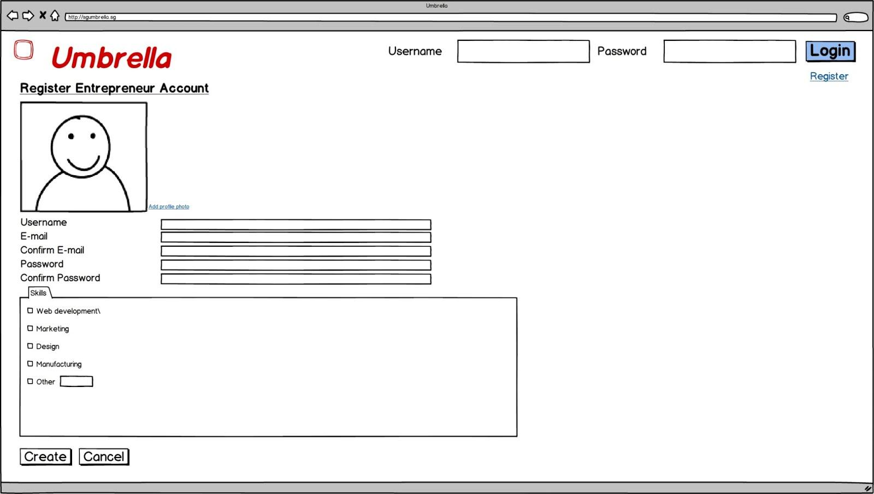

Slide 8
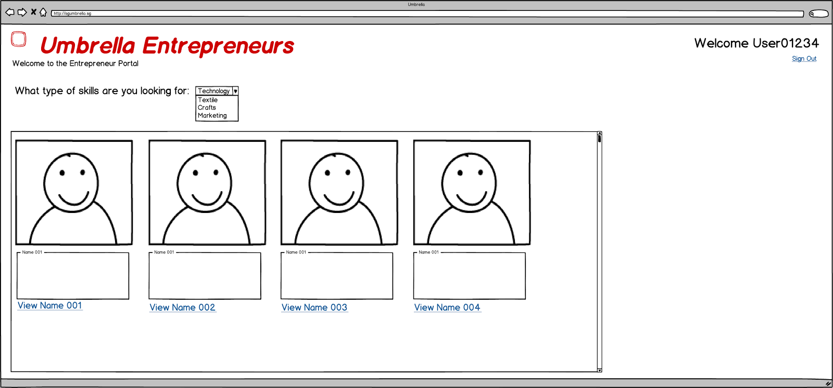

Slide 9
Questions?
Team: HackHers
Notes:
Talk about Umbrella...

