Slide 1
MOVIE RECOMMENDATION SYSTEM
DOMAIN: MACHINE LEARNING
GUIDE: Mr.Arun Muralidharan
PG-2223-ETSD-486 : Medisetty Venkata Nikhil

Slide 2
01
ABSTRACT
02
PROBLEM STATEMENT
03
DESCRPTION OF THE MODEL
CONTENTS
04
EXPLORATORY DATA ANALYSIS
05
STATISTICAL ANALYSIS
06
MACHINE LEARNING MODEL
07
CONCLUSION & REFERENCES

Slide 3
01
ABSTRACT

Slide 4
The importance of a movie recommendation system is acknowledged by the users as it helps them enhance their entertainment. It can suggest a set of movies to the users based on their interests and the popularity of the movies. This movie recommendation system that can help users find the best movies. The system can collect various information about the movies, such as their popularity, genre, and plot. It can then generate movie swarms to help the producers plan a new movie.

Slide 5
02
PROBLEM STATEMENT

Slide 6
The rise of recommendation systems has also been attributed to the increasing number of people constantly looking for the best possible products and services. To help them make informed decisions and avoid spending their cognitive resources on something that they don't need. Create a “Movie Recommendation System” to help the users with the problem.

Slide 7
03
DESCRPTION OF THE MODEL

Slide 8
The goal of the movie-based filtering Model is to analyze the similarities between different movies based on their metadata. It will then suggest those that are most similar to the one that a user searched.
Types Of Filtering:
1.Content-based Filtering System:
The concept of content-based filtering is a domain-dependent method that focuses more on analyzing the attributes of web pages and publications to generate predictions. It is very effective when articles and publications are recommended. In content-based filtering technique, recommendation is made based on the user profiles using features extracted from the content of the items the user has evaluated in the past.
2.Collaborative Filtering System:
A collaborative filtering technique is a domain-independent method that can help predict the content that cannot be easily described by metadata such as music and movies. It uses a database to build a list of users' preferences for items, and it then matches those preferences with those of users based on similarities between them.
3.Hybrid Filtering System:
The goal of hybrid filtering is to combine different methods in order to improve the system's efficiency and avoid some of the drawbacks of a single algorithm. It's also beneficial to have a combination of algorithms that can provide better recommendations.

Slide 9
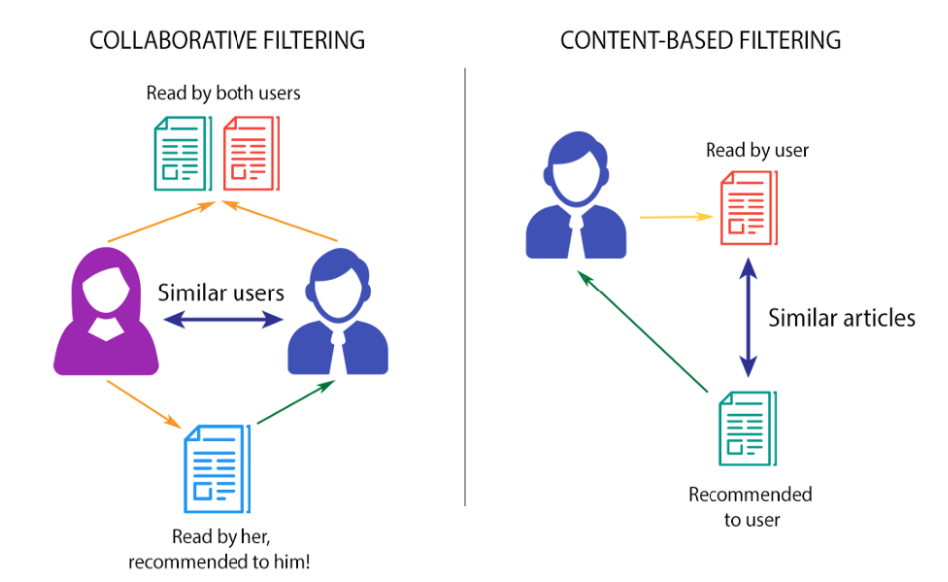
For this Model, we use collaborative filtering system.
The goal of a collaborative filtering system is to analyze and predict the behaviors and preferences of its users. It then uses this information to recommend the most appropriate movies based on their specific search. Unlike machine-based filtering techniques, this method does not rely on analyzable content. Its ability to recommend complex products without requiring an understanding of the item itself is also a key advantage of this method.
We will create a Model using K-Nearest Neighbour(KNN) Algorithm.
We will build a Collaborative Based Recommender using
Movie Genres, Cast, Crew, and Keywords.

Slide 10
04
EXPLORATORY DATA ANALYSIS

Slide 11
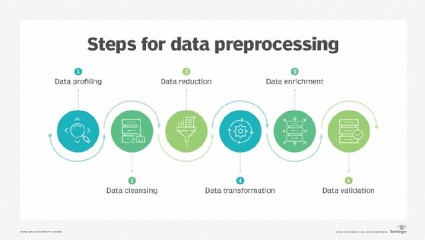
Data preprocessing in Machine Learning refers to the technique of preparing (cleaning and organizing) the raw data to make it suitable for a building and training Machine Learning models.

Slide 12
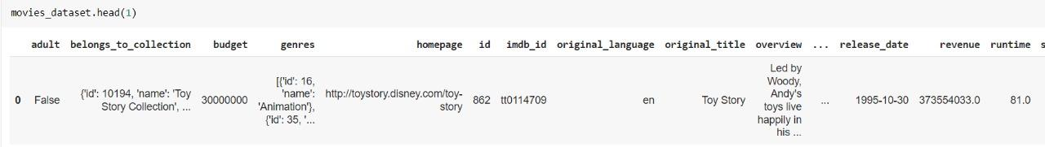
From the source, we have collected three datasets, i.e., Movies, Keywords,and Credits for our model.
MOVIES DATASET AND CREDITS DATASET
We have observed data type "date" is present in place of "int" data type in the column ID. To overcome this, we use drop method to remove all the rows containing the date as the data type in the column "ID".
There are over 10 unused columns in the movie dataset. To drop those unwanted columns, we used the "drop" method.
Fig: Movies Dataset

Slide 13
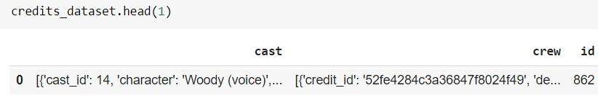
Fig: Credits Dataset
KEYWORDS DATASET
Alike the movies dataset and credits dataset, the keywords dataset is also given in JSON format so we converted it into a list.
We have combined all three datasets into a single dataset called "movies" using the "merge" method on column "ID".
We encountered null values in the columns vote_count, genres, and many more. To remove rows with null values we used the "dropna" method.
We cannot remove all the NaN values, so we have also used the method "fillna" in some rows and columns.

Slide 14
05
STATISTICAL ANALYSIS
OBJECTIVE To analyze the most Popular movies according to their genres.

Slide 15
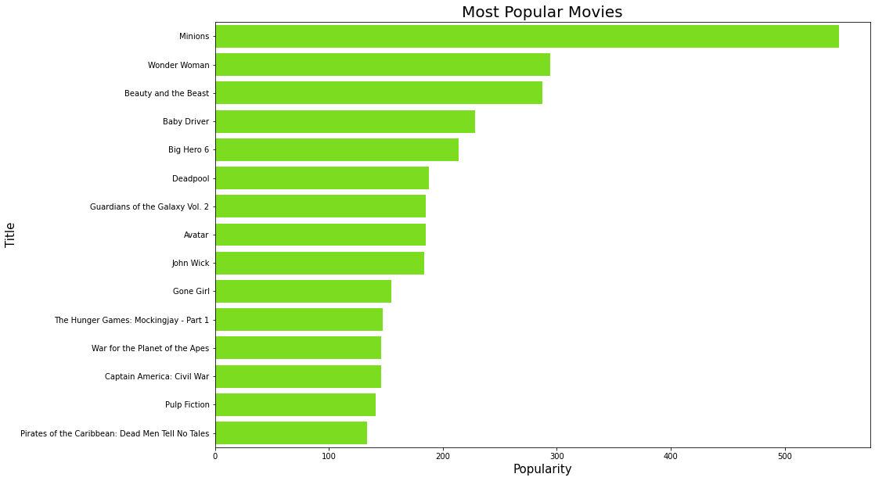
Fig-1: The graph shows “Top 15 Most Popular Movies”.
We can see that from the fig-1, Minions was the most popular movie with a popularity rating of over 500 followed by Wonder woman, Beauty and the beast, etc.

Slide 16
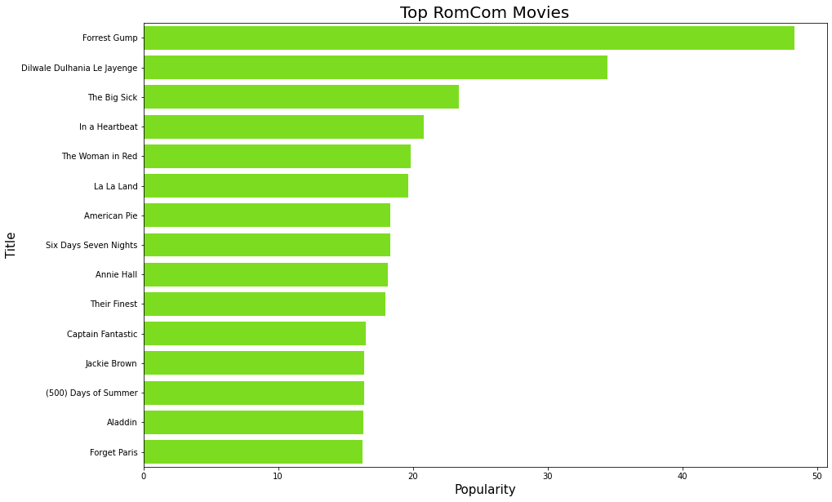
Fig-2: The graph shows “Top 15 Most Popular Rom Com Movies”.
We can see that from the fig-2, Forrest Gump was the most popular romance comedy movie with a popularity rating nearly 50.

Slide 17
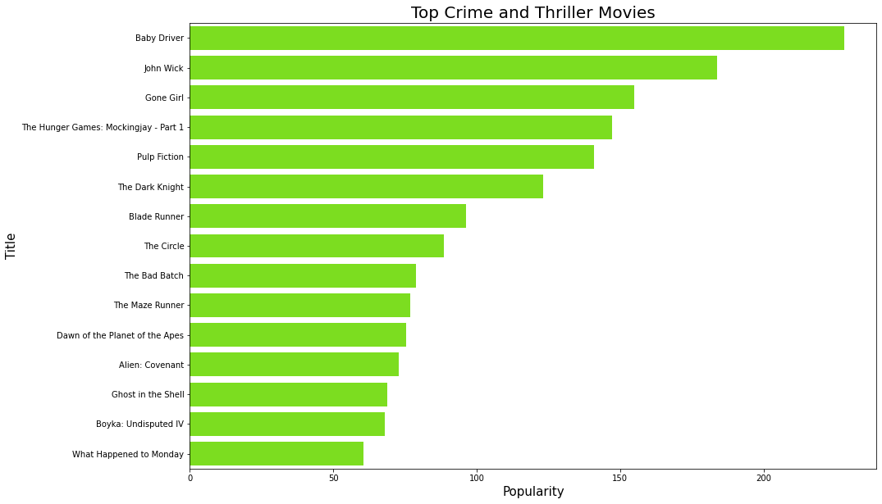
Fig-3: The graph shows “Top 15 Most Popular Crime & Thriller Movies”.
We can see that from the fig-2, Baby Driver was the most popular romance comedy movie with a popularity rating over 200.

Slide 18
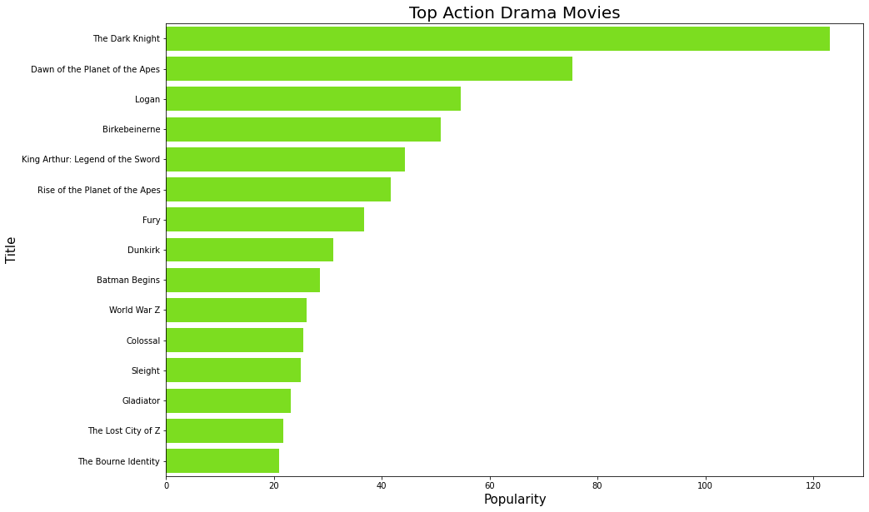
Fig-4: The graph shows “Top 15 Most Popular Action Drama Movies”.
We can see that from the fig-4, Dark Knight was the most popular Action Drama movie with a popularity rating over 120.

Slide 19
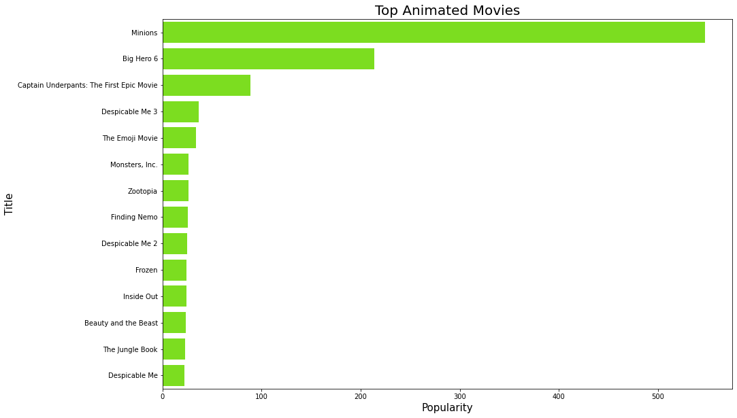
Fig-5: The graph shows “Top 15 Most Popular Animated Movies”.
We can see that from the fig-5, Minions was the most popular Animated movie with a popularity rating over 500.

Slide 20
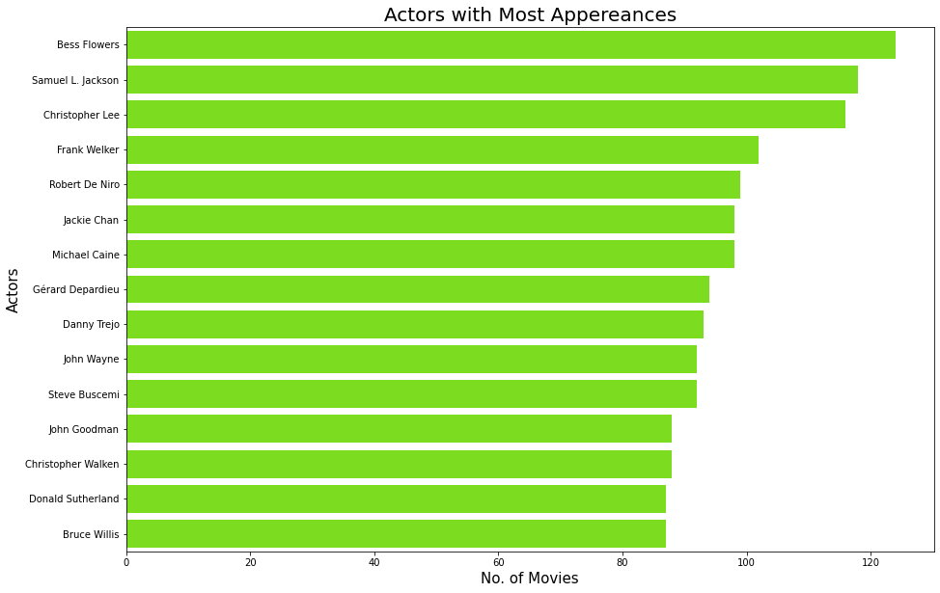
Fig-6: The graph shows “Top 15 Actors with Most Appearances”.
We can see that from the fig-6, Bess Flowers was the Actor with the Most Appearances in over 120 films(i.e., 124 Movies). followed by Samuel L. Jackson, Christopher lee with 118 and 116 Movies respectively.

Slide 21
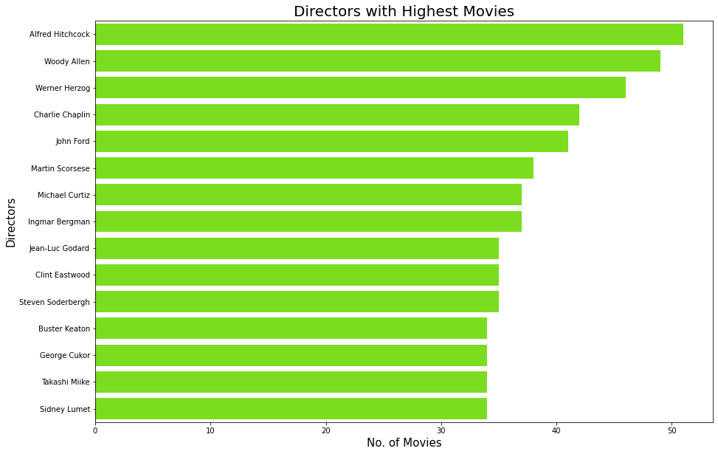
Fig-7: The graph shows “Top 15 Directors with Most Directed Films”.
We can see that from the fig-7, Alfred Hitchcock was the Director with the Most with Most Directed Films i.e.,51 Movies. Followed by Woody Allen, Werner with 49 and 46 Movies respectively.

Slide 22
06
MACHINE LEARNING MODEL
1.Movie Recommendation System using Cosine Similarity.
2.Movie Recommendation System using KNN Algorithm.

Slide 23
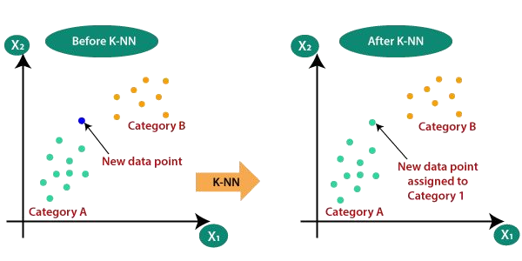
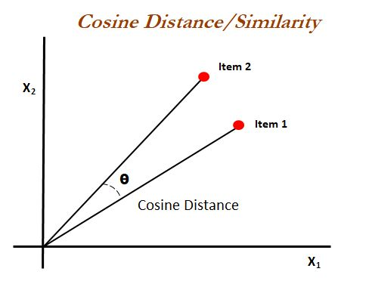
1.Movie Recommendation System using Cosine Similarity
Cosine similarity measures the similarity between two vectors of an inner product space.
To find Cosine Similarity :
1.1 First we have converted textual data into feature vectors using TfidfVectorizer.fit_transform. The “TfidfVectorizer” converts a collection of raw documents to a matrix of TF-IDF features. The “fit_transform” learn vocabulary and idf, return document-term matrix.
1.2. Now, we find similarity between Feature vectors using Cosine Similarity.
1.3. We’ll check distance between each movie using output from 1.2 and display the first K lowest difference to the user.

Slide 24
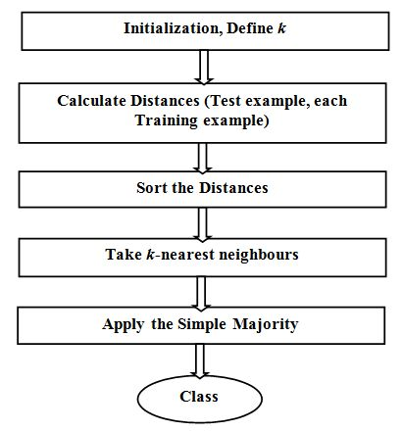
2.Movie Recommendation System using KNN Algorithm
The k-nearest neighbor algorithm is a type of “Supervised Machine Learning Algorithm” used to solve classification problems. This Algorithm doesn't perform any training when you supply the training data. Instead, it just stores the data during the training time and doesn't perform any calculations. It doesn't build a model until a query is performed on the dataset.
Steps to build Model using KNN Algorithm:
2.1. Using Cosine similarity we will check the euclidean distance
between the 2 points(I.e., two Movies).
2.2 Choose the value of K and select K neighbors closet to the new
point.
2.3 Count the votes of all the K neighbors / Predicting Values.

Slide 25
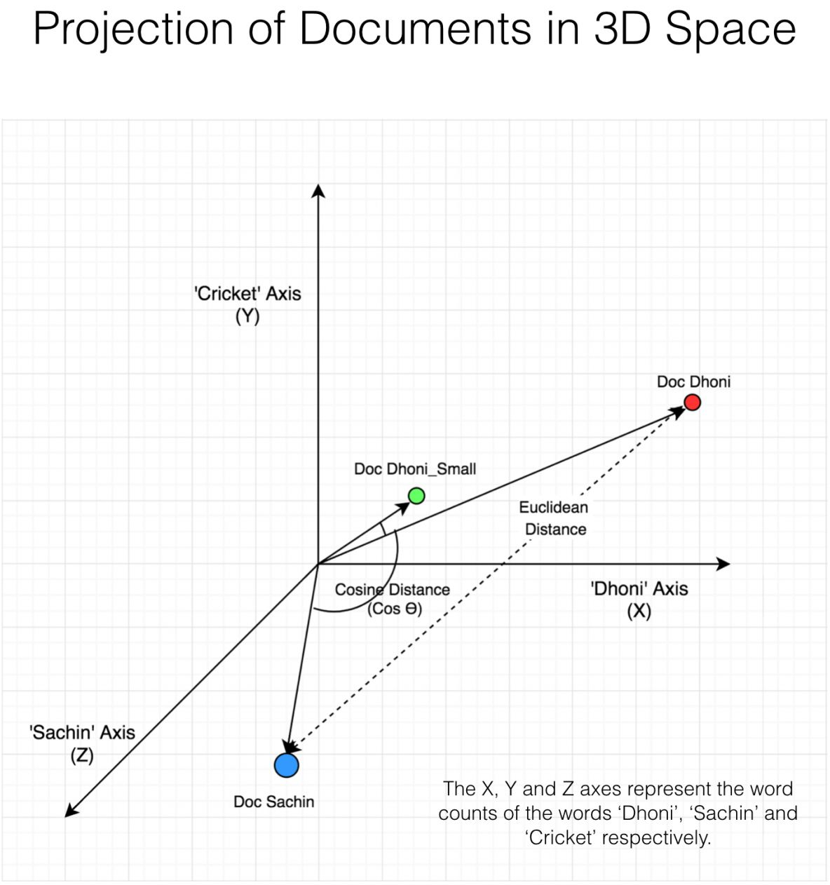
1. Cosine Similarity:
We took four parameters for measuring distance between
2 points. They are:
Genres
Cast
Director
Keywords
2.In this step, we need to choose the value of K. In our case
value of K is equal to 15.
3.After declaring K, we will iterate through the distances, and
we'll pick the 15 nearest neighbors. These 15 nearest
neighbors are our recommended movies.

Slide 26
07
CONCLUSION & REFERENCES

Slide 27
Conclusion:
The importance of a good recommendation system has become more apparent due to the increasing number of information overloads. This is why we are working on a collaborative-based system that aims to improve the accuracy of the movie's suggestions.
Movie Recommendation system helps to clear the problem of information overload with information retrieval systems. We come up with a strategy that focuses on dealing with the user’s personal interests, and based on his previous search list, movies are recommended to users.This strategy helps in improving the accuracy of the recommendations.
Future Scope:
If you have ever shopped on Amazon, or watched a TV show on Netflix, you have encountered recommender systems at work. Not only do recommender systems provide a way to quickly show customers what they are looking for, but they also help customers discover new products or media that they might like.
We can conclude that “The Recommendation System” can be a very powerful tool in a company’s arsenal, and future developments are going to increase business value even further. Some of the applications include being able to anticipate seasonal purchases based on recommendations, determine important purchases, and give better recommendations to customers which can increase retention and brand loyalty.

Slide 28
REFERENCES
01
DATASET
The dataset contains data about movies details including cast, crew etc. in form of CSV file of nearly 47000 values.
02
KNN ALGORITHM
To Access Complete Model using KNN Algo
03
COSINE SIMILARITY
To Access Complete Model using Cosine Similarity

Slide 29
THANK YOU

