Slide 1
Next Best Offer for Bank of Portugal

Slide 2
Agenda
Notes:
Today we’ll go thought the ... <agenda topics> and have a discussion about what we can do going forward and clarify some things around the next steps.

Slide 3
Timeline
2022/10/03 Project initiation
2022/10/26 End of development proccess
2022/11/02 Project end
10/18 Descisions about model
10/13 Initial/descriptive investigation completed

Slide 4
Situation
Create a Next Best Offer (NBO) solution
NBO is a form of predictive analytics that helps marketers and their organizations better judge customer spending habits and guide marketing efforts toward connecting with customers to close a deal.
Will increase the success rate of the campaigns
1% increase ~ 1MSEK
MVP: use the current campaign to produce the model.
It will give a baseline of how much an NBO will increase the success rate, compared to not having one
Notes:
Allows you to treat your customers individually, tailoring their experience with your products based on their behaviour
Since thre is a campaign going on right now it would be beneficial to use the existing data and try to create a model for the current campaign to see how it could have performed so we can create a baseline for how much we can better the numbers.

Slide 5
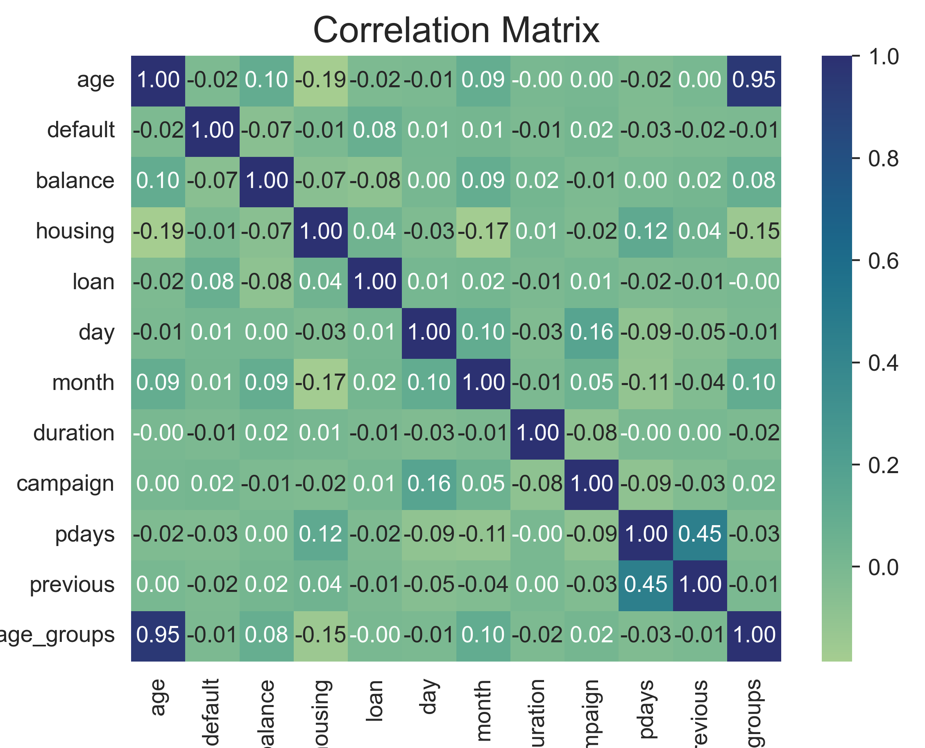
Descriptive Analysis
Data investigation
Correlation analysis
Feature investigation
Creation of disision tree
To identify the most relevant features

Slide 6
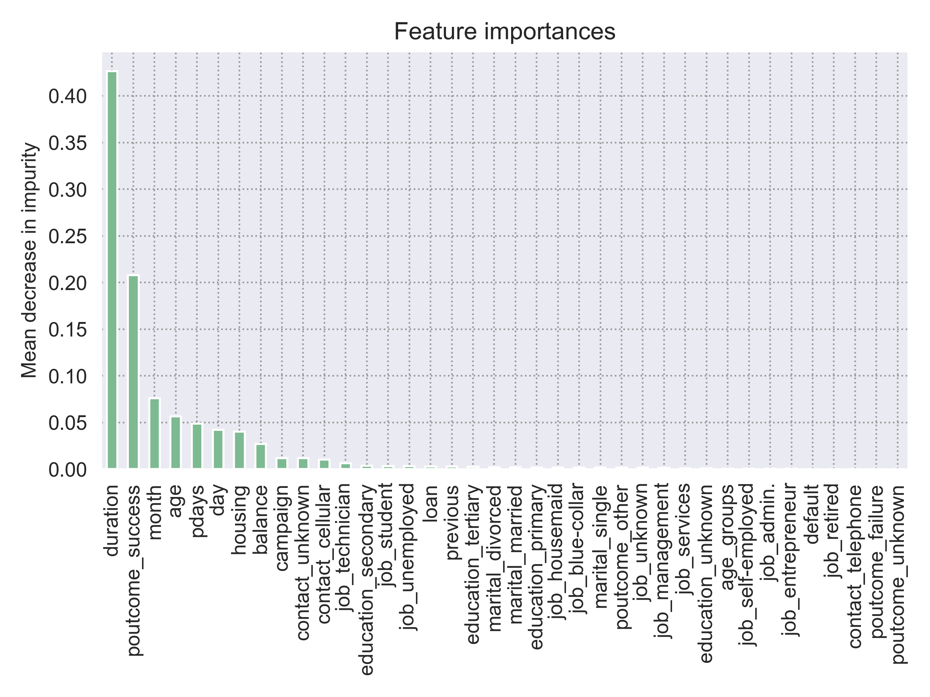
Descriptive Analysis – Disison Tree
Use of all the columns
Except for y (outcome of curent campaign)
Categorical data turned to features
Most important features
Duration of last call
If the last campaign was successfull
The month the call was made in
The age of the client
The number of days ellapsed since the last call
...

Slide 7
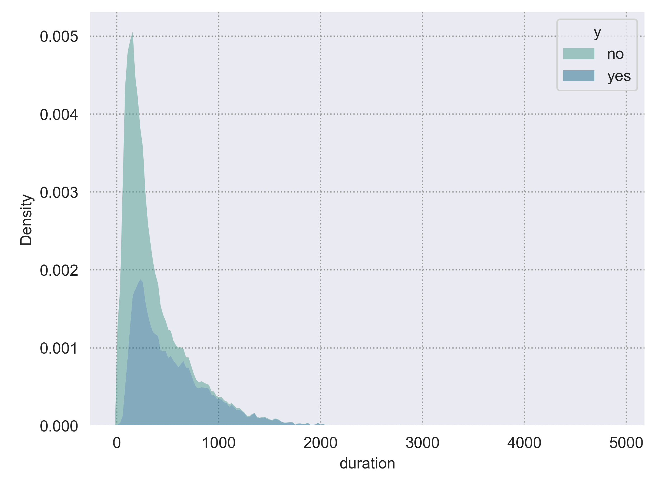
Descriptive analysis - Duration
Most important feature

Slide 8
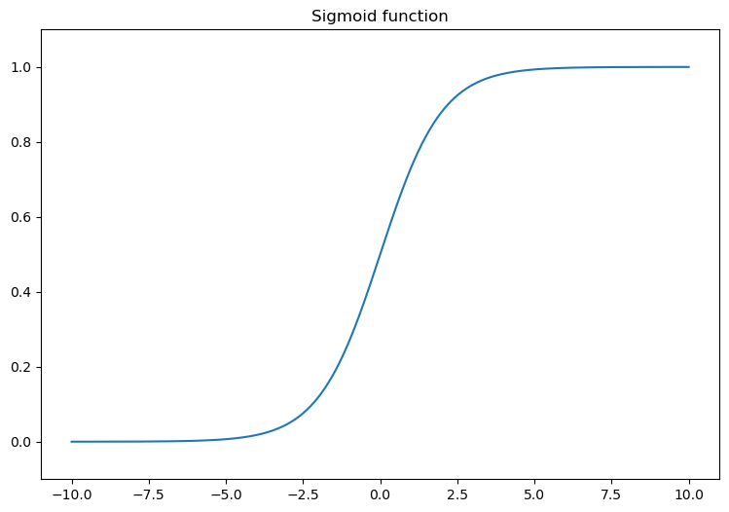
Logistic regration model
The output of a logistic regression is in the `(0, 1)` range
For each example, it represents the probability that the example belongs to the positive class.
Training set: 33908
0.75 of the data
Test set: 11303

Slide 9
Accuracy
Flactuates due to the higher number of “no” values in the target

Slide 10
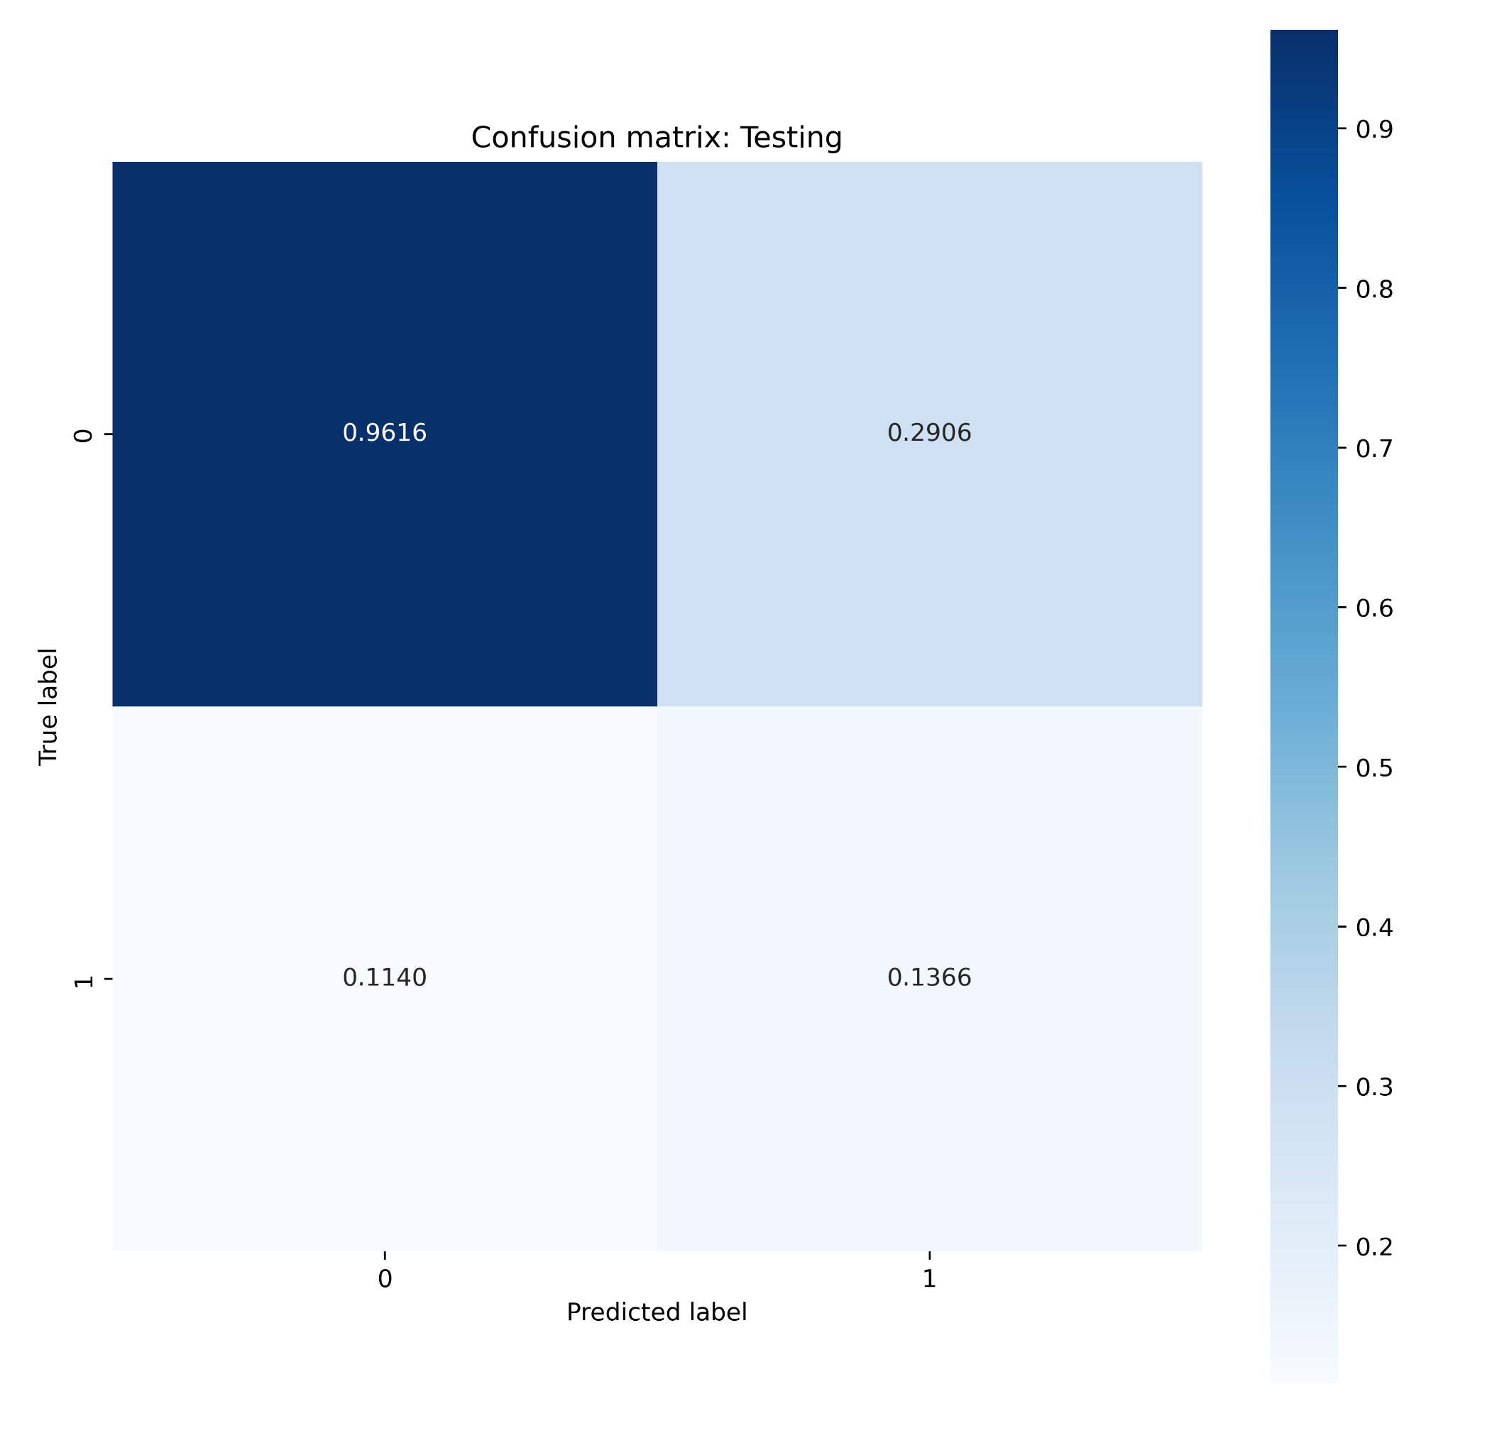
Confusion Matrix
Shows how well the model performed
For the “no” values very high, due to their hier frequency

