Slide 1
Next Best Offer for

Slide 2
Agenda
Notes:
Today we’ll go thought the ... <agenda topics> and have a discussion about what we can do going forward and clarify some things around the next steps.

Slide 3
Timeline
2022/10/03 Project initiation
2022/10/26 End of development proccess
2022/11/02 Project end
10/18 Descisions about model
10/13 Initial/descriptive investigation completed

Slide 4
Situation
Create a Next Best Offer (NBO) solution
NBO is a form of predictive analytics that helps marketers and their organizations better judge customer spending habits and guide marketing efforts toward connecting with customers to close a deal.
Will increase the success rate of the campaigns
Notes:
Allows you to treat your customers individually, tailoring their experience with your products based on their behaviour
Since thre is a campaign going on right now it would be beneficial to use the existing data and try to create a model for the current campaign to see how it could have performed so we can create a baseline for how much we can better the numbers.

Slide 5
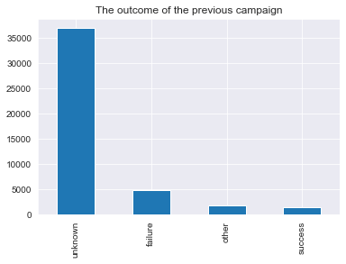
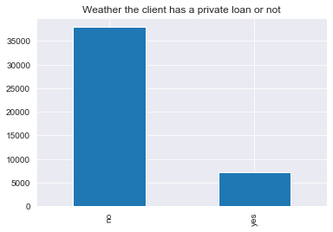
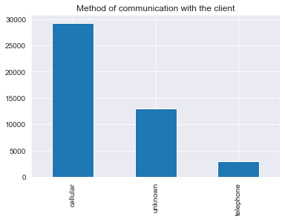
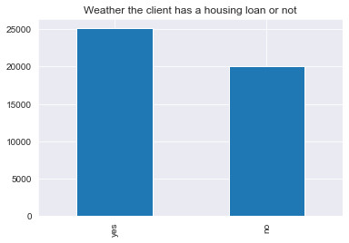
Gap
Campaigns are running frequently
Data is gathered from those campaigns
Demographic of the customers
Duration & frequency of calls with customers
Usage of existing products
Success of campaign on customers
Some examples include:
Campaigning for products is done the same way for all clients
Outcome is not ensured
Success is very low
Notes:
They have really well gathered data, stored and labeled in a easy to use format.
As of now
the campaigns are running frequently
They are gahtering the data from them
Not using the data
Each campaign is run the same way
Towards all clients and with the same aproach towards all of them

Slide 6
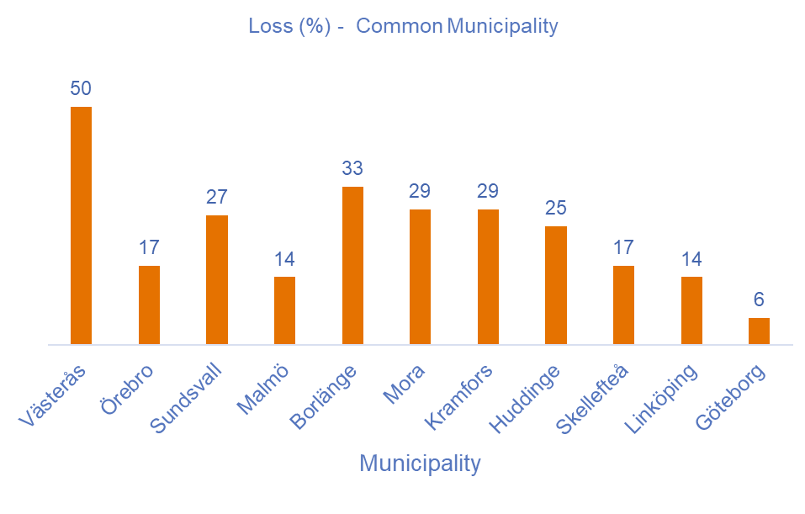
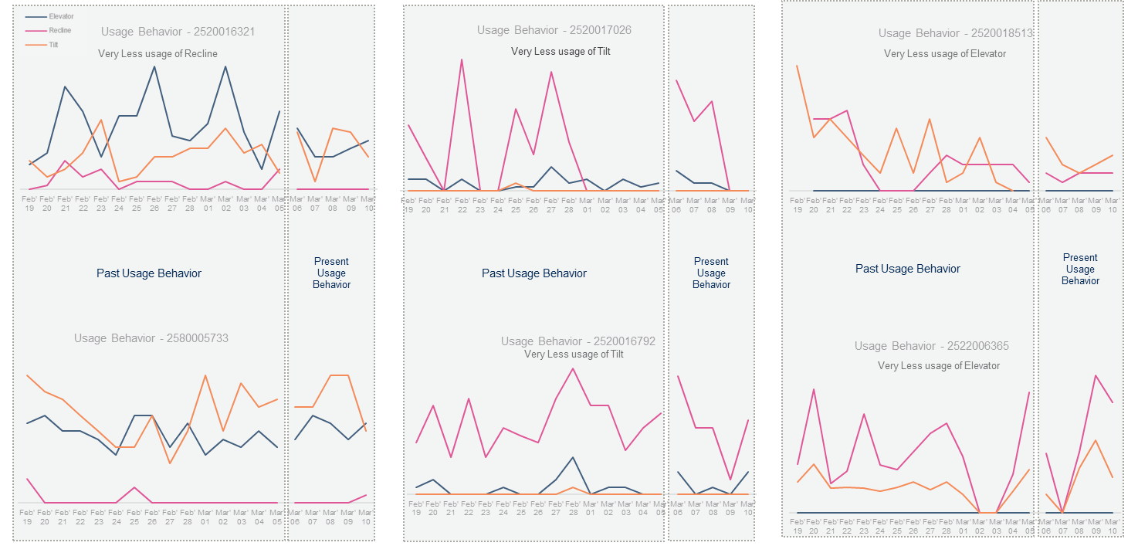
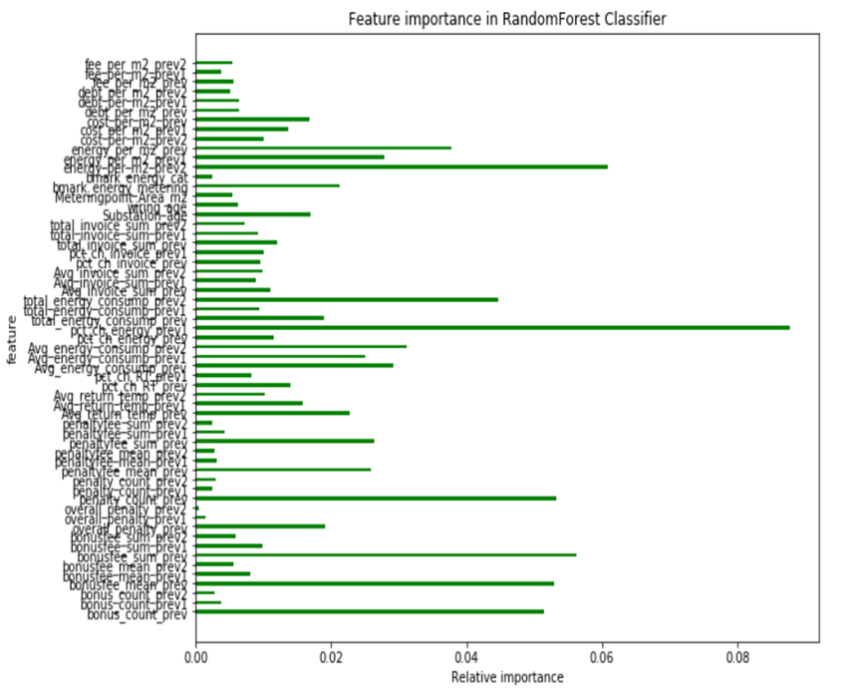
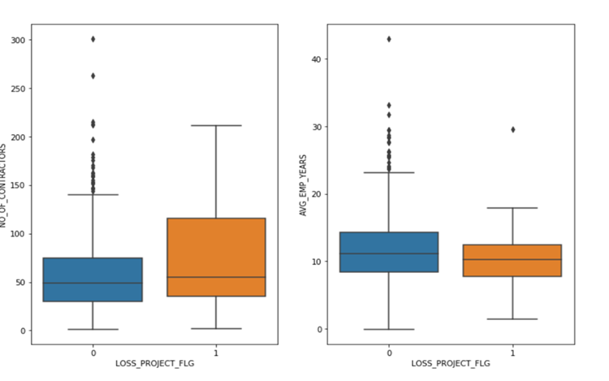
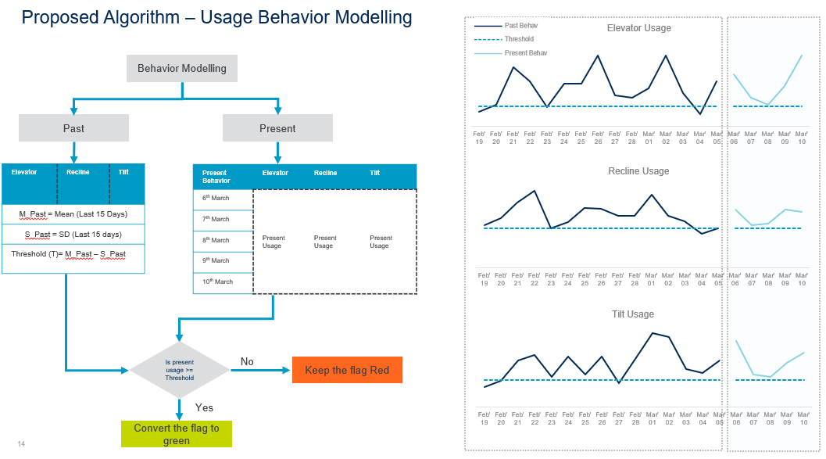
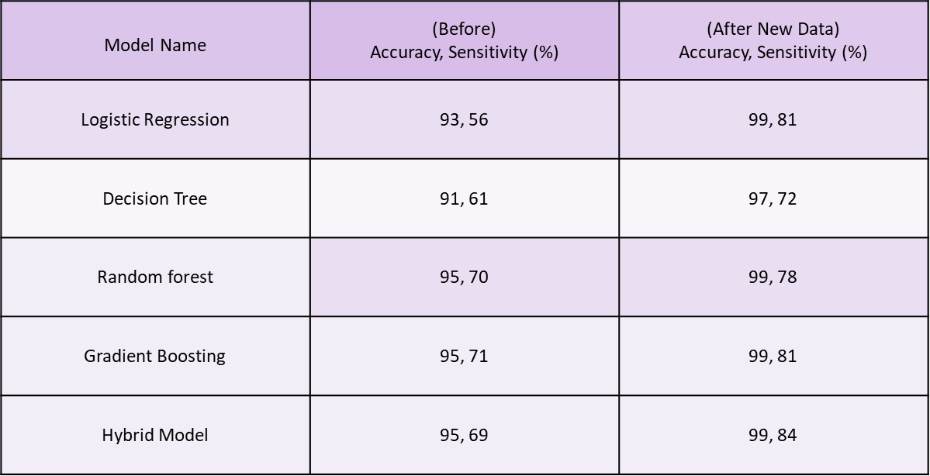
Value examples from advanced analysis
Project Profitability
Analysis
Predictive Maintenance
Analysis
Churn Prevention
Analysis
Deviation between successful and non-successful projects are used for modeling purposes.
Features like combinations of alarms and usage behavior are used to predict which vehicles to prioritize for service.
Machine Learning algorithms used to predict B2B churn risk behavior and create targeted marketing activities.
Notes:
This is what we have done in the past for clients
Cecking which of the projects will be successfull
Maintenance prioritisation for vehicles
Targeted marketing algos
Comination of cases 1 and 3

Slide 7
Case & MVP
MVP: use the current campaign to produce the model.
It will give a baseline of how much an NBO will increase the success rate, compared to not having one
By having a 1% increase in the success for a campaign the revenue will increase by 1MSEK
Notes:
Allows you to treat your customers individually, tailoring their experience with your products based on their behaviour
Since thre is a campaign going on right now it would be beneficial to use the existing data and try to create a model for the current campaign to see how it could have performed so we can create a baseline for how much we can better the numbers.

Slide 8
Getting started with Advanced Analytics
 | Phase 1 – week 1 |  | Phase 2 - week 2-3 | Phase 3 - week 4
Activities | Secure business use case and data Agile analytics workshop 1.1 Use case definition and prioritization with stakeholders. 1.2 Define the minimum viable product 1.3 Select relevant KPIs/Metrics/Outcome for use case. 1.4 Define cross-functional team structure. Select & deliver data 1.5 Define technology to be used for MVP. 1.6 Secure access to analytics platform 1.7 Select data sets required for MVP 1.8 Deliver data for MVP |  | Data Analytics Develop Data & Analytics 2.1 Prepare data for analytics 2.2 Data exploration 2.3 Data feature analysis 2.4 First iteration: Pattern recognition and model development 2.5 Workshop to review analytics findings 2.6 Second iteration: Pattern refinement based on workshop | Present the MVP Deliver Analytics Insights 3.1 Documentation of findings. 3.2 Stakeholder presentation of MVP. 3.3 Present next steps.
Deliverables | Relevant KPIs/Metrics/Outcome for the use case. Data to be used in MVP. |  | Data profiling findings Analytics feature data set Initial ideas based on data analysis | MVP package Data Science methodology used in MVP Presentation with outcome and recommended next steps
Setup environment for MVP
Notes:
This is the standard methodology and process we are proposing to be followed in this project.
We are already halfway down phase 1 and have some steps of phase 2 initiated
One question is if they have existing age groups they would like to use? (18-95)
18 and 34; 35 - 50; 51 – 69; 70 – 87; 88 - 95
Or any other business rule there is for this data
What does other mean in the poutcome
50 low, 30 mid, 20 high
Timeline for meetigs and stuff, in slide (contracts, meetings, deadlines…)

