Slide 1
Attrition detection - <medi-tech company X>

Slide 2
Agenda
Background & Timeline
Data and analysis
Attrition prediction model
Next steps
Notes:
Idag ska vi gå igenom ... <agenda ämnen> och ha en diskussion om vad vi kan göra framöver och klargöra några saker kring nästa steg.

Slide 3
Background & Timeline
Notes:
Så låt oss börja med bakgrunden och tidslinjen vi följde i det här projektet.

Slide 4
Project statement
Situation
Complication
Tech company in the medical/pharma field
Employment has been steady and declining
Is it possible to identify what are the characteristics of people that have resigned so far?
Question
Employment is being reported to stakeholders monthly
Employment records are being kept
Satisfaction is being tracked quarterly
Answer
Predictive model estimating attrition
Notes:
När vi tittar på projektbeskrivningen måste vi först ta en titt på den nuvarande situationen.
Anställningen spåras kontinuerligt och rapporteras till nyckelintressenter varje månad.
Det som identifierades är att sysselsättningen har hållit sig stabil och sjunkit under de senaste månaderna, när de borde befinna sig i en stor tragik.
Frågan blev då om vi kan identifiera vad som beskriver de personer som redan har sagt upp sig och om de kan grupperas.
För att svara på denna fråga bestämde vi oss för att använda prediktiva modeller som uppskattar attrition.
---
Looking at the project statement we have to first take a look at the current situation.
The employment is being tracked continuously and reported to key stakeholders monthly.
What was identified is that employment has been keeping steady and declining in the last few months, when they should be in a groth tragectory.
The question then became, if we are able to identified what describes the people that have already resigned and if they can be grouped.
To answer this question we decided to use predictive models that estimate attrition.

Slide 5
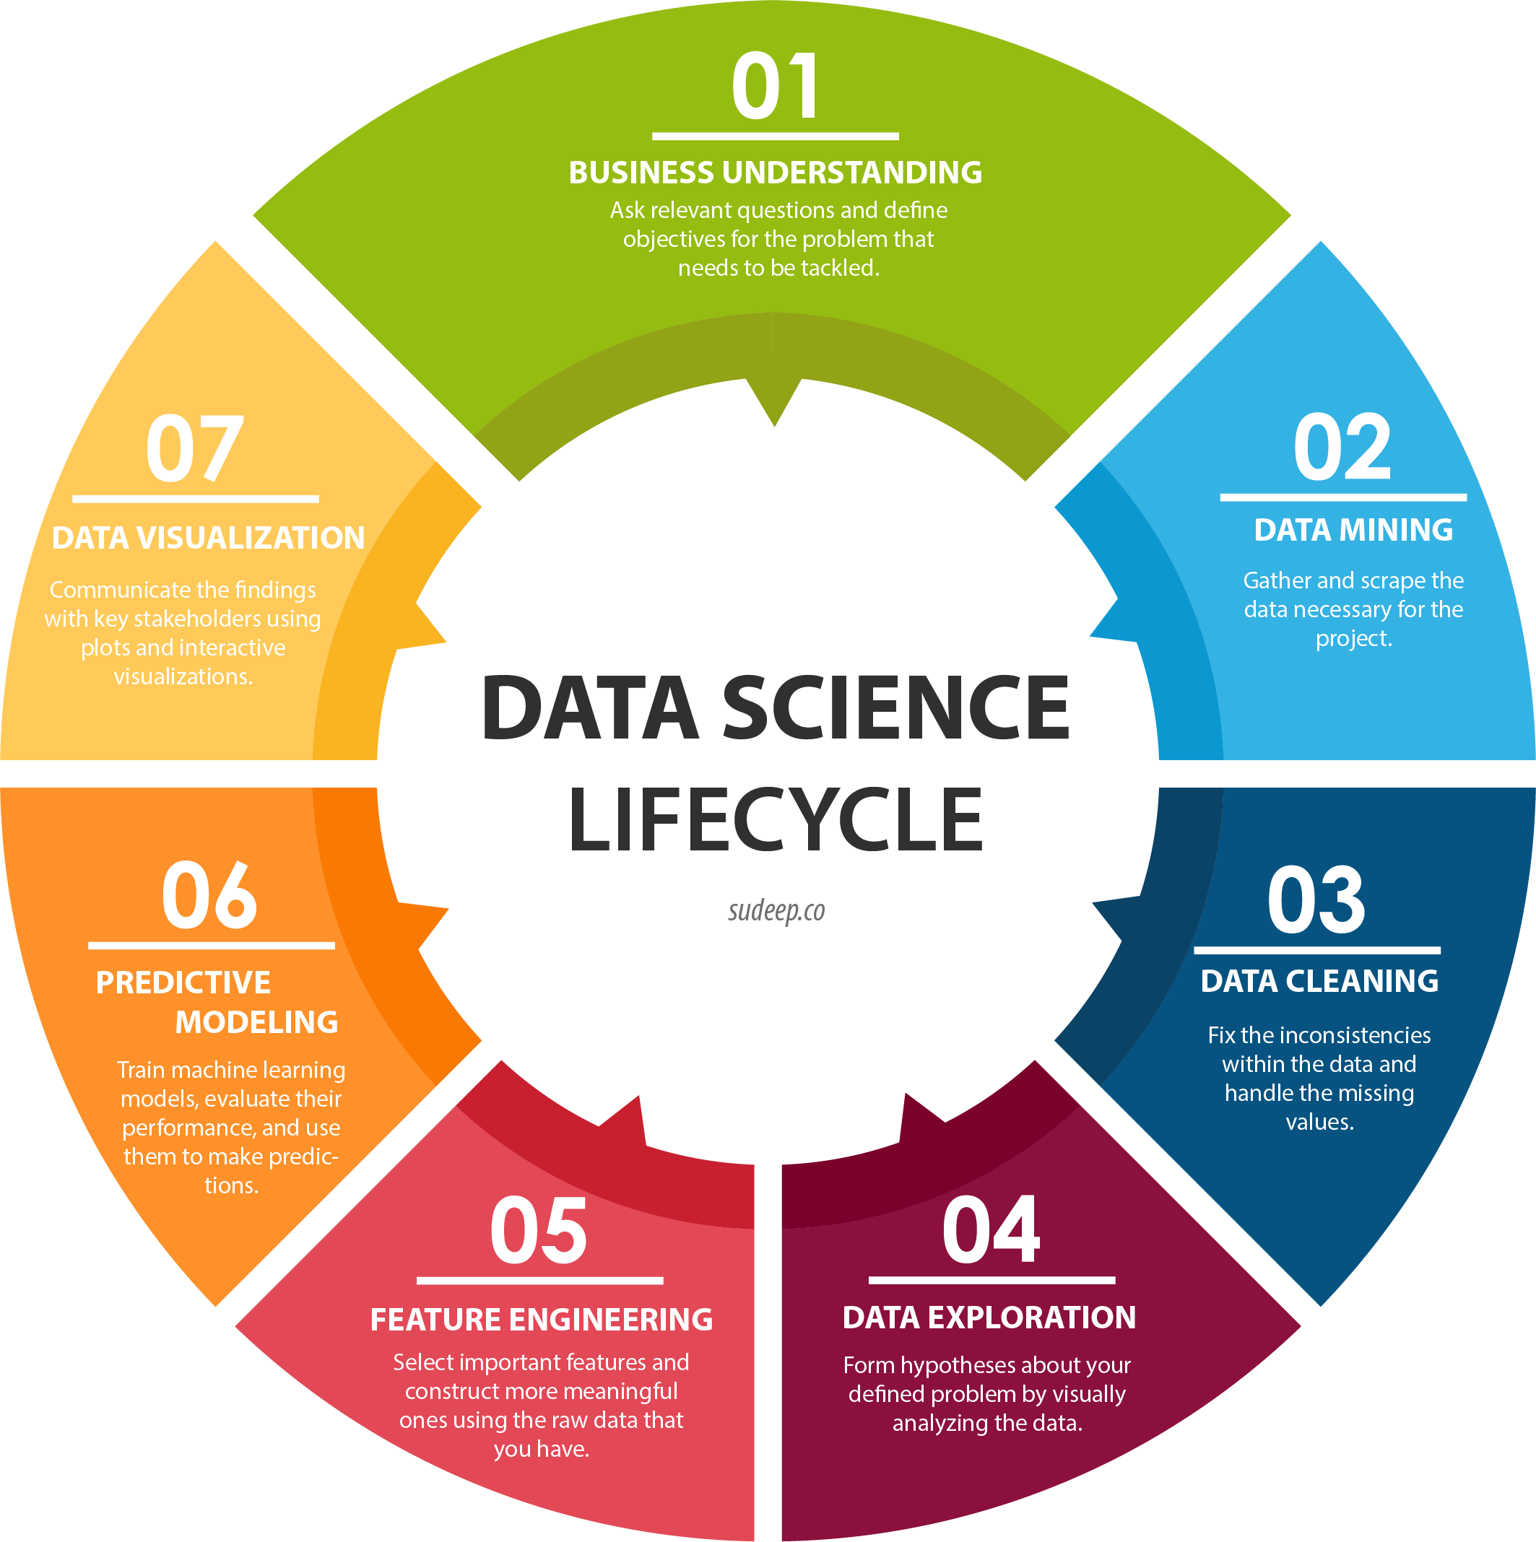
Data Science Lifecycle
Definiera ett problem att lösa och formulera lösningen
Tillgängliggör nödvändig data och källor
Preparera data
Testa att hitta lösningen på problemet (nr. 1). Funkar det tilltänkta datat/metoden för ändamålet?
Iterera
Träna modell och utvärdera output
Visualisera för att kommunicera insikter på ett pedagogiskt sätt
Börja om
Notes:
Eftersom vi går ett datavetenskapligt projekt måste vi följa vissa steg.
I vårt fall är datautvinning inte viktigt eftersom uppgifterna redan finns tillgängliga.
---
Since we are going a data science project we need to follow certain steps.
In our case data mining is not importance since the data is already available.

Slide 6
Analytics solutions DevOps model
Business Governance
DevOps model for Analytics Solutions
Better interaction with business stakeholders
Optimizing prioritization
Retaining knowledge in-house
Ability to flex resources as required
Efficient resource allocation
Solution Prio
Mgmt
Development & Maintenance
Prioritized Backlog
Develop
Design
Sprint
Plan
Test
Demo
In Use
Release
Correction
Correction
Correction
Notes:
Dessa steg kommer att utföras på ett iterativt sätt för att säkerställa att vi uppnår det bästa resultatet.
---
These steps will be performed in an iterative way to make sure we are achieving the best outcome.

Slide 7
Getting started with Advanced Analytics
 | Phase 1 – week 1 |  | Phase 2 - week 2-3 | Phase 3 - week 4
Activities | Secure business use case and data Agile analytics workshop 1.1 Use case definition and prioritization with stakeholders. 1.2 Define the minimum viable product 1.3 Select relevant KPIs/Metrics/Outcome for use case. 1.4 Define cross-functional team structure. Select & deliver data 1.5 Define technology to be used for MVP. 1.6 Secure access to analytics platform 1.7 Select data sets required for MVP 1.8 Deliver data for MVP |  | Data Analytics Develop Data & Analytics 2.1 Prepare data for analytics 2.2 Data exploration 2.3 Data feature analysis 2.4 First iteration: Pattern recognition and model development 2.5 Workshop to review analytics findings 2.6 Second iteration: Pattern refinement based on workshop | Present the MVP Deliver Analytics Insights 3.1 Documentation of findings. 3.2 Stakeholder presentation of MVP. 3.3 Present next steps.
Deliverables | Relevant KPIs/Metrics/Outcome for the use case. Data to be used in MVP. |  | Data profiling findings Analytics feature data set Initial ideas based on data analysis | MVP package Data Science methodology used in MVP Presentation with outcome and recommended next steps
Setup environment for MVP
Notes:
I det här projektet följde vi en standardprojektplan för datavetenskap.
Den första fasen, som sträckte sig över en vecka, ägnades åt att analysera affärsfallet och data, att identifiera dess innehåll och se till att vi alla är anpassade till vad det är vi producerar.
Fas 2, vecka 2 och 3, ägnas åt modellbygge och förfining. Den sista fasen, under vecka 4, är reserverad för att skapa dokumentation för projektet och leveranserna.
---
In this project we followed a standard data science project plan.
The first phase, spanning one week, was devoted to analysing the busness case and data, to identifying its content and making sure we are all aligned to what it is we are producing.
Phase 2, weeks 2 and 3, are devoted to the model building and refinement. The last phase, during week 4 is reserved for creating documentation for the project and the deliverables.

Slide 8
Timeline
03/11/2022 Project initiation
11/25 End of development process
2022/11/30 Project end
11/16 Descriptive analysis completed
11/09 Business knowledge set
Notes:
under projektet hade vi några viktiga datummilstolpar, som vi kan se här.
Som vi också kan se ligger vi i tid med den tidslinje vi tilldelade i början av projektet.
---
during the project we had some important dates milestones, as we can see here.
As we can also see we are on time with the timeline we have assigned at the beginning of the project.

Slide 9
Data and analysis
Notes:
Låt oss nu gå vidare till att titta på data
---
Let's move now to looking at the data

Slide 10
Descriptive Analysis
Correlation matrix
Distinct feature investigation
Continuous feature investigation
Investigation of interesting attributes
Notes:
För den beskrivande analysen skapade vi en korrelationsmatris för att identifiera egenskaper som är relaterade till varandra.
Utförde sedan en distinkt funktionsundersökning och en separat för den kontinuerliga såväl som de distinkta som innehöll för många nivåer.
Slutligen gjorde vi en parvis undersökning av funktioner som det beslöts med att verksamheten skulle undersökas tillsammans för att identifiera om de ger intressanta resultat.
----
For the descriptive analysis we created a correlation matrix to identify features that are related to eachother.
Then performed a distinct feature investigation, and a seperate one for the continuous one as well as the distinct ones that contained too many levels.
Lastly we did a pair wise investigation of features that it was dicided with the business should be investigated together to identify if they produce interesting results.

Slide 11
Data contents
Used features
Ignored features
Target variable:
Attrition
Demographic information – Infrmationa bout the employee
Age, EducationField, Gender, NumCompaniesWorked, MaritalStatus, DistanceFromHome
Position information – Information about the position and how long the employee has held it
JobRole, JobLevel, Department, YearsAtCompany, TotalWorkingYears, YearsInCurrentRole, YearsSinceLastPromotion, YearsWithCurrManager
Satisfaction information – self reported information (surveys) about the wellbeing of the employee
JobSatisfaction, RelationshipSatisfaction, WorkLifeBalance, EnvironmentSatisfaction
Payment information – Salary information broken down to different denominaitons
MonthlyIncome, MonthlyRate, DailyRate, HourlyRate, PercentSalaryHike
Benefits & perks information – Information about the benefits the employee receives
StockOptionLevel, TrainingTimesLastYear, PerformanceRating, JobInvolvement, OverTime, BusinessTravel
Information that is the same for all employees or is too uniquely identifying to provide any interesting information
EmployeeNumber – it uniquely identifies the employee
EmployeeCount – it shows how many employees are associated with this record. It is always 1
Over18 –all employees are over 18
StandardHours – all employees are fully employed (40 hours)
Notes:
funktionerna kan delas in i 7 kategorier, där en är målfunktionen och en annan är funktioner som togs bort från datauppsättningen eftersom de inte gav någon extra information om medarbetaren eller att de var extremt specifika och inte skulle hjälpa till i generaliseringen.
---
the features can be divided into 7 categories, with one being the target feature and another being features that were removed fromt eh dataset because they provided no extra information about the employee or they were ultra specific and were not going to help in the generalisation.

Slide 12
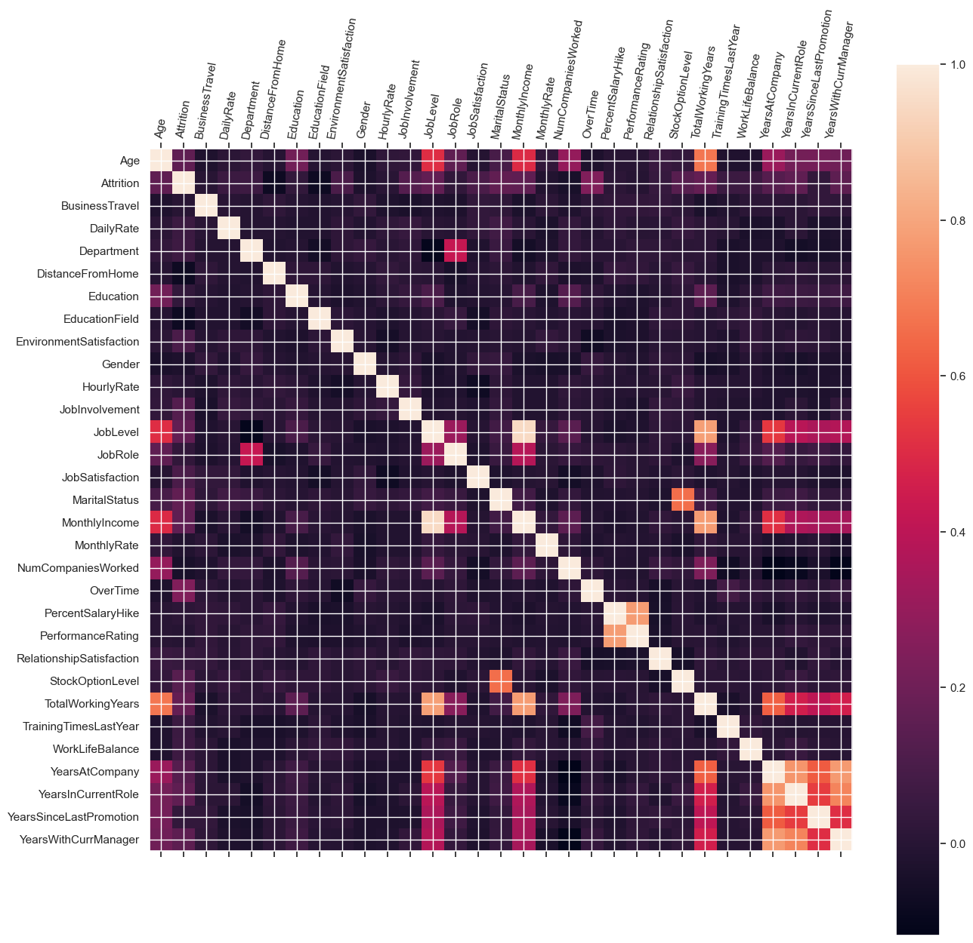
Correlation matrix
High correlation between the following:
Job level & marital status
Job level & total working years
Marital status & stock options
Monthly income & job level
Last salary increase & performance rating
Total working years & age
Total working years & monthly income
Total working years & years at company
Years at company & years in current role
Years at company & years since last promotion
Years at company & years with current manager
Notes:
I korrelationsmatrisen kan vi i de ljusare färgerna se de egenskaper som är mer korrelerade med varandra.
Som väntat är de egenskaper som har att göra med ålder och de anställdas arbetsår starkt korrelerade, liksom den om anställningens varaktighet och lön och jobbnivåer.
Oväntat är civilståndet och arbetsnivån också starkt korrelerade.
---
In the correlation matrix we can see in th lighter colours the feaures that are more correlated together.
As expected the features that have to do with age and the employees working years are highily correlated, as are the one about duration of employment and salary and job levels.
Unexpectadly the marital status and the job level is also higily correlated.

Slide 13
Definitions
Attrition "Yes" is for people that have resigned and "No" is for people that are still employed.
NumCompaniesWorked is the number of companies with 0 meaning that the person has just worked in the current company
The levels at JobLevel range from entry level to higher management.
For JobSatisfaction, 1 = low satisfaction, 4 = high
For RelationshipSatisfaction, 1 = low satisfaction, 4 = high. We are also assuming this is about their personal relationship.
For WorkLifeBalance, 1 = low satisfaction, 4 = high
For EnvironmentSatisfaction, 1 = low satisfaction, 4 = high. And we are assuming it shows office environment satisfaction.
For StockOptionLevel 0 means that they do not have stock options
For TrainingTimesLastYear a year is the last
PerformanceRating has only levels 3 and 4 meaning ghat all employees have been ranked as performing at a high level.
OverTime indicates if the person has been pre-approved to have payed overtime.
Incomes are recorded in $ USD
Notes:
Under datautredningen behövde vi också komma med några datadefinitioner såsom betydelsen för nivåerna av tillfredsställelse, måttenheter för löner och annat.
---
During the data investigation we also needed to come up with some data definitions such as the meanings for the levels of satisfaction, units of measurement for salaries, and other.

Slide 14
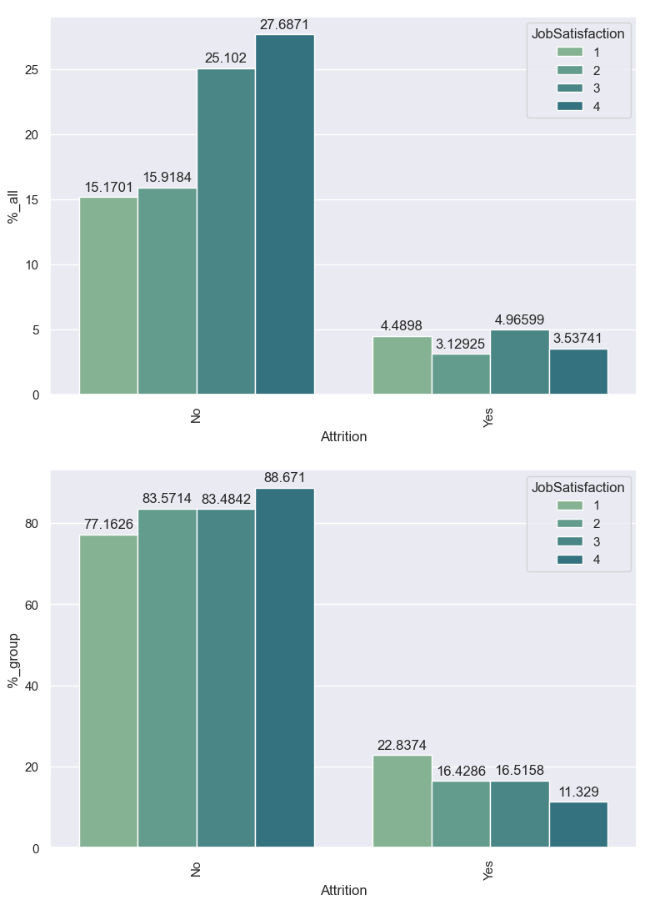
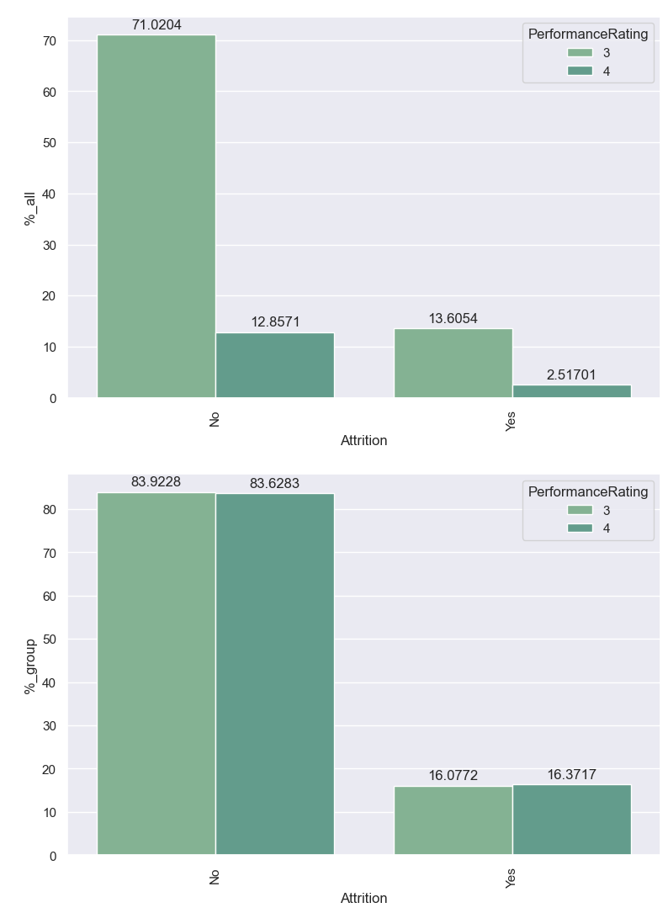
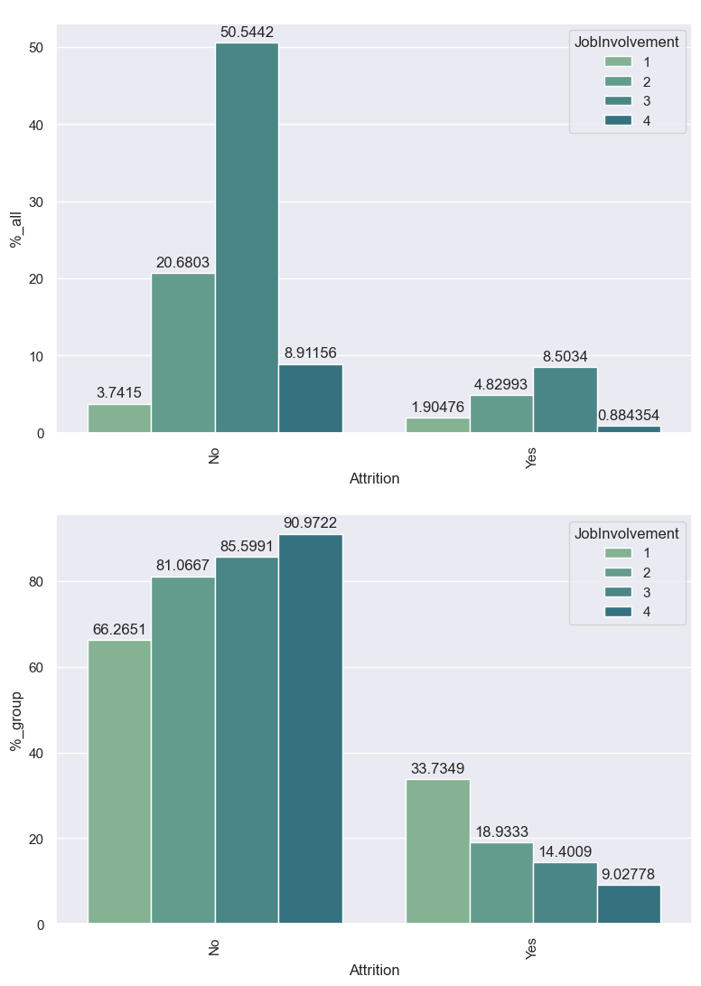
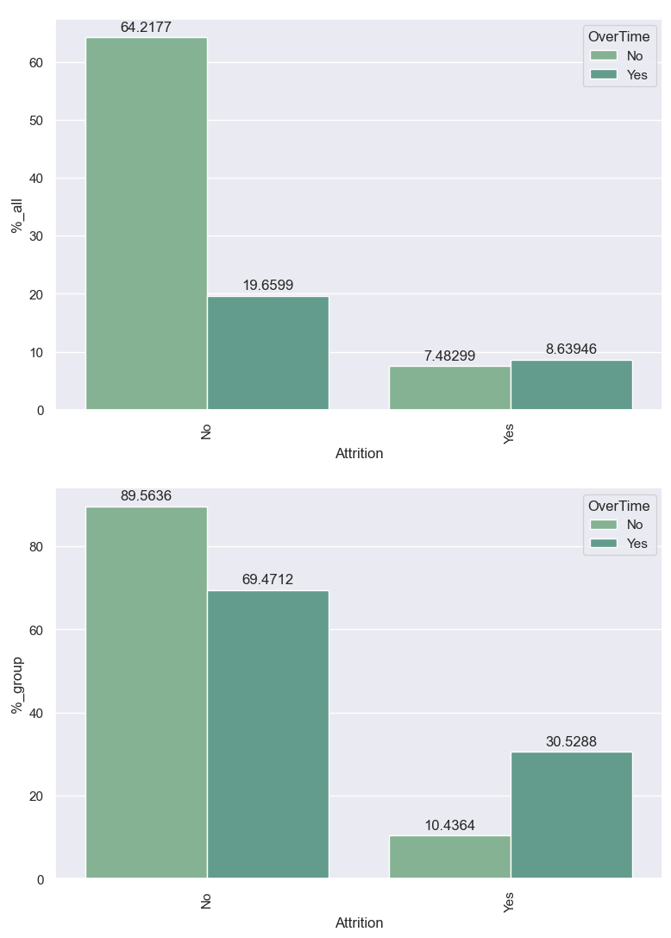
Distinct features investigation
Education - Attrition is highest for people that have Life Science degrees, followed by those with Medical ones.
Gender – Attrition is balanced between the 2 genders
NumCompaniesWorked - Overall the highest attrition is found on people that have worked in at least one more company.
MaritalStatus - The highest attrition is found in single people, both overall in the workforce and within their group.
JobRole - Within their group, sales representatives have the highest attrition.
JobLevel - Level 1 employees, they also have the highest level of attrition both overall and within their group.
JobSatisfaction - Overall people that have a level of satisfaction of 3 have left the company. The same is true for people with job satisfaction of 1, withing their group. Variance of attrition is quite low.
RelationshipSatisfaction - Overall people that have a level of satisfaction of 3 have left the company. The same is true for people with relationship satisfaction of 1, withing their group. Variance of attrition is quite low.
WorkLifeBalance - Overall people that have a level of balance of 3 have left the company. The same is true for people with balance satisfaction of 1, withing their group. Variance of attrition is quite low.
EnvironmentSatisfaction - Both overall and within their group people that have a level of satisfaction of 1 have left the company. Variance of attrition is quite low.
StockOptionLevel - Both overall and within their group people with 0 stock options are more likely to leave.
TrainingTimesLastYear - Overall, the group that has the highest attrition is those that have had 2 trainings in the last year, followed closely by those with 3. Within their group the people that have not received any training in the last year are more likely to leave.
PerformanceRating - Attrition is higher in the group that has level 3 performance. - Within the groups the attrition levels are equal.
JobInvolvement - Overall the levels follow a proportional pattern when it comes to the attrition. - Within their own groups the proportions are inverted.
OverTime - Most employees do not have overtime. While the attrition is higher for employees without overtime (due to higher amount), people with overtime have left the company more both overtime and within their group.
BusinessTravel - Most of the people that have left overall traveled rarely. The people with frequent travel are the ones that have higher attrition within their group.
Notes:
Här kan vi se de observationer som vi gjorde under undersökningen av distinkta egenskaper.
Funktionsmarkeringarna med fetstil är de vi kan se i graferna.
----
Here we can see the observations that we made during the distinct features investigation.
The features marks with bold are the ones we can see in the graphs.

Slide 15
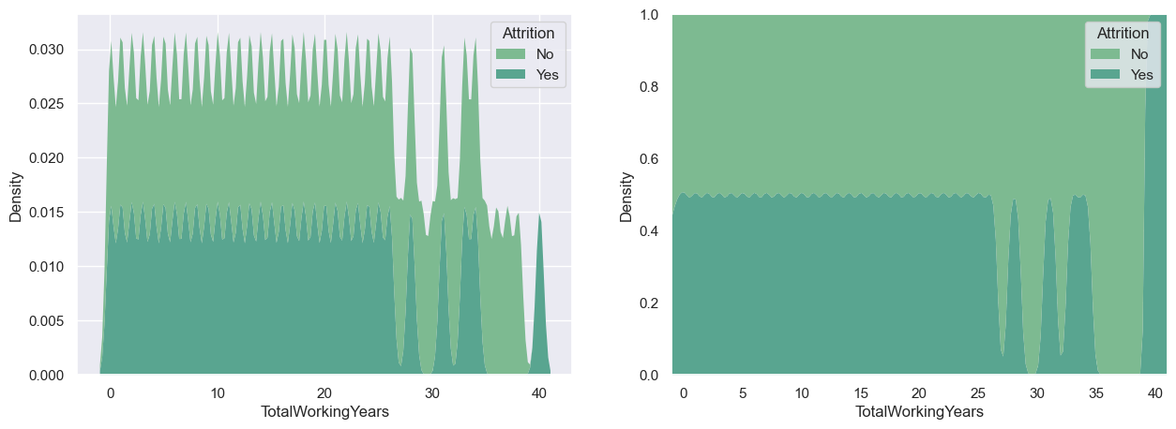
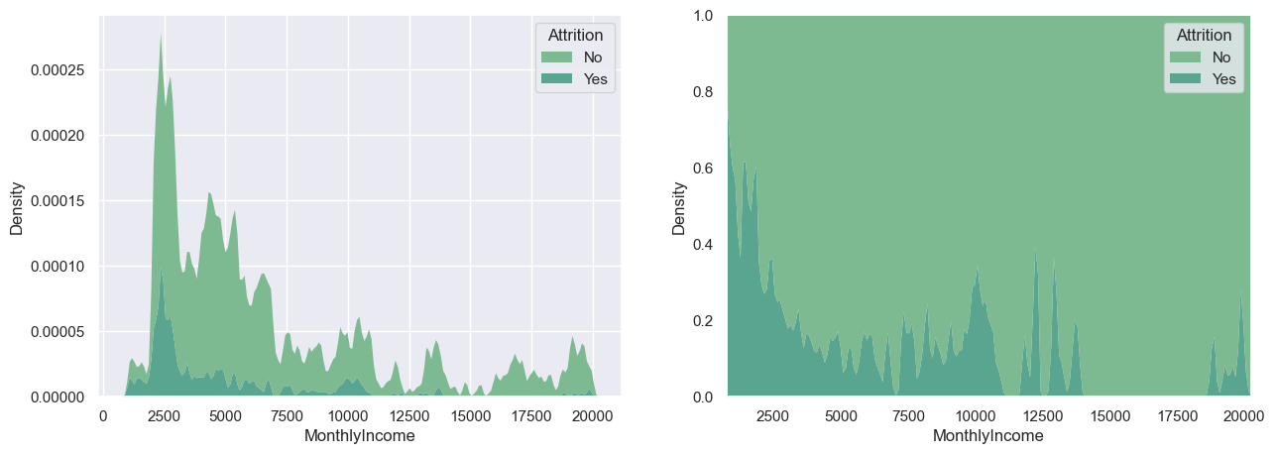
Continuous features investigation
A lot of the continuous variables have attrition close to 50% within their groups
YearsAtCompany – All people that have been in the company 40 years have left. People working at the company 25-30 and 35-40 years don’t leave.
TotalWorkingYears – It follows similar pattern as YearsAtCompany
YearsInCurrentRole – People that have worked 10.5 or more than 15.5 years in the same role have not left the company
MonthlyIncome – Most people that have left the company have had monthly income less than $ 2500
Notes:
För de kontinuerliga features och de nominela som har för många nivåer gjorde vi en liknande undersökning men istället för räkningar och procenttal använde vi fördelningen av värdena över deras intervall.
Vad vi identifierade var att många av funktionerna var nästan lika fördelade mellan de personer som har lämnat företaget och de som inte har gjort det.
---
For the continuous features and the distinct ones that have too many levels we did a similar investigation but instead of counts and percentages we used the distribution of the values over their range.
What we identified was that a lot of the features were almost equaly distributed betweent eh people that have left the company and those that have not.

Slide 16
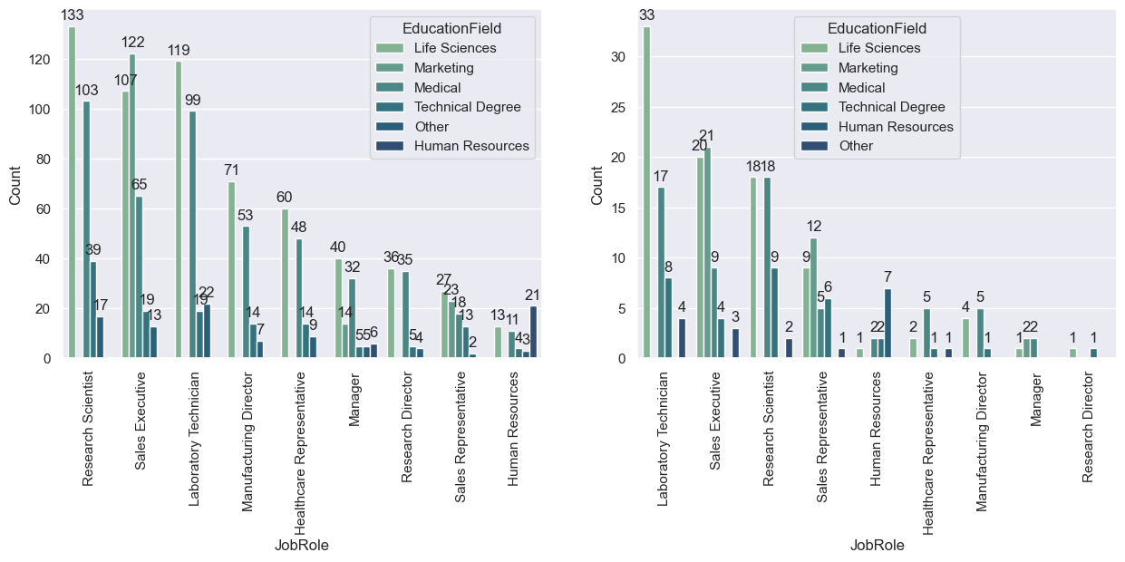
Pairwise Investigation
There are certain combinations of education and job title that have not left the company
Notes:
Under våra diskussioner med verksamheten identifierade vi att utbildningsområdet och arbetsrollsfälten skulle vara intressanta att undersöka tillsammans.
Så här kan vi se hur utbildningsområdena är fördelade på jobbrollerna och sedan samma parning för de personer som lämnat organisationen.
---
During our discussions with the business we identified that the education field and job role fields would be interesting to investigate together.
So here we can see how the educational fields are distributed in the job roles and then the same pairing for the people that have left the organization.

Slide 17
Predictive model
Notes:
Nu när vi har tittat på data, låt oss ta en titt på modellerna som skapats för att undersöka attrition.
---
Now that we have looked into the data, let's take a look at the models created to look into attrition.

Slide 18
Model
Model competition
Feature importance
Notes:
Nu när vi har tittat på data, låt oss ta en titt på modellerna som skapats för att undersöka attrition.
---
Now that we have looked into the data, let's take a look at the models created to look into attrition.

Slide 19
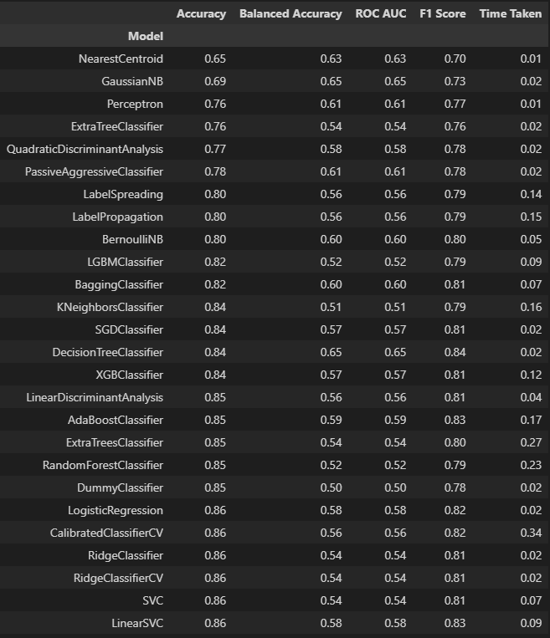
Model competition
Use of the Lazy Classifier library
Testing of 26 algorithms
Comparing
Accuracy
Balanced accuracy
ROC AUC
F1 score
Time it took to run
Notes:
Först använder vi lazy classifier-libret för att köra alla modeller som är tillgängliga för referens.
Libret/packet presenterar dessa egenskaper för jämförelse.
F1-poängen kombinerar precisionen och återkallandet av en klassificerare till ett enda mått genom att ta deras harmoniska medelvärde
Från dessa valde vi Perceptron, knn och logistiska regressionsklassificerare för att jämföra ytterligare. Vi använde också klassificeraren multinomial NB (neive bayes).
---
First we use the lazy classifier library to run all the models available for reference.
The library presents these characteristics for comparison.
The F1 score combines the precision and recall of a classifier into a single metric by taking their harmonic mean
From these we selected the Perceptron, the knn and the logistic regresion classifiers to compare further. We also used the multinomial NB (neive bayes) classifier.

Slide 20
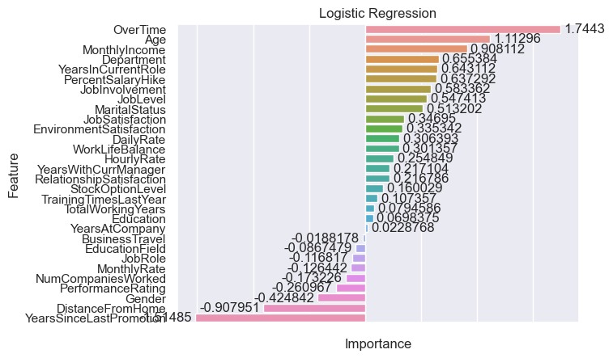
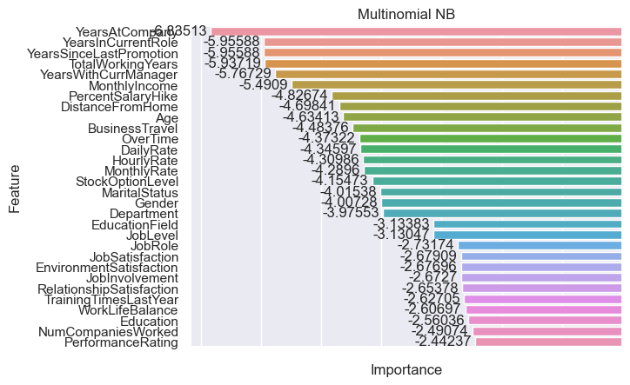
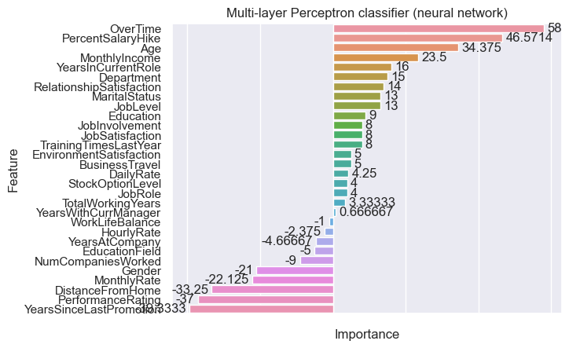
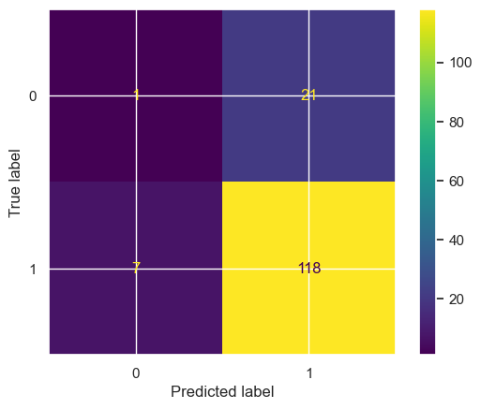
Model & feature competition
Comparison of
K- nearest neighbors (.80)
Logistic regression (.86)
Multinomial NB (.85)
Multi-layer Perceptron classifier (neural network) (.80)
Notes:
ytterligare undersökning i dessa modeller gav oss ett ganska högt betyg i testsetet, alla modeller är över .8.
Detta gav oss också möjlighet att undersöka vilka funktioner som var viktigare för att göra dessa klassificeringar.
Som vi kan se i åtminstone 2 av klassificerarna får över tiden höga poäng liksom åldern på den anställde.
Förvirringsmatrisen för knn visar 7 personer som inte har lämnat företaget ännu men som med stor sannolikhet kommer att lämna.
---
further investigation in these models gave us a quite high score in the test set, all models are over .8.
This also gave us the opportunity to look into which features were more important in making these classifications.
As we can see in at lest 2 of the classifiers Over time scores high as does the age of the employee.
The confusion matrix for knn shows 7 people that have not left the company yet but are very likely to leave.

Slide 21
Next steps
Notes:
Nu när vi har tittat på modellerna ska vi titta på hur de kan användas för att förbättra verksamheten.
---
Now that we have looked into the models let's look at how they can be used to improve the business.

Slide 22
Next steps
Model implementation
Change management organization
Storage of results
Monitoring
Model
Value
Move model to a production environment
For use in future consultations
Implementation of findings in organization
To ensure its performance
To ensure it produces the outcome we are looking for
Model refinement
Use time dimension
Notes:
I korthet är nästa steg:
för att förfina modellen,
för att sedan sätta modellen i produktion,
När modellerna används i produktionen är det viktigt att lagra resultaten för att förbättra framtida resultat.
det är också viktigt att börja genomföra förändringar i organisationen baserat på resultaten,
och naturligtvis att implementera övervakningssystem för både eh-modellen och resultaten för att se till att de är i linje med våra förväntningar.
---
In short the next steps are:
to refine the model,
to then put the model in production,
When the models is deployed in production it is important to store the results in order to improve future results.
it is also mportant to start implementing changes in the organisation based on the results,
and of course to implement monitoring systems for botht eh model and the results to make sure they are aligned with our expectations.

Slide 23
Next steps
Change management organization
Use of findings in select departments to verify accuracy
Selection of most logical model
Test if altering things that have been identified as important reduces attrition.
Model Refinement
Time dimension will give insight on weather there have been spikes in certain times/periods
Knowing if a person has resigned and why, if they were fired or went into retirement will make sure that better groupings are made
Run models again to test improvement
Use a bigger and more random set to verify the results
Notes:
Jag skulle vilja prata mer specifikt om hur vi kan förfina modellen och hur vi kan genomföra förändringar i organisationen utifrån resultaten.
Om vi har datumen för varje anställd lämnade företaget, hur de gjorde och möjligen orsaken, kan vi identifiera, spåra och till och med förutsäga perioder med högre uppsägningar.
För organisationen,
vi kan välja den mest logiska modellen baserat på de resultat vi såg idag och sedan börja implementera den på olika avdelningar för att identifiera dess noggrannhet och eventuella förbättringar som kan behövas.
Resultaten kan sedan användas för att förbättra de anställdas arbetsupplevelse för att säkerställa att de inte lämnar företaget.
---
I would like to talk more specifically about how we can refine the model and how we can implement changes in the organisation based on the results.
B having the dates each employee left the company as well as the way they did and possibly the reason, we can identify, track and even predict periods wth higher amounts of resignations.
For the organisation,
we can select the most logical model based on the results we saw today and then start implementing it to different departments to identify its accuracy and possible refinments that might be needed.
The results can then be used to improve the work overal experience of the employees to ensure they do not leave the company.

