Slide 1
Next Best Offer for Bank of Portugal

Slide 2
Agenda
Background & Timeline
Data and analysis
Next Best Offer model
Next steps
Notes:
Today we’ll go thought the ... <agenda topics> and have a discussion about what we can do going forward and clarify some things around the next steps.

Slide 3
Background & Timeline

Slide 4
Situation
Gap
Value
Solution
Campaigning for products is done the same way for all clients
Next Best Offer (NBO) model
Better insights on the clients
Notes:
Allows you to treat your customers individually, tailoring their experience with your products based on their behaviour
Since thre is a campaign going on right now it would be beneficial to use the existing data and try to create a model for the current campaign to see how it could have performed so we can create a baseline for how much we can better the numbers.
Again what is the vallue
know your custumers more
spend more time on customers you are more likely to sell (they buy)

Slide 5
Situation
Solution
Next Best Offer (NBO) model
Get the likelihood of each customer buying each specific product
Interpreted as a suggestion (prediction) on if we should suggest this specific product to this specific client
Notes:
Allows you to treat your customers individually, tailoring their experience with your products based on their behaviour
Since thre is a campaign going on right now it would be beneficial to use the existing data and try to create a model for the current campaign to see how it could have performed so we can create a baseline for how much we can better the numbers.
Again what is the vallue
know your custumers more
spend more time on customers you are more likely to sell (they buy)

Slide 6
Situation
Value
Better insights on the clients
Increase the possibility of them accepting a campaign
Use of resources more cost-effectively
Invest valuable time on customers that are likely to buy the product being suggested to them
Notes:
Allows you to treat your customers individually, tailoring their experience with your products based on their behaviour
Since thre is a campaign going on right now it would be beneficial to use the existing data and try to create a model for the current campaign to see how it could have performed so we can create a baseline for how much we can better the numbers.
Again what is the vallue
know your custumers more
spend more time on customers you are more likely to sell (they buy)

Slide 7
Timeline
2022/10/03 Project initiation
2022/10/26 End of development process
2022/11/02 Project end
10/18 Decisions about model
10/13 Initial/descriptive investigation completed

Slide 8
Data and analysis

Slide 9
Descriptive Analysis
Data investigation
Correlation analysis
Feature investigation
Decision tree

Slide 10
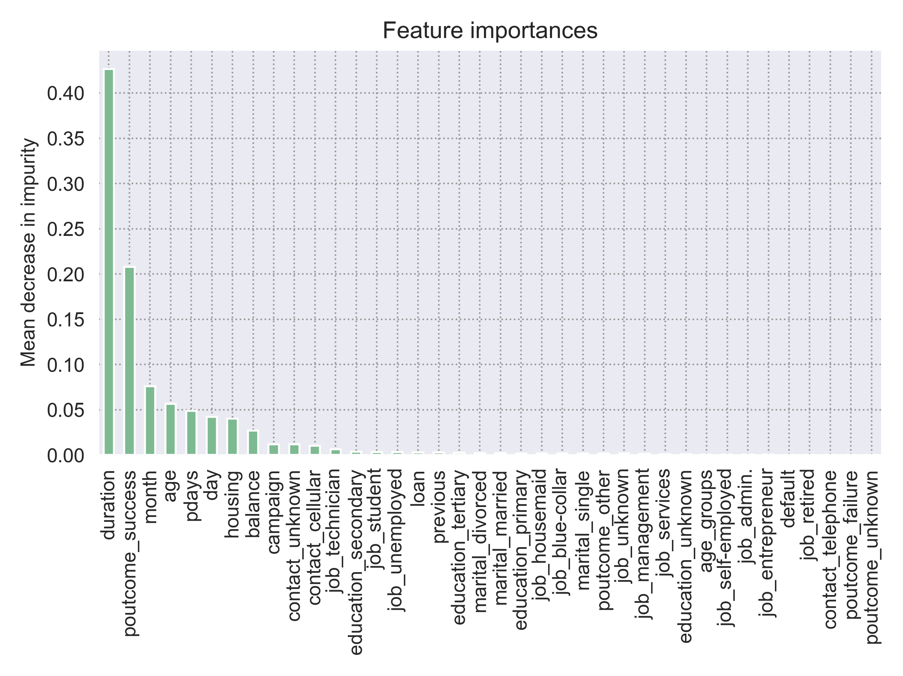
Descriptive Analysis
Feature investigation
Help identify importance
The duration of the last call informs most if the client will accept the campaign or not
Helps create groupings of clients
Should not be too specific
Notes:
Since it’s only one product we are predicting if we should present this to this client (if it is a success)
These are important because they tell us what it’s important
Distinctive features about what was successfull last time
They need to be generalisable
These are good because they are also logical
Talked with epople in business and verified they are indeed important

Slide 11
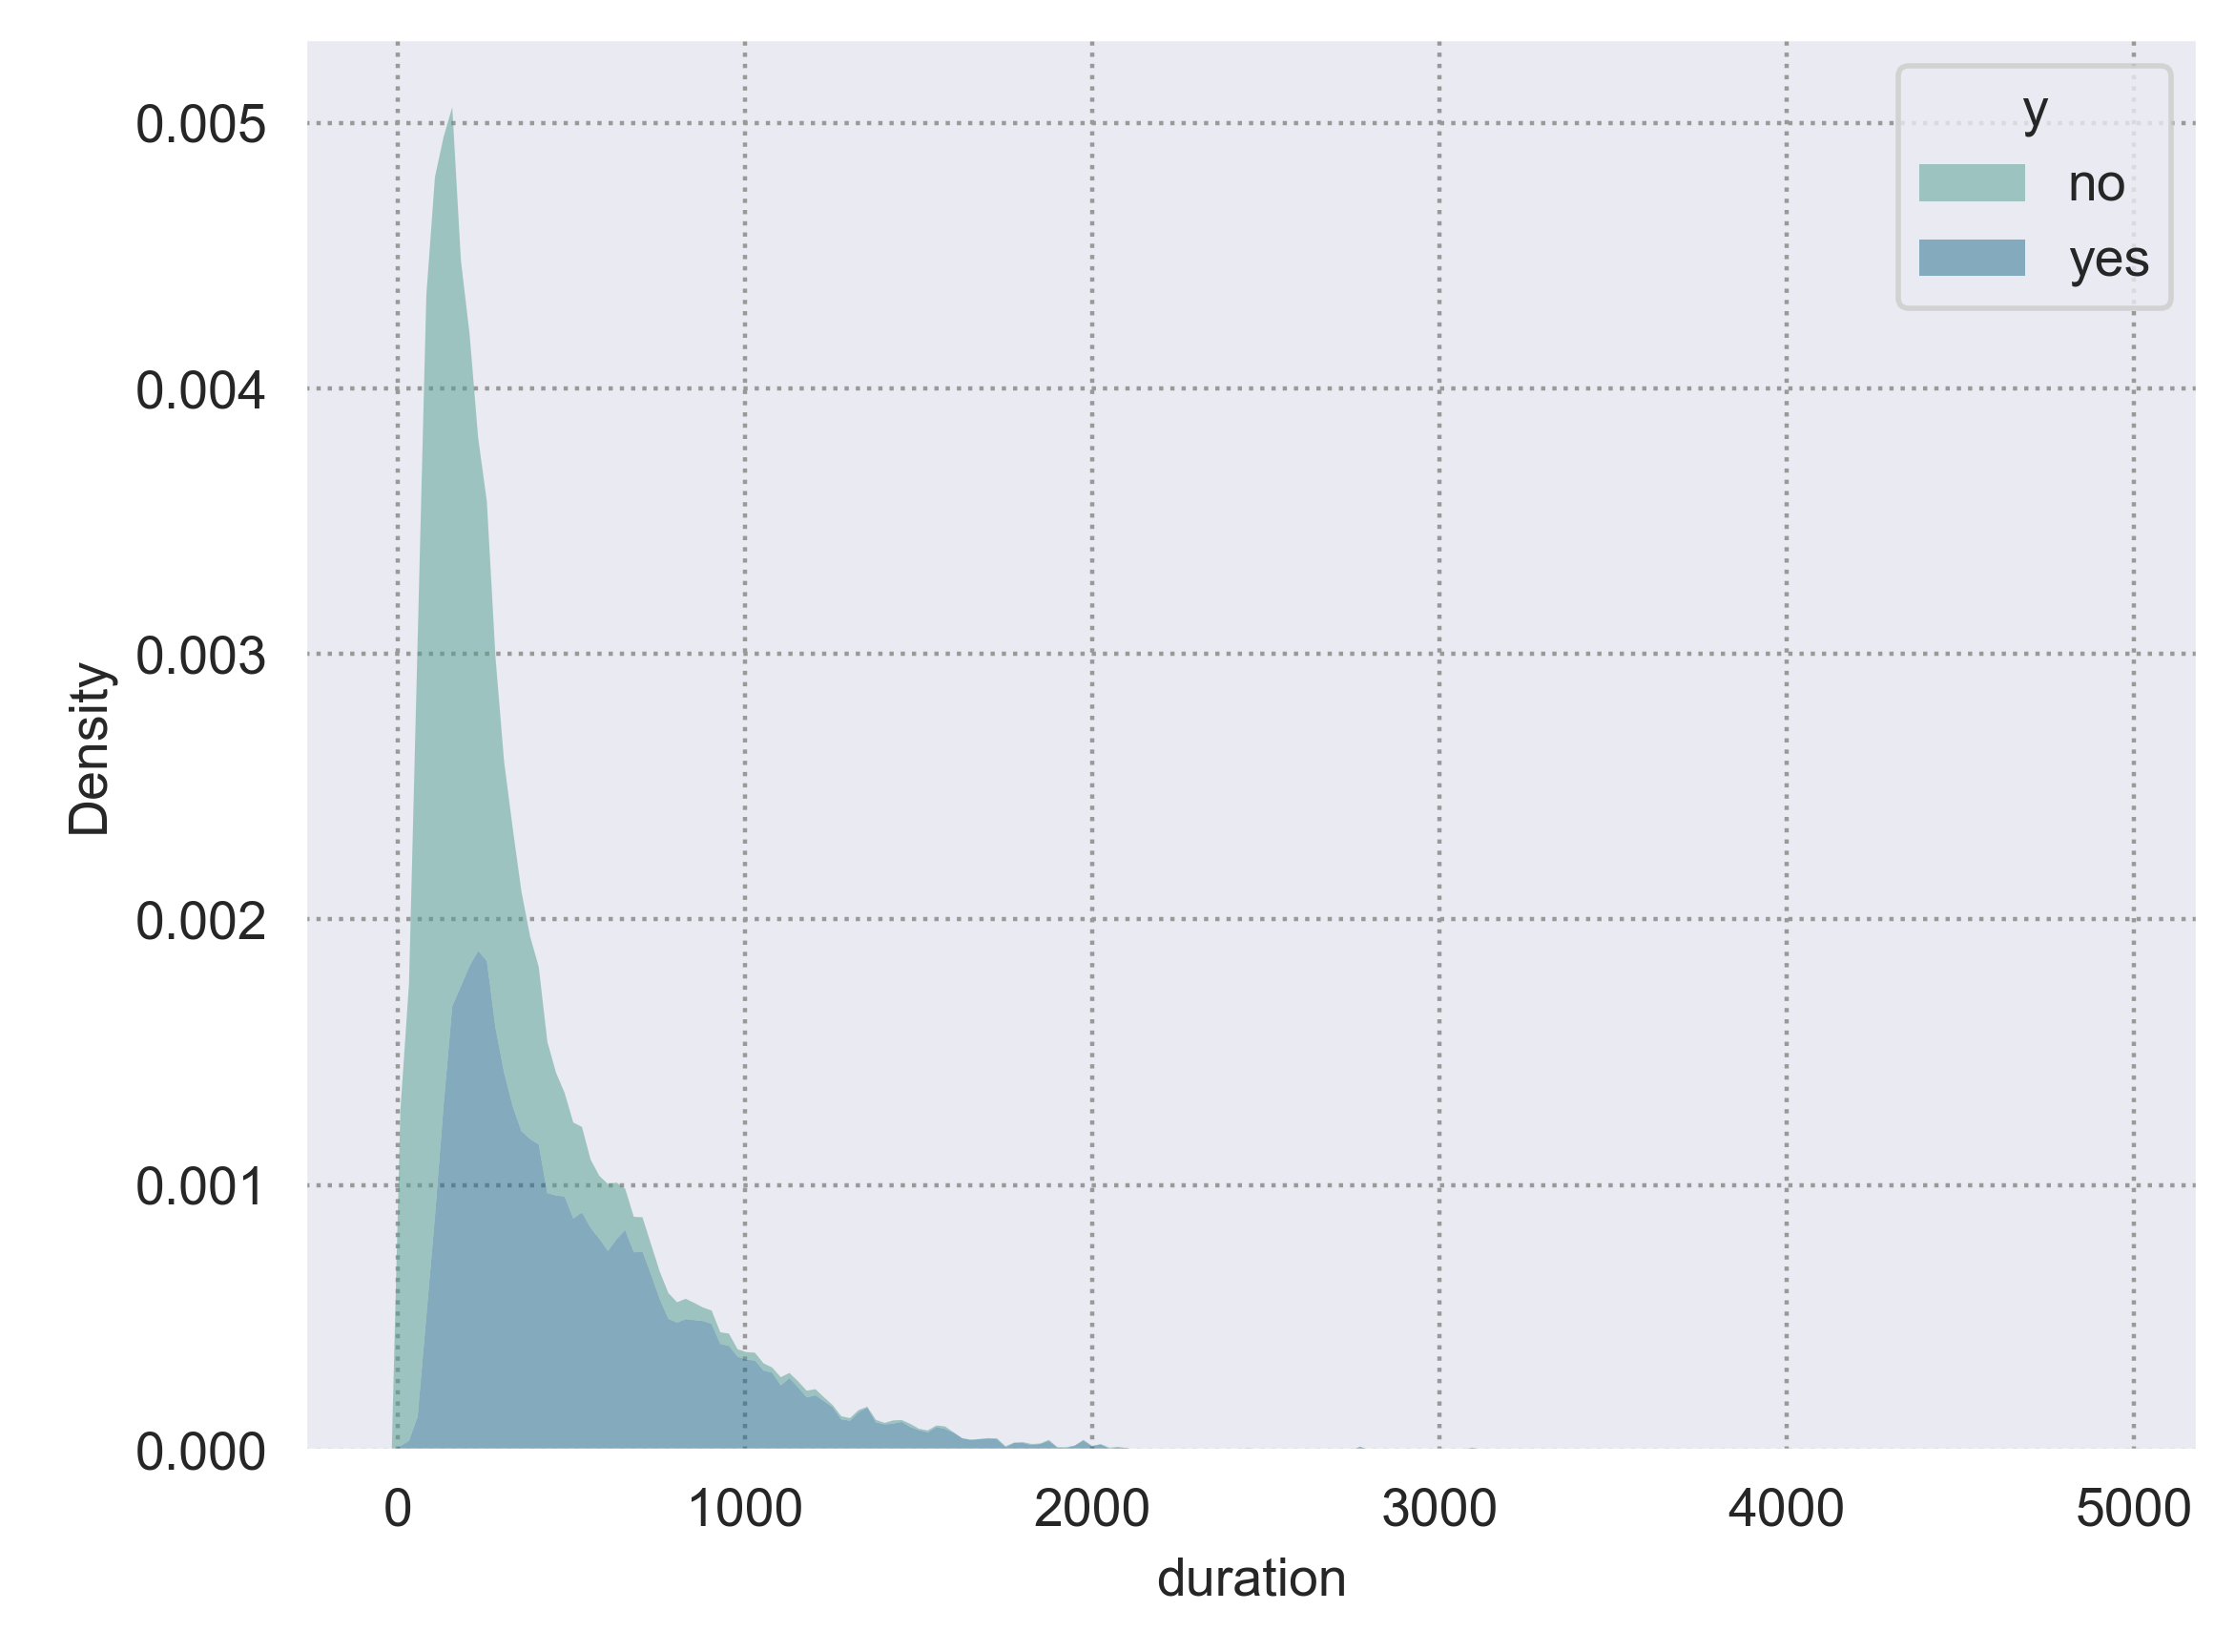
Descriptive analysis - Duration
Most important feature

Slide 12
Next Best Offer model

Slide 13
Model
Model competition
Accepted model
Decision process
Logistic regression

Slide 14
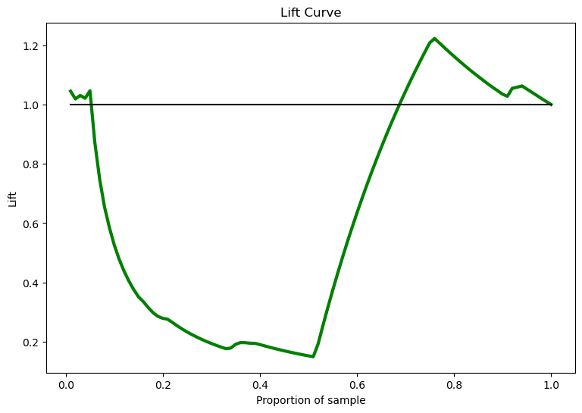
Model
Model Competition
Comparison of the accuracy and lift
Creation of multiple algorithms (predictive models)
Use of the same features in all of them
Use of the features that the feature investigation had highlighted as important, and the business verified
Notes:
Now we are trying to identify the ones they fulffil the criteria from the tree
Predictive model
Competition of different models to get the best one

Slide 15
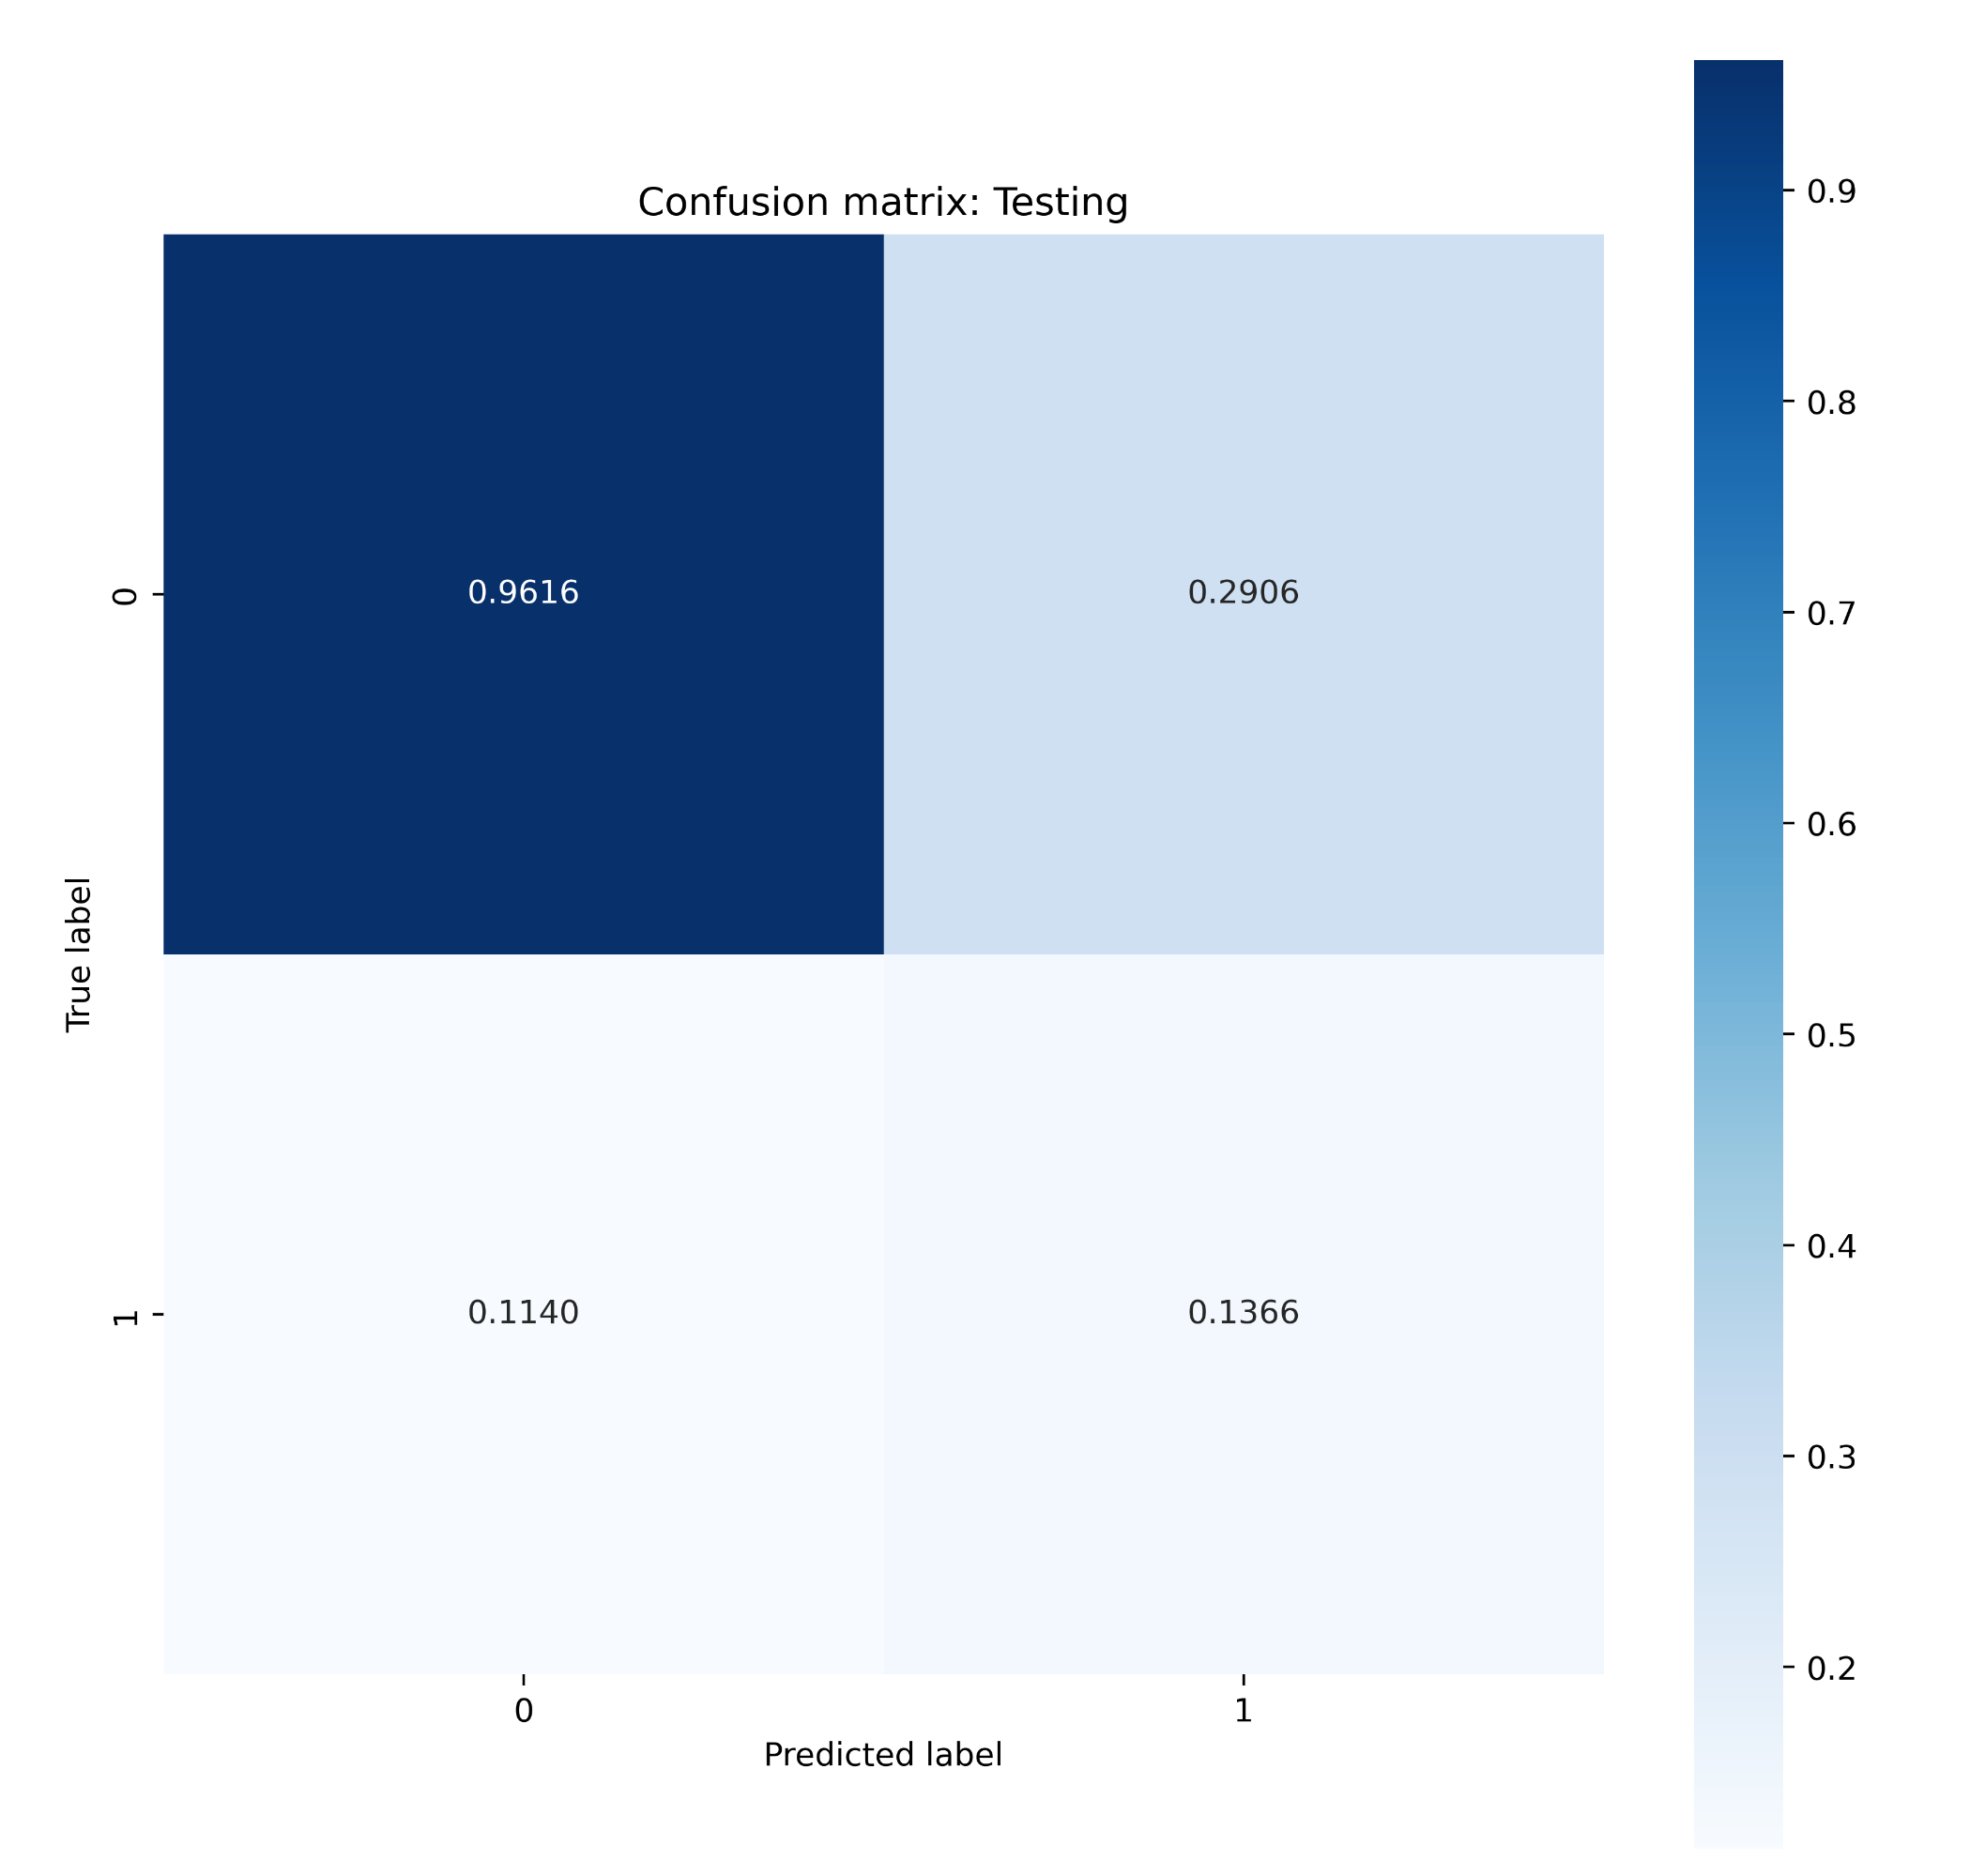
Model
Accepted model
Logistic regression
Accuracy of the training and test was good
Probabilities were good compared to a random decision (result of the existing campaign)
For each entry, it checks the probability of it being a success
Interested in all the combinations in the matrix
Notes:
How do we evaluate if a model is good or not
Talk about falce possitives
Talk about lift (how much better than random = talking to everyone)
Baeine of imporvment in current campaign is lift

Slide 16
Next steps

Slide 17
Next steps
Model implementation
Change management organization
Storage of results
Monitoring
Model
Value
Move model to a production environment
For use in future iterations
Use of model in select call centers to verify usefulness
To ensure its performance
To ensure it produces the outcome we are looking for
Notes:
Model is built
It performs like this …
Suggestions Next step
Try it in real customers in controled env
Few of call center people
Change management in the organisation (we can help)
Store data from it(we can help)
Mot´nitor model and value of it (help)
Pretend thit campagn was only done on phone

Slide 18
Next steps
Change management organization
Use of model in select call centers to verify usefulness
Train specific call center employees to establish usability of results
Use the model for other types of campaigning (e-mail, SMS, flyers etc.)
Create training material for the whole organization
Notes:
Model is built
It performs like this …
Suggestions Next step
Try it in real customers in controled env
Few of call center people
Change management in the organisation (we can help)
Store data from it(we can help)
Mot´nitor model and value of it (help)
Pretend thit campagn was only done on phone

