Slide 1
Attrition detection - <medi-tech company X>

Slide 2
Agenda
Background & Timeline
Data and analysis
Attrition prediction model
Next steps
Notes:
Today we’ll go thought the ... <agenda topics> and have a discussion about what we can do going forward and clarify some things around the next steps.

Slide 3
Background & Timeline

Slide 4
Project statement
Situation
Complication
Tech company in the medical/pharma field
Employment has been steady and declining
Is it possible to identify people that are likely to resign?
If so, which people are more likely to resign?
Question
Employment is being tracked monthly
Employment records are being kept
Satisfaction is being tracked quarterly
Answer
Predictive model estimating attrition

Slide 5
Getting started with Advanced Analytics
 | Phase 1 – week 1 |  | Phase 2 - week 2-3 | Phase 3 - week 4
Activities | Secure business use case and data Agile analytics workshop 1.1 Use case definition and prioritization with stakeholders. 1.2 Define the minimum viable product 1.3 Select relevant KPIs/Metrics/Outcome for use case. 1.4 Define cross-functional team structure. Select & deliver data 1.5 Define technology to be used for MVP. 1.6 Secure access to analytics platform 1.7 Select data sets required for MVP 1.8 Deliver data for MVP |  | Data Analytics Develop Data & Analytics 2.1 Prepare data for analytics 2.2 Data exploration 2.3 Data feature analysis 2.4 First iteration: Pattern recognition and model development 2.5 Workshop to review analytics findings 2.6 Second iteration: Pattern refinement based on workshop | Present the MVP Deliver Analytics Insights 3.1 Documentation of findings. 3.2 Stakeholder presentation of MVP. 3.3 Present next steps.
Deliverables | Relevant KPIs/Metrics/Outcome for the use case. Data to be used in MVP. |  | Data profiling findings Analytics feature data set Initial ideas based on data analysis | MVP package Data Science methodology used in MVP Presentation with outcome and recommended next steps
Setup environment for MVP

Slide 6
Analytics solutions DevOps model
Business Governance
DevOps model for Analytics Solutions
Better interaction with business stakeholders
Optimizing prioritization
Retaining knowledge in-house
Ability to flex resources as required
Efficient resource allocation
Solution Prio
Mgmt
Development & Maintenance
Prioritized Backlog
Develop
Design
Sprint
Plan
Test
Demo
In Use
Release
Correction
Correction
Correction

Slide 7
Timeline
03/11/2022 Project initiation
11/25 End of development process
2022/11/30 Project end
11/16 Descriptive analysis completed
11/09 Business knowledge set

Slide 8
Data and analysis

Slide 9
Descriptive Analysis
Correlation matrix
Distinct feature investigation
Continuous feature investigation
Investigation of interesting attributes

Slide 10
Data contents
Used features
Ignored features
# Constants
ISRESIGNED_T = 'Attrition'
# employee related information
AGE = 'Age'
EDUCATION_T = 'EducationField'
GENDER_T = 'Gender'
COMPANIES = 'NumCompaniesWorked'
STATUS_T = 'MaritalStatus'
HOMEDISTANCE = 'DistanceFromHome'
# role of the employee in the company
ROLE_T = 'JobRole'
LEVEL = 'JobLevel'
DEPARTMENT_T = 'Department'
YEARSCOMPANY = 'YearsAtCompany'
YEARSEMPLOYED = 'TotalWorkingYears'
YEARSROLE = 'YearsInCurrentRole'
YEARSLASTPROMO = 'YearsSinceLastPromotion'
YEARSMANAGER = 'YearsWithCurrManager'
# satisfaction informaiton
SATISFACTION = 'JobSatisfaction'
TEAMCLICK = 'RelationshipSatisfaction'
LIFEBALANCE = 'WorkLifeBalance'
ENVIRONMENT = 'EnvironmentSatisfaction'
# salary and money related
SALARY = 'MonthlyIncome'
MONTHLYRATE = 'MonthlyRate'
DAILYRATE = 'DailyRate' # Daily rate = the amount of money you are paid per day
HOURLYRATE = 'HourlyRate'
# Percent salary hike = the % change in salary from 2016 vs 2015.
LASTINCREMENTPERCENT = 'PercentSalaryHike'
STOCKOPTIONS = 'StockOptionLevel' # Stock option level = how much company stocks you own.
TRAINING = 'TrainingTimesLastYear'
# rating and involvement related
RATING = 'PerformanceRating'
INVOLVEMENT = 'JobInvolvement'
OVERTIME_T = 'OverTime' # Y/N
TRAVEL_T = 'BusinessTravel' # rare / requent
# redundant fields
EMPLYEENO_R = 'EmployeeNumber' # number
EMPLOYEECOUNT_R = 'EmployeeCount' # all 1
ISOVER18_R = 'Over18' # all Y
STDHOURS_R = 'StandardHours' # all 40

Slide 11
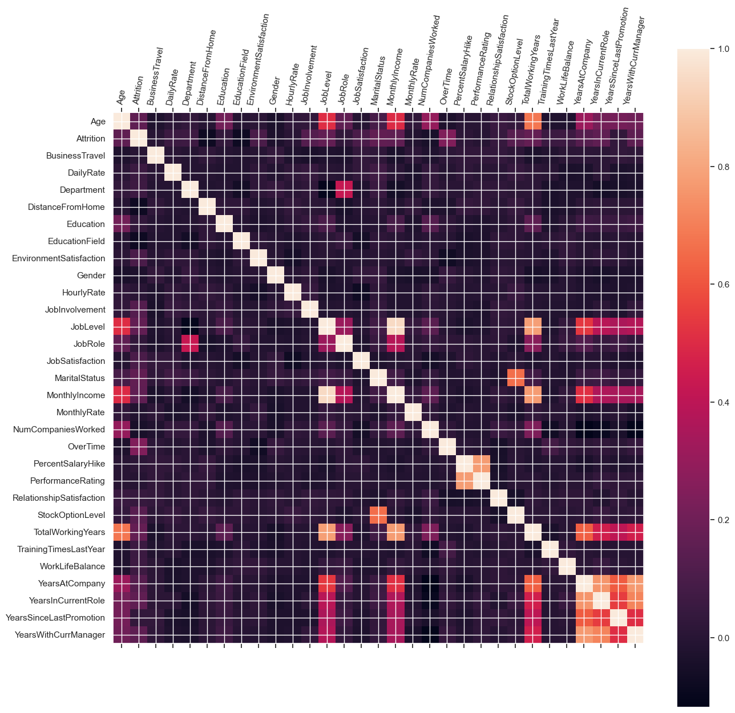
Correlation matrix
High correlation between the following:
Job level & marital status
Job level & total working years
Marital status & stock options
Monthly income & job level
Last salary increase & performance rating
Total working years & age
Total working years & monthly income
Total working years & years at company
Years at company & years in current role
Years at company & years since last promotion
Years at company & years with current manager

Slide 12
Descriptive analysis

Slide 13
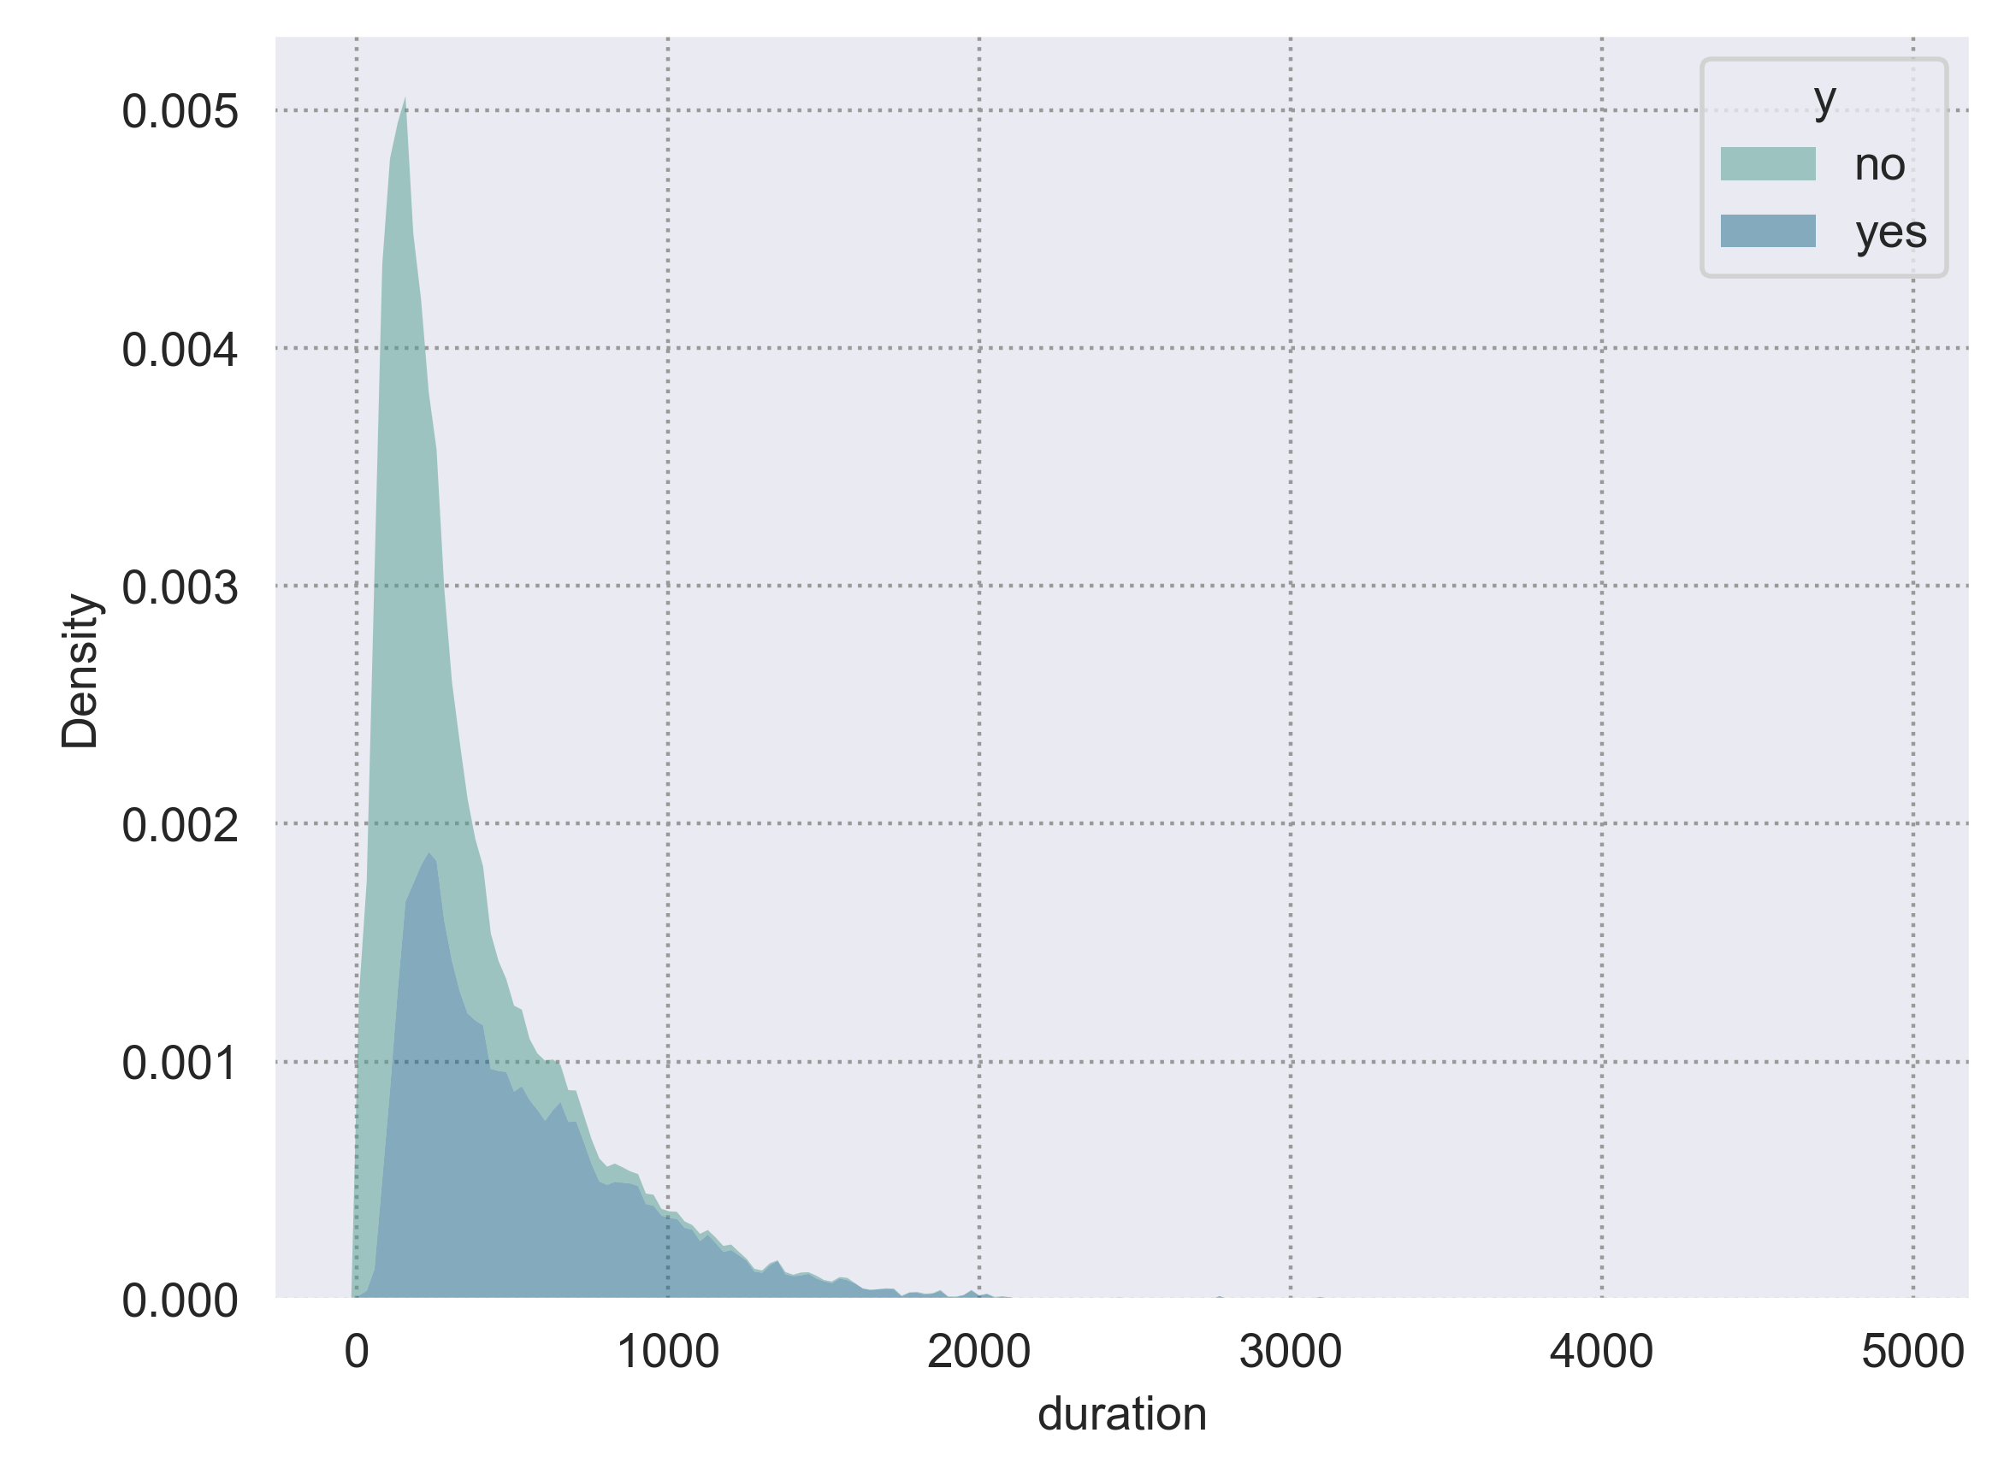
Descriptive analysis - Duration
Most important feature

Slide 14
Next Best Offer model

Slide 15
Model
Model competition
Accepted model
Decision process
Logistic regression

Slide 16
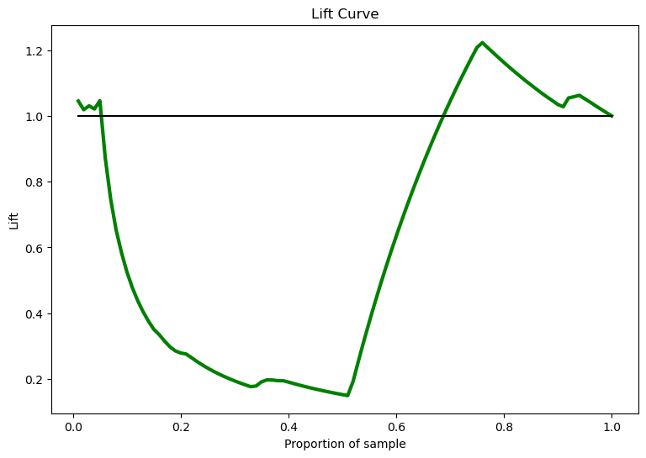
Model
Model Competition
Comparison of the accuracy and lift
Creation of multiple algorithms (predictive models)
Use of the same features in all of them
Use of the features that the feature investigation had highlighted as important, and the business verified
Notes:
Now we are trying to identify the ones they fulffil the criteria from the tree
Predictive model
Competition of different models to get the best one

Slide 17
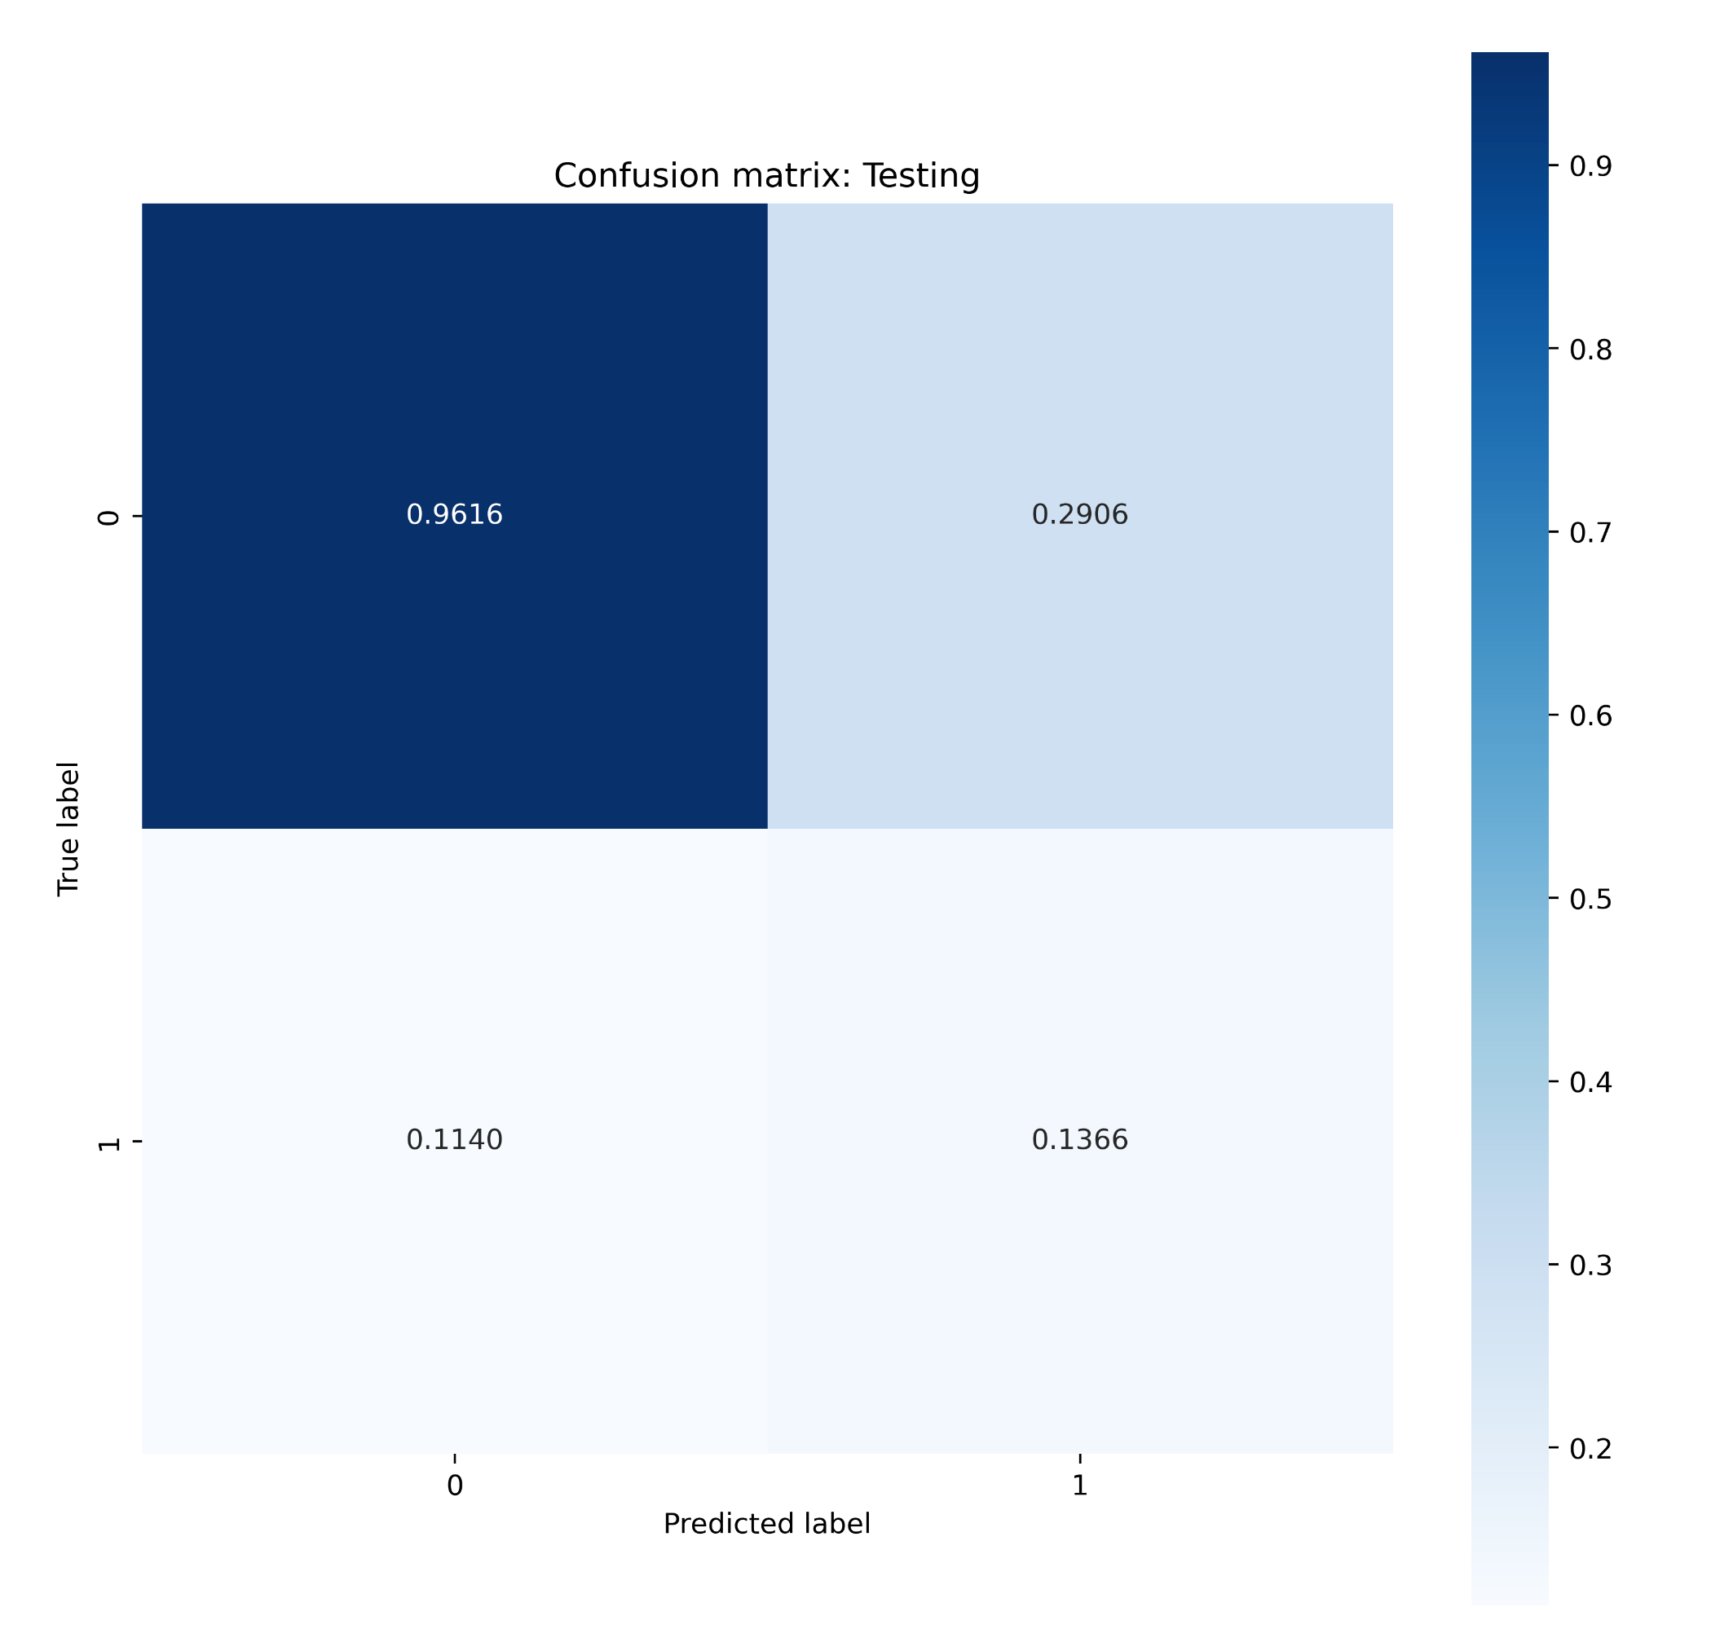
Model
Accepted model
Logistic regression
Accuracy of the training and test was good
Probabilities were good compared to a random decision (result of the existing campaign)
For each entry, it checks the probability of it being a success
Interested in all the combinations in the matrix
Notes:
How do we evaluate if a model is good or not
Talk about falce possitives
Talk about lift (how much better than random = talking to everyone)
Baeine of imporvment in current campaign is lift

Slide 18
Next steps

Slide 19
Next steps
Model implementation
Change management organization
Storage of results
Monitoring
Model
Value
Move model to a production environment
For use in future iterations
Use of model in select call centers to verify usefulness
To ensure its performance
To ensure it produces the outcome we are looking for
Notes:
Model is built
It performs like this …
Suggestions Next step
Try it in real customers in controled env
Few of call center people
Change management in the organisation (we can help)
Store data from it(we can help)
Mot´nitor model and value of it (help)
Pretend thit campagn was only done on phone

Slide 20
Next steps
Change management organization
Use of model in select call centers to verify usefulness
Train specific call center employees to establish usability of results
Use the model for other types of campaigning (e-mail, SMS, flyers etc.)
Create training material for the whole organization
Notes:
Model is built
It performs like this …
Suggestions Next step
Try it in real customers in controled env
Few of call center people
Change management in the organisation (we can help)
Store data from it(we can help)
Mot´nitor model and value of it (help)
Pretend thit campagn was only done on phone

