Slide 1
COTIVITI INTERN ASSESSMENT | PROMPT 2
Federated Claim-Graph Intelligence
Provider
Code
A reviewer cockpit for privacy-preserving pattern recognition and auditor-ready evidence cards
Claim
Member
Policy
Author: Mohammad Saleh Nikoopayan Tak
Report + Hackathon POC + Slide Overview
1
Notes:
Open with the thesis: the project is not generic healthcare automation. It is a Cotiviti-relevant payment integrity idea.
Say that the report and POC focus on graph pattern recognition, privacy-preserving collaboration, and evidence cards for human reviewers.

Slide 2
TOPIC CONCEPT
A claim is a relationship graph
Prompt 2 narrowed to clinical decision making and pattern recognition for payment operations.
Instead of treating a claim as a flat row, the system links member, provider, CPT, diagnosis, time, modifier, peer group, and policy context.
Time
Provider
CPT
Output
Claim
Classification: is this claim likely clean, questionable, or urgent?
Inference: which relationship explains the risk?
Member
Policy
Clustering: which providers, codes, and members form unusual groups?
Time-series anomaly detection: what changed suddenly?
Design principle: no score without a story.
No automated payment action without human review.
2
Notes:
Define the topic in plain language.
Emphasize that graph intelligence adds context and reasoning to ordinary claims analytics.

Slide 3
WHY NOW
Pressure, connectivity, trust
The market is ready because payment risk is visible, payer data is more connected, and AI governance expectations are rising.
$94B+
455
$21.2B
FY 2025 CMS improper payment estimates across Medicare FFS, Part C, Part D, and Medicaid
Defendants charged in DOJ's June 23, 2026 health care fraud takedown
Suspect FWA claims Cotiviti says it identified for clients in 2025
Strategic read
Earlier lead prioritization matters because bad payments are expensive to chase after the fact.
Interoperability makes richer graph features possible across claims, policies, encounters, and contracts.
Trust becomes a feature: privacy, explainability, human review, and drift monitoring have to be built in.
Sources: CMS FY 2025 improper payments fact sheet; DOJ June 23, 2026 takedown; Cotiviti FWA Pattern Review.
3
Notes:
Use this slide to justify urgency.
Explain that the figures show pressure and opportunity, not that every improper payment is fraud.

Slide 4
COTIVITI OPPORTUNITY
A natural extension of payment accuracy
The strongest angle is not novelty alone. It is a practical layer on top of Cotiviti's existing strengths.
Payment accuracy foundation
Interoperability flywheel
Managed-service trust
Cotiviti already operates across claim accuracy, payment policy, coding validation, clinical review, data mining, contracts, coordination of benefits, and FWA review.
The Edifecs acquisition can strengthen the data fabric needed for connected claim, policy, encounter, and contract evidence.
Cotiviti can package evidence cards with specialist review, case tracking, client governance, and provider-facing defensibility.
Positioning: broaden learning across payers without broadening raw data exposure.
Sources: Cotiviti payment accuracy pages; Cotiviti Edifecs acquisition announcement.
4
Notes:
This is the business fit slide.
Connect the idea to Cotiviti's actual product footprint and not just technical excitement.

Slide 5
THREATS AND GUARDRAILS
Do not ship a black box
The strategic risk is not that the model is imperfect. The risk is acting on a score without context, controls, or accountability.
False positives
Lead fatigue, delayed payment, and provider abrasion.
Calibrate thresholds by domain and require human review before action.
Bias
Payer mix and access patterns can masquerade as misconduct.
Monitor cohorts, explain features, and use appeal outcomes as feedback.
Privacy leakage
Model updates and aggregates can reveal sensitive patterns.
Use secure aggregation, minimum cohort sizes, and client approval gates.
Adversarial adaptation
Fraud patterns shift once signals are learned.
Track drift, rotate features, and treat investigator notes as signal.
Governance frame aligned to NIST AI RMF: govern, map, measure, manage.
5
Notes:
This slide shows judgment.
Say that the investment must include governance, not just model development.

Slide 6
STRATEGIC OPTIONS
Three investable moves
The recommendation is to start narrow, prove lift, then turn the evidence card into a reusable product layer.
1
2
3
Claim-Graph Utility Layer
Cross-Payer Signal Exchange
Evidence Card Product
Create reusable entities, edges, graph features, and explainers for prepay and postpay analytics.
Pilot privacy-preserving aggregate learning where raw claims remain inside each client boundary.
Show graph path, peer comparison, time-series change, code-policy rationale, confidence, model-card note, reviewer override reason, and next action.
Recommended starting point: pair Option 3 with a narrow Option 2 shadow-mode pilot in one domain such as wound care, DME, high-volume labs, or behavioral health.
6
Notes:
Frame the options as a roadmap.
The strongest recommendation is evidence-chain productization, supported by a narrow federated pilot.

Slide 7
HACKATHON POC
Claim Integrity Radar architecture
The prototype proves the first principles without overbuilding.
Synthetic claims
Local baselines
Federated summary
Evidence card
Generate payer, provider, member, CPT, diagnosis, modifier, week, units, and amount.
>
Train peer norms by client, domain, specialty, procedure, and week.
>
Share aggregate percentiles and drift signals only. Raw member records stay local.
>
Score anomalies, render graph paths, and recommend a human review action.
Proof point: the demo can be shown in under three minutes, and every score has a reviewer-readable evidence card.
7
Notes:
Walk the evaluator through the POC flow before showing the actual app.
Say the POC is intentionally synthetic and transparent so the core engineering is visible.

Slide 8
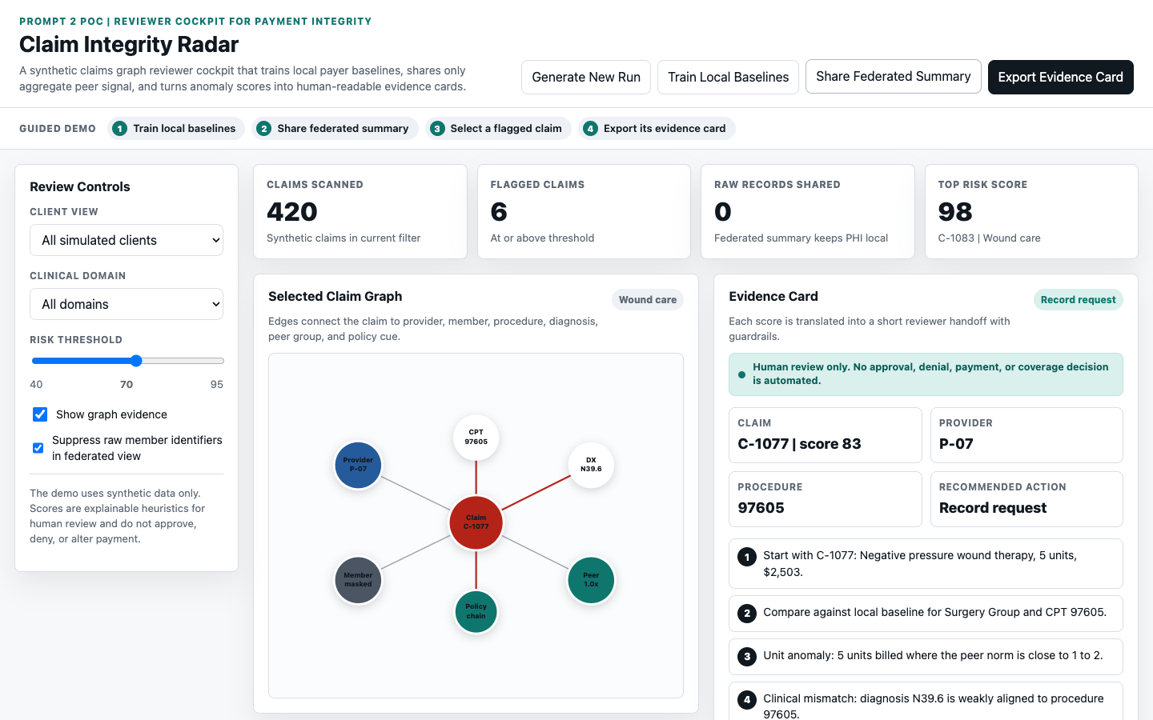
DEMO WALKTHROUGH
What the evaluator should notice
The demo is built to prove speed to value, not production completeness.
Train Local Baselines: peer-group learning.
Share Federated Summary: zero raw records shared.
Select high-risk claim: graph path plus evidence card.
Export Evidence Card: reviewer handoff.
Asset: screenshot from the included Claim Integrity Radar POC.
8
Notes:
This is the handoff slide before screensharing the browser POC.
Keep the demo short: train, federate, click a claim, export the evidence card.

Slide 9
RECOMMENDED NEXT STEP
A 90-day pilot for speed to value
Constrain the domain, measure lift, and decide whether to invest in a reusable layer.
Weeks 1-2
Pick one domain
Wound care, DME, high-volume labs, or behavioral health.
Weeks 3-6
Build graph features
Entity resolution, peer baselines, time windows, and policy hooks.
Weeks 7-10
Shadow-mode comparison
Precision, recall proxy, reviewer agreement, provider abrasion, and turnaround.
Weeks 11-12
Investment decision
Scale, pivot, or stop based on lift and governance readiness.
Close with the thesis: no score without a story.
The cockpit supports reviewers rather than replacing them.
9
Notes:
End decisively.
The key message is that this idea is novel enough to stand out but practical enough to pilot quickly.

