Slide 1
The End
Honorable Mentions & Wrap Up

Slide 2
Structure
Week 1: Introduction
Week 2: Syntax, Variables & Functions
Week 3: Control Structures
Week 4: Lists & Collections
Week 5: RegEx & Strings
Week 6: Sorting & I/O
Week 7:Debugging, Errors & Strategies
Week 8: 4P: Packages, Practices and Patterns
Week 9: Object Oriented Programming
Week 10: Time, Space & Documentation
Week 11: Numpy & Matplotlib
Week 12&13: Neural Nets & Psychopy
Week 14: Honorable Mentions & Wrap Up

Slide 3
Last Week's Homework

Slide 4
Last Week's Homework
We only noticed after hand in, that we forgot to pass a parameter in the hangman game
The game always accessed “words.txt” no matter what you passed it
The mapping from mood to ASCII art often was no dictionary
Some used lists or constants for every mood
Sometimes the read in was performed every time the bunny was printed instead of once and then just queried again
File I/O is slow and when you need the contents of a file several times (and it is not several GB big) it is often worth it to save it in a variable

Slide 5
The Evaluation

Slide 6
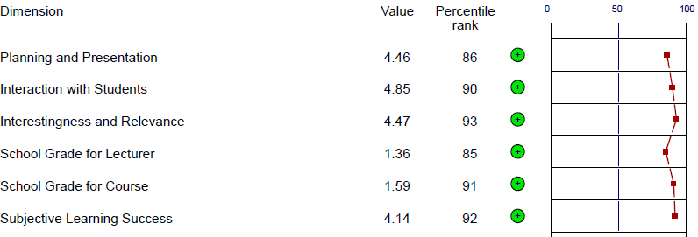
:)
Well, thank you. Apparently you were rather happy with our course!

Slide 7
Honorable Mentions

Slide 8
Web Scraping

Slide 9
Web Scraping
Sometimes the data you need is not something you can collect yourself
10,000 images of cars, for example
Or the literature of the late 19th century
But a lot of this data is readily available on the internet
Care for licensing! Not everything is free to use!
Especially images, and text. They are easy to acquire but often copyrighted
There are several Python libraries that allow to parse web requests, web pages and extract information from them
There is the built in html and html.parser modules, but there are well designed 3rd party libraries as well, like beautiful soup or lxml
Choose what you are most comfortable working with
RegEx is super useful here!

Slide 10
Web Programming

Slide 11
Some Web Basics
Webpages are not written in Python, but in some kind of HTML
The internet (or the “web”) uses the HTTP-Protocol to transport this code
The widely used standard was defined in 1999 in RFC2616
Since then some changes were made and there are more modern definitions, but the basics are still the same
RFC2616 is a 175 pages long definition of the HTTP/1.1 standard that is the most used one
The process is basically always the same
Communicating happens using HTTP verbs
The most important one are GET & POST
Request
Computer (Client)
Server
Response

Slide 12
Python in the Web
Python can be (and is) used for client & server applications
The requests module can do the same web browsers do, and request webpages using the HTTP protocol
Have a look at flask, Django and Django cms
Cms are content management systems
They can host web servers which you can access via your browser for example
An example for this is jupyter notebook
It also hosts a server to use the notebooks

Slide 13
Visual Computing

Slide 14
Let's Get Visual
The terminal is not the most interesting thing to look at all the time
Working with graphics can be rather complicated though
In fact, there are whole fields dedicated to analyzing or manipulating images as well as creating own graphics or 3D environments
The general term for anything in computer science related to images and 3D models is Visual Computing
Most of the algorithms that are commonly used can be found in libraries as well, so you don't have to implement them from scratch

Slide 15

OpenCV
OpenCV (Open Computer Vision) is a library that supplies many algorithms for computer vision
It is also used in the Computer Vision class sometimes
Some of its functionalities also touch on related fields such as machine learning
Computer Vision is not the same as Visual Computing
Put informally, its main objective is to teach computers to see like humans can
So you're using algorithms in order to (most of the time) acquire some high-level information from images, but you are not synthesizing images or scenes from scratch
Website and documentation can be found at https://opencv.org/

Slide 16
OpenCV
Just some of OpenCVs functionalities include:
Just the basic loading, displaying and saving of images
Filtering: often to highlight certain features in the image, like edges
Segmentation: separating foreground and background
Detection of keypoints and features
Calibrating cameras and determining their viewpoint in the 3-dimensional space
Image stitching: this is what happens when you take panorama pictures
...which you could then use to...
Improve images
Recognize objects and faces
Track camera movements
...and so on and so forth

Slide 17
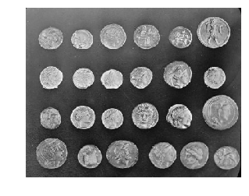
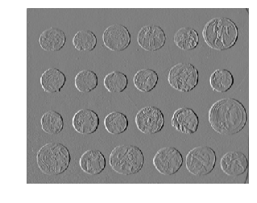
OpenCV
Example: Extracting edges using a Sobel filter in OpenCV

Slide 18

OpenGL
OpenGL (Open Graphics Library) offers tools for the the rendering of 2D and 3D graphics and models
What makes it so useful is that it is well documented, widespread in the industry and is able to use your GPU which can speed up the process of rendering your images tremendously
https://www.opengl.org/
OpenGL is merely the API, but there are Python bindings out there such that it is usable as a library in Python as well
Notes:
It's an API, the actual implementation is the library
GPU is faster because it multithreads your stuff

Slide 19
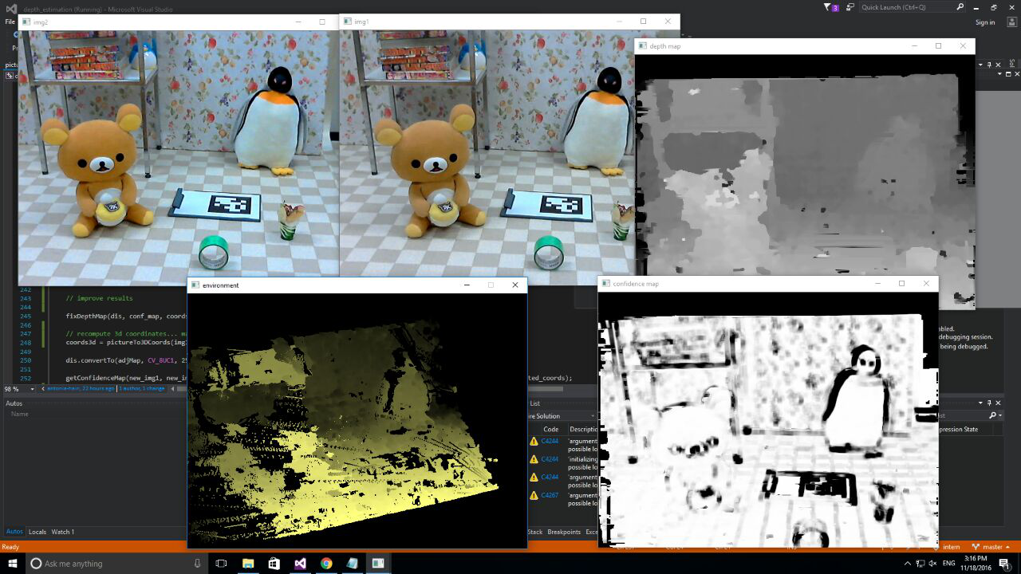
OpenCV and OpenGL in Practice
This is just an example of how one could use OpenCV and OpenGL (from my internship abroad, code was written in C++, which doesn't change the libraries' functionalities though)
1) Take two images with two slightly different camera positions
2) Use the two images to create a depth map of the scene using several OpenCV functions
4) Render the scene according to the depth map in 3D using OpenGL (the user viewpoint could be changed, the scene would still run with 60fps thanks to the GPU use of OpenGL)
( 3) Create confidence map for the depth map (manual without specific library functions) )

Slide 20
Disclaimer
The whole range of possibilites offered by those libraries will probably be understood only if you already have some experience with the field
This is a whole new topic to explore
Courses like Computer Vision or Computer Graphics (the latter so far only offered every 2 years) might give a small introduction
There are even more fields where Visual Computing is applied, like Robotics and Virtual Reality
But these are probably handled better in programming languages or frameworks other than Python

Slide 21
GUI

Slide 22
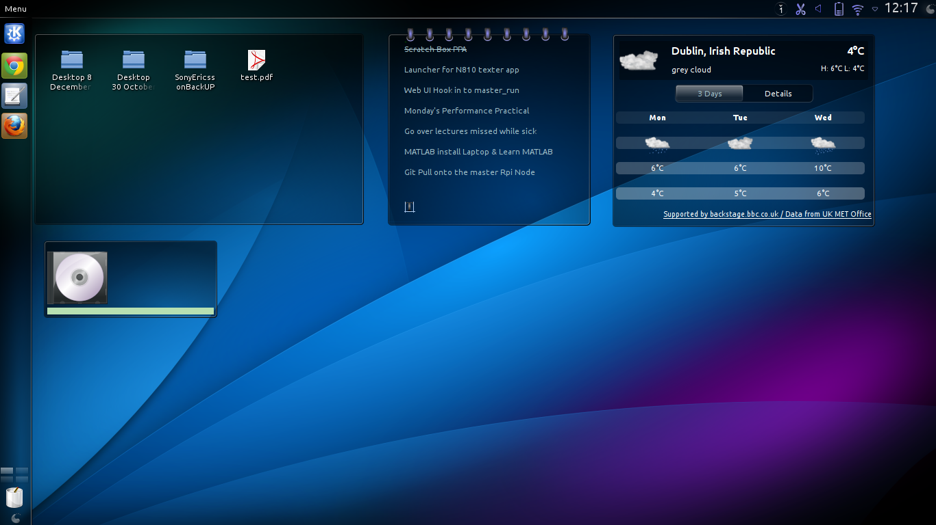
GUIs
So far we interacted with the Command Line Interface (CLI)
There also are Graphical User Interfaces (GUIs)
CLIs are command driven, meaning that they react to specific commands that are typed in (and need to be remembered by the user)
GUIs are event driven, meaning that they are constantly waiting/listening for events to happen and then react to those
There are several options to do this in Python
Tkinter, Qt, native stuff
Register Listeners
Main Loop: Any events?
Notify and execute listeners
No
yes

Slide 23
Games

Slide 24
Games
Technically you can use Python to program games!
Using GUIs, sound, animations etc. in a high-level library
Some libraries
KivEnt, Pyglet, PyGame, cocos2d, Panda3d, Irrlicht
It can also be “abused” for experiment design, as it is more portable
For simple games this can be enough
For more complex game design consider a specialised game engine
Unity, Unreal, GameMaker, Godot, OGRE, RPG Maker

Slide 25
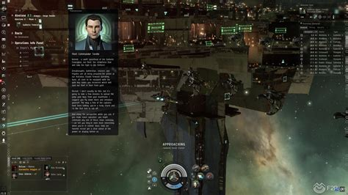
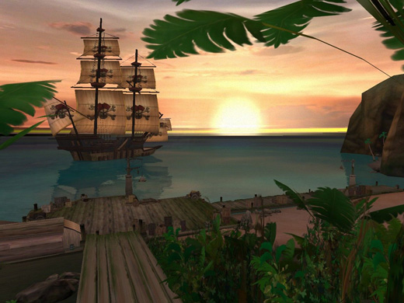
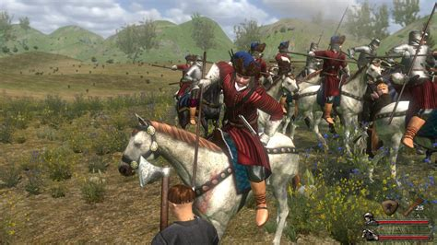
Games that use Python
EVE Online
 | Disney's Pirates of the Caribbean Online
Mount & Blade: With Fire & Sword

Slide 26
What’s Next

Slide 27
Stuff we did not do and where to find it
Multithreading / Multiprocessing -> Info B
Software Architectures and Project Design -> Software Engineering
Low level system architecture & Hardware -> Info C
Theoretical Computer Science -> Info D

Slide 28
What to do now
Do some challenges to stay in routine
Learn a new language
Experiment and see what you can do
Automate everything
Visit Scientific Programming in Python, Informatik B, Web-Technologien, Datenbanksysteme, Machine Learning, Implementing Artificial Neural Networks in Tensorflow, Computer Vision, so so so so many more

Slide 29
Thanks for doing this with us!

