Slide 1
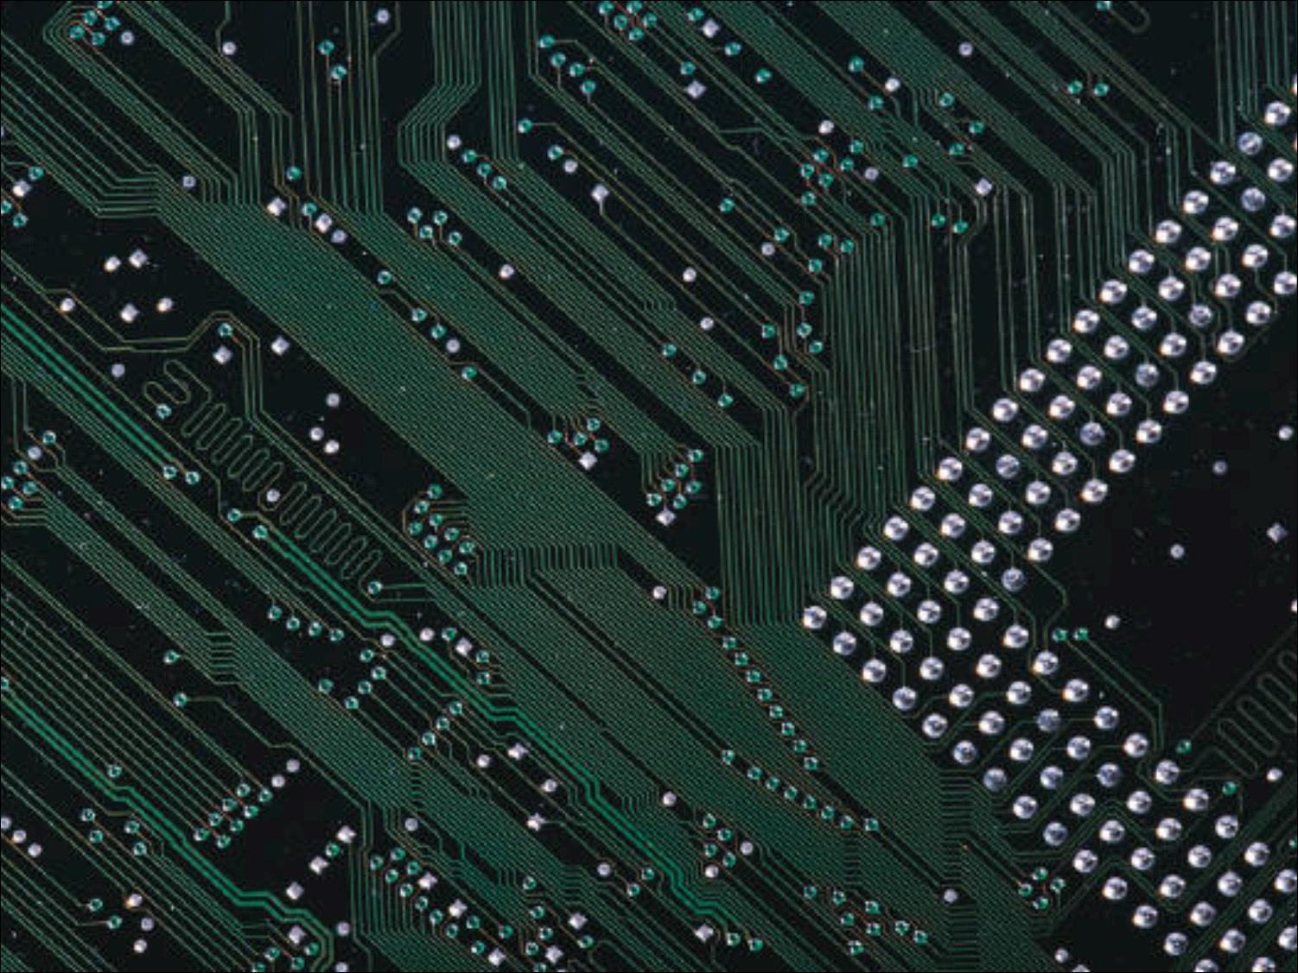

Chapter 1:
Unwrapping the Gift

Slide 2

The Pace of Change
Change and Unexpected Developments
Themes
Ethics
3

Slide 3

“In a way not seen since Gutenberg’s printing press
that ended the Dark Ages and ignited the Renaissance,
the microchip is an epochal technology with unimaginably far-reaching economic, social, and political consequences.”
̶ Michael Rothschild¹
4

Slide 4
1940s: First computer was built.
1956: First hard-drive disk weighed a ton and stored five megabytes.
1991: Space shuttle had a one-megahertz computer. Ten years later, some automobiles had 100-megahertz computers. Speeds of several gigahertz are now common.
4-5

Slide 5
Discussion Question
What devices are now computerized that were not originally? Think back 10, 20, 50 years ago.
4-6
Notes:
In addition to automobiles you can prompt the class with the following:
TVs
Clocks and watches
Phones
Cash registers
Cameras
Ovens
Etc.

Slide 6

“It is precisely this unique human capacity to transcend
the present, to live one’s life by purposes stretching into
the future – to live not at the mercy of the world, but as a builder and designer of that world – that is the distinction between human and animal behavior, or between the
human being and the machine.”
̶ Betty Friedan³
7

Slide 7
Cell Phones
Relatively few in 1990s. Approximately five billion worldwide in 2011.
Used for conversations and messaging, but also for:
  taking and sharing pictures
  downloading music and watching videos
  checking email and playing games
  banking and managing investments
  finding maps
Smartphone apps for many tasks, including:
  monitoring diabetes
  locating water in remote areas
7-8
Notes:
Writers describe the dramatic changes with observations such as, “A Masai warrior with a smartphone and Google has access to more information than the President did 15 years ago” and “More folks have access to a cellphone than to a toilet.”⁴

Slide 8
Cell Phones (cont.):
Location tracking raises privacy concerns.
Cameras in cell phones affect privacy in public and non-public places.
Cell phones can interfere with solitude, quiet and concentration.
Talking on cell phones while driving is dangerous.
Other unanticipated negative applications: teenagers sexting, terrorists detonating bombs, rioters organizing looting parties.
8-9
Notes:
Cameras in cell phones threaten privacy. Where is the line between capturing news events and evidence of crimes, and voyeurism?
Some states have passed laws prohibiting use of hand-held devices while driving. Recent studies show hands-free devices, while freeing up the hands, do not reduce distractions, particularly among young adult and teenage drivers who often text message while driving.

Slide 9
Kill switches
Allow a remote entity to disable applications and delete files.
Are in operating systems for smartphones, tablets and some computers.
Used mainly for security, but raise concerns about user autonomy.
9-10
Notes:
Kills switches could remove content that infringes copyrights. Could also be used to remove content that a company or government deems offensive.
What if malicious hackers found a way to operate the skill switches on our devices?

Slide 10
“While all this razzle-dazzle connects us electronically, it disconnects us from each other, having us “interfacing” more with computers and TV screens than looking in the face of our fellow human beings. Is this progress?”
̶ Jim Hightower, radio commentator, 1995⁷
10

Slide 11
Social Networking:
First online social networking site was www.classmates.com in 1995.
Founded in 2003, Myspace had roughly 100 million member profiles by 2006.
Facebook was started at Harvard as an online version of student directories
Social networking is popular with hundreds of millions of people because of the ease with which they can share aspects of their lives.
10-11
Notes:
Sites like Second Life (www.secondlife.com) combine many of the features of social networking sites with the 3-D aspects of video games. What new problems/benefits arise when a person can take on a physical persona (an avatar) that may be completely different from who they are in real life? Some people with physical disabilities can interact with others without revealing their disability.

Slide 12
Social Networking (cont.):
Businesses connect with customers.
Organizations seek donations.
Groups organize volunteers.
Protesters organize demonstrations and revolutions.
Individuals pool resources through “crowd funding”.
10-11

Slide 13
Social Networking (cont.):
Stalkers and bullies stalk and bully.
Jurors tweet about court cases during trials.
Socialbots simulate humans.
10-11
Notes:
Jurors tweeting about court cases during trials have caused mistrials, overturned convictions, and resulted in jail time for offending jurors.

Slide 14
Communication and the Web
In the 1980s, email messages were short and contained only text.
People worldwide still use email, but texting, tweeting , and other social media are now preferred.
11-12
Notes:
People worldwide still send several billion emails daily (not counting spam), although texting, tweeting, and other social media have replaced email as the favored communication method in many contexts.⁹

Slide 15
Communication and the Web
Blogs (“Web log”) began as outlets for amateurs wanting to express ideas, but they have become significant source of news and entertainment.
Inexpensive video cameras and video-manipulation tools have resulted in a burst
of amateur videos.
Many videos on the Web can infringe copyrights owned by entertainment companies.
12-13

Slide 16
Telemedicine
Remote performance of medical exams and procedures, including surgery.
14
Notes:
Also known as long-distance medicine, it can be used in prisons to reduce chance of escape, on long airplane flights to treat sick passengers, or in rural areas to consult with medical specialists.

Slide 17
Collaboration
Wikipedia: The online, collaborative encyclopedia written by volunteers.
Informal communities of programmers create and maintain free software.
Watch-dogs on the Web: Informal, decentralized groups of people help investigate crimes.
14-15
Notes:
Wikipedia’s reliability was brought into question when a major contributor was found to be a 14 year-old boy instead of a scientist with a PhD and years of experience. He got most of his information from other Web sources.
Web Watch-dog sites are controversial. Mobs and individuals emotionally involved in a political, religious, or moral cause do not always pause to consider consequences or follow due process.

Slide 18
E-commerce
Amazon.com started in 1994 selling books on the Web. It has grown to be one of the most popular, reliable, and user-friendly commercial sites.
eBay.com facilitates online auctions.
Traditional brick-and-mortar business have established Web sites.
Online sales in the United States now total hundreds of billions of dollars a year.
Sellers can sell directly to buyers, resulting in a peer-to-peer economy.
15
Notes:
Some benefits are obvious: Consumers can save time, money, and gasoline while researching products.
Some benefits are less obvious or were not obvious before they appeared: Auction sites give people access to customers they could not have found efficiently before. Lower overhead and ease of comparison shopping have brought down prices of many products. Small businesses and artists can sell directly to buyers, avoiding fees to middlemen and distributors. The Web has enabled a peer-to-peer economy.

Slide 19
E-commerce and trust concerns
People were reluctant to provide credit card information to make online purchases, so PayPal.com grew out of need for trusted intermediary to handle payments.
Encryption and secure servers made payments safer.
The Better Business Bureau established a Web site to help consumers see if others have complained about a business.
Auction sites implemented rating systems.
15-16

Slide 20
Free stuff
Email programs and email accounts, browsers, filters, firewalls, encryption software, word processors, spreadsheets, software for viewing documents, software to manipulate photos and video, and much more
Phone services using VOIP such as Skype
Craigslist classified ad site
University lectures
16

Slide 21
Free stuff (cont.)
Advertising pays for many free sites and services, but not all.
Wikipedia funded through donations.
Businesses provide some services for good public relations and as a marketing tool.
Generosity and public service flourish on the Web. Many people share their expertise just because they want to.
16-17
Notes:
Some free programs and services do not have all the features of the paid versions.

Slide 22
Free stuff (cont.)
In order for companies to earn ad revenue to fund multimillion-dollar services, many free sites collect information about our online activities and sell it to advertisers.
17
Notes:
This tracking is not always obvious; we consider it in Chapter 2.

Slide 23
Artificial intelligence
A branch of computer science that makes computers perform tasks normally requiring human intelligence.
Researchers realized that narrow, specialized skills were easier for computers than what a five-year-old does: recognize people, carry on a conversation, respond intelligently to the environment.
17
Notes:
In 1997, IBM’s chess computer, Deep Blue, beat World Champion Garry Kasparov in a tournament.
In 2011, another IBM computer system called Watson defeated human Jeopardy! champions by answering questions more quickly than the humans.

Slide 24
Artificial intelligence (cont.)
Many AI applications involve pattern recognition.
Speech recognition is now a common tool.
18
Notes:
AI applications involving pattern recognition: Reading handwriting for automatic mail sorting, matching fingerprints, matching faces in photos.
Personal assistants in smartphones use speech recognition to respond to users’ questions.

Slide 25
Artificial intelligence (cont.)
Turing Test: If the computer convinces the human subject that the computer is human, the computer is said to “pass”.
18
Notes:
Philosopher John Searle argues that computers cannot be intelligent. They do not think; they manipulate symbols. They do so at a very high speed, and they can store, access, and manipulate a huge quantity of data, but they are not conscious. They do not understand; they simulate understanding.
Searle might say that although Watson won at Jeopardy!, Watson does not know it won.

Slide 26
Discussion Questions
How will we react when we can go into a hospital for surgery performed entirely by a machine? Will it be scarier than riding in the first automatic elevators or airplanes?
How will we react when we can have a conversation and not know if we are conversing with a human or a machine?
How will we react when chips implanted in our brains enhance our memory with gigabytes of data and a search engine? Will we still be human?
19

Slide 27
Robots
Mechanical devices that perform physical tasks traditionally done by humans.
Can operate in environments that are hazardous for people.
19-20
Notes:
Robots inspect undersea structures and communication cables, search for survivors in buildings collapsed by bombs or earthquakes, explore volcanoes and other planets, and move or process nuclear and other hazardous wastes.

Slide 28
Smart sensors, motion, and control
Motion sensing devices are used to give robots the ability to walk, trigger airbags in a crash, and protect laptops when dropped.
Sensors can detect leaks, acceleration, position, temperature, and moisture.
20-21
Notes:
Accelerometer or mems (microelectromechanical systems) are tiny motion-sensing and gravity-sensing devices that collect status data. Complex software interprets the data and determines the necessary motions, and then sends signals to motors.
Wearware refers to clothing with special sensors.

Slide 29
Tools for disabled people
Assistive technology devices help restore productivity and independence to people with disabilities.
Researchers are experimenting with chips that convert brain signals to controls for leg and arm muscles.
21-23
Notes:
A blind person can use handheld devices that combine optical-character-recognition with a speech synthesizer to read menus and receipts.
Flexible, responsive prosthetic devices can now be digitally controlled, enabling amputees to walk, climb stairs, even participate in sports and fly airplanes.
People who cannot use their hands can dictate documents to a word processor and give commands to a computer to control household appliances.

Slide 30

Old problems in a new context: crime, pornography, violent fiction
Adapting to new technology: thinking in a new way
Varied sources of solutions to problems: natural part of change and life
Global reach of Net: ease of communication with distant countries
23-24
Notes:
Old problems in a new context: Cyberspace has many of the problems, annoyances, and controversies of non-cyber life: crime, pornography, violent fiction and games, advertising, copyright infringement, gambling, and products that do not work right.
Adapting to new technology: Changes in technology require adaptive changes in laws, social institutions, business policies, personal skills, attitudes, and behavior.
Varied sources of solutions to problems: Solutions for problems that result from new technology come from more or improved technology, the market, management policies, education and public awareness, volunteer efforts, and law.
Global reach of Net: The ease of communication with distant countries has profound social, economic, and political effects – some beneficial, some not.

Slide 31

Trade-offs and controversy: Increasing security means reducing convenience.
Perfection is a direction, not an option.
There is a difference between personal choices, business policies, and law.
24-26
Notes:
Trade-offs and controversy: Increasing privacy and security often means reducing convenience. Protecting privacy makes law enforcement more difficult. Unpleasant, offensive, or inaccurate information accompanies our access to the Web’s vast amounts of useful information.
We should not compare new technologies and applications to some ideal perfect service with zero side effects and zero risk. Instead, we should compare them to the alternatives and weigh the problems against the benefits.
The criteria for making personal choices, for making policies for businesses and organizations, and for writing laws are fundamentally different.

Slide 32

What is Ethics:
Study of what it means to “do the right thing”.
Assumes people are rational and make free choices.
Rules to follow in our interactions and our actions that affect others.
26-27

Slide 33
A variety of ethical views:
Deontological theories
Utilitarianism
Natural rights
28-31

Slide 34
A variety of ethical views (cont.):
Negative rights (liberties)
  The right to act without interference
Positive rights (claim-rights)
  An obligation of some people to provide certain things for others
31

Slide 35
A variety of ethical views (cont.):
Golden rules
  Treat others as you would want them to treat you.
Contributing to society
  Doing one’s work honestly, responsibly, ethically, creatively, and well is virtuous.
32-33

Slide 36
A variety of ethical views (cont.):
Social contracts and a theory of political justice
  People willingly submit to a common law in order to live in a civil society.
33-35
Notes:
Thomas Hobbes developed ideas of social contract theory in his book Leviathan (1651).
Philosopher John Rawls took social contract theory further, developing provisions of the “contract” based on his view of justice as fairness.

Slide 37
A variety of ethical views (cont.):
No simple answers
  Human behavior and real human situations are complex. There are often trade-offs to consider.
  Ethical theories help to identify important principles or guidelines.
35-36
Notes:
Ethical theories do not provide clear, incontrovertibly correct positions on most issues. We can use the approaches we described to support opposite sides of many an issue.

Slide 38
A variety of ethical views (cont.):
Do organizations have ethics?
  Ultimately, it is individuals who are making decisions and taking actions. We can hold both the individuals and the organization responsible for their acts.
36
Notes:
Some philosophers argue that it is meaningless to speak of a business or organization as having ethics. Individual people make all decisions and take all actions. Others argue that an organization that acts with intention and a formal decision structure is a moral entity. However, viewing an organization as a moral entity does not diminish the responsibility of the individual people.

Slide 39
Some important distinctions:
Right, wrong, and okay
Distinguishing wrong and harm
Separating goals from constraints
Personal preference and ethics
Law and ethics
36-40
Notes:
We can think of acts as either ethically obligatory, ethically prohibited, or ethically acceptable.
Harm alone is not a sufficient criterion to determine that an act is unethical.
The ethical character of a company depends on whether the actions taken to achieve the goal are consistent with ethical constraints.
It can be difficult to draw a line between what we consider ethically right or wrong and what we personally approve or disapprove of.
Ethics precedes law in the sense that ethical principles help determine whether or not we should pass specific laws. A good law will set minimal standards that can apply to all situations, leaving a large range of voluntary choices. Ethics fills the gap between general legal standards that apply to all cases and the particular choices made in a specific case.

Slide 40
Discussion Question
Can you think of examples of liberties (negative rights) and claim-rights (positive rights) that are at opposition to each other?
40
Notes:
This question is the foundation for many issues and controversies discussed in later chapters. One example you can introduce here is the right to freedom of speech versus the need to protect children from materials that are inappropriate for them. Have the class identify who the affected parties are. What are the negative and positive rights for the different parties? Note: the laws pertaining to this particular issue are discussed in chapter three.

