Slide 1

Hardware Store Business 360 with Power BI

Slide 2

01 – Objective
02 - Atliq Hardware Introduction.
03 – Project Planning
04 – Business Keywords
05– Dashboard Walkthrough and live demonstration.
Data
Visualization

Slide 3
Objective
Analyzing data enables informed decision-making
The objective of this project was to apply the skills and knowledge gained from the Power BI course to analyze a Hardware store and derive actionable insights.
This is a project-based learning. We will use an imaginary company called AtliQ Hardware and discuss its business model using power bi.
It is a consumer goods electronics company having operations in various countries. Their business is growing rapidly and they still rely on excel files for data analytics.
Also due to the lack of effective analytics the company faced a major loss in Latin America. Senior executives of this company have decided to invest in a data analytics project and have assigned a team for this work.
Hence, as the data analytics team we are going to help them to get the insights.
Data
Data analysis helps uncover valuable insights from complex datasets
Visualization

Slide 4
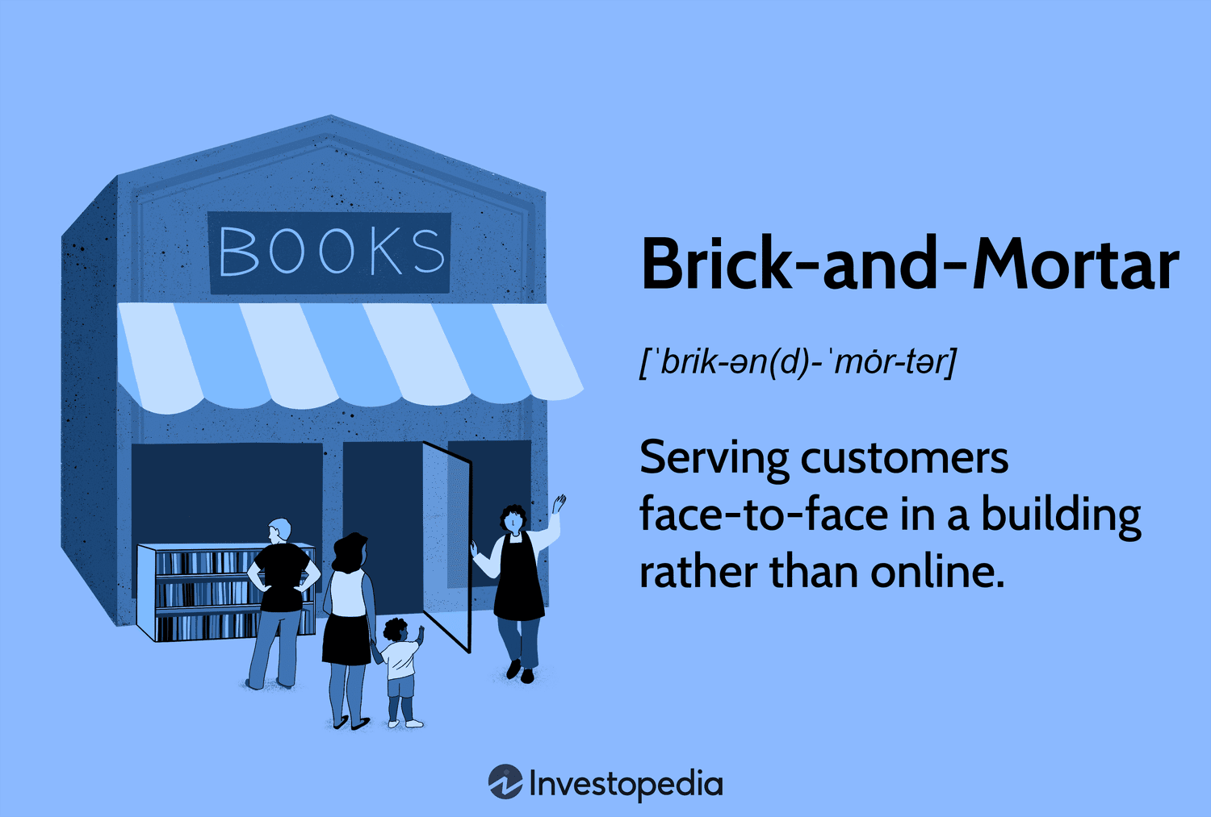

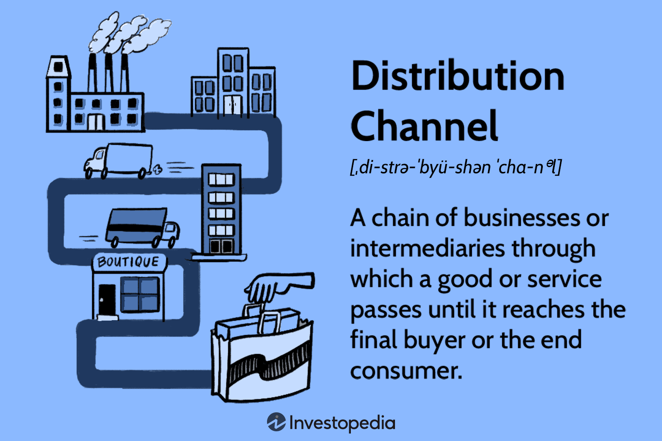
Atliq Hardware
Business Model
Meet Atliq Hardware, a leading computer hardware producer based in India, with a growing presence in international markets. As Atliq navigates the complex landscape of sales channels and platforms, let's delve into their journey of reaching customers across borders and continents.
1. Platform Diversity: Atliq Hardware caters to two distinct types of businesses or platforms: brick-and-mortar retailers such as Croma and Best Buy, and e-commerce giants like Amazon and Flipkart. This diversified approach allows Atliq to reach a wide range of customers through different sales channels.
2. Channel Dynamics: Within each platform, Atliq utilizes various channels to distribute its products to end consumers. When platforms directly sell Atliq's products to consumers, it is referred to as the "Retailer" channel. This channel ensures accessibility and visibility of Atliq's products to customers browsing online or shopping in physical stores.
3. Direct Sales Strategy: In addition to selling through platforms, Atliq also adopts a direct sales strategy, engaging with customers directly to offer its products. This "Direct" channel enables Atliq to build direct relationships with consumers, providing personalized services and tailored solutions to meet their needs.
4. Global Reach through Distributors: As Atliq expands its footprint beyond India, it leverages distributors in various countries to reach international markets. Through the "Distributor" channel, Atliq establishes partnerships with local distributors who handle the distribution and sales of its products in their respective regions, facilitating seamless access to Atliq's hardware solutions worldwide.

Slide 5

Project Planning
The data analytics project starts with an email from a product owner roughly outlining the requirements of 5 different dashboards in Power BI.
A project kick-off meeting is held between the product owner, senior data analyst, and a junior data analyst to discuss the project. The senior data analyst Tony Sharma asks some important questions during the meeting.
A project charter is a short document describing the entire project.
Project Goals
Key Stakeholder
Hope and Fears
Risks
Timeline
Senior data analyst, Tony Sharma, will now set up the next steps with Junior data analyst, Peter Pandey like setting up the Microsoft teams and answering questions.
Spending time to understand the problem, the end goal, and the bigger picture of the project is the very important first step of any project.
It is critical to constantly align your understanding of project scope, requirements, and timelines with the product owner / key stakeholder throughout the project.

Slide 6

Business Keywords
Gross sales: Total revenue generated before any deductions or adjustments.
Pre-invoice deduction: Reductions made before issuing an invoice, such as discounts or allowances.
Net invoice sales: Revenue after deducting pre-invoice deductions.
Post-invoice deduction: Further reductions made after issuing an invoice, like returns or refunds.
Net sales: Revenue after deducting both pre- and post-invoice deductions.
Cost of goods sold (COGS): Direct costs associated with producing goods or services sold.
Gross margin: The difference between net sales and COGS, indicating profitability before other expenses.
Other expenses: Operating expenses incurred beyond COGS, such as administrative or marketing costs.
Net profit: The final profit after deducting all expenses, including other expenses, from gross margin.
Profit and Loss Statement (P&L)
A profit and loss statement, often referred to as an income statement, is a financial document that provides a summary of a company's revenues, expenses, and net income over a specific period of time, usually a fiscal quarter or year. It shows how much money a company has generated from its normal business operations and how much it has spent to generate that revenue.
Data
Fiscal Year
A defined 12-month period for financial reporting, not necessarily matching the calendar year. It sets the boundaries for budgeting, planning, and reporting financial performance.
Year to Date
The period from the beginning of the fiscal year to the current date, showing cumulative financial results.
Year to Go
The remaining portion of the fiscal year from the present date until its end, used for forecasting and planning future financial activities and targets.

Slide 7

Thanks
Manjula Burman

