Slide 1
Variables
Variables are reserved memory locations to store values.
That means, when you create a variable, you reserve a space
in memory for its storage temporarily.
Python has no command for declaring a variable.
A variable is created the moment you first assign a value to it.

Slide 2

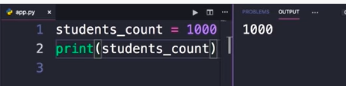
When we run this program, python interpreter will allocate some memory and store the #( 1000) in that memory space then it will have variable (students_counts) reference that memory location.
This variable is just like a label for that memory location. We can use this variable/ label anywhere in our program to get access to that memory location and the data stored there.

Slide 3
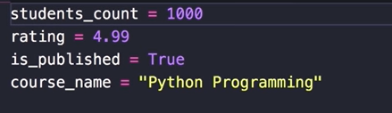
What kind of data is stored in variables?
Numbers
Integers – (negative (-5), 0, positive(6))
Float – (1.9)
Complex numbers = 2+3j
Boolean – True/ False
String – defined either with a single quote or a double quote
double quotes makes it easy to include apostrophes

Slide 4
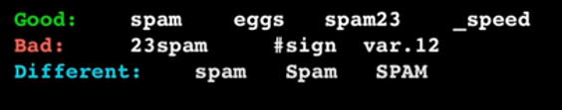
Variable Names
Must start with a letter or the underscore character(_) – can’t start with a number
Key words cannot be used (def, if, print, input, for, while, class)
Special character(*,#,^, ~, $, &, |) cannot be used. (_) is the only exception to the rule
Case sensitive
Underscore to separate multiple words
Others:
Descriptive & meaningful
Lower case to name the variables
Space around the equal sign ( x = y )

Slide 5
Variables Tips & Tricks
you can assign one type of data to a variable and later reassign another type of data to the same variable
x = 5
x = “Earthquake Wanjiku”
x = [1,2,3,4,5]
Python allows us to assign a single value to several variables simultaneously
a = b = c = f = 19
You can also assign multiple objects to multiple variables
a, b, c = 2, 3, “hakuna matata”

Slide 6
Operators
Operators in python are used to perform operations between variables.
We can refer to operators as constructs or special symbols that are used to manipulate the values of the operands (values used in an operations)

Slide 7
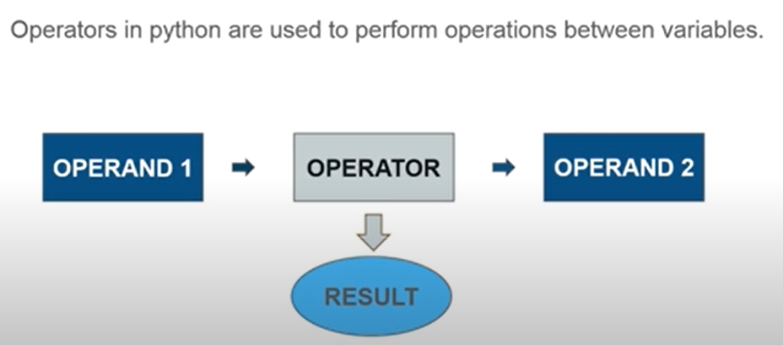

Slide 8
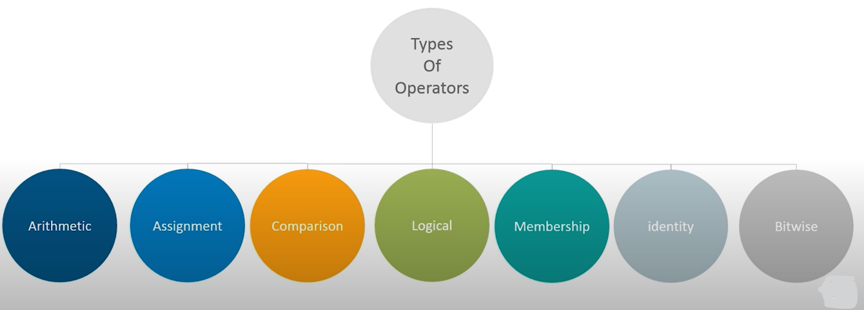

Slide 9
Types of Operators
Arithmetic operators
Assignment operators
Comparison operators
Logical operators
Identity operators
Membership operators
Bitwise operators

Slide 10
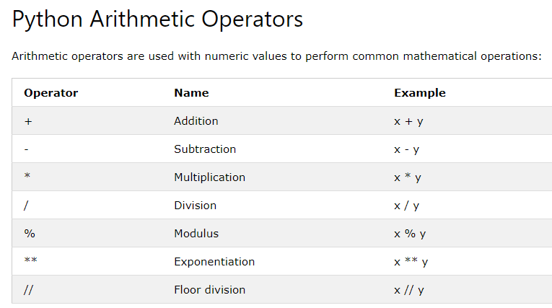
Note: int + int/ str + str
Input() & print() receive values as string

Slide 11
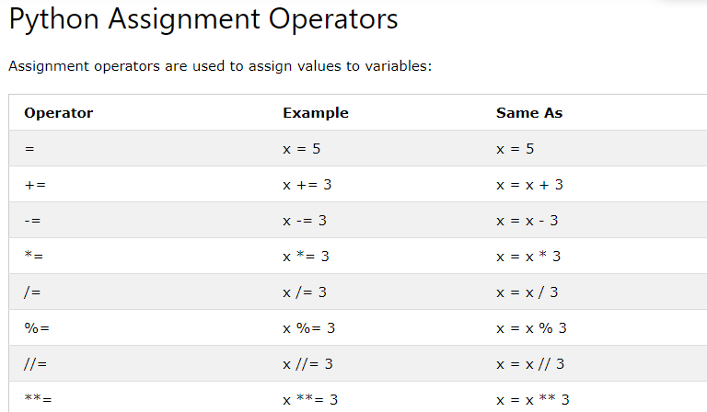

Slide 12
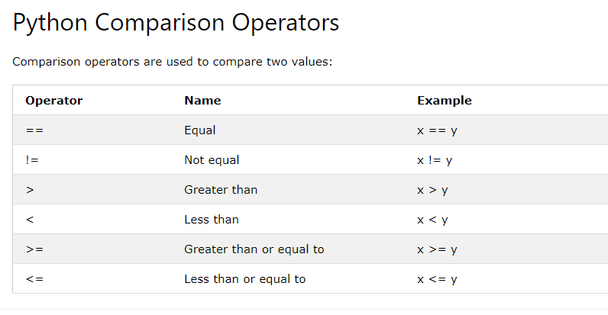
Relational/ conditional
Difference between (=) and (==)

Slide 13
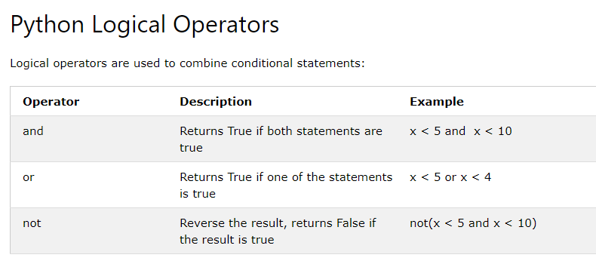

Slide 14
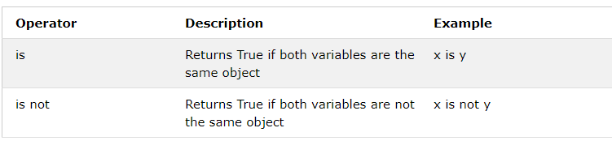
Python Identity Operators
Identity operators are used to compare the objects, not if they are equal, but if they are actually the same object, with the same memory location

Slide 15
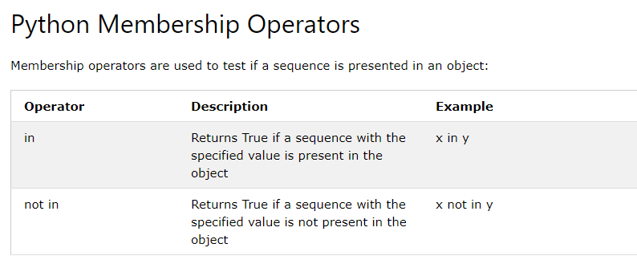
Is x a member?

Slide 16
Stay Blessed
END

