Slide 1
Foundation Model
CLIP

Slide 2
What is Foundation Model
Foundation model refers to a model (typically large) that is pretrained so that it can be used as base for various downstream tasks.
Scale: They are often trained with large datasets (most often different distributions) so that they learn complex (but common) patterns that are invarient to distributions.
Adapt: They can be adapted to various downstream task with relatively less effort interms of dataset and training time.
Transfer Learning: “Knowledge” gathered from training one / common task can be leaveraged to perform downstream tasks
Ex. of downstream tasks: weather an ingredients is cooked or not, weather stirrer is present, what is the consistency of the dish etc

Slide 3
CLIP (recap)
CLIP (Contrastive Language–Image Pre-training) is a model developed by OpenAI that learns to bind images and the text together.
Goal: is to connect the visual content (from image) to natural language (from text)
Constrastive Objective: maximizes the similarity between the correct image-text pairs and minimizes the similarity between incorrect pairs.
Transfer learning between different modality: Transfer learning of rich representation between image (model) and text (model)
Zero Shot Capacity: It can generalize to tasks it hasn't specifically been trained on, simply by providing the appropriate text prompt.

Slide 4
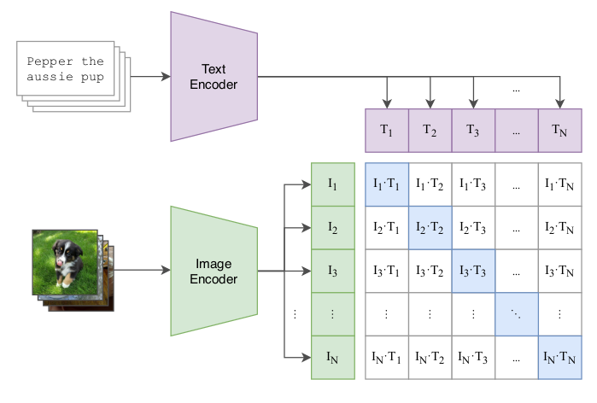
Contrastive Learning

Slide 5
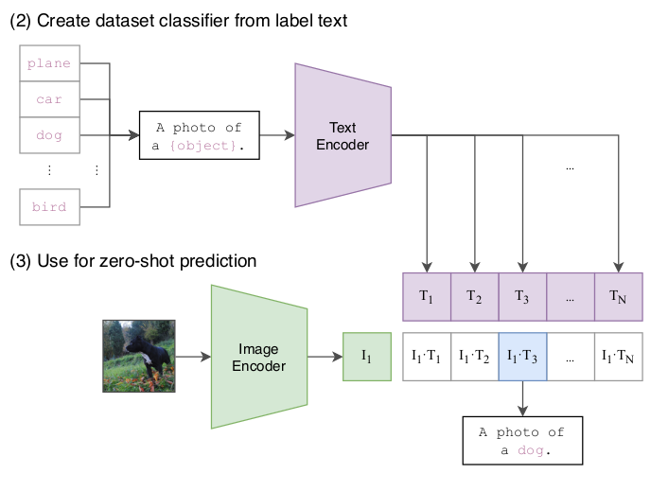
Inferenence - As Zero Shot Classifier

Slide 6
CLIP Model Arch
From OpenAI (source)
  Image Encoder - 'RN50', 'RN101', 'RN50x4', 'RN50x16', 'RN50x64', 'ViT-B/32', 'ViT-B/16', 'ViT-L/14', 'ViT-L/14@336px'
  Text Encoder – GPT like (with some optimisations)
From OpenCLIP (source)
  ConvNext-Base ConvNext-Large ConvNext-XXLarge
  ViT-B/32 ViT-B/16 ViT-L/14 ViT-H/14 ViT-L/14 ViT-G/14
  ViT-L/14 (Original CLIP) ViT-SO400M/14 (SigLIP) ViT-SO400M-14-SigLIP-384 (SigLIP) ViT-H/14-quickgelu (DFN) ViT-H-14-378-quickgelu (DFN)

Slide 7
Evaluate CLIP - Accuracy
Evaluate CLIP models on our pre-existing dataset.
Classification Accuracy metrics – Confusion matrix, F1 Score
Emphasis on text prompt engineering – Like def’n of “cooked” might not be obvious so describe it (visually)
Use florenze model for the describtion
Start of with just onion then iteratively including other ingredients like rice, tomato etc

Slide 8
Evaluate CLIP - Performance
Time (on Board)
FLOPs / MAC
  Floating point operations
  Multiplier Accumulator Count
Memory – No of params
Evaluate the feasibility of running the ResNet-50 / ViT models on board.
Quantization ?

Slide 9
Gathering Dataset
Gather all the available dataset from S3
Standardize, Organize and cleanup
  Reorganize the dataset
  Manual annotation maybe required
Train val test splits
Storage space (in the server) – Extra HardDisk

Slide 10
Fine Tuning CLIP
Initially start of with single ingredient – like say onion with brief text pairs
After reaching sufficient accuracy – include one ingredient at a time and repeat.
Final – Evaluate for “unknown” downstream tasks.
If unsuccessful, try training from scratch.

