Slide 1
Layout
Minju Cho
Kangwon National Univ.

Slide 2
Outline
nch vs nmos_rf
Layout
DRC
LVS
PEX
Comparison
Summary

Slide 3
nch vs nmos_rf
구분 | nch (Standard) | nmos_rf (RF)
주요 용도 | 디지털 로직, 저주파 Analog | LNA, Mixer, VCO 등 RF 회로
모델링 정밀도 | DC 및 저주파 위주 | GHz 대역 고주파 특성 포함
Layout | 최소 면적 | Guard Ring 포함
Gate 저항 | 대략적 모델링 | 정밀 모델링
Deep N-well | Bulk가 공통 P-sub에 연결되는 경우가 많아, 거의 불필요 | 기판을 통해 들어오는 다른 회로의 노이즈를 차단하기 위해, NMOS의 Bulk를 독립적인 노드로 분리하는 경우가 많음

Slide 4
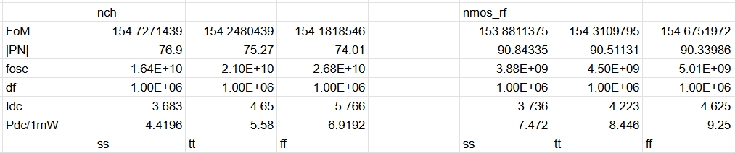
nch vs nmos_rf

Slide 5
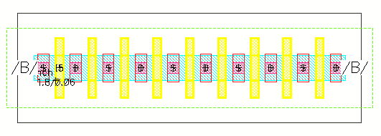
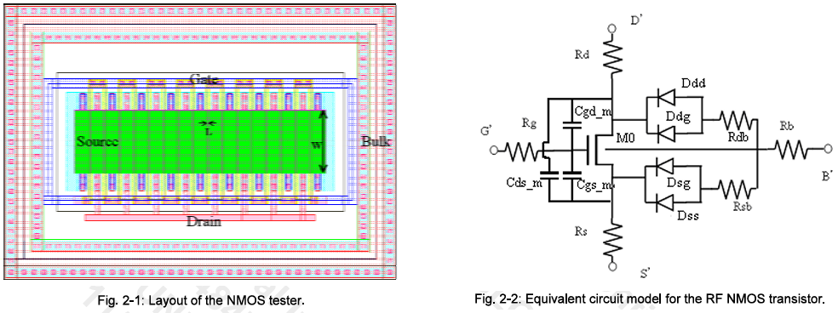
nch vs nmos_rf
nch
nmos_rf

Slide 6

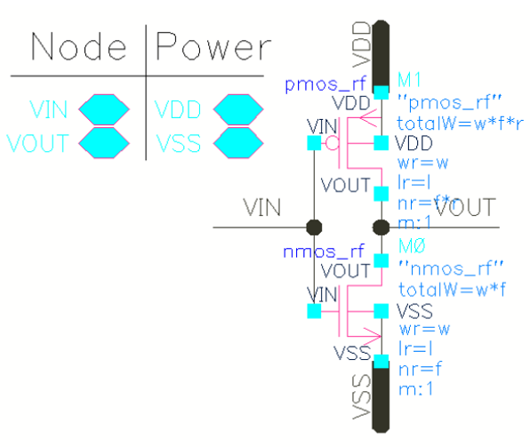
Layout

Slide 7
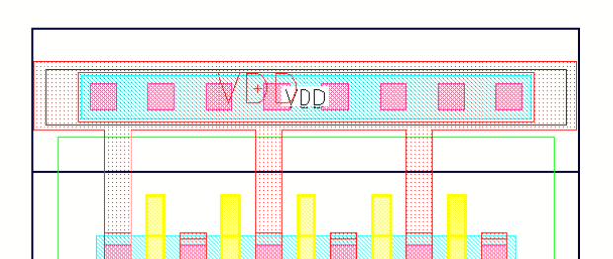
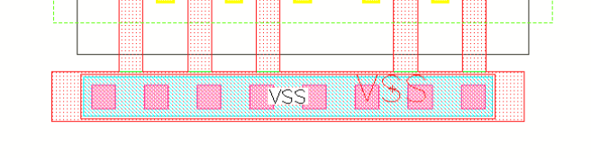
Layout
VDD
VSS

Slide 8
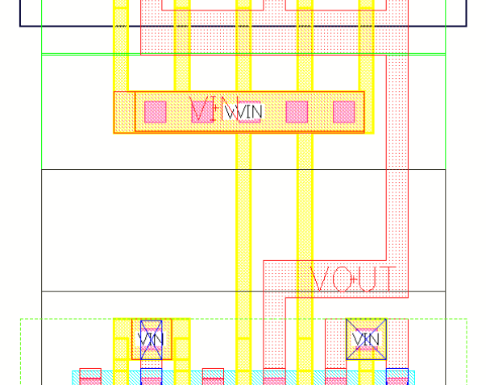
Layout
VIN,VOUT

Slide 9
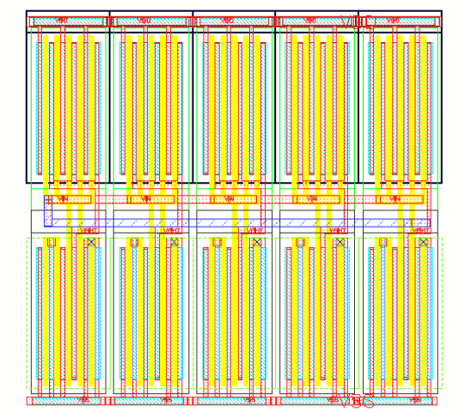
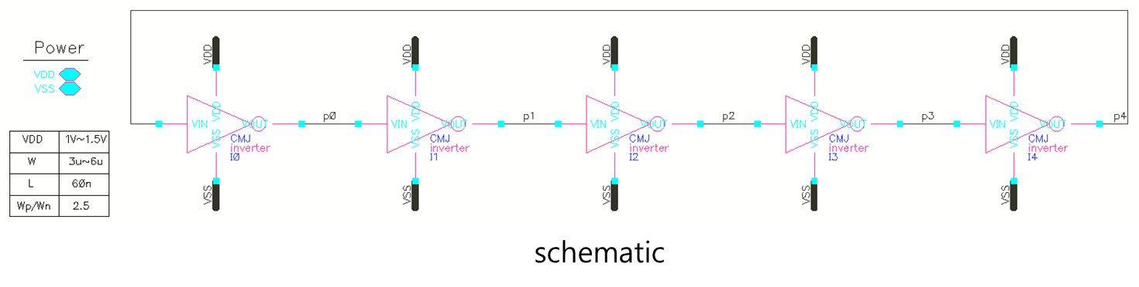
Layout

Slide 10
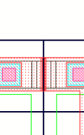
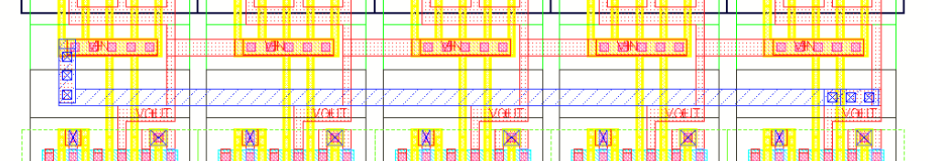
Layout
Between Inv4, Inv5
In VDD
VIN,VOUT

Slide 11
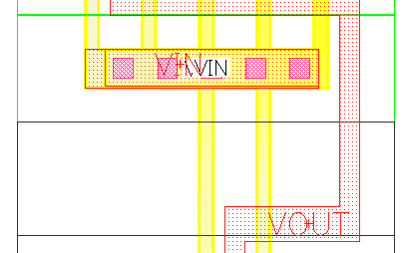
DRC
PP.EN.1 { @ {NP OR PP} enclosure of PO (except DPO) >= 0.15 um
ENC POLY IMP < PP_EN_1 ABUT < 90 SINGULAR REGION
((POLY NOT SRAM_EXCLUDE) NOT LOGO) NOT IMP
PP
NP
PO should be enclosed with NP or PP
POLY
PO should be enclosed with NP or PP

Slide 12
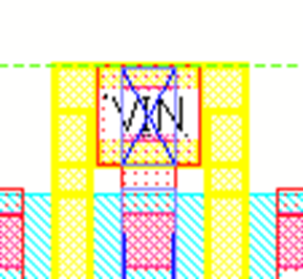
DRC
PO.S.4 { @ Field PO space to OD >= 0.05 um
EXT POLY OD < PO_S_4 ABUT < 89.5 SINGULAR REGION
PO
be enclosed with NP or PP
OD
Field PO should be at
a distance of 0.05 um from OD

Slide 13
DRC
CO.S.1 { @ Spacing >= 0.11 um
EXT CO < CO_S_1 ABUT < 90 SINGULAR REGION
CO
NP or PP
CO should be at a distance of 0.11 um from another CO
CO

Slide 14

DRC
VIA1.R.2__VIA1.R.3 { @ When M1 or M2 width > 0.3 um, more than one VIA1 is required.
~~~~~~~~~~~~~~~~~~~~~~~~
CO x3
NP or PP
When M1 or M2 width is larger than 0.3um,
more than one VIA1 is required.

Slide 15
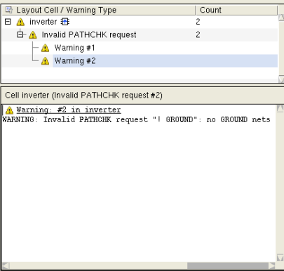
LVS
Label needs to write with METAL PIN

Slide 16
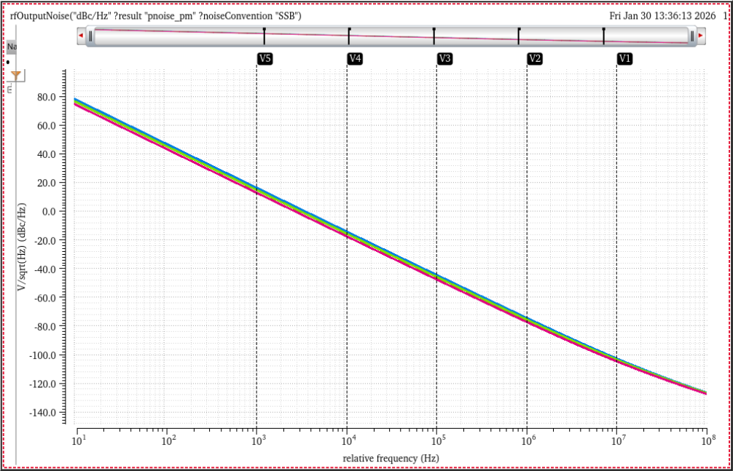
PEX
Hz | dB
1k-10k | -30.62 -30.56 -30.50
10k-100k | -30.45 -30.36 -30.28
100k-1M | -30.08 -29.93 -29.78
1M-10M | -28.53 -28.12 -27.64
17.08021
15.52751
13.614
-43.99349
-45.38933
-47.16541
-13.54459
-15.03021
-16.88529
-102.6056
-103.4489
-104.5833
-74.07831
-75.32476
-76.94579

Slide 17
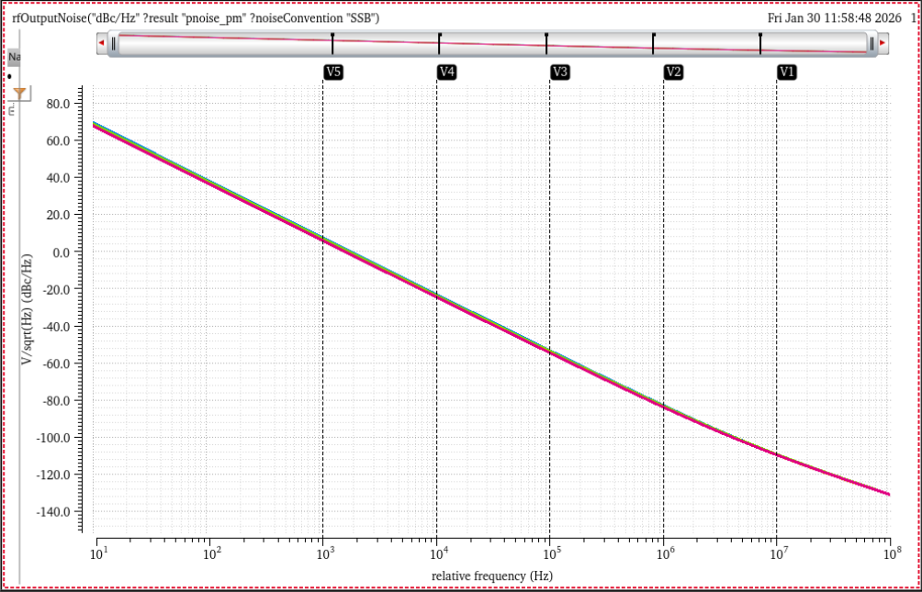
PEX
Hz | dB
1k-10k | -30.57 -30.5 -30.45 -30.45
10k-100k | -30.38 -30.29 -30.23 -30.22
100k-1M | -29.7 -29.54 -29.41 -29.38
1M-10M | -26.63 -26.34 -26.08 -25.98
-22.3545
-22.87161
-23.68301
-23.76687
-82.42974
-82.70152
-83.31742
-83.37125
8.213013
7.63151
6.772193
6.689063
-109.0594
-109.0375
-109.3938
-109.3507
-52.73113
-53.1601
-53.90561
-53.98731
DSPF

Slide 18
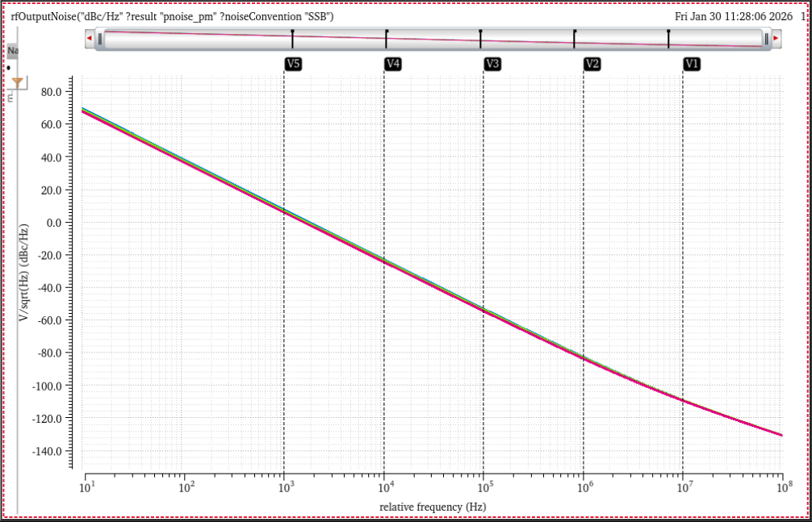
PEX
Hz | dB
1k-10k | -30.62 -30.56 -30.50
10k-100k | -30.45 -30.36 -30.28
100k-1M | -30.08 -29.93 -29.78
1M-10M | -28.53 -28.12 -27.64
8.209871
7.56896
6.569844
-52.73232
-53.21182
-54.09036
-22.37242
-22.9449
-23.89434
-108.9535
-108.9559
-109.3021
-82.3858
-82.69881
-83.41456
Calibreview

Slide 19
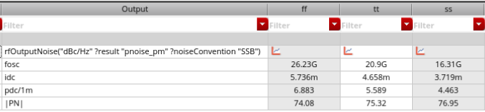

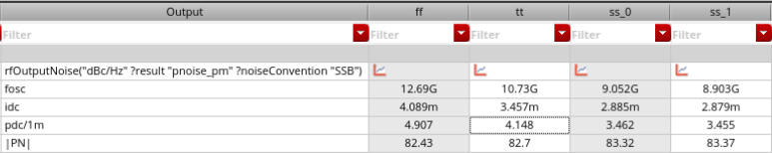

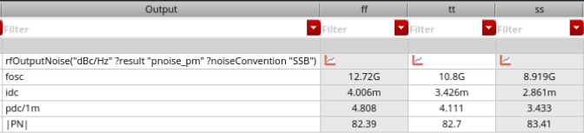

PEX
Pre-sim
DSPF
Calibreview
RCC

Slide 20
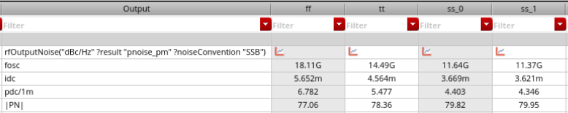
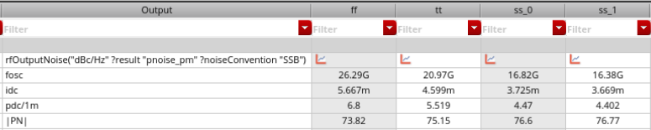
PEX
C+CC
RCC
NoRC
DSPF

Slide 21
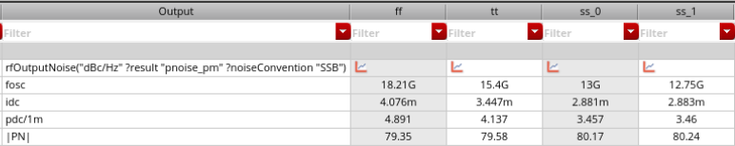
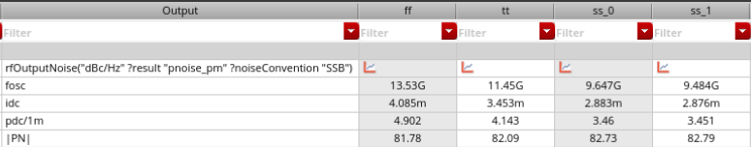
PEX
R
RC
DSPF

Slide 22
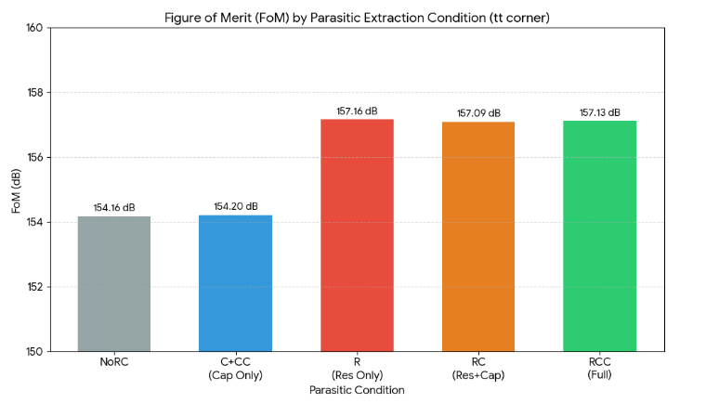
Comparison
Reason of the rise of FoM:
Not because of the performance improvement,
=> the voltage drop caused by the parasitic resistor has abnormally reduced the power consumption.

Slide 23
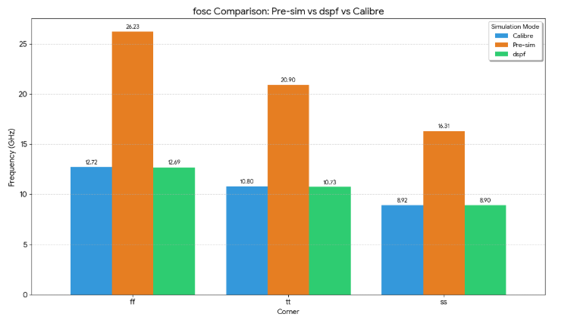
Comparison

Slide 24
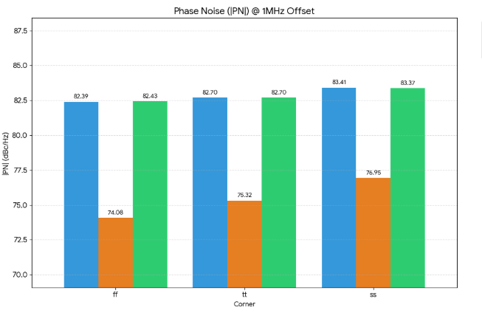
Comparison

Slide 25
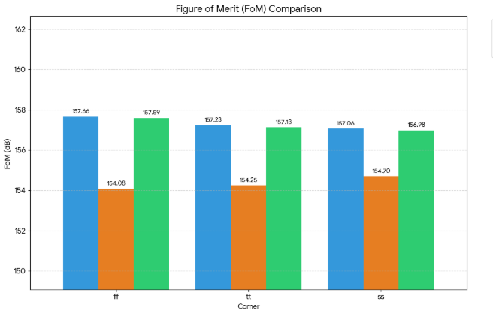
Comparison

Slide 26
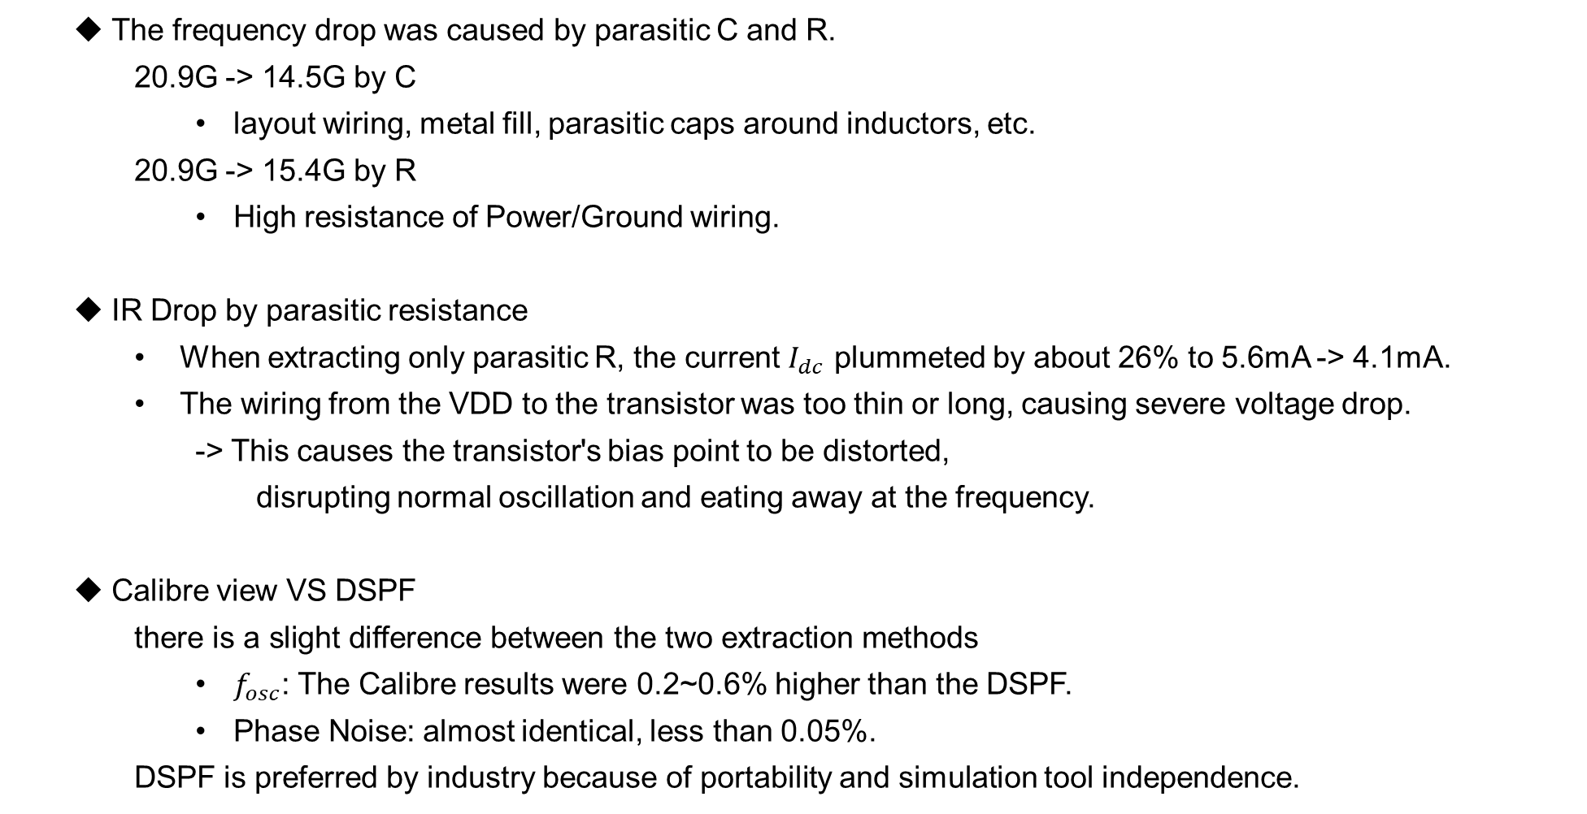
Summary
The frequency drop was caused by parasitic C and R.
20.9G -> 14.5G by C
layout wiring, metal fill, parasitic caps around inductors, etc.
20.9G -> 15.4G by R
High resistance of Power/Ground wiring.
IR Drop by parasitic resistance
When extracting only parasitic R, the current $I_{dc}$ plummeted by about 26% to 5.6mA -> 4.1mA.
The wiring from the VDD to the transistor was too thin or long, causing severe voltage drop.
-> This causes the transistor's bias point to be distorted,
disrupting normal oscillation and eating away at the frequency.
Calibre view VS DSPF
$$\text{there} \text{is} \text{a} \text{slight} \text{difference} \text{between} \text{the} \text{two} \text{extraction} \text{methods}$$
$f_{osc}$: The Calibre results were 0.2~0.6% higher than the DSPF.
Phase Noise: almost identical, less than 0.05%.
DSPF is preferred by industry because of portability and simulation tool independence.

